Slide 1
7 First order ordinary differential equations (ODE)

Slide 2
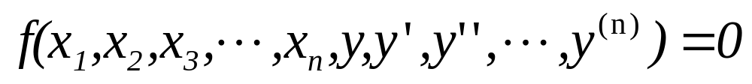
Basic Concepts and Definitions
Differential equations
Ordinary differential equations (ODE)
Partial differential equations (PDE)
Order of differential equations

Slide 3

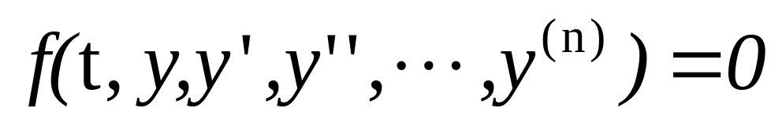

Differential equations

Slide 4
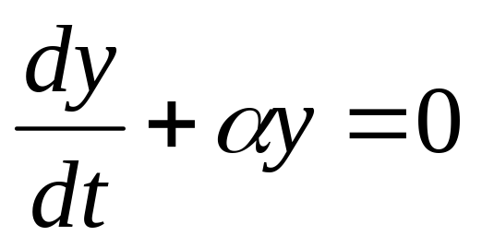
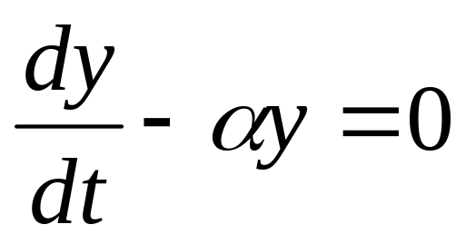
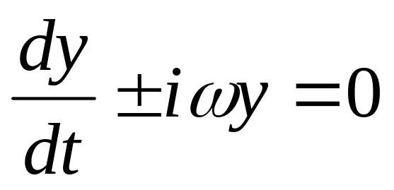

Slide 5
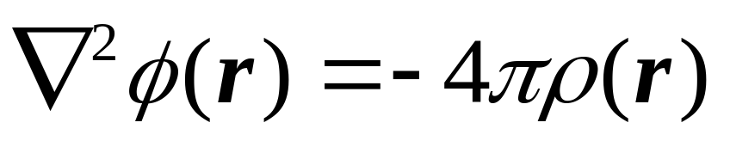
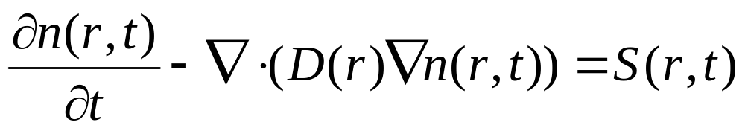
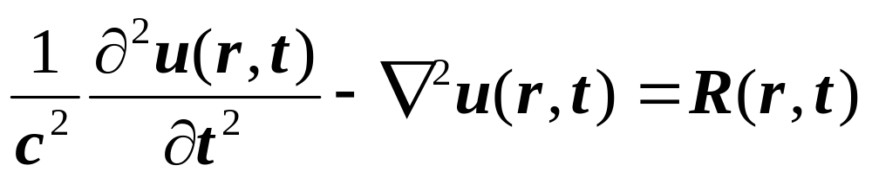
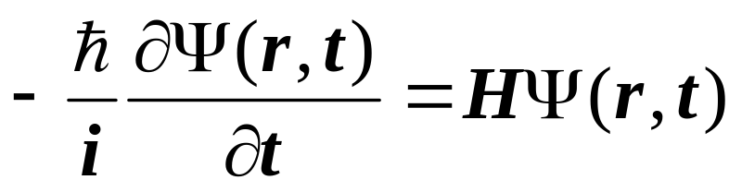
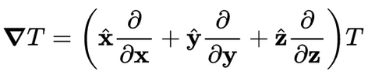

Differential equations in Physics

Slide 6
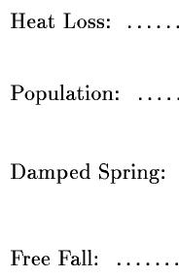
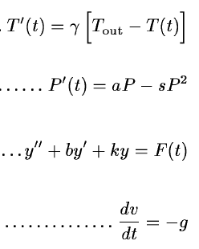

Slide 7
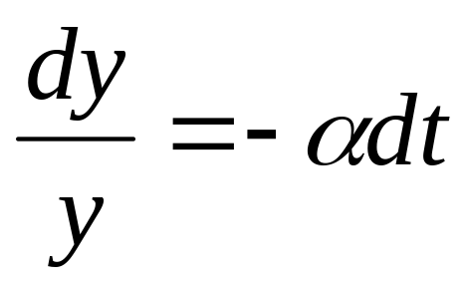
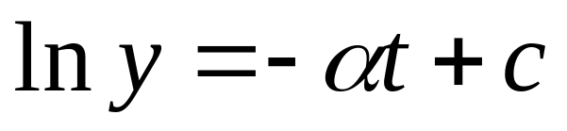
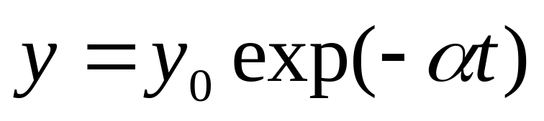
The solutions of differential equations.
t=0 时，y=y₀

Slide 8
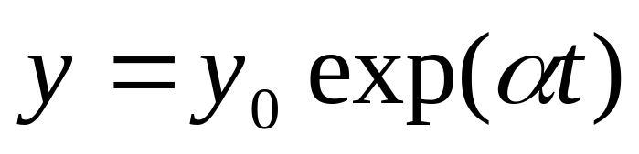
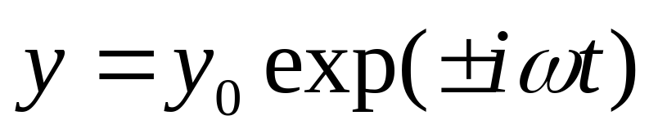
The analytical solutions of differential equations

Slide 9
在自然科学的许多领域中，都会遇到微分方程的求解问题。然而，我们知道，只有少数十分简单的微分方程能够用初等方法求得它们的解析解，多数情形只能利用近似方法求解。在常微分方程课中有级数解法，逐步逼近法等就是近似解法。这些方法可以给出解的近似表达式，通常称为近似解析方法。还有一类近似方法称为数值方法，它可以给出解在一些离散点上的近似值。利用计算机解微分方程主要使用数值方法。

Slide 10
This section of the course introduces some commonly used methods for determining the numerical solutions of ordinary differential equations. These methods will then be used as the basis for solving some types of partial differential equations.

Slide 11




Here we use the notations:
In most physical problem, one only needs to find a special solution by adding some condition, such as the solution of
This is called an initial value problem.

Slide 12
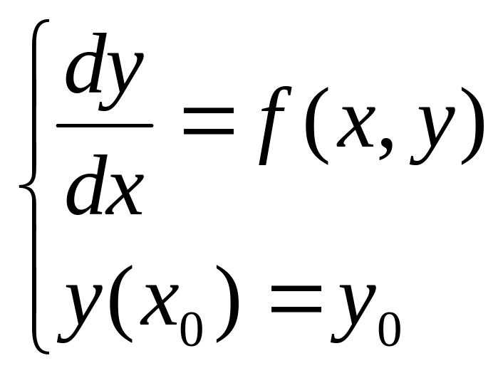
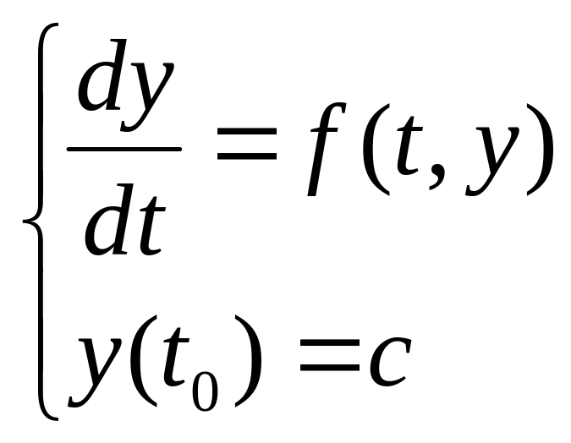
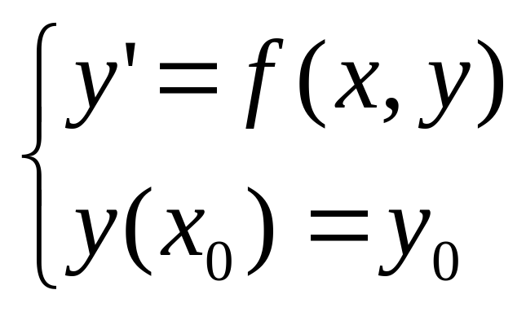
The numerical solutions of first order ODE

Slide 13
7.1 Taylor series
7.2 Finite difference
7.3 Euler method
7.4 Implicit methods
7.4.1 Backward Euler
7.4.2 Richardson extrapolation
7.4.3 Crank-Nicholson
7.5 Truncation error and Stability
7.6 Multistep methods
7.7 Predictor-corrector methods.

Slide 14
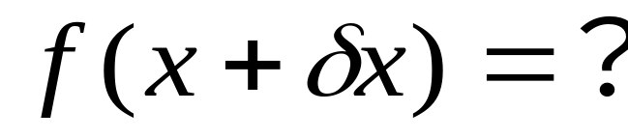
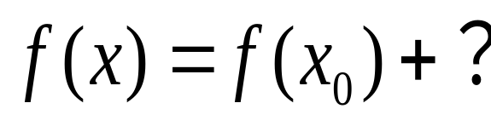
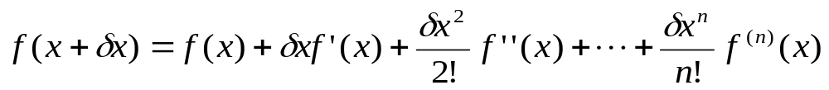
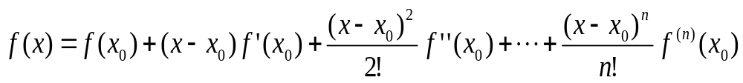
Taylor series
The central idea behind the majority of methods discussed in this course is the Taylor Series expansion of a function about a point

Slide 15
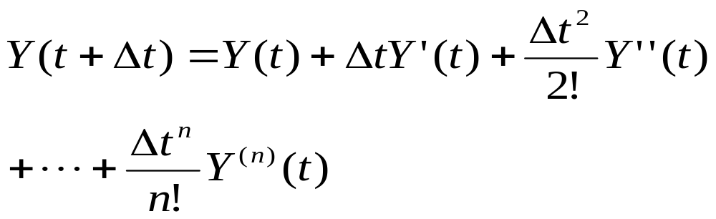

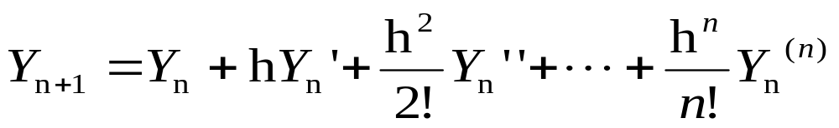

Slide 16
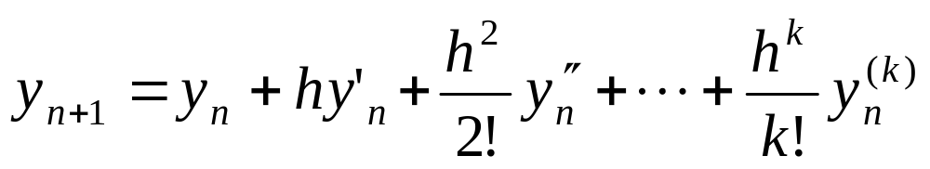
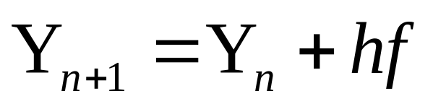
7.1 Taylor series
The first-order Taylor series method: Let y(x) be a solution and

Slide 17
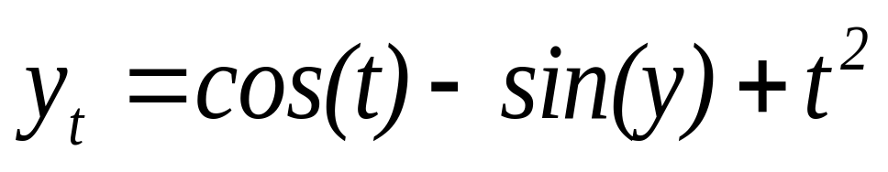
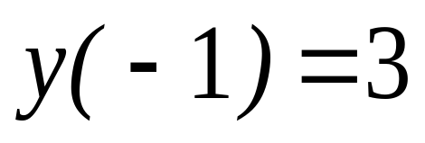
Example: Solve the following initial value problem by using the first-order Tayor series methods to obtain y(−0.8) with h = 0.1.

Slide 18
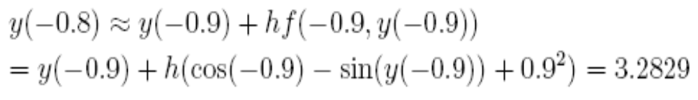
First-order Taylor method:

Slide 19
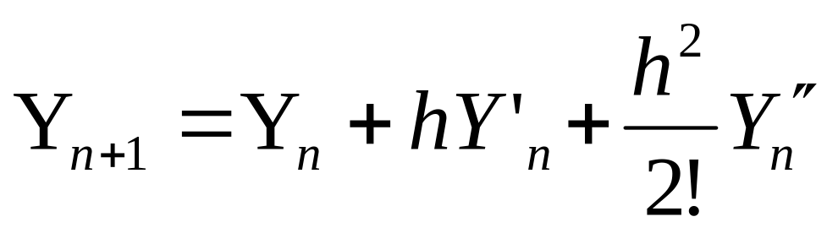
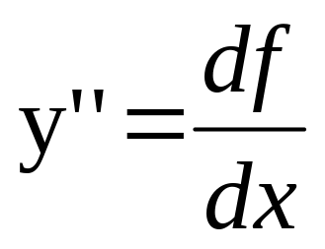
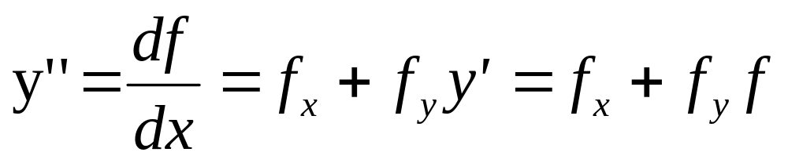
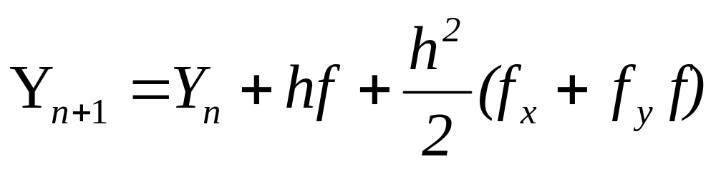

The second-order Taylor series method:

Slide 20
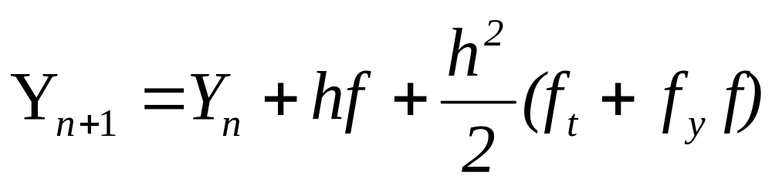
Example: Solve the following initial value problem by using the second order Tayor series methods to obtain y(−0.8) with h = 0.1.

Slide 21

Second-order Taylor method. Since

Slide 22

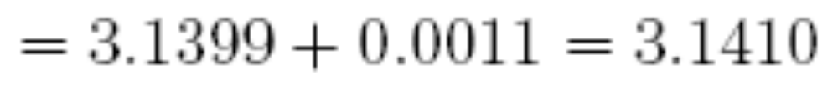
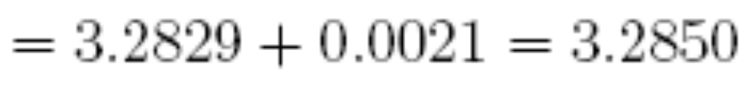

Slide 23
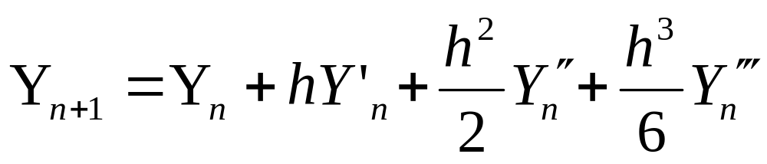
三阶泰勒级数法

Slide 24
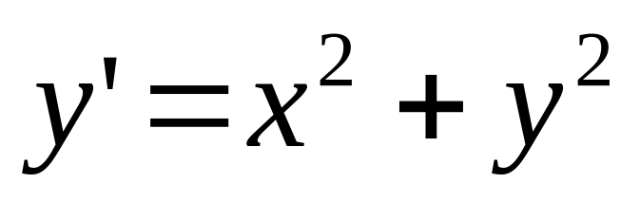
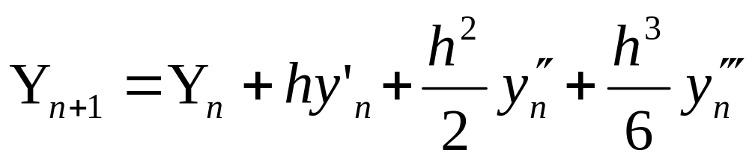
例 导出用三阶泰勒级数法解方程
的计算公式

Slide 25
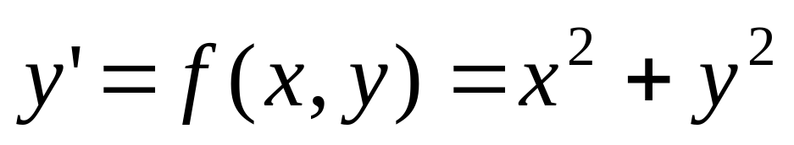
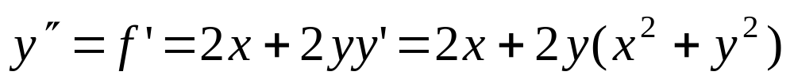
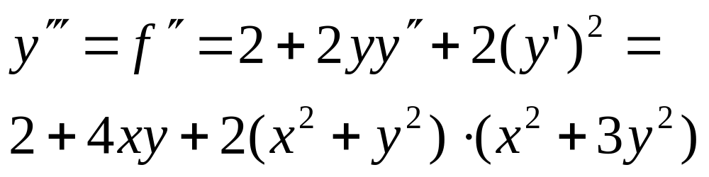

Slide 26
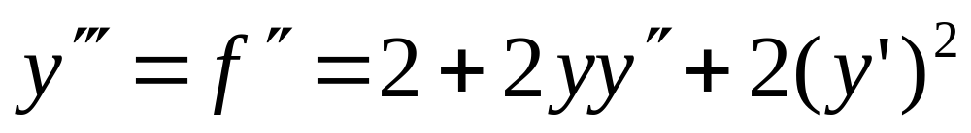
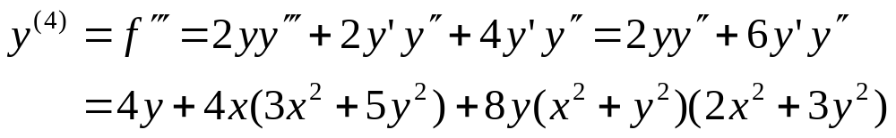
泰勒级数法只要初值问题的真解充分光滑，就可以获得精确度较高的数值解。但是须计算y(x)的各阶导数，这当f (x, y)的表达式复杂时是很繁琐的。
能否构造一种格式，既保留泰勒级数法精确度较高的优点，又避免过多的计算 f (x, y)的各阶偏导数呢？

Slide 27
7.2 Finite difference
We shall denote the exact solution at some t = t_{n} = t₀+nΔt by y_{n} = y(t=t_{n}) and our approximate solution by Y_{n}. We then look to solve Y’_{n}=f(t_{n},Y_{n} ).
at each of the points in the domain, where Y’_{n} is an approximation to dy/dt based on the discrete set of Y_{n}.

Slide 28

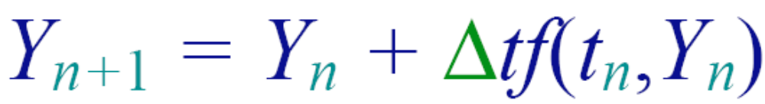
7.3 Euler method

Slide 29
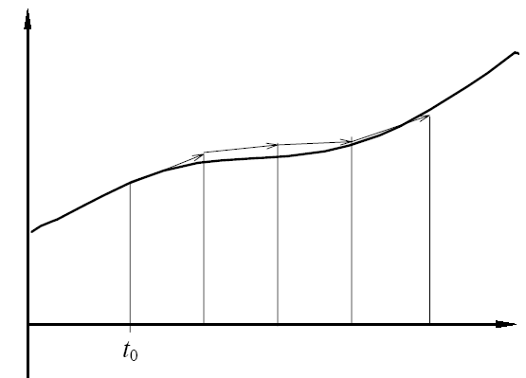
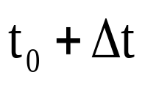
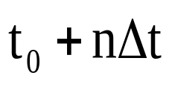

Slide 30
Comparing the Euler method equation for Y_{n} with the the Taylor Series expansion for Y_{n+1}, shows that the error in the finite difference approximation becomes an O(Δt²). Thus the Euler method is first order accurate and is often referred to as a first order method.

Slide 31




Slide 32





Slide 33

Y
Y
Y
Y

Slide 34


Slide 35

The Euler method is termed an explicit method because we are able to write down an explicit solution for Y_{n+1} in terms of “known” values at t_{n}.

Slide 36

7.4 Implicit methods
explicit
implicit
computationally more expensive for a single step than explicit methods, but offer advantages in terms of stability and/or accuracy in many circumstances.
7.4.1 Backward Euler
7.4.2 Richardson extrapolation
7.4.3 Crank-Nicholson

Slide 37




7.4.1 Backward Euler
Forward Euler
Backward Euler

Slide 38


Slide 39
As the derivative Y’_{n} is approximated only to the first order, the Backward Euler method has errors of O(Δt²), exactly as for the Euler method. The solution process will, however, tend to be more stable and hence accurate, especially for stiff problems (problems where f’ is large). An example of this is shown in the following figure .

Slide 40


Slide 41
7.4.2 Richardson extrapolation
The Romberg integration approach

Slide 42


Romberg integration
龙贝格求积公式
With the Trapezium Rule
Δx=h
With the Compound Trapezium Rule
While the error for each step is O(Δx³), the cumulative error is n times this or O(Δx²) ~ O(n⁻²)
T(Δx) cΔx²
T(Δx/2) cΔx²/4

Slide 43

α/4+1-α=0
α=4/3
By choosing the weighting factor α = 4/3 we eliminate the leading order (O(Δx²)) error terms, relegating the error to O(Δx⁴). Thus we have

Slide 44





龙贝格公式
一般地，有
同理可得
龙贝格公式

Slide 45
The Romberg integration approach (presented in section 6.7) of using two approximations of different step size to construct a more accurate estimate may also be used for numerical solution of ordinary differential equations.

Slide 46
Again, if we have the estimate for some time t calculated using a time step Δt, then for both the Euler and Backward Euler methods the approximate solution is related to the true solution by
Y(t,Δt) = y(t) + cΔt².
Similarly an estimate using a step size Δt/2 will
follow Y(t,Δt/2) = y(t) + 1/4cΔt² as Δt→0. Combining these two estimates to try and cancel the O(Δt²) errors gives the improved estimate as

Slide 47
The same approach may be applied to higher order methods such as those presented in the following sections.

Slide 48



7.4.3 Crank-Nicholson
Euler method
backward Euler
the Euler method and the Backward Euler method have errors of O(Δt²)

Slide 49





Slide 50




Slide 51
As with the Backward Euler, the method is implicit and it is not, in general, possible to write an explicit expression for Y_{n+1} in terms of Y_{n}.
Proof that the Crank-Nicholson method is second order accurate

Slide 52



左=

Slide 53




=右

Slide 54
左=
右=

Slide 56


7.5 Truncation error and Stability
Y₁=y₀+hΔ(t₀ ,y₀)+… =y₁+ err₁
Y₂=Y₁+hΔ(t₁ ,Y₁) +…=y₂+C₁₂ err₁ + err₂
The global truncation error at the nth step is the cumulative total of the truncation error at the previous steps and is
In contrast, the local truncation error for the nth step is
where y_{n}* the exact solution of our differential equation but with the initial condition y_{n–1}*=Y_{n–1}.

Slide 57

The global truncation error at the nth step
In contrast, the local truncation error for the nth step is
Y_{n}=Y_{n-1}+hΔ(t_{n-1} ,Y_{n-1} )+O(h^{p+1})
Note that E_{n} is not simply
which would give E_{n} = O(ne_{n}). It also depends on the stability of the method and we aim for E_{n} = O(e_{n}).

Slide 58
Stability of the method
The stability of a method can be even more important than its accuracy as measured by the order of the truncation error.
Y₁=y₀+hΔ(t₀ ,y₀)+… =y₁+ err₁
Y₂=Y₁+hΔ(t₁ ,Y₁) +…=y₂+C₁₂ err₁ + err₂
Y_{i+1}=y_{i+1}+C_{1(i+1)} err₁ +C_{2(i+1)} err₂ + … C_{i(i+1)} err_{i}

Slide 59


Stability
Suppose we are solving
The exact solution is bounded (i.e. does not increase without limit) provided Reλ ≤ 0. Substituting this into the Euler method shows
Y_{n+1}= Y_{n}+Δt f(t_{n} , Y_{n} )

Slide 60
Y_{n+1}= Y_{n}+Δt f(t_{n} , Y_{n} )
Y_{n+1}= Y_{n}+Δt λ Y_{n}
Y_{n}= Y_{n-1}+Δt λ Y_{n-1}
Y_{n+1}= (1+ λΔt) Y_{n}
Y_{n}= (1+ λΔt) Y_{n-1}
Y_{n+1}= (1+λΔt) Y_{n} = (1+λΔt)² Y_{n-1}
=…= (1+λΔt) ^{n+1} Y₀
we require |1 + λΔt| ≤ 1.
If Reλ < 0
1+ λΔt ≤ 1
λΔt ≤ 0
|1+ λΔt | ≤ 1
-(1+ λΔt) ≤ 1
Δt ≤ 2|λ|^{–1}

Slide 61

Δt < 2|λ|^{–1}

Slide 62
Δt ≤2|λ|^{–1}
The reason why we consider the behavior of above equation is that it is a model for the behavior of small errors.
Suppose that at some stage during the solution process our approximate solution is
y$ = y + ε
where ε is the (small) error. Substituting this into our differential equation of the form y’ = f(t,y) and using a Taylor Series expansion gives

Slide 63








y$ = y + ε, y’ = f(t,y)
Δt ≤2|λ|^{–1}
Y_{i+1}=y_{i+1}+C_{1(i+1)} err₁ +C_{2(i+1)} err₂ + … err_{i+1}

Slide 64
In Backward Euler method
Y_{n+1}= Y_{n}+Δt f(t_{n+1} , Y_{n+1} )

Slide 65
Y_{n+1}= Y_{n}+Δt f(t_{n+1} , Y_{n+1} )
In comparison, solution of above equation by the Backward Euler method
Y_{n+1}= Y_{n}+Δt f(t_{n+1} , Y_{n+1} )
Y_{n+1}= Y_{n}+Δt λ Y_{n+1}
Y_{n+1}= Y_{n} /(1- λΔt)
Y_{n} = Y_{n-1}+Δt λ Y_{n}
Y_{n} = Y_{n-1} /(1- λΔt)
Y_{n+1}=Y_{n} /(1- λΔt) =Y_{n-1} /(1- λΔt) ² =…=Y₀ /(1- λΔt) ^{n+1}
|1- λΔt | ≥ 1

Slide 66
Y_{n+1}=Y_{n} /(1- λΔt) =Y_{n-1} /(1- λΔt) ² =…=Y₀ /(1- λΔt) ^{n+1}
|1- λΔt | ≥ 1
1- λΔt ≥ 1
- λΔt ≥ 0
-(1- λΔt) ≥ 1
λΔt ≥ 2
For Reλ ≤ 0 this is always satisfied and so the Backward Euler method is unconditionally stable.

Slide 67
The Crank-Nicholson method may be analyzed in a similar fashion with

Slide 68
Y_{n+1} -Y_{n}=1/2[Δt λ Y_{n+1} + Δt λ Y_{n} ]
(1- λΔt/2) Y_{n+1}= (1+ λΔt/2) Y_{n}
Y_{n+1}= [(1+ λΔt/2) /(1- λΔt)] Y_{n}
Y_{n+1}= [(1+ λΔt/2) /(1- λΔt)] ^{n+1} Y₀

Slide 69
Y_{n+1}= [(1+ λΔt/2) /(1- λΔt)] ^{n+1} Y₀
with the magnitude of the term in square brackets always less than unity for Reλ < 0. Thus, like Backward Euler, Crank-Nicholson is unconditionally stable.

Slide 70
7.7 线性多步法 （Multistep methods）
前面介绍的方法，统称为单步法，就是在计算 y_{n+1} 时，只用到前面一步 y_{n} 的值。本节我们将介绍利用前边已经算出来的若干个值 y_{n-k}，y_{n-k+1}，…，y_{n-1}，y_{n}，来求得 y_{n+1} 的高精度公式――线性多步方法。

Slide 71






=
+
+…+
+h(
)
By utilising only Y_{n–s+1},Y_{n–s+2},…,Y_{n} we may construct an approximation to the derivatives of orders 1 to s at t_{n}.
For example, if s = 2, by utilising Y_{n–1}, Y_{n} then
Y"_{n} = f ’_{n}

Slide 72



Y"_{n} = f ’_{n}
Y"_{n} = f ’_{n}=

Slide 73

For s=3 by utilising Y_{n–2}, Y_{n–1}, Y_{n} then we can have Y’_{n} , Y"_{n} and Y’"_{n}
f _{n-2} -4 f _{n-1} = -3f_{n} +2Δt f’_{n}
Y’" _{n} = f" _{n}
Y"_{n} = f’_{n}= (3f _{n} -4 f _{n-1}+ f _{n-2})/2Δt

Slide 74
f _{n-2}- 2f _{n-1}= -f _{n} + f" _{n} Δt²
Y’" _{n} = f" _{n} = (f _{n} - 2f _{n-1}+f _{n-2})/Δt²
Y" _{n} = f’ _{n}= (3f _{n} -4 f _{n-1}+ f _{n-2})/2Δt
=Y_{n} + Δt f _{n}+Δt (3f _{n} -4 f _{n-1}+ f _{n-2})/4 _{n}
+Δt (f_{n} -2 f _{n-1}+ f _{n-2})/6

Slide 75

These methods are called Adams-Bashforth methods. Note that s = 1 recovers the Euler method.

Slide 76

For s=4 by utilising f_{n–3}, f_{n–2}, f_{n–1}, f_{n} then we can have Y’ , Y" , and Y'" and Y"'' n

Slide 77

Implicit Adams-Bashforth methods are also possible if we use information about f_{n+1} in addition to earlier time steps.
The corresponding s = 2 method then uses
Y" _{n} = f’
Y ’ ’ ’ _{n} = f ’ ’ _{n}

Slide 79

This family of implicit methods is known as Adams-Moulton methods.

Slide 80



Slide 81


四 阶亚当斯隐式公式。

Slide 82

7.8 Predictor-corrector methods
the Euler method has the form
the Backward Euler method has the form
Applying the theory for direct iteration, we may write
The solution will gradually approach the Backward Euler solution.

Slide 83


A similar strategy may be applied to the Crank-Nicholson method to obtain
Note that this convergence criterion is more stringent than the stability criterion

Slide 84

One can apply a less accurate algorithm to predict the next value Y_{n+1} first, for example, using the Euler algorithm, and then apply a better algorithm to improve the new value.

Slide 85


7.8.1 Improved Euler method
The simplest of these methods combines the Euler method as the predictor
and then the Backward Euler to give the corrector
The final solution is the mean of these:

Slide 86


迭代 n 次的改进欧拉法计算公式如下：

Slide 87
这就是先用欧拉法由(x_{n}, y_{n})得出y(x_{n+1})的初始近似值y_{n+1}⁰ ，然后用上式中第二式进行迭代，反复改进这个近似值，直到 |y_{n+1}^{k+1} - y_{n+1}^{k} |<ε （ε为所允许的误差）为止，并把 y_{n+1}^{k} 取作y(x_{n+1})的近似值y_{n+1}。这个方法就叫改进欧拉方法。

Slide 88





To understand the stability of this method we again use the y’ = λy so that the three steps described by the above equations become

Slide 89
(for Reλ < 0)
which in turn restricts Δt < 2|λ|^{–1}.
The accuracy of the method is, however, second order as may be seen by comparisons with the Taylor Series expansion.

Slide 90


例
在区间[0, 1.5]上，取h = 0.1，求解。
解：
（1）用欧拉法计算公式如下：

Slide 91



（2）用迭代一次的改进欧拉法计算公式如下：

Slide 92

本题的精确解为
可用来检验近似解的精确程度计算结果如下:
x_{n} | 欧拉法y_{n} | 迭代改进 | 准确解
0 | 1 | 1 | 1
0.1 | 1.1 | 1.095909 | 1.095445
0.2 | 1.191818 | 1.184096 | 1.183216
0.3 | 1.277438 | 1.260201 | 1.264911
0.4 | 1.358213 | 1.343360 | 1.341641
0.5 | 1.435133 | 1.416102 | 1.414214
0.6 | 1.508966 | 1.482956 | 1.483240
0.7 | 1.580338 | 1.552515 | 1.549193

Slide 93
x_{n} | 欧拉法y_{n} | 迭代改进 | 准确解
0.8 | 1.649783 | 1.616476 | 1.612452
0.9 | 1.717779 | 1.678168 | 1.673320
1.0 | 1.784770 | 1.737869 | 1.732051
1.1 | 1.85118 | 1.795822 | 1.788854
1.2 | 1.917464 | 1.852242 | 1.843909
1.3 | 1.984046 | 1.907323 | 1.897367
1.4 | 2.051404 | 1.961253 | 1.949359
1.5 | 2.120052 | 2.014207 | 2.000000

Slide 94
7.8.2 Runge-Kutta (龙格―库塔) methods
由上节知道，截断误差的阶是衡量一个方法精度高低的主要依据。能否用提高截断误差阶来提高方法的精确度呢？回答是肯定的。前面介绍的泰勒级数法就是基于这种思想构造出来的。本节介绍的龙格―库塔法就是基于这种思想构造出来的。

Slide 95



龙格―库塔法的思想
k⁽¹⁾=h f(t_{n}, Y_{n});
显然，当 N = 1时，上式就是欧拉公式。
当 N > 1时，上式就是N阶的龙格―库塔公式。
下面我们先导出N =2时的公式。

Slide 96


k⁽¹⁾=h f(t_{n}, Y_{n});

Slide 97



k⁽¹⁾=h f(t_{n}, Y_{n});

Slide 98



k⁽¹⁾=h f(t_{n}, Y_{n})

Slide 99



Slide 100








Slide 101

k⁽¹⁾=h f(t_{n}, Y_{n});
Y_{n+1} = Y_{n} + (k⁽¹⁾ + k⁽²⁾)/2.
k⁽¹⁾=h f(t_{n}, Y_{n});
k⁽²⁾= h f(t_{n} +h, Y_{n} + k⁽¹⁾)

Slide 102

Second orderRunge-Kutta methods
Y_{n+1} = Y_{n} + (k⁽¹⁾ + k⁽²⁾)/2.
k⁽¹⁾=h f(t_{n}, Y_{n});
k⁽²⁾= h f(t_{n} +h, Y_{n} + k⁽¹⁾)
Improved Euler method

Slide 103

k⁽¹⁾=h f(t_{n}, Y_{n});
Third order

Slide 104
k⁽¹⁾=h f(t_{n}, Y_{n});
Fourth order
Y_{n+1} = Y_{n} + (k⁽¹⁾ + 2k⁽²⁾ + 2k⁽³⁾ + k⁽⁴⁾)/6.
k⁽¹⁾=h f(t_{n}, Y_{n});
k⁽²⁾= h f(t_{n} +h/2, Y_{n} + k⁽¹⁾/2)
k⁽³⁾= h f(t_{n} +h/2, Y_{n} + k⁽²⁾/2)
k⁽⁴⁾= h f(t_{n} +h, Y_{n} + k⁽³⁾)

Slide 105
k⁽¹⁾=h f(t_{n}, Y_{n});
Second order
Y_{n+1} = Y_{n} + (k⁽¹⁾ + k⁽²⁾)/2.
k⁽¹⁾=h f(t_{n}, Y_{n});
k⁽²⁾= h f(t_{n} +h, Y_{n} + k⁽¹⁾)
Y_{n+1} = Y_{n} + h(k⁽¹⁾ + k⁽²⁾)/2.
k⁽¹⁾= f(t_{n}, Y_{n});
k⁽²⁾= f(t_{n} +h, Y_{n} +h k⁽¹⁾)

Slide 106
Fourth order
Y_{n+1} = Y_{n} + (k⁽¹⁾ + 2k⁽²⁾ + 2k⁽³⁾ + k⁽⁴⁾)/6.
k⁽¹⁾=h f(t_{n}, Y_{n});
k⁽²⁾= h f(t_{n} +h/2, Y_{n} + k⁽¹⁾/2)
k⁽³⁾= h f(t_{n} +h/2, Y_{n} + k⁽²⁾/2)
k⁽⁴⁾= h f(t_{n} +h, Y_{n} + k⁽³⁾)
Y_{n+1} = Y_{n} + h(k⁽¹⁾ + 2k⁽²⁾ + 2k⁽³⁾ + k⁽⁴⁾)/6.
k⁽¹⁾= f(t_{n}, Y_{n});
k⁽²⁾= f(t_{n} +h/2, Y_{n} +h k⁽¹⁾/2)
k⁽³⁾= f(t_{n} +h/2, Y_{n} + hk⁽²⁾/2)
k⁽⁴⁾= f(t_{n} +h, Y_{n} + hk⁽³⁾)

Slide 107
对初值问题u’=u/2, u(0)=1,分别用二阶和四阶Runge-Kutta 法求其数值解，步长为h=0.2，求解区间为[0，0.4]。
Y_{n+1} = Y_{n} + (k⁽¹⁾ + k⁽²⁾)/2.
k⁽¹⁾=h f(t_{n}, Y_{n});
k⁽²⁾= h f(t_{n} +h, Y_{n} + k⁽¹⁾)
Y_{n+1} = Y_{n} + (k⁽¹⁾ + 2k⁽²⁾ + 2k⁽³⁾ + k⁽⁴⁾)/6.
k⁽¹⁾=h f(t_{n}, Y_{n});
k⁽²⁾= h f(t_{n} +h/2, Y_{n} + k⁽¹⁾/2)
k⁽³⁾= h f(t_{n} +h/2, Y_{n} + k⁽²⁾/2)
k⁽⁴⁾= h f(t_{n} +h, Y_{n} + k⁽³⁾)

Slide 108
对初值问题u’=u/2, u(0)=1,分别用二阶Runge-Kutta 法求其数值解，步长为h=0.2。
k⁽¹⁾=h f(t_{n}, Y_{n});
Y_{n+1} = Y_{n} + (k⁽¹⁾ + k⁽²⁾)/2.
k⁽²⁾= h f(t_{n} +h, Y_{n} + k⁽¹⁾)
k⁽¹⁾=h f(t_{n}, Y_{n})=0.2*u(0)/2 = 0.2*1/2= 0.1
k⁽²⁾= h f(t_{n} +h, Y_{n} + k⁽¹⁾)=0.2*(1+0.1)/2=0.11
Y_{n+1} = Y_{n} + (k⁽¹⁾ + k⁽²⁾)/2.=1.+0.21/2=1.105
k⁽¹⁾=h f(t_{n}, Y_{n})=0.2*1.105/2=0.1105
k⁽²⁾= h f(t_{n} +h, Y_{n} + k⁽¹⁾)=0.2*(1.105+0.1105)/2=0.12155
Y_{n+1} = Y_{n} + (k⁽¹⁾ + k⁽²⁾)/2.=1.105+0.23205/2=1.221025

Slide 109
u’=u/2, u(0)=1, 步长为h=0.2，
Y_{n+1} = Y_{n} + (k⁽¹⁾ + 2k⁽²⁾ + 2k⁽³⁾ + k⁽⁴⁾)/6.
k⁽¹⁾=h f(t_{n}, Y_{n});
k⁽²⁾= h f(t_{n} +h/2, Y_{n} + k⁽¹⁾/2)
k⁽³⁾= h f(t_{n} +h/2, Y_{n} + k⁽²⁾/2)
k⁽⁴⁾= h f(t_{n} +h, Y_{n} + k⁽³⁾)
k⁽¹⁾=h f(t_{n}, Y_{n})=0.2*1/2=0.1
k⁽²⁾= h f(t_{n} +h/2, Y_{n} + k⁽¹⁾/2)=0.2*(1+0.1/2)/2=0.105
k⁽³⁾= h f(t_{n} +h/2, Y_{n} + k⁽²⁾/2) =0.2*(1+0.105/2)/2=0.1055
k⁽⁴⁾= h f(t_{n} +h, Y_{n} + k⁽³⁾) =0.2*(1+0.1055)=0.11055
Y_{n+1} = Y_{n} + (k⁽¹⁾ + 2k⁽²⁾ + 2k⁽³⁾ + k⁽⁴⁾)/6.
=1+(0.1+2*.105+2*.1055+.11055)/6=1.1053

Slide 110


用龙格――库塔法解初值问题
y’ = x² – y (0≤x≤1) y(0) = 1
解 ： 取 h = 0.1，
把初始条件x₀ = 0，y₀ = 1，代入,得k₁ = -1，k₂ = -0.9475，k₃ = -0.9501，k₄ = 0.8950，将这些k值代（9.22），得
重复上述步骤可算出y₂，y₃，…，y₁₀等。

