Slide 1
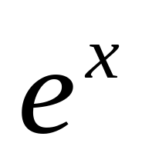
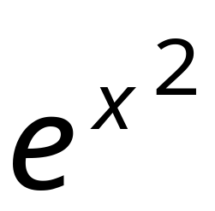
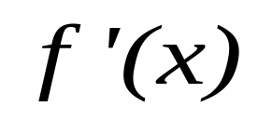

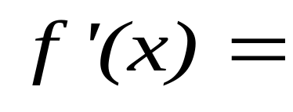
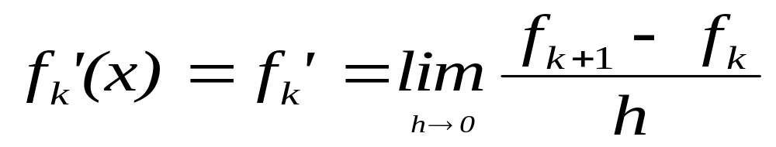
第二章: Numerical differentiation
differentiation: (微分法, 求导数)
The mathematical definition of the derivative of a function

Slide 2
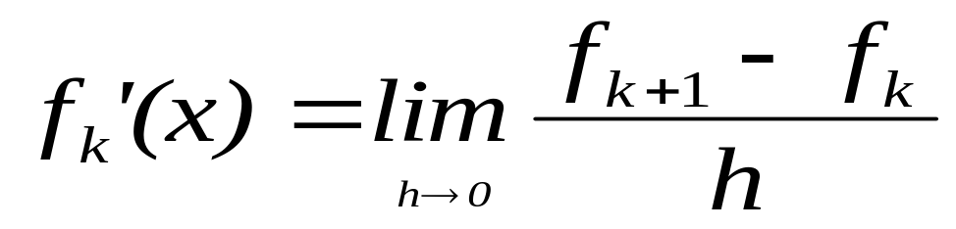
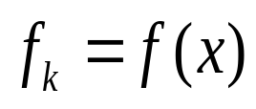

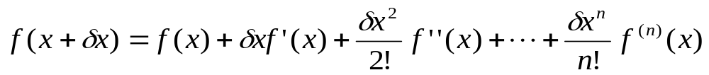
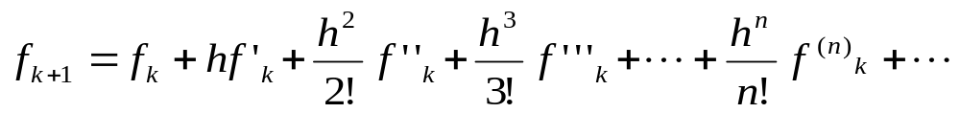
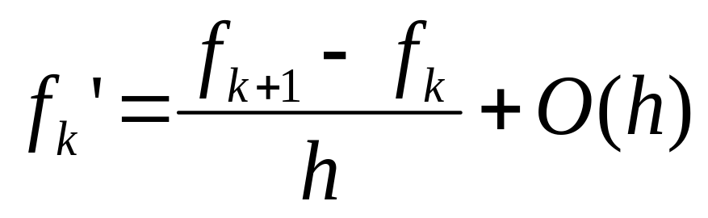
The first-order derivative
The two-point formula for the first-order derivative

Slide 3
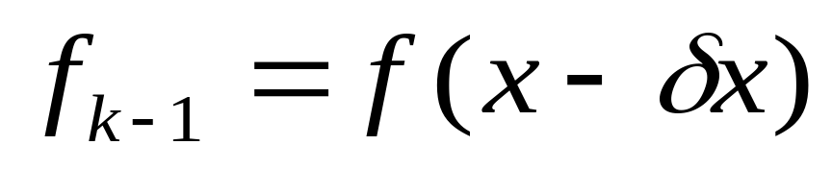
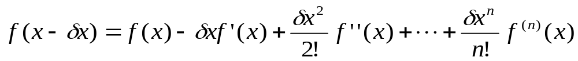
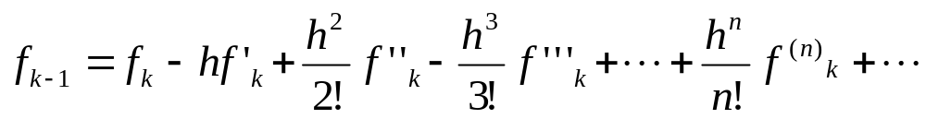
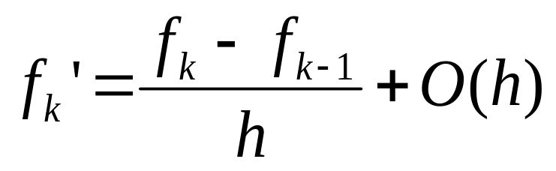

Slide 4
差商
一阶向前差分（简称差分）
一阶向后差分

Slide 5
Example
When x= 2
Calculate the first derivative of
exact
h= 0.1
h= 0.01

Slide 6
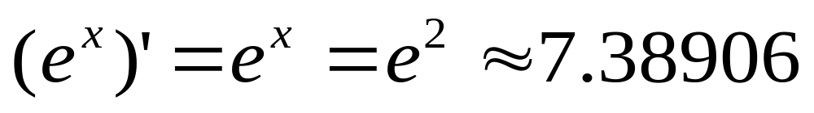
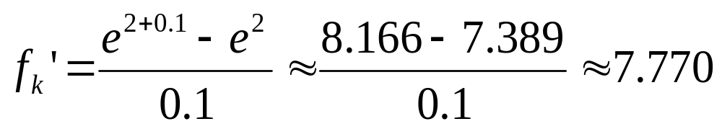
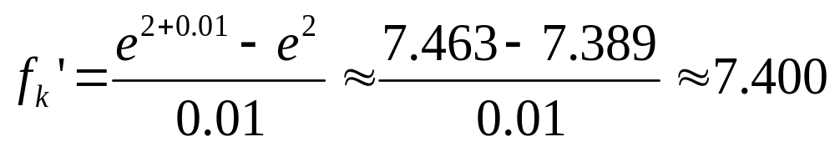
exact
h= 0.1
h= 0.01

Slide 7
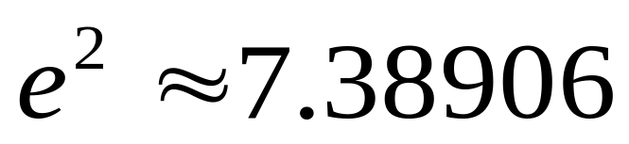
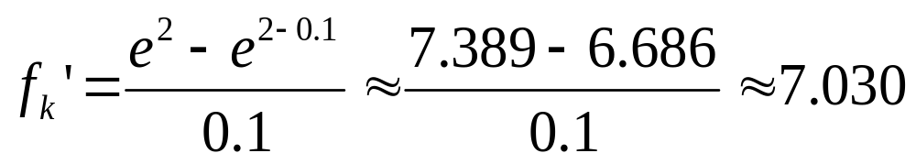
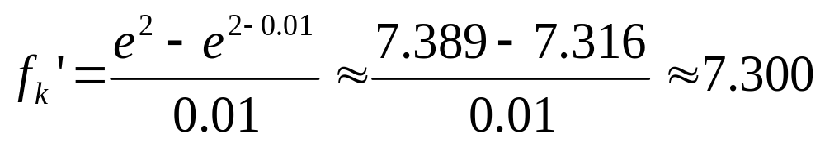
exact
h= 0.1
h= 0.01

Slide 8
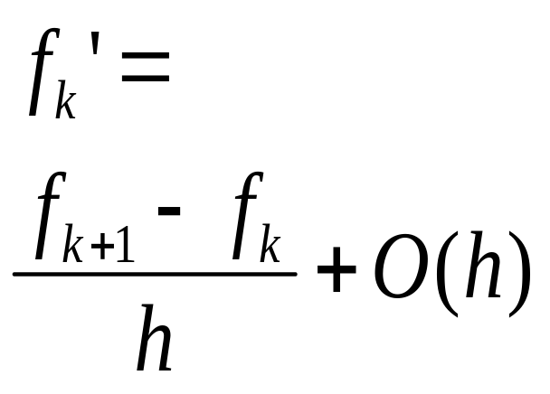
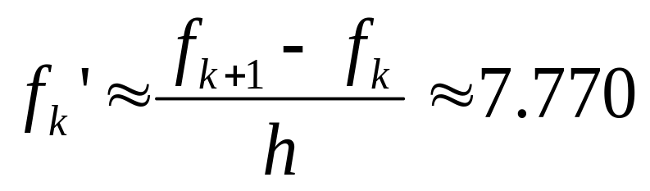
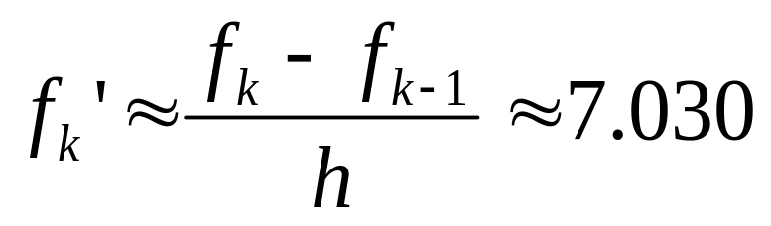
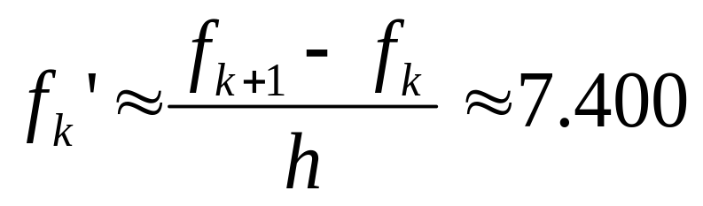
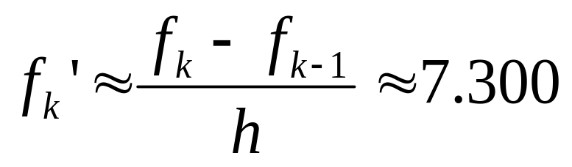
exact
h= 0.1
h= 0.01

Slide 9
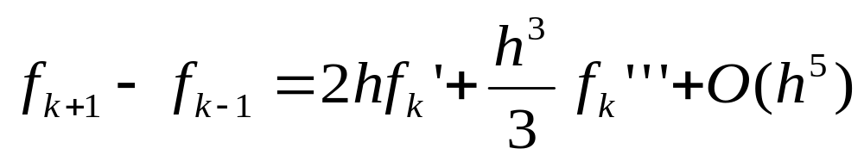
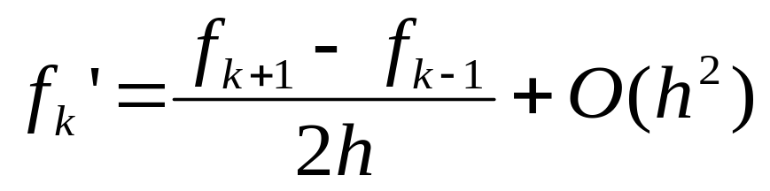
The three-point formula for the first-order derivative
中心差分

Slide 10
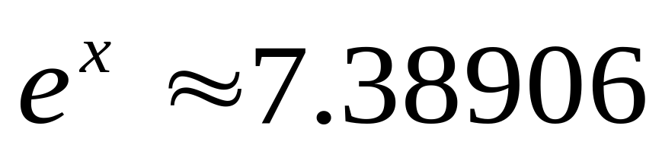
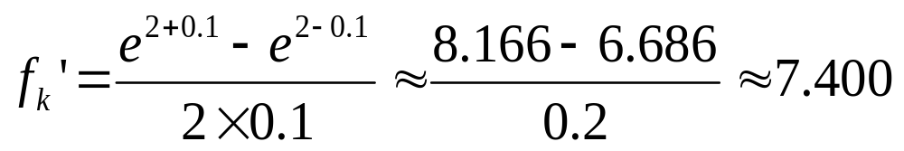
exact
When x= 2
h= 0.1

Slide 11
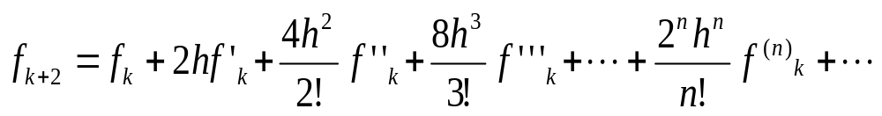
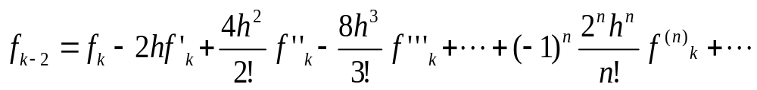
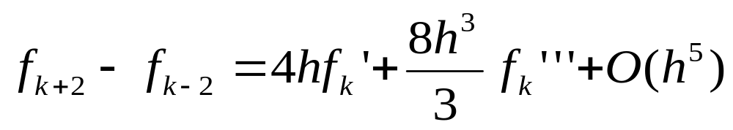

Slide 12
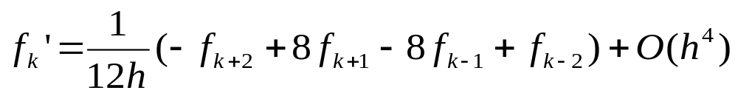
The five-point formula for the first-order derivative

Slide 13
truncation errors: which result when approximations are used to represent exact mathematical procedures.
The two-point formula for the first-order derivative
The three-point formula for the first-order derivative
The five-point formula for the first-order derivative

Slide 14
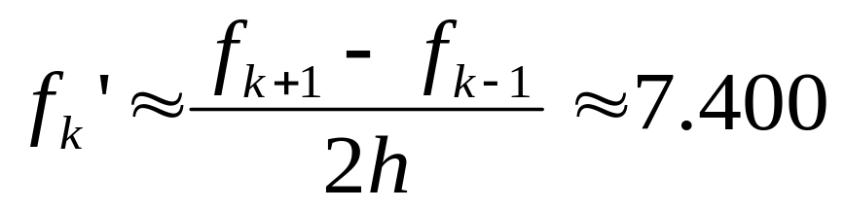
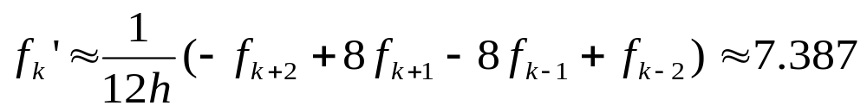
exact
h= 0.1

Slide 15
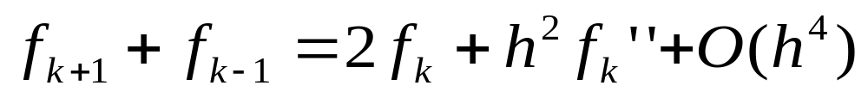
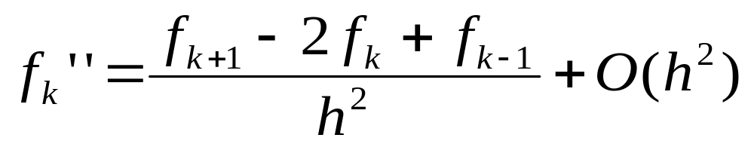
The second-order derivative
The three-point formula for the second-order derivative

Slide 16
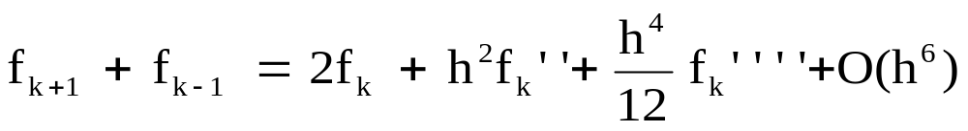
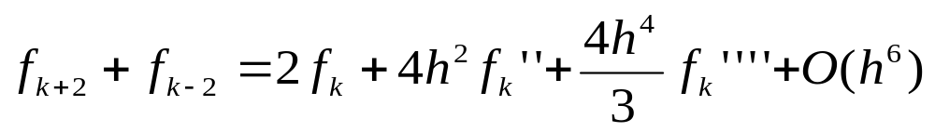

Slide 17
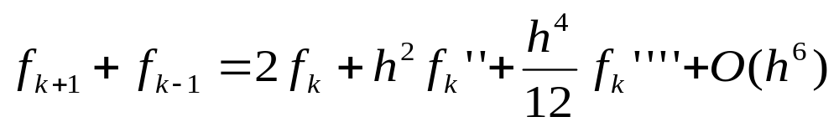
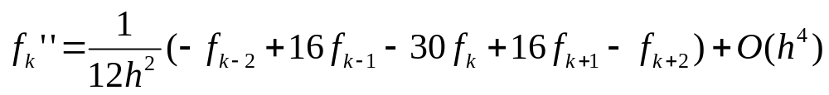
The five-point formula for the second-order derivative

Slide 18
Example
Calculate the second derivative of
exact
x= 2
h= 0.1

Slide 19
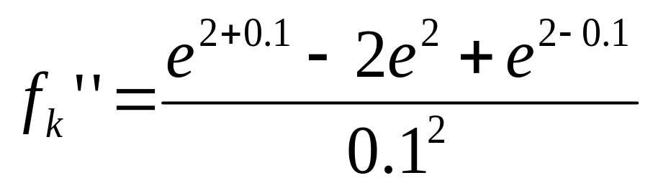
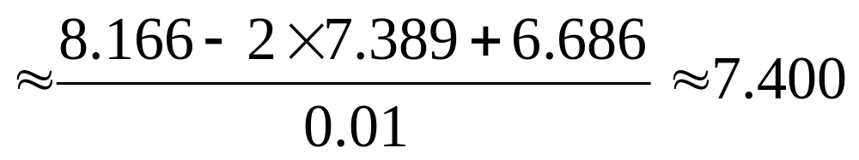
exact
h= 0.1

Slide 20
Calculate the second derivative of
exact
x=0- 5
h=0.5, 0.1, 0.01, 0.001, 0.0000001

Slide 21
x
h=0.1
h=0.01
h=0.001
h=0.0001
h=0.0000001
Exact
0.0
1.000834
1.000008
1.000000
1.000000
1.010303
1.000000
1.0
2.720548
2.718304
2.718282
2.718282
2.753353
2.718282
2.0
7.395216
7.389118
7.389057
7.389056
7.283063
7.389056
3.0
20.102280
20.085704
20.085539
20.085537
20.250467
20.085537
4.0
54.643664
54.598605
54.598155
54.598151
54.711789
54.598150
5.0
148.536878
148.414396
148.413172
148.413161
150.635056
148.413159

Slide 22
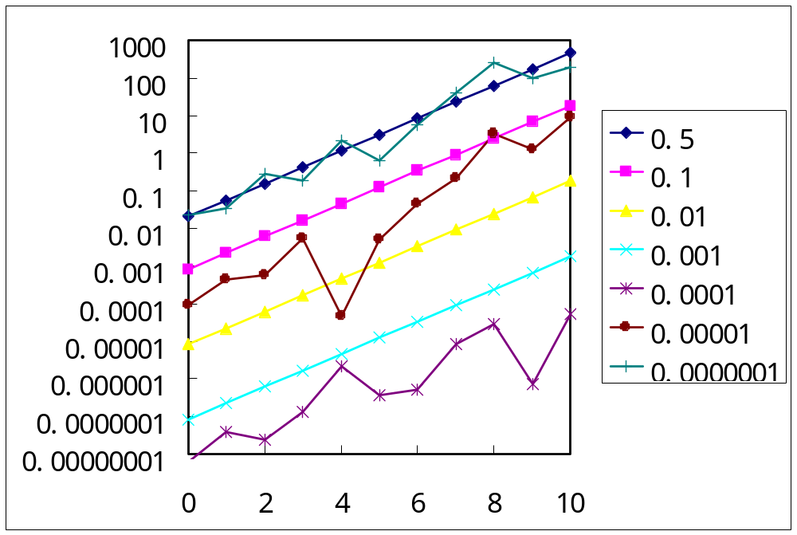
h
error of the second derivative of exp(x) as a function of x

Slide 23
The total numerical error is the summation of the truncation and round-off errors. In general, the only way to minimize round-off errors is to increase the number of significant figures of the computer. Furthermore, we have noted that round-off errors will increase due to subtractive cancellation or due to an increase in the number of computations in an analysis. In contrast, the truncation error can be reduced by decreasing the step size.

Slide 24
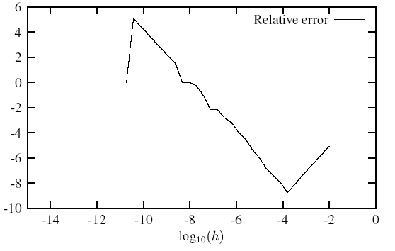
Figure: Log-log plot of the relative error of the second derivative of exp(x) as function of decreasing step lengths h . The second derivative was computed for x=10.

Slide 25
Because a decrease in step size can lead to subtractive cancellation or an increase in computations, the truncation errors are decreased as the round-off errors are increased. Therefore, we are faced by the following dilemma: The strategy for decreasing one component of the total error leads to an increase of the other component!
One challenge in calculations that we face is
to determine an appropriate step size for a particular computation.

Slide 26
We would like to choose a large (an adequately large) step size in order to decrease the amount of calculations and round-off errors without incurring the penalty of a large truncation error.

