Slide 1
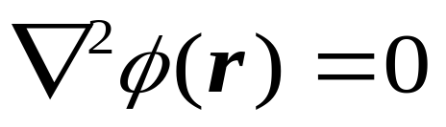
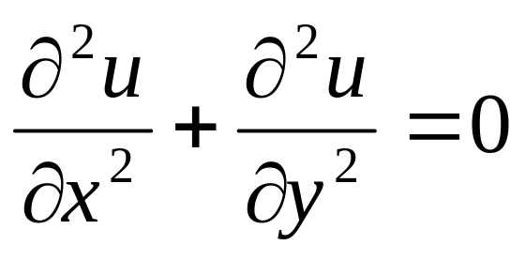
9 Partial differential equations (PDE)
In this section we shall concentrate on the numerical solution of second order linear partial differential equations.
Partial differential equations in physics
Laplace equation

Slide 2
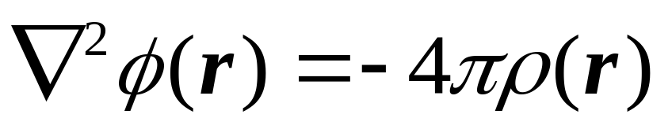
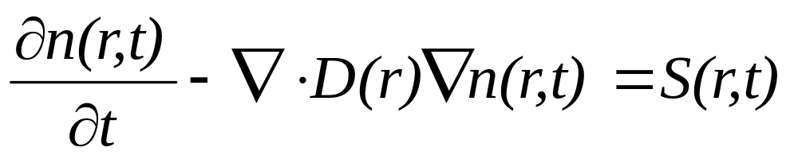
The Poisson equation
The diffusion equation

Slide 3
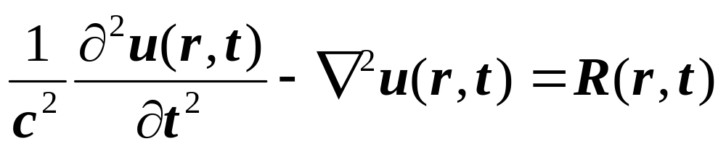
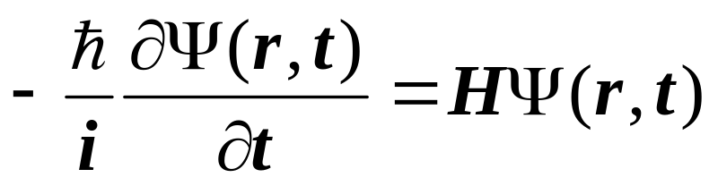
The wave equation
The time-dependent Schrodinger equation

Slide 4
Classification of Second-order PDEs
Analytical Solutions of PDEs
9.1 Laplace equation
9.2 Poisson equation
9.3 Diffusion equation
9.3.1 Semi-discretisation
9.3.2 Euler method
9.3.3 Stability
9.3.4 Model for general initial conditions
9.3.5 Implicit methods
9.4 Hyperbolic Equations - Wave Equations

Slide 5
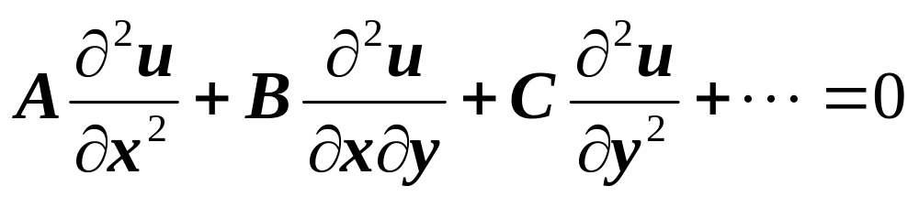
Classification of Second-order Partial Differential Equations
The general form of second-order PDE’s is:
A, B, C,是 x,y 的函数。

Slide 6
B²-4AC<0 是椭圆形的(Elliptic)
B²-4AC=0 是抛物型的(Parabolic)
B²-4AC>0 是双曲型的(Hyperbolic)

Slide 7
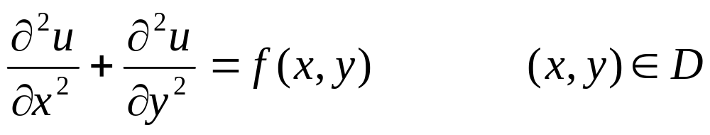
1. 椭圆型方程
(Elliptic) B²-4AC<0
Poisson方程
Laplace 方程

Slide 8
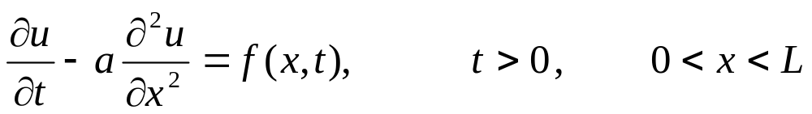
2. 抛物型方程
(Parabolic) B² - 4AC = 0
热传导方程
其中a是常数。它表示长度为L的细杆内，物体温度分布的规律

Slide 9
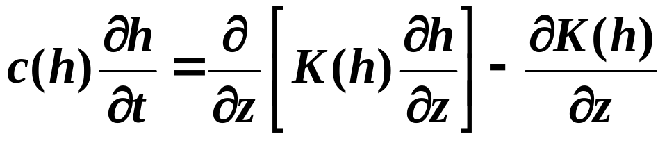
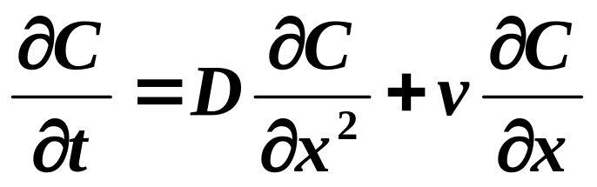
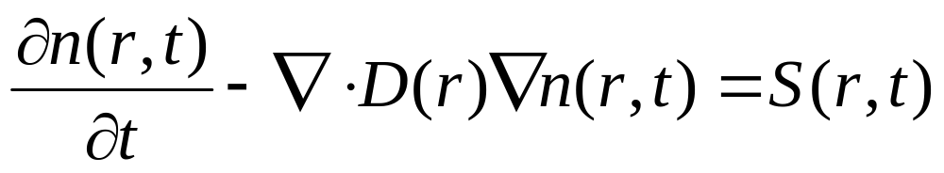
土壤水运动方程：
溶质运移方程：
（水流稳态）

Slide 10
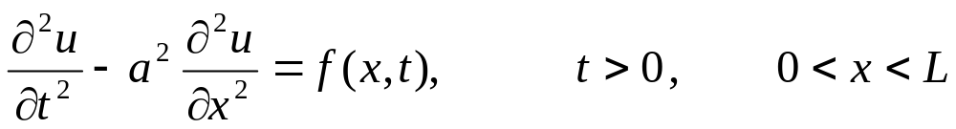
3．双曲型方程
(Hyperbolic) B²-4AC>0
波动方程
它表示长度为L的弦振动的规律。

Slide 11
u_{xx}+u_{yy} +u_{x}+sinxu_{y}-u=x²+y²
u_{xx}-u_{yy} +2u_{x}+2u_{y}+e^{x}u=x-y
u_{xx}=u_{y} +u-u_{x}+y
u_{xy}=u-u_{x}-u_{y}
3u_{xx}+u_{xy} +u_{yy}=e^{xy}
u_{xx}+u_{yy} +u_{x}+sinxu_{y}-u=x²+y
u_{xy}=u-u_{x}-u_{y}
u_{xx}+u_{yy} +u_{x}+sinxu_{y}-u=x²+y

Slide 12
• Since the coefficients A, B, C are all functions of the variables in the problem, they may change value in different parts of the solution area.
• Equations may change type in different regions of the solution space

Slide 13
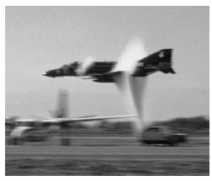
· Solutions for the subsonic (elliptic) and supersonic (hyperbolic) zones have to be obtained by different methods and patched together!

Slide 14
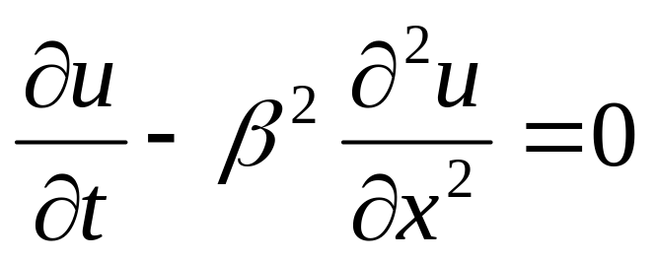
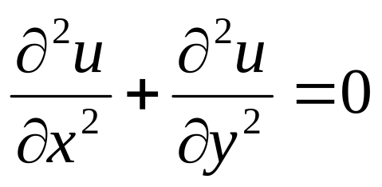
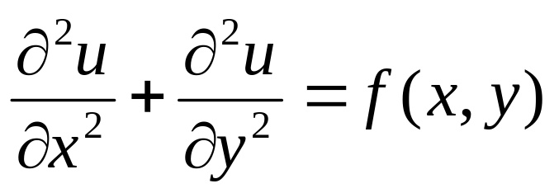
Analytical Solutions of PDEs
Heat equation
Case 1: If the heat conduction is steady state we get
Laplace’s Equation
Case 2: If there is a driving function on the right hand side, such as in electrostatics with charge present, we get
Poisson’s Equation

Slide 15
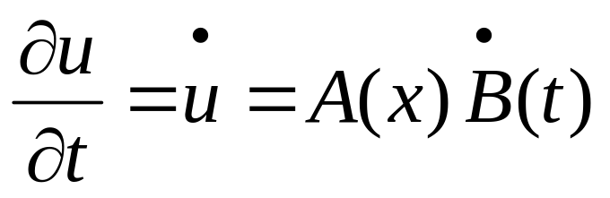
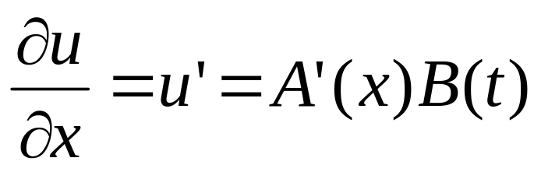
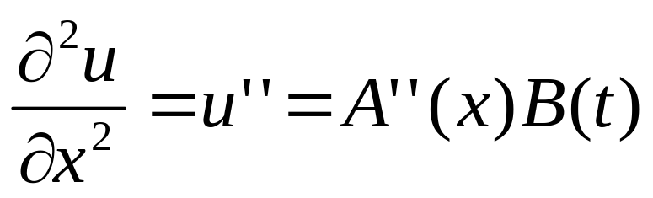
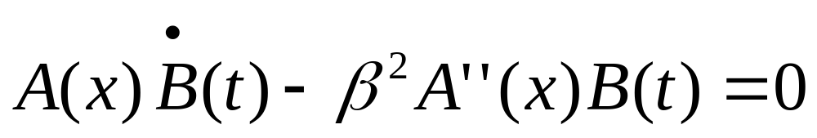
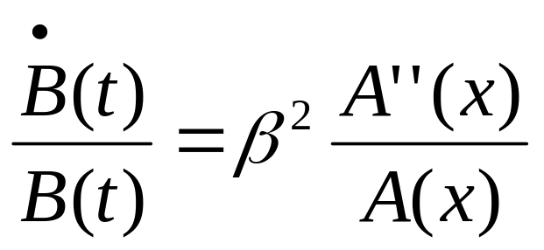
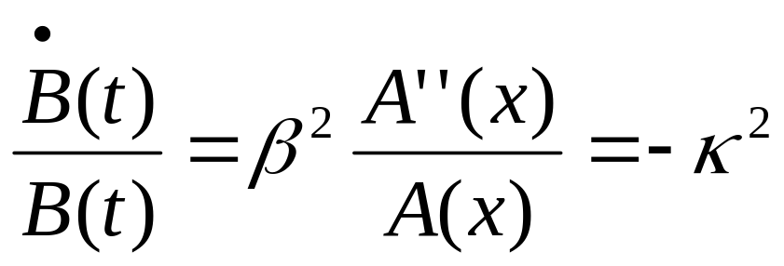
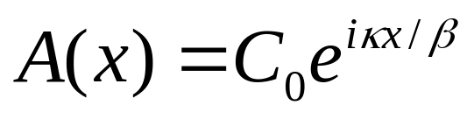
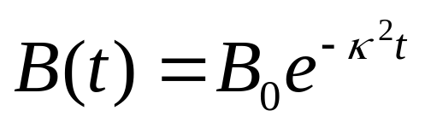
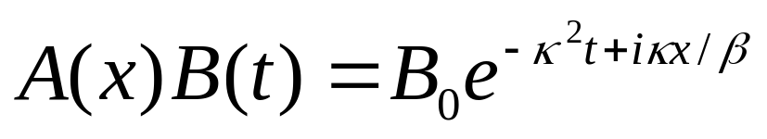
u(x,t)=A(x)B(t)

Slide 16
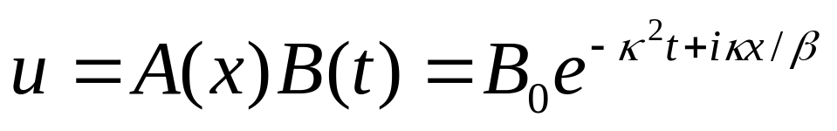
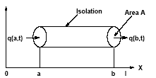
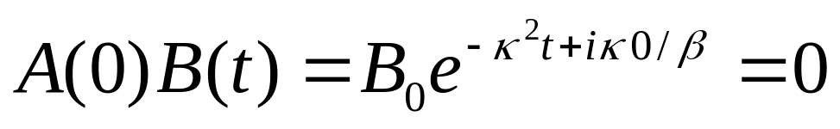
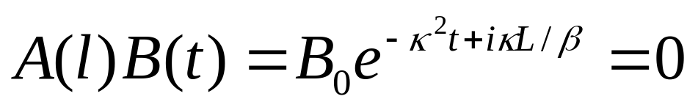


U(L,t)=0
U(0,t)=0

Slide 17
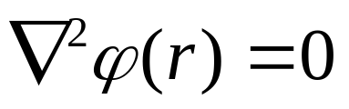
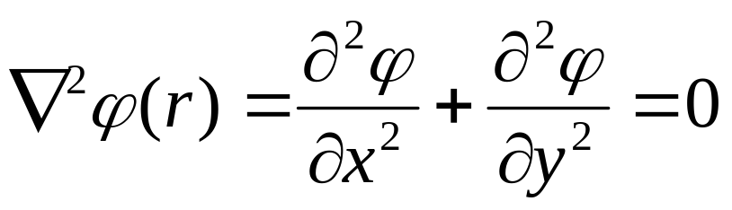
9.1 Laplace equation
Consider the Laplace equation in two dimensions
in some rectangular domain described by
x in [x₀ , x₁], y in [y₀ , y₁].

Slide 18
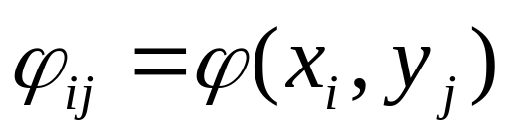
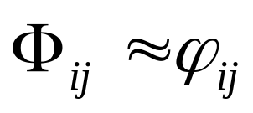
Suppose we discretise the solution ϕ onto a m+1 by n+1 rectangular grid (or mesh) given by
x_{i} = x₀ + iΔx
i=0, m
y_{j} = y₀ + jΔy
j=0, n
Δx = (x₁–x₀ )/m
and Δy = (y₁–y₀ )/n
Let
be the exact solution at the mesh point i,j,
be the approximate solution at that mesh point

Slide 19
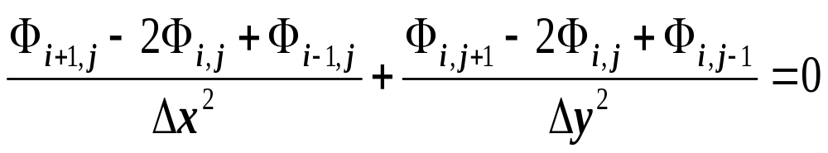
(x,y+h)
for the internal points 0<i<m, 0<j<n
(x,y)
The five-point formula for the finite difference method
(x+h,y)

Slide 20
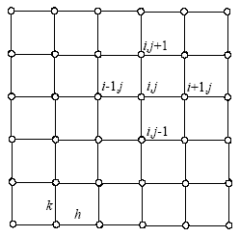
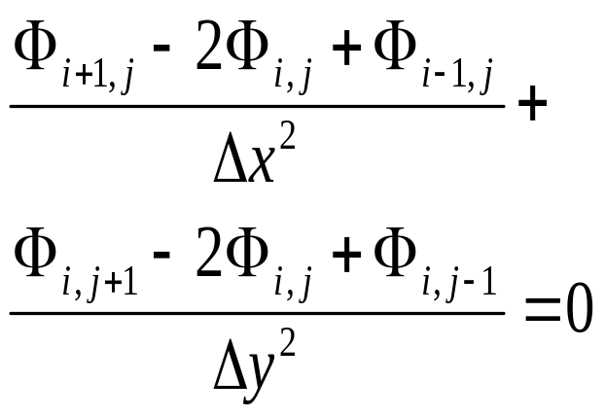
y = jk
x = nh

Slide 21
(149)
In addition to this we will have either Dirichlet, von Neumann or mixed boundary conditions to specify the boundary values of ϕij. The system of linear equations described by (148) in combination with the boundary conditions may be solved in a variety of ways.

Slide 22
9.1.1 Direct solution
Provided the boundary conditions are linear in ϕ, our finite difference approximation is itself linear and the resulting system of equations may be written as
Δx = Δy
i=1, m-1
i=0, m
-4 Φ_{ij} + Φ_{i–1,j} + Φ_{i,j–1} +Φ_{i+1,j} + Φ_{i,j+1} =0
j=1, n-1
j=0, n
Aϕ = b
with (m+1)(n+1) equations.
This system may be solved directly using Gauss Elimination as discussed in section 4.1.

Slide 23
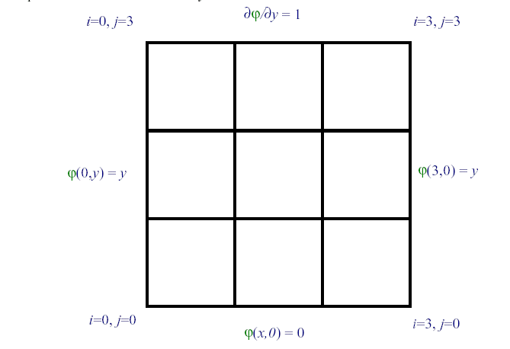
(3,y)=y
(00)(10)(20)(30)(01)(11)(21)(31)(02)(12)(22)(32)(03)(13)(23)(33)

Slide 24
ϕ₀₀ = 0
ϕ₁₀ = 0
ϕ₂₀ = 0
ϕ₃₀ = 0
ϕ₀₁ = 1
−4Φ₁₁+ ϕ₀₁+ϕ₁₀+Φ₂₁+Φ ₁₂= 0
(3,y)=y
−4Φ₂₁+ Φ₁₁+ ϕ₂₀+Φ ₃₁+ Φ₂₂= 0
ϕ₃₁ = 1
ϕ₀₂ = 2
−4Φ₁₂+ ϕ₀₂+Φ₁₁+Φ ₂₂+Φ₁₃= 0
−4Φ₂₂+Φ₁₂+Φ₂₁+ ϕ₃₂+ ϕ₂₃= 0
ϕ₃₂ = 2
ϕ₀₃ −ϕ₀₂ =1
-4 Φ_{ij} + Φ_{i–1,j} + Φ_{i,j–1} +Φ_{i+1,j} + Φ_{i,j+1} =0
ϕ₁₃ −ϕ₁₂ =1
ϕ₂₃ −ϕ₂₂ =1
ϕ₃₃ −ϕ₃₂ =1
(00)(10)(20)(30)(01)(11)(21)(31)(02)(12)(22)(32)(03)(13)(23)(33)

Slide 25
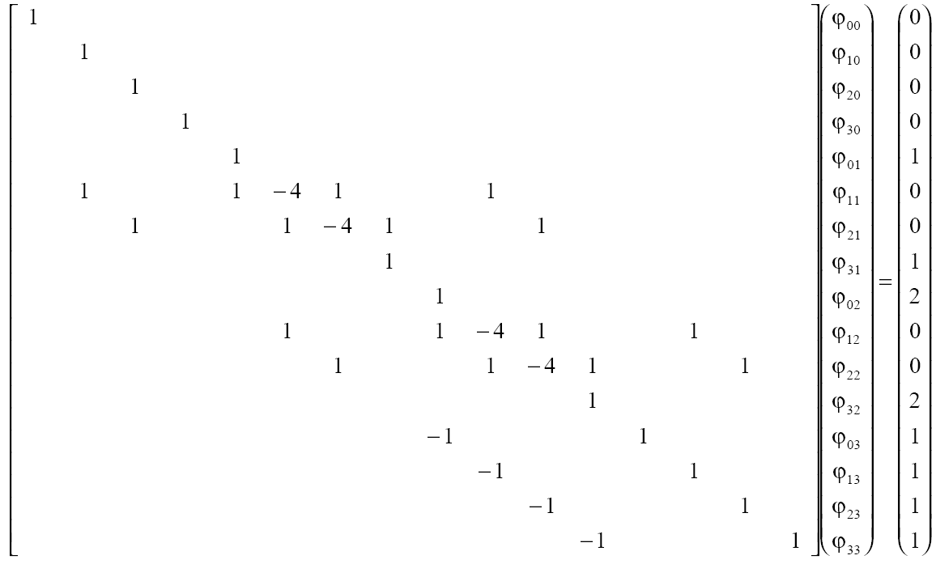
(00) (10) (20) (30) (01) (11) (21) (31) (02) (12) (22 )(32) (03) (13) (23) (33)
(00) (10) (20) (30) (01) (11) (21) (31) (02) (12) (22 )(32) (03) (13) (23) (33)

Slide 26
However, this approach may be feasible if the total number of mesh points (m+1)(n+1) required is relatively small, but as the matrix A used to represent the complete system will have [(m+1)(n+1)]² elements, the storage and computational cost of such a solution will become prohibitive even for relatively modest m and n.

Slide 27
Aϕ = b
The structure of the system ensures A is relatively sparse, consisting of a tridiagonal core with one nonzero diagonal above and another below this. These nonzero diagonals are offset by either m or n from the leading diagonal.

Slide 28
Provided pivoting (if required) is conducted in such a way that it does not place any nonzero elements outside this band then solution by Gauss Elimination or LU Decomposition will only produce nonzero elements inside this band, substantially reducing the storage and computational requirements (see section 4.4). Careful choice of the order of the matrix elements (i.e. by x or by y) may help reduce the size of this matrix so that it need contain only O(m³) elements for a square domain.

Slide 29
Because of the wide spread need to solve Laplace’s and related equations, specialized solvers have been developed for this problem. One of the best of these is Hockney’s method for solving Aϕ = b which may be used to reduce a block tridiagonal matrix (and the corresponding right-hand side) of the form

Slide 30
(00) (10) (20) (30) (01) (11) (21) (31) (02) (12) (22 )(32) (03) (13) (23) (33)
(00) (10) (20) (30) (01) (11) (21) (31) (02) (12) (22 )(32) (03) (13) (23) (33)

Slide 31
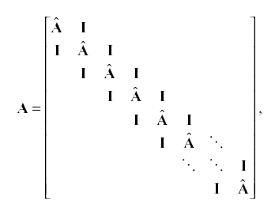

Slide 32
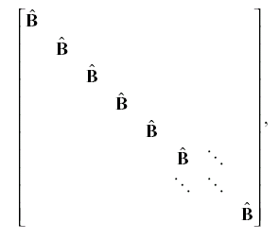
into a block diagonal matrix of the form

Slide 33
where A and B are themselves block tridiagonal matrices and I is an identity matrix. This process may be performed iteratively to reduce an n dimensional finite difference approximation to Laplace’s equation to a tridiagonal system of equations with n–1 applications.
The computational cost is O(p log p), where p is the total number of mesh points.
The main drawback of this method is that the boundary conditions must be able to be cast into the block tridiagonal format.

Slide 34
9.1.2 Relaxation
An alternative to direct solution of the finite difference equations is an iterative numerical solution. These iterative methods are often referred to as relaxation methods as an initial guess at the solution is allowed to slowly relax towards the true solution, reducing the errors as it does so. There are a variety of approaches with differing complexity and speed. We shall introduce these methods before looking at the basic mathematics behind them.

Slide 35
9.1.2.1 Jacobi
The Jacobi Iteration is the simplest approach. For clarity we consider the special case when Δx = Δy. To find the solution for a two-dimensional Laplace equation simply:
-4 Φ_{ij} +Φ_{i+1,j} + Φ_{i–1,j} + Φ_{i,j+1} + Φ_{i,j–1}=0
Φ*_{ij} = (Φ_{i+1,j} + Φ_{i–1,j} + Φ_{i,j+1} + Φ_{i,j–1})/4.

Slide 36
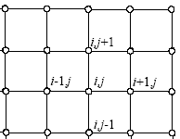
1. Initialise Φ_{ij} to some initial guess.
2. Apply the boundary conditions.
3. For each internal mesh point set
-4 Φ_{ij} +Φ_{i+1,j} + Φ_{i–1,j} + Φ_{i,j+1} + Φ_{i,j–1}=0
Φ*_{ij} = (Φ_{i+1,j} + Φ_{i–1,j} + Φ_{i,j+1} + Φ_{i,j–1})/4.
4. Replace old solution Φ with new estimate Φ*.
5. If solution does not satisfy tolerance, repeat from step 2.

Slide 37
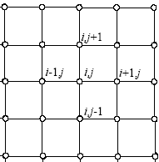
An example of this algorithm is given in the table below where ϕ = 0 on the boundaries and the initial guess is ϕ = 1 in the interior (clearly the answer is ϕ = 0 everywhere).
i=0,j=4
i=4,j=4
i=0,j=0
i=4,j=0
(00)(10)(20)(30) (40)(01)(11)(21)(31) (41)(02)(12)(22)(32) (42)(03)(13)(23)(33) (43)

Slide 38
0
0
0
0
0
0
1
1
1
0
0
1
1
1
0
0
1
1
1
0
0
0
0
0
0
Φ*_{ij} = (Φ_{i+1,j} + Φ_{i–1,j} + Φ_{i,j+1} + Φ_{i,j–1})/4.

Slide 39
0
0
0
0
0
0
1
1
1
0
0
1
1
1
0
0
1
1
1
0
0
0
0
0
0
0
0
0
0
0
0
1/2
3/4
1/2
0
0
3/4
1
3/4
0
Φ*_{ij} = (Φ_{i+1,j} + Φ_{i–1,j} + Φ_{i,j+1} + Φ_{i,j–1})/4.
0
1/2
3/4
1/2
0
0
0
0
0
0

Slide 40
0
0
0
0
0
0
0
0
0
0
0
1
1
1
0
0
3/8
1/2
3/8
0
0
1
1
1
0
0
1/2
3/4
1/2
0
0
1
1
1
0
0
3/8
1/2
3/8
0
0
0
0
0
0
0
0
0
0
0
0
0
0
0
0
0
0
0
0
0
0
1/2
3/4
1/2
0
0
1/4
3/8
1/4
0
0
3/4
1
3/4
0
0
3/8
1/2
3/8
0
0
1/2
3/4
1/2
0
0
1/4
1/2
1/4
0
0
0
0
0
0
0
0
0
0
0

Slide 41
SUBROUTINE Jacobi(NX,NY,H,ITMAX,U,IU)
DIMENSION U(IU,NY), UP(IU,NY)
DO K=1,ITMAX
DO J=2,NY-1
DO I=2,NX-1
UP(I,J)=(U(I+1,J)+ U(I-1,J)+ U(I,J+1)+ U(I,J-1))/4.
ENDDO
ENDDO
U=UP
Φ*_{ij} = (Φ_{i+1,j} + Φ_{i–1,j} + Φ_{i,j+1} + Φ_{i,j–1})/4.
ENDDO
RETURN END

Slide 42
9.1.2.2 Gauss-Seidel
The Gauss-Seidel Iteration is very similar to the Jacobi Iteration, the only difference being that the new estimate Φ*_{ij} is returned to the solution Φ_{ij} as soon as it is completed, allowing it to be used immediately rather than deferring its use to the next iteration. The advantages of this are:
· Less memory required (there is no need to store Φ*).
· Faster convergence (although still relatively slow).

Slide 43
On the other hand, the method is less amenable to vectorisation as, for a given iteration, the new estimate of one mesh point is dependent on the new estimates for those already scanned.
An example of the first iteration of the Gauss-Seidel approach using the same initial guess as our Jacobi iteration in §9.1.2.1 is given below, with the iteration starting at the bottom left and moving across then up.

Slide 44
0
0
0
0
0
0
1
1
1
0
0
1
1
1
0
0
1
1
1
0
0
0
0
0
0
0
0
0
0
0
0
13/32
71/128
71/256
0
0
5/8
13/16
71/128
0
0
1/2
5/8
13/32
0
0
0
0
0
0

Slide 45
0
0
0
0
0
0
1/2
3/4
1/2
0
0
3/4
1
3/4
0
Jacobi
0
1/2
3/4
1/2
0
0
0
0
0
0
0
0
0
0
0
0
13/32
71/128
71/256
0
Gauss-Seidel
0
5/8
13/16
71/128
0
0
1/2
5/8
13/32
0
0
0
0
0
0

Slide 46
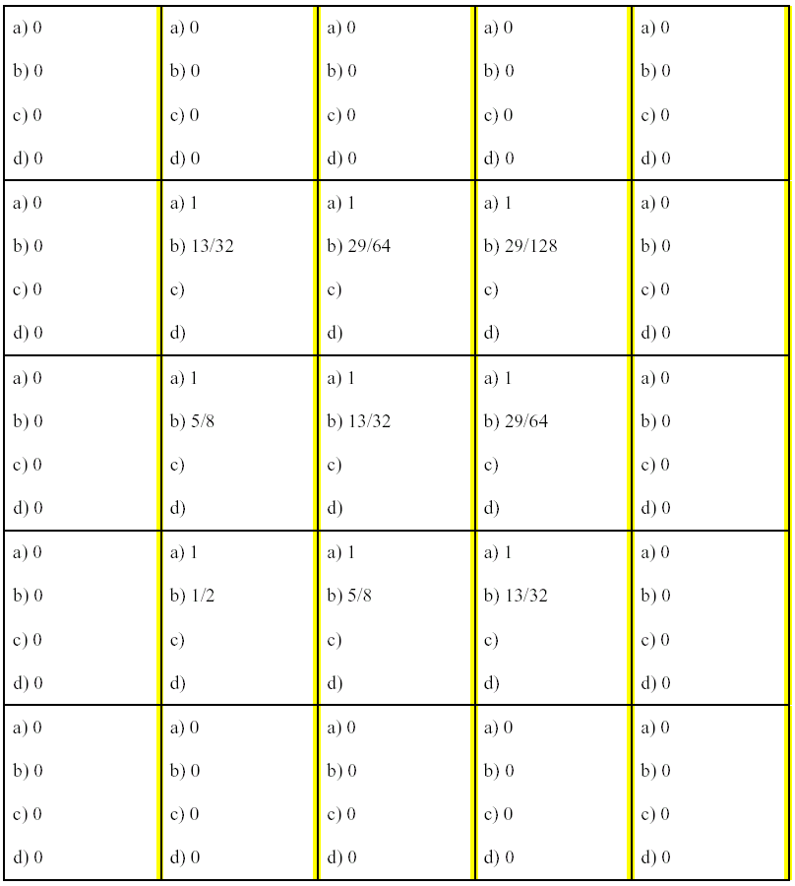

Slide 47
SUBROUTINE SEIDEL(NX,NY,H,ITMAX,U,IU)
DIMENSION U(IU,NY)
DO K=1,ITMAX
DO J=2,NY-1
DO I=2,NX-1
U(I,J)=(U(I+1,J)+ U(I-1,J)+ U(I,J+1)+ U(I,J-1))/4.
ENDDO
ENDDO
ENDDO
RETURN
END

Slide 48
9.1.2.3 Red-Black ordering
A variant on the Gauss-Seidel Iteration is obtained by updating the solution Φ_{ij} in two passes rather than one. If we consider the mesh points as a chess board, then the white squares would be updated on the first pass and the black squares on the second pass.
The advantages
· No interdependence of the solution updates within a single pass aids vectorisation.
· Faster convergence at low wave numbers

Slide 49
An example, based on those in the previous two sections, is given below. Note that the cells labeled “Red” are updated on the first pass and those labeled “Black” on the second pass. Unlike the Gauss-Seidel, the order in which the cells are updated within one pass does not matter.

Slide 50
0
0
0
0
0
0
1
1
1
0
0
1
1
1
0
0
1
1
1
0
0
0
0
0
0
B0
R0
B0
R0
B0
B
R
B
R
B
R
B
R
B
R
R0
B1
R1
B1
R0
B
R
B
R
B
B0
R1
B1
R1
B0
R
B
R
B
R
R0
B1
R1
B1
R0
B
R
B
R
B
B0
R0
B0
R0
B0

Slide 51
B0
R0
B0
R0
B0
R0
B1
R1
B1
R0
B0
R1
B1
R1
B0
R0
B1
R1
B1
R0
B0
R0
B0
R0
B0
B0
R0
B0
R0
B0
R0
B1
R3/4
B1
R0
B0
R3/4
B1
R3/4
B0
Chang R
R0
B1
R3/4
B1
R0
B0
R0
B0
R0
B0

Slide 52
B0
R0
B0
R0
B0
R0
B1
R3/4
B1
R0
B0
R3/4
B1
R3/4
B0
R0
B1
R3/4
B1
R0
B0
R0
B0
R0
B0
Chang B
B0
R0
B0
R0
B0
R0
B3/8
R3/4
B3/8
R0
B0
R3/4
B3/4
R3/4
B0
R0
B3/8
R3/4
B3/8
R0
B0
R0
B0
R0
B0

Slide 53
B0
R0
B0
R0
B0
R0
B3/8
R3/4
B3/8
R0
B0
R3/4
B3/4
R3/4
B0
R0
B3/8
R3/4
B3/8
R0
B0
R0
B0
R0
B0
Chang R
B0
R0
B0
R0
B0
R0
B3/8
R3/8
B3/8
R0
B0
R3/8
B3/4
R3/8
B0
R0
B3/8
R3/8
B3/8
R0
B0
R0
B0
R0
B0

Slide 54
B0
R0
B0
R0
B0
R0
B3/8
R3/8
B3/8
R0
B0
R3/8
B3/4
R3/8
B0
R0
B3/8
R3/8
B3/8
R0
B0
R0
B0
R0
B0
Chang B
B0
R0
B0
R0
B0
R0
B3/16
R3/8
B3/16
R0
B0
R3/8
B3/8
R3/8
B0
R0
B3/16
R3/8
B3/16
R0
B0
R0
B0
R0
B0

Slide 55
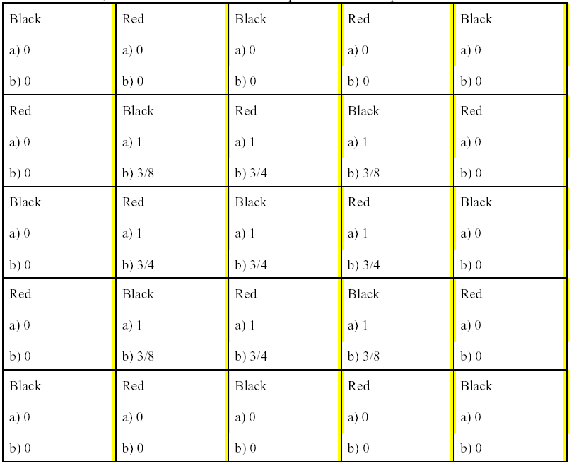

Slide 56
0
0
0
0
0
B0
R0
B0
R0
B0
0
1/2
3/4
1/2
0
R0
B3/8
R3/4
B3/8
R0
0
3/4
1
3/4
0
B0
R3/4
B3/4
R3/4
B0
0
1/2
3/4
1/2
0
R0
B3/8
R3/4
B3/8
R0
0
0
0
0
0
B0
R0
B0
R0
B0
0
0
0
0
0
0
13/32
71/128
71/256
0
0
5/8
13/16
71/128
0
0
1/2
5/8
13/32
0
0
0
0
0
0

Slide 57
In this example the solution is converging faster than the Jacobi iteration and at a comparable rate to Gauss-Seidel, yet is maintaining the symmetries which existed in the initial guess. For many problems, particularly those looking at instabilities, the maintenance of symmetries is important.

Slide 58
9.1.2.4 Successive Over Relaxation (SOR)
It has been found that the errors in the solution obtained by any of the three preceding methods
decrease only slowly and often decrease in a monotonic manner. Hence, rather than setting
Φ*_{ij} = (Φ_{i+1,j} + Φ_{i–1,j} + Φ_{i,j+1} + Φ_{i,j–1})/4.
for each internal mesh point, we use
Φ*_{ij} = (1–σ) Φ_{i,j} + σ(Φ_{i+1,j} + Φ_{i–1,j} + Φ_{i,j+1} + Φ_{i,j–1})/4.

Slide 59
for some value σ. The optimal value of σ will depend on the problem being solved and may vary as the iteration process converges. Typically, however, a value of around 1.2 to 1.4 produces good results. In some special cases it is possible to determine an optimal value analytically.

Slide 60
9.1.3 Multigrid*
The big problem with relaxation methods is their slow convergence. If σ= 1 then application of the stencil removes all the error in the solution at the wave length of the mesh for that point, but has little impact on larger wave lengths. This may be seen if we consider the one-dimensional equation
Suppose our initial guess for the iterative solution is that
for all internal mesh points. With the Jacobi Iteration the correction to the internal points diffuses only slowly along from x = 1

Slide 61
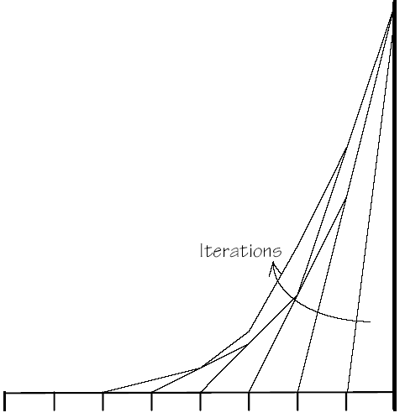

Slide 62
Multigrid methods try to improve the rate of convergence by considering the problem of a hierarchy of grids. The larger wave length errors in the solution are dissipated on a coarser grid while the shorter wave length errors are dissipated on a finer grid. For the example considered above, the solution would converge in one complete Jacobi multigrid iteration, compared with the slow asymptotic convergence above.

Slide 63
9.1.4 The mathematics of relaxation*

Slide 64
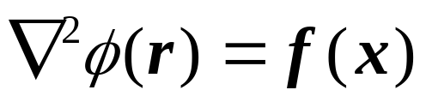



9.2 Poisson equation
In electrostatics, we can write the electric E in terms of an electric potential :
where ρ(r) is the charge density, and ε₀ the permittivity of free-space. In Newtonian
gravity, we can write the force f exerted on a unit test mass in terms of a gravitational potential

Slide 65
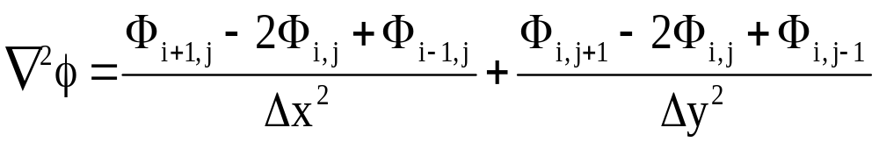
The Poisson equation
may be treated using the same techniques as Laplace’s equation. It is simply necessary to set the right-hand side to f, scaled suitably to reflect any scaling in A.
(∇²Φ*)_{ij} = (Φ_{i+1,j} + Φ_{i–1,j} + Φ_{i,j+1} + Φ_{i,j–1}- 4Φ_{i,j})/h²

Slide 66
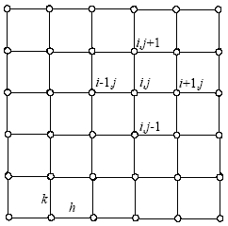
(∇²Φ*)_{ij} = (Φ_{i-1,j} + Φ_{i+1,j} + Φ_{i,j-1} + Φ_{i,j+1}- 4Φ_{i,j})/h² =f_{i,j}

Slide 67
(∇²Φ*)_{ij} = (Φ_{i-1,j} + Φ_{i+1,j} + Φ_{i,j-1} + Φ_{i,j+1}- 4Φ_{i,j})/h² =f_{i,j}
-Φ₁₂ - Φ₃₂ - Φ₂₃ - Φ₂₁+ 4Φ₂₂ =h² f₂₂
-Φ₁₃ - Φ₃₃ - Φ₂₄ - Φ₂₂+ 4Φ₂₃ =h² f₂₃
-Φ₁₄ - Φ₃₄ - Φ₂₃ - Φ₂₅+ 4Φ₂₄ =h² f₂₄
-Φ₂₂ - Φ₄₂ - Φ₃₃ - Φ₂₁+ 4Φ₃₂ =h² f₃₂
-Φ₅₂ - Φ₃₂ - Φ₄₃ - Φ₄₁+ 4Φ₄₂ =h² f₄₂
Aϕ = b
-Φ₂₃ - Φ₄₃ - Φ₃₄ - Φ₂₂+ 4Φ₃₃ =h² f₃₃
-Φ₅₃ - Φ₃₃ - Φ₄₄ - Φ₄₂+ 4Φ₄₃ =h² f₄₃

Slide 68
9.2.2 Gauss-Seidel
-4 Φ_{ij} +Φ_{i+1,j} + Φ_{i–1,j} + Φ_{i,j+1} + Φ_{i,j–1}=0
Φ*_{ij} = (Φ_{i+1,j} + Φ_{i–1,j} + Φ_{i,j+1} + Φ_{i,j–1})/4.
(∇²Φ*)_{ij} = (Φ_{i-1,j} + Φ_{i+1,j} + Φ_{i,j-1} + Φ_{i,j+1}- 4Φ_{i,j})/h² =f_{i,j}
Φ*_{ij} = (Φ_{i+1,j} + Φ_{i–1,j} + Φ_{i,j+1} + Φ_{i,j–1}-h² f _{i,j} )/4.

Slide 69





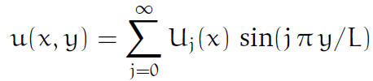


Slide 70
SUBROUTINE SEIDEL(NX,NY,H,ITMAX,U,IU)
DIMENSION U(IU,NY),
DO K=1,ITMAX
DO J=2,NY-1
DO I=2,NX-1
U(I,J)=(U(I+1,J)+ U(I-1,J)+ U(I,J+1)+ U(I,J-1)-h*h*f(I,J))/4.
ENDDO
ENDDO
ENDDO
RETURN
END

Slide 71





Slide 72







Slide 74






Slide 75
快速Fourier Transform
Fast Fourier Transform
Nlog₂N
N²
N=10⁶
30s verse two weeks

Slide 76


9.3 Diffusion equation
B²-4AC<0 是椭圆形的
B²-4AC=0 是抛物型的
B²-4AC>0 是双曲型的

Slide 77


Slide 78


ice
ice
0
1
with u(x=0,t) = u(x=1,t) = 0 and u(x,t=0) = u0(sinπx)

Slide 79

Consider the two-dimensional diffusion equation,
subject to u(x,y,t) = 0 on the boundaries x=0, 1 and y=0, 1.
1
Suppose the initial conditions are
u(x,y,t=0) = u0(x,y)
0
0
1
We wish to evaluate the solution for t > 0

Slide 80

9.3.1 Semi-discretisation
One of the simplest and most useful approaches is to discretise the equation in space and then solves a system of (coupled) ordinary differential equations in time in order to calculate the solution.

Slide 81


ice
ice
9.3.1 Semi-discretisation
0
1
with u(x=0,t) = u(x=1,t) = 0 and u(x,t=0) = u0(sinπx)
apply the standard spatial discretisation for the second derivative term to obtain

Slide 82
In principle we may utilise any of the time stepping algorithms discussed in earlier lectures to solve this system. As we shall see, however, care needs to be taken to ensure the method chosen produces a stable solution.

Slide 83




9.3.2 Euler method
Y_{n+1} = Y_{n}+Δt f(Y_{n},t_{n})

Slide 84


(x,t+k)
(x-h,t)
(x,t)
(x+h,t)

Slide 85
Consider the two-dimensional diffusion equation,
subject to u(x,y,t) = 0 on the boundaries x=0, 1 and y=0, 1.
1
0
0
1
Suppose the initial conditions are
u(x,y,t=0) = u0(x,y)
We wish to evaluate the solution for t > 0

Slide 86

(∇²u)_{ij} = (u_{i-1,j} +u_{i+1,j} +u_{i,j-1} +u_{i,j+1}- 4u_{i,j})/h²

Slide 87

for the internal points i=1,m–1 and j=1,m–1. On the boundaries (i=0,j), (i=m,j), (i,j=0) and (i,j=m) we simply have u_{ij}=0. If U _{ij} represents our approximation of u at the mesh points x_{ij}, then we must simply solve the (m–1)² coupled ordinary differential equations

Slide 88


Y_{n+1} = Y_{n}+Δt f(Y_{n},t_{n})
μ = Δt/Δx²

Slide 89
where the Courant number (库朗数)
μ = Δt/Δx²
describes the size of the time step relative to the spatial discretisation. As we shall see, stability of the solution depends onμ in contrast to an ordinary differential equation where it is a function of the time step Δt only.

Slide 90
Stability
Stability of the Euler method solving the diffusion equation may be analyzed in a similar way to that for ordinary differential equations. We start by asking the question “does the Euler method converge as t–>infinity?” The exact solution will have u –> 0 and the numerical solution must also do this if it is to be stable.

Slide 91



Sin[θ(i+1)]= sin(θi)cos(θ) + cos(θi) sin(θ)

Slide 92
Sin[θ(i+1)]= sin(θi)cos(θ) + cos(θi) sin(θ)
U⁽¹⁾_{i} = [sin(θi)cos(θ) + cos(θi) sin(θ)]+ sin(θi) -2s sin(θi) +[sin(θi)cos(θ) - cos(θi) sin(θ)]
= 2sin(θi)cos(θ) + sin(θi) -2s sin(θi)
= sin(θi) -2s sin(θi) [ 2sin²(θ /2)]
U⁽¹⁾_{i} = sin(θi) [1 – 4s sin²(θ /2)]

Slide 93
U⁽¹⁾_{i} = sin(θi) [1 – 4s sin²(θ /2)]
U^{(n)}_{i} = sin(θi) [1 – 4s sin²(θ /2)] ^{n}
which then requires |1 - 4s sin²(θ /2)| < 1

Slide 94
U⁽¹⁾_{i} = sin(θi) [1 – 4s sin²(θ /2)]
U^{(n)}_{i} = sin(θi) [1 – 4s sin²(θ /2)] ^{n}
which then requires |1 - 4s sin²(θ /2)| < 1
1 - 4s sin²(θ /2) < 1
- 4s sin²(θ /2) < 0
-(1 - 4s sin²(θ /2)) < 1
4s sin²(θ /2) < 2
s < ½
Δt <Δx²/2.

Slide 95
Stability of 2D diffusion equation
Applying the Euler method Y_{n+1} = Y_{n}+Δt f(Y_{n},t_{n}) to our spatially discretised diffusion equation gives
where the Courant number
μ = Δt/Δx²

Slide 96
We choose
U⁽⁰⁾ _{i,j}=sin(αi) sin(βj),

Slide 97
U⁽⁰⁾ _{i,j}=sin(αi) sin(βj),
for some α and β chosen as multiples of π/m to satisfy u = 0 on the boundaries. Substituting this into (173) gives
U(1) _{i,j}=sin(αi) sin(βj) + μ{sin[α(i+1)]sin(βj)
+ sin[α(i-1)]sin(βj)+ sin(αi)sin[β(j+1)] + sin(αi)sin[β(j-1)] - 4 sin(αi)sin(βj)}

Slide 98
sin[α(i+1)]=sin(αi) *cos(α)+cos(αi) *sin(α)

Slide 99
U⁽¹⁾ _{i,j}=sin(αi) sin(βj) + μ{sin[α(i+1)]sin(βj) + sin[α(i--1)]sin(βj)+ sin(αi)sin[β(j+1)] + sin(αi)sin[β(j-1)] - 4 sin(αi)sin(βj)}
= sin(αi)sin(βj) +μ{[sin(αi)cos(α) + cos(αi) sin(α)] sin(βj) + [sin(αi)cos(α) - cos(αi) sin(α)] sin(βj)+ sin(αi)[sin(βj)cos(β) + cos(βj)sin(β)] + sin(αi)[sin(βj)cos(β) - cos(βj)sin(β)] - 4 sin(αi) sin(βj)}
= sin(αi)sin(βj) + 2μ{sin(αi)cos(α) sin(βj) + sin(αi)sin(βj)cos(β) - 2 sin(αi)sin(βj)}
= sin(αi)sin(βj){1 + 2μ[cos(α) + cos(β) - 2]}
= sin(αi)sin(βj){1 - 4μ[sin²(α/2) + sin²(β/2)]}.

Slide 100
U⁽⁰⁾ _{i,j}=sin(αi) sin(βj),
U⁽¹⁾ _{i,j}= sin(αi)sin(βj){1 - 4μ[sin²(α/2) + sin²(β/2)]}.
Applying this at consecutive times shows the solution at time tn is
U^{(n)}_{i,j} = sin(αi)sin(βj) {1 - 4μ[sin²(α/2) + sin²(β/2)]}^{n},
which then requires |1 - 4 μ [sin²(α/2) + sin²(β/2)]| < 1

Slide 101
U^{(n)}_{i,j} = sin(αi)sin(βj) {1 - 4μ[sin²(α/2) + sin²(β/2)]}^{n},
which then requires
|1 - 4 μ [sin²(α/2) + sin²(β/2)]| < 1
1 - 4 μ [sin²(α/2) + sin²(β/2)] < 1
-(1 - 4 μ [sin²(α/2) + sin²(β/2)]) < 1
μ < 1/4
for this to converge as n->infinity. For this to be satisfied for arbitrary α and β we require μ < 1/4. Thus we must ensure
Δt <Δx²/4.

Slide 102
Δt <Δx²/4.
A doubling of the spatial resolution therefore requires a factor of four more time steps so overall the expense of the computation increases sixteen-fold.
The analysis for the diffusion equation in three dimensions may be computed in a similar manner.

Slide 103
9.3.4 Model for general initial conditions
Our analysis of the Euler method for solving the diffusion equation in section 9.3.3 assumed initial conditions of the form sin(kπx/L_{x}) sin(lπy/L_{y}) where k, l are integers and Lx, Ly are the dimensions of the domain. In addition to satisfying the boundary conditions, these initial conditions represent a set of orthogonal functions which may be used to construct any arbitrary initial conditions as a Fourier series.

Slide 104
Now, since the diffusion equation is linear, and as our stability analysis of the previous section shows the conditions under which the solution for each Fourier mode is stable, we can see that the equation (178) applies equally for arbitrary initial conditions.

Slide 105
9.3.5 Implicit methods
The implicit method is significantly better in terms of stability than the Euler method for ordinary differential equations. For partial differential equations such as the diffusion equation we may analyze this in the same manner as the Euler method of section 9.3.3.
9.3.5.1 Backward Euler
9.3.5.2 Crank-Nicholson

Slide 106


Backward Euler
Y_{n} = Y_{n-1}+Δt f(Y_{n},t_{n})
Y_{n+1} = Y_{n}+Δt f(Y_{n +1},t_{n +1})

Slide 107


Crank-Nicholson

Slide 108


9.3.5.1 Backward Euler
Y_{n+1} = Y_{n}+Δt f(Y_{n +1},t_{n +1})
Y_{n} = Y_{n-1}+Δt f(Y_{n},t_{n})

Slide 109




r=2+s
(x-h,t)
(x,t)
(x+h,t)
(x,t-k)

Slide 110




r=4

Slide 111


9.3.5.2 Crank-Nicholson

Slide 112


μ = Δt/Δx²

Slide 113
(x-h,t)
(x,t)
(x+h,t)
(x-h,t-k)
(x,t-k)
(x+h,t-k)
for the i=1,m-1 internal points. Solution of this expression will involve the solution of a tridiagonal system for this one-dimensional problem at each time step:

Slide 114


Slide 115

To test the stability we again choose a Fourier mode. Here we have only one spatial dimension so we use U(0) i = sin(θi) which satisfies the boundary condition if θ is a multiple of π. Substituting this into (182) we find
[1–2μsin²(θ/2)]/[1+2μsin²(θ/2)] < 1
for all μ > 0

Slide 116



with u(x=0,t) = u(x=1,t) = 0 and

Slide 117





9.4 Hyperbolic Equations - Wave Equations
advection equation

Slide 118


9.4.1. The 1-d advection equation
一阶线性双曲型方程最简单的形式为
当给定初始条件
we discretize in time on the uniform grid tn = t0 + n t, for n = 0; 1; 2; . Furthermore, in the x-direction, we discretize on the uniform grid

Slide 119
The 1-d advection equation
t
(x_{j}, t_{n})
τ
o
h
x

Slide 120


1.The 1-d advection equation
stability analysis
Unconditionally unstable.

Slide 121



2. The Lax scheme
stability analysis

Slide 122


The Lax scheme
is violated

Slide 123



3. The Crank-Nicholson scheme

Slide 124


The Crank-Nicholson scheme
stability analysis
Unconditionally stable.

Slide 125
4. The upwind differencing scheme
迎风格式
We might be forgiven for concluding that the Crank-Nicholson scheme represents an efcient and accurate general purpose numerical method for solving the advection equation. This is indeed the case, provided we restrict ourselves to fairly smooth wave-forms. Unfortunately, the Crank-Nicholson scheme does a very poor job at advecting wave-forms with sharp leading or trailing edges.

Slide 126

The Crank-Nicholson scheme does a very poor job at advecting wave-forms with sharp leading or trailing edges.

Slide 127


The upwind differencing scheme
stability analysis
It follows that |A| < 1 for all k provided that C < 1.

Slide 128

The The upwind differencing scheme at advecting wave-forms with sharp leading or trailing edges.

Slide 129

The upwind differencing scheme
the downwind differencing scheme
is unconditionally unstable

Slide 130

9.4.2 The 1-d wave equation
Consider a plane polarized electromagnetic wave propagating in vacuo along the z-axis. Suppose that the electric and magnetic fields take the form E =
[Ex(z; t); 0; 0], and B = [0; By(z; t); 0]. Now, according to Maxwell's equations
where Hy = c By, and c is the velocity of light.

Slide 131

The 1-d wave equation
Let us find the numerical solution of these equations in some region 0 ≤ z ≤ L which is bounded by perfectly
conducting walls at z = 0 and z = L. Now, both the tangential electric field and the normal magnetic field must be zero at a perfect conductor. It follows that

Slide 132

The 1-d wave equation
As before, we discretize in time on the uniform grid tn = t0 + n δt, for n = 0; 1; 2; …. Furthermore, in the z-direction, we discretize on the uniform grid zi = i δz, for i = 0; I, where δz = L/I. Adopting a Crank-Nicholson temporal
differencing scheme similar to that discussed in before,

Slide 133



The 1-d wave equation

Slide 134




9.4.3 二阶双曲型方程的差分格式
直接构造方程 的差分格式
u_{tt}, u_{xx}均用中心差商代替之，得
其中网格比 :
截断误差

Slide 135





b）隐格式
利用关系
可得三层隐式格式：
截断误差 :
绝对稳定

