Slide 1
8 Higher order ordinary differential equations
In this section we look at how to solve higher order ordinary differential equations. Some of the techniques discussed here are based on the techniques introduced in §7, and some rely on a combination of this material and the linear algebra of §5.

Slide 2
8 Higher order ordinary differential equations
8.1 First order ordinary differential equation sets
8.2 Higher order ordinary differential equations
8.2.1 Initial value problems (初始值问题)
8.2.2 Boundary value problems (边值问题)

Slide 3
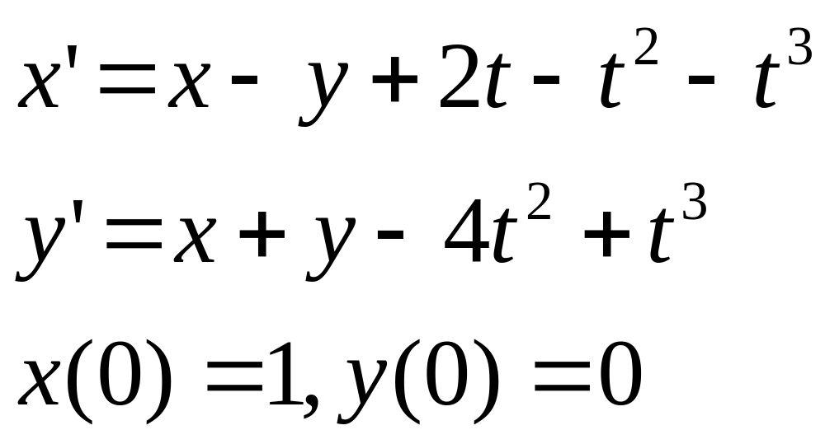
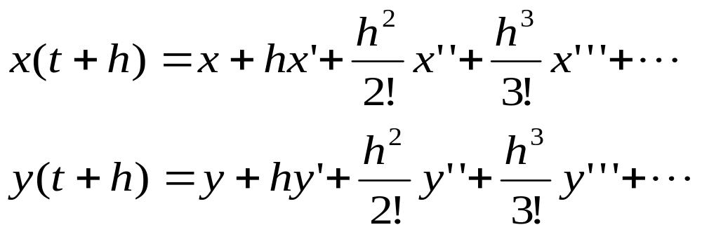
8.1 First order ordinary differential equation sets
(1) The Taylor Series expansion

Slide 4
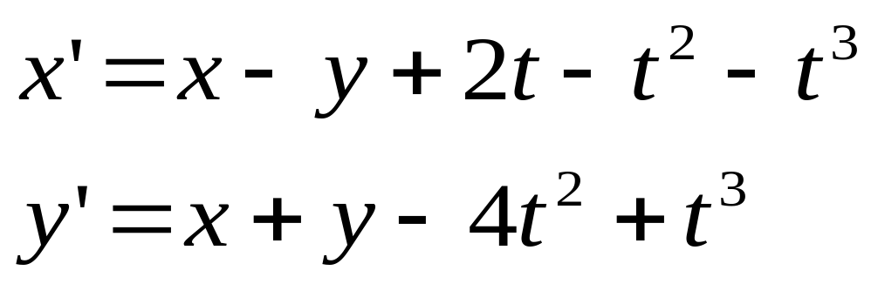
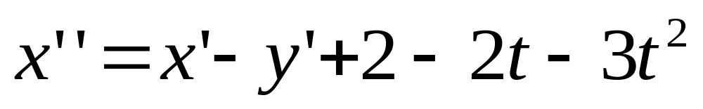
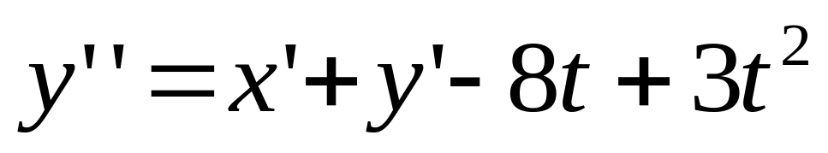
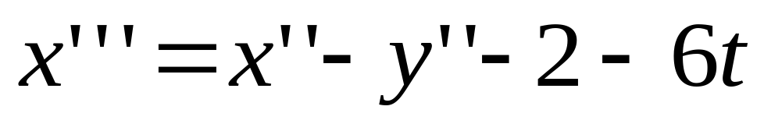
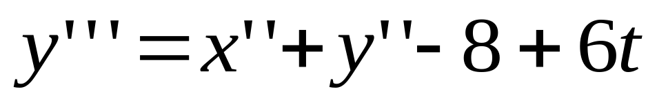
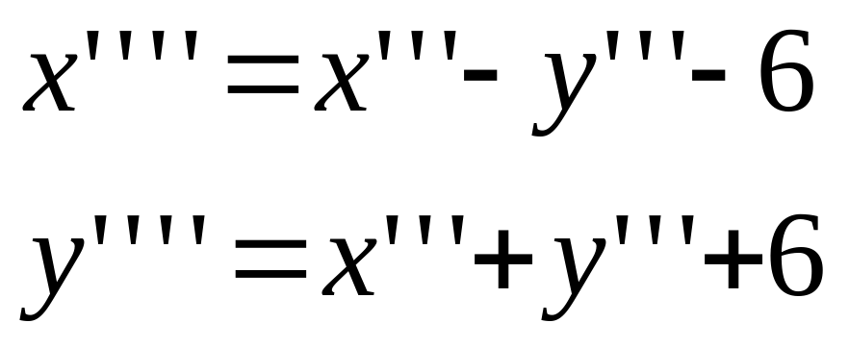

Slide 6

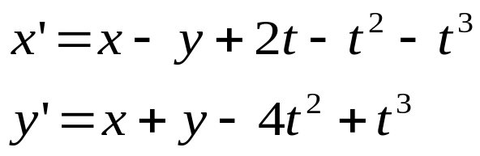
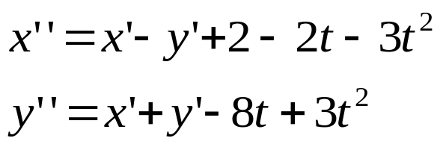
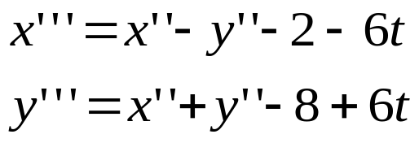
h=0.01, T=0
X1=X-Y+T*(2.0-T*(1.0+T)
Y1=X+Y+T*T*(4.0+T)
X2=X1-Y1+2.0-T*(2.0+3.0*T)
Y2=X1+Y1+T*(8.0+3.0*T)
X3=X2-Y2-2.0-6.0*T
Y3=X2+Y2-8.0+6.0*T
X4=X3-Y3-6.0
Y4=X3+Y3+6.0
X=X+H*X1+H*(X2/2.+H*(X3/6.+H*X4/24.)))
Y=Y+H*Y1+H*(Y2/2.+H*(Y3/6.+H*Y4/24.)))
T=REAL(K)*H

Slide 7
DATA T/0.0/,X/1.0/,Y/0.0/,H/0.01/,NSTEP/100/
DO K=1,NSTEP
X1=X-Y+T*(2.0-T*(1.0+T)
Y1=X+Y+T*T*(4.0+T)
X2=X1-Y1+2.0-T*(2.0+3.0*T)
Y2=X1+Y1+T*(8.0+3.0*T)
X3=X2-Y2-2.0-6.0*T
Y3=X2+Y2-8.0+6.0*T
X4=X3-Y3-6.0
Y4=X3+Y3+6.0
X=X+H*X1+H*(X2/2.+H*(X3/6.+H*X4/24.)))
Y=Y+H*Y1+H*(Y2/2.+H*(Y3/6.+H*Y4/24.)))
T=REAL(K)*H
WRITE(*,*)T,X,Y
ENDDO
STOP
END

Slide 8
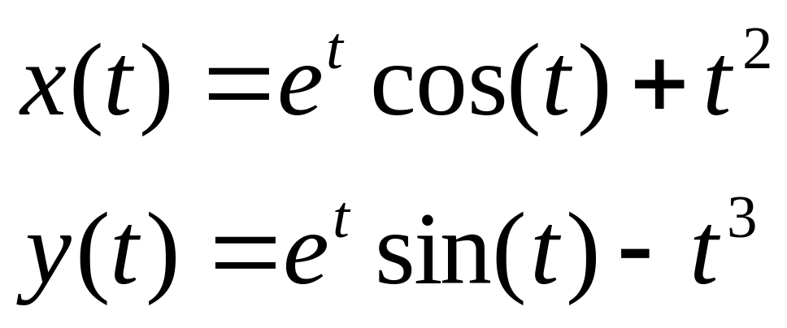
解析解:

Slide 9
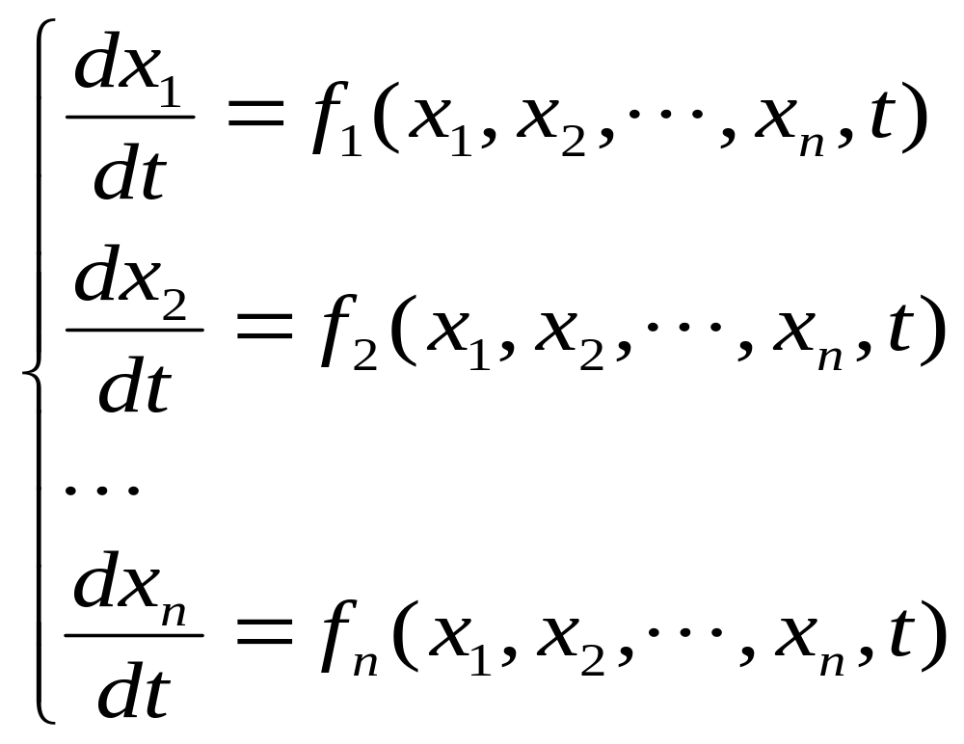
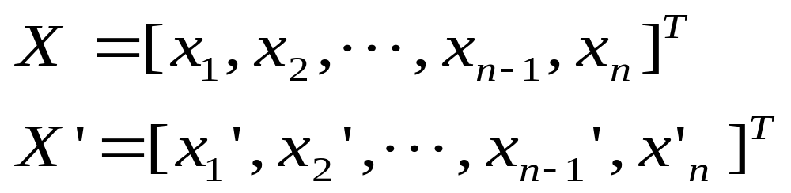
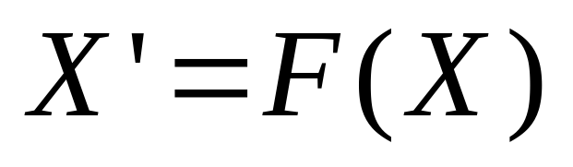
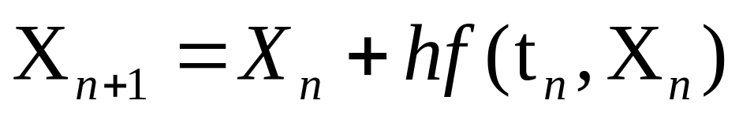
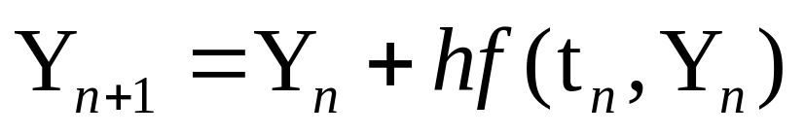
Euler method

Slide 10
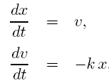
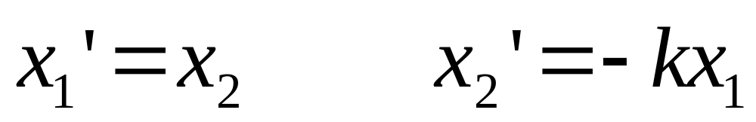

x

Slide 11
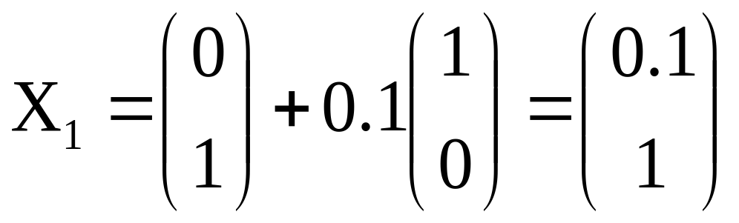
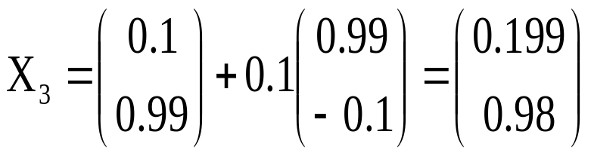
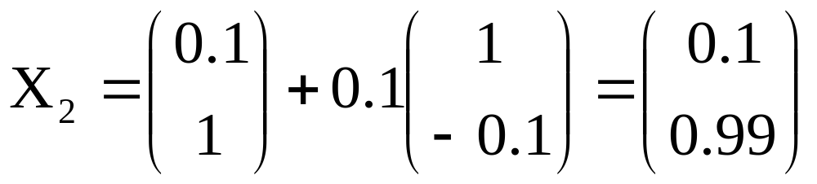
例

Slide 12
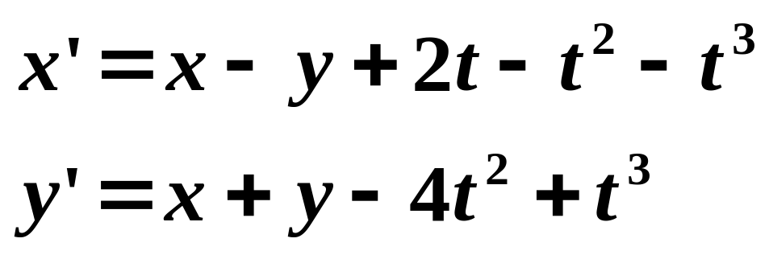
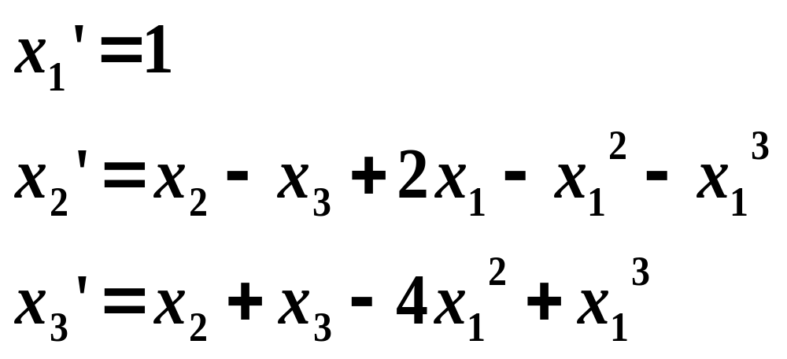
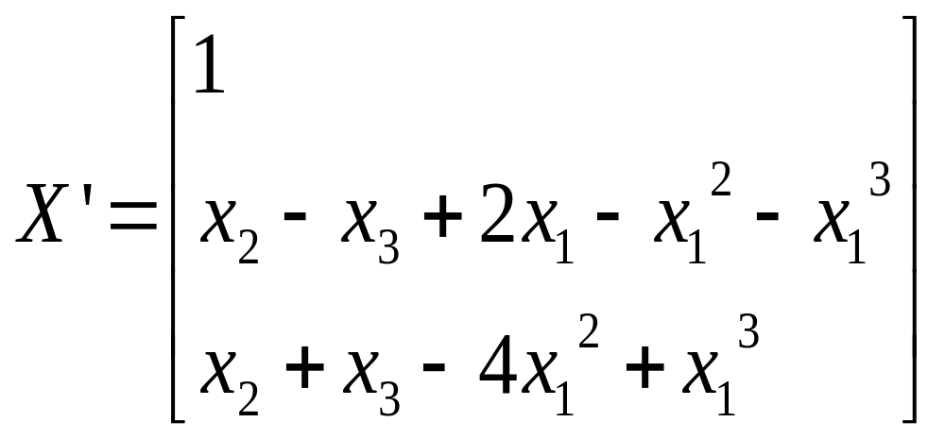
例
x₁=t, x₂=x, x₃=y

Slide 13
Runge-Kutta methods
Y_{n+1} = Y_{n} + (k⁽¹⁾ + k⁽²⁾)/2.
k⁽¹⁾=h f(t_{n}, Y_{n});
k⁽²⁾= h f(t_{n} +h, Y_{n} + k⁽¹⁾)
Y_{n+1} = Y_{n} + (k⁽¹⁾ + 2k⁽²⁾ + 2k⁽³⁾ + k⁽⁴⁾)/6.
k⁽¹⁾=h f(t_{n}, Y_{n});
k⁽²⁾= h f(t_{n} +h/2, Y_{n} + k⁽¹⁾/2)
k⁽³⁾= h f(t_{n} +h/2, Y_{n} + k⁽²⁾/2)
k⁽⁴⁾= h f(t_{n} +h, Y_{n} + k⁽³⁾)

Slide 14

Y_{n+1} = Y_{n} + h(k⁽¹⁾ + 2k⁽²⁾ + 2k⁽³⁾ + k⁽⁴⁾)/6.
k⁽¹⁾= f(t_{n}, Y_{n});
k⁽²⁾= f(t_{n} +h/2, Y_{n} +h k⁽¹⁾/2)
k⁽³⁾= f(t_{n} +h/2, Y_{n} + hk⁽²⁾/2)
k⁽⁴⁾= f(t_{n} +h, Y_{n} + hk⁽³⁾)
X_{n+1} = X_{n} + h(F⁽¹⁾ + 2F⁽²⁾ + 2F⁽³⁾ + F⁽⁴⁾)/6.
F⁽¹⁾= F(X_{n});
F⁽²⁾= F( X_{n} + hF⁽¹⁾/2)
F⁽³⁾= F(X_{n} + hF⁽²⁾/2)
F⁽⁴⁾= F(X_{n} + hF⁽³⁾)

Slide 15
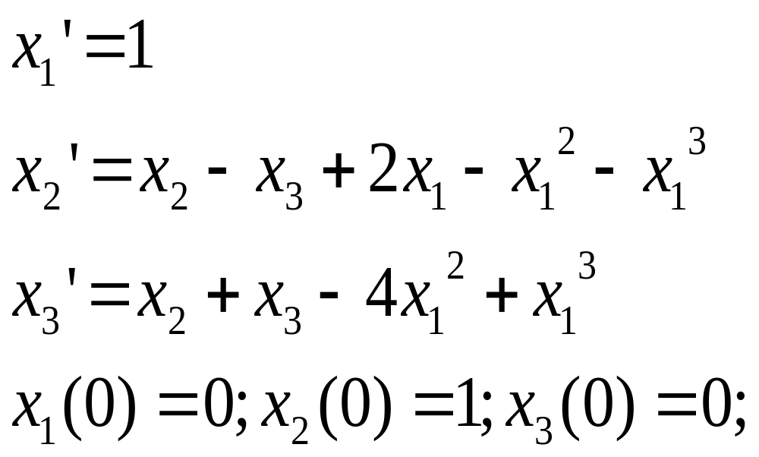
例
x₁=t, x₂=x, x₃=y
X_{n+1} = X_{n} + h(F⁽¹⁾ + 2F⁽²⁾ + 2F⁽³⁾ + F⁽⁴⁾)/6.
F⁽¹⁾= F(X_{n});
F⁽²⁾= F( X_{n} + hF⁽¹⁾/2)
F⁽³⁾= F(X_{n} + hF⁽²⁾/2)
F⁽⁴⁾= F(X_{n} + hF⁽³⁾)

Slide 16
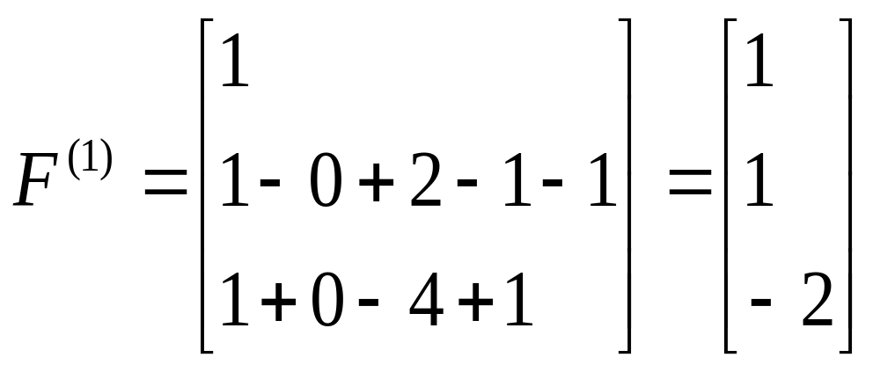
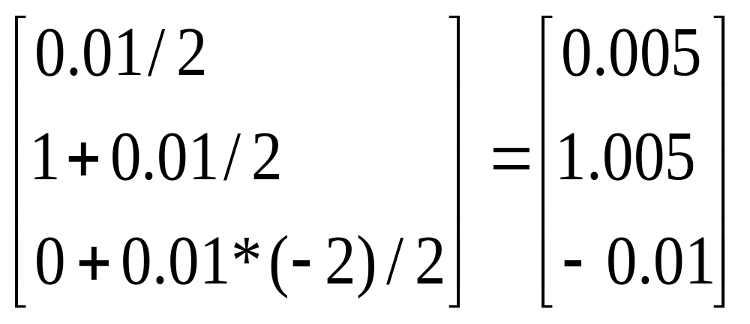
x₁=t, x₂=x, x₃=y
F⁽¹⁾= F(X_{n});
F⁽²⁾= F( X_{n} + hF⁽¹⁾/2)
h=0.01
X_{n} + hF⁽¹⁾/2=

Slide 17
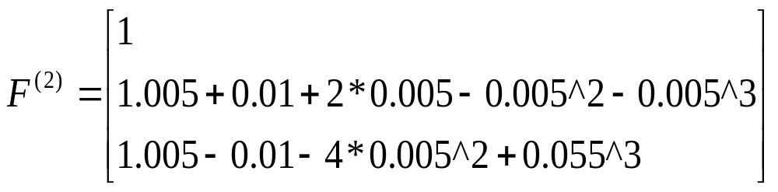
F⁽¹⁾= F(X_{n});
F⁽²⁾= F( X_{n} + hF⁽¹⁾/2)
X_{n} + hF⁽¹⁾/2=

Slide 18
F⁽²⁾= F( X_{n} + hF⁽¹⁾/2)
F⁽¹⁾= F(X_{n});
可使用与求 F⁽²⁾相同的方法求 F⁽³⁾ 和 F⁽⁴⁾
F⁽³⁾= F(X_{n} + hF⁽²⁾/2)
F⁽⁴⁾= F(X_{n} + hF⁽³⁾)
X_{n+1} = X_{n} + h(F⁽¹⁾ + 2F⁽²⁾ + 2F⁽³⁾ + F⁽⁴⁾)/6.

Slide 19
SUBROUTINE XPSYS ( X, F)
DIMENSION X(3), F(3)
F(1)=1.0
F(2)=X(2)-X(3)+X(1)*(2.0-X(1)*(1.0+ X(1))
F(3)=X(2)+X(3)-X(1)* X(1)*(4.0-X(1))
RETURN
END

Slide 20
SUBROUTINE RK4SYS(N, T, X, H, NSTEP)
DIMENSION X(10),Y(10), F1(10), F2(10), F3(10), F4(10)
DO K=1, NSTEP
CALL XPSYS(X, F1)
DO I=1, N Y(I)=X(I)+H*F1(I)/2. ENDDO
CALL XPSYS(Y, F2)
DO I=1, N Y(I)=X(I)+H*F2(I)/2. ENDDO
CALL XPSYS(Y, F3)
DO I=1, N Y(I)=X(I)+H*F3(I) ENDDO
CALL XPSYS(Y, F4)
DO I=1, N
X(I)=X(I)+H*(F1(1)+2.*(F2(I)+F3(I))+F4(I))/6.
ENDDO
T=T+REAL(K)*H
WRITE(*,*) T, (X(I), I=1,N)
ENDDO
RETURN

Slide 21
dimension x(3)
data n/3/,t/0.0/,x/0.0,1.0,0.0/,h/0.01/,nstep/100/
call rk4sys(n,t,x,h,nstep)
stop
end

Slide 22


8.2 Higher order ordinary differential equations
8.2.1 Initial value problems (初始值问题)

Slide 23
y" = f(t, y, y’)
subject to y(0) = c0 and y’(0) = c1
Initial value problems (初始值问题)
subject to y(0) = c0 and y(1) = c1
y’(1)=0, y’(0)=0
y’(0)=0, y(1)=0
Boundary value problems (边值问题)

Slide 24
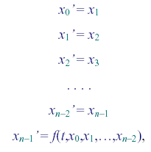
where at t = t0 we know the values of x₀, x₁, ,x_{n-1}

Slide 25
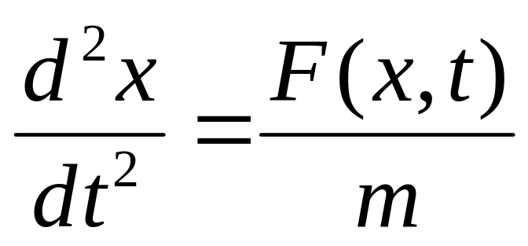
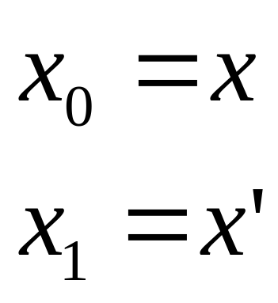
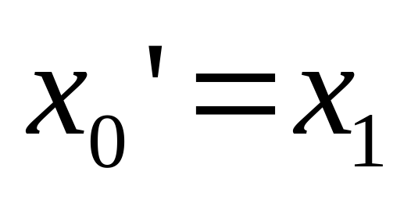
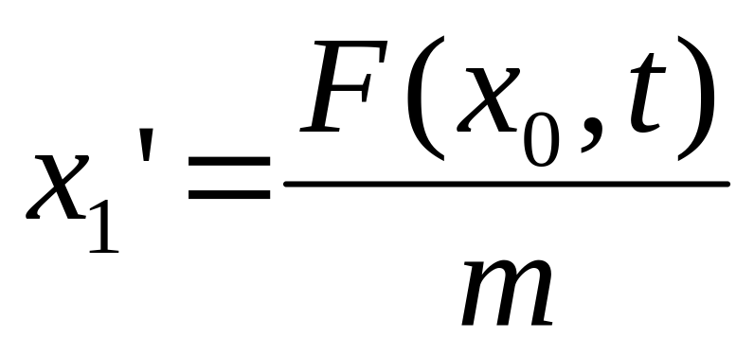

Slide 26
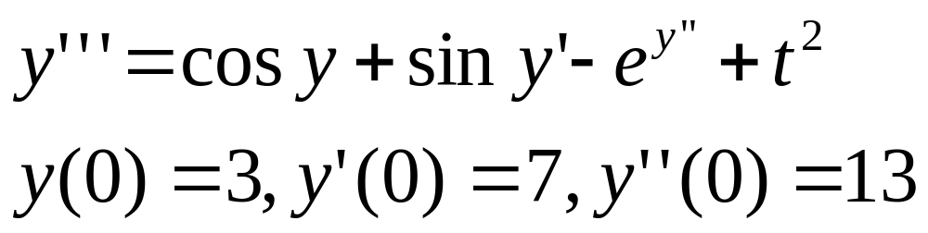
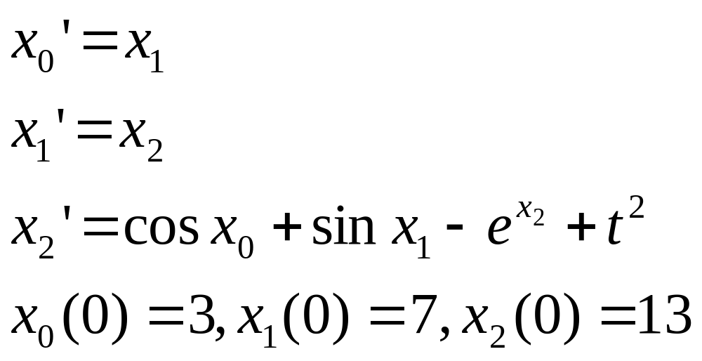

Slide 27
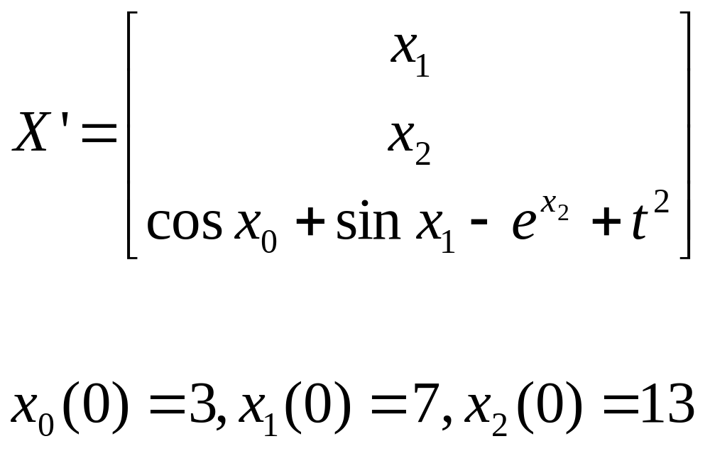

Slide 28
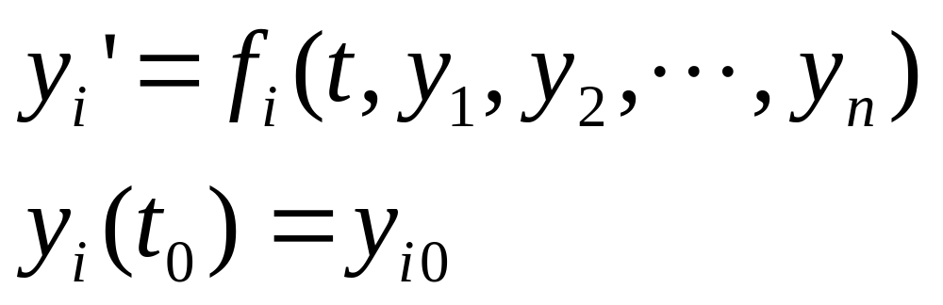
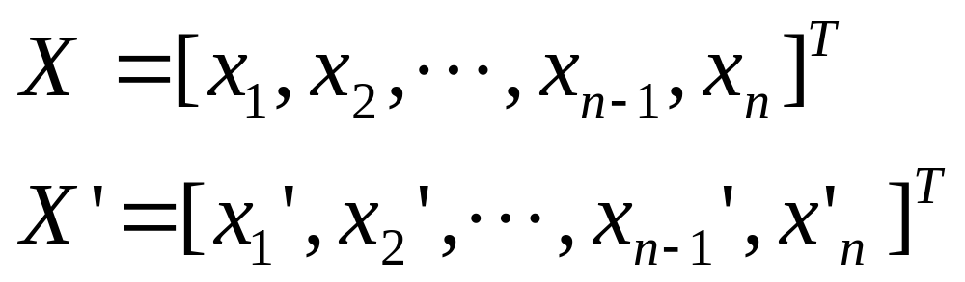
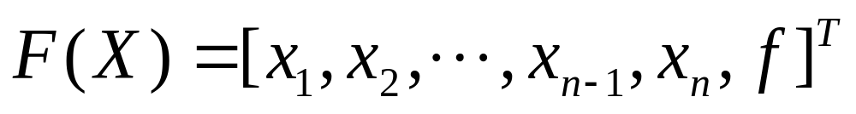
x₁=y₁, x₂=y₂ ,…, x_{n}=y_{n}

Slide 29
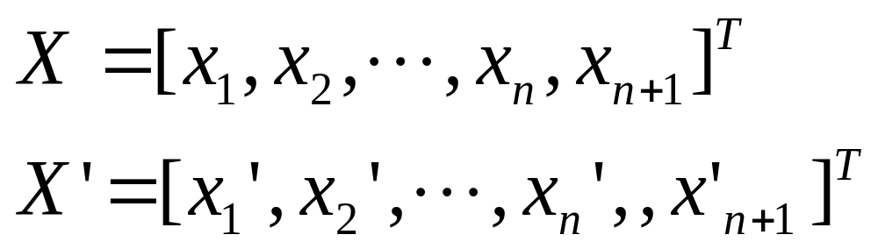
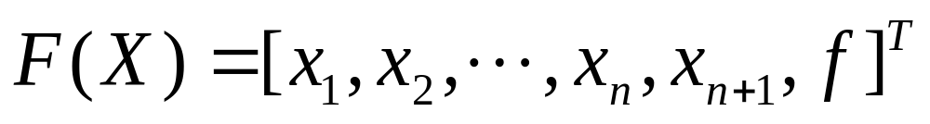
x₁=t, x₂=y₁, x₃=y₂ ,…, x_{n+1}=y_{n}

Slide 30
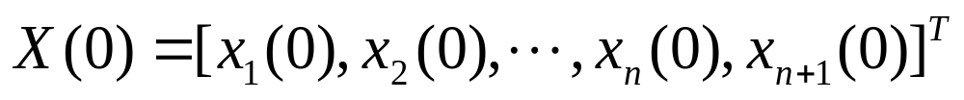
where at t = t0 we know the values of y₁, y₂, … , y_{n}
x₁=t, x₂=y₁, x₃=y₂ ,…, x_{n+1}=y_{n}

Slide 31
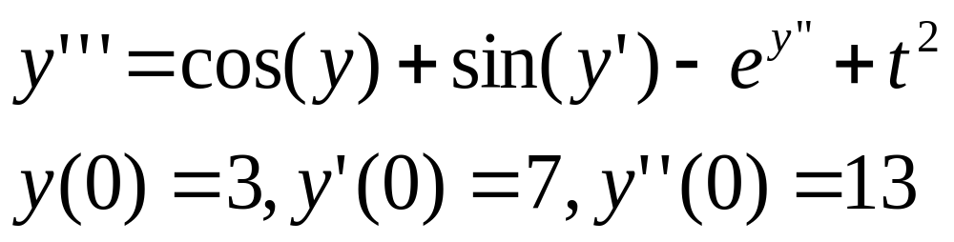
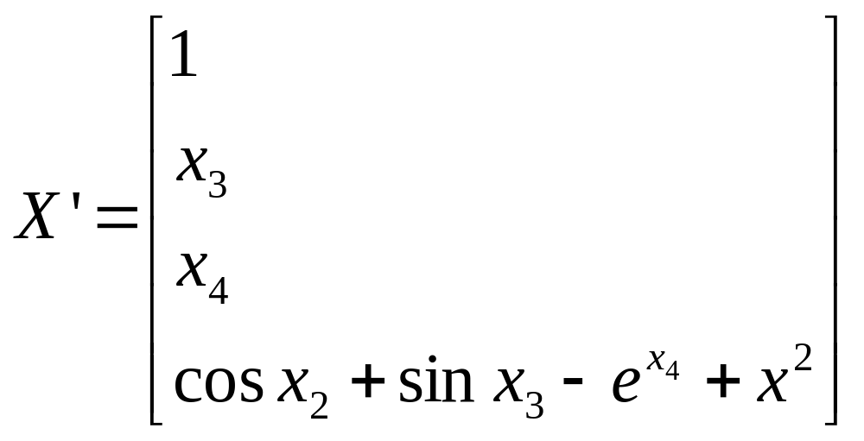
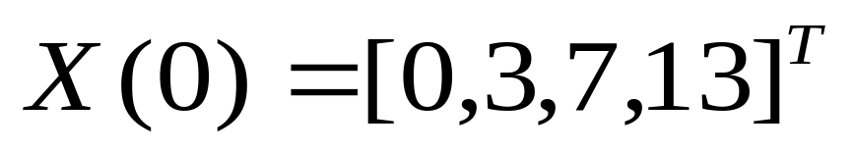
x₁=t, x₂=y, x₃=y’ , x₄=y’’

Slide 33
Higher order equation sets

Slide 34
8.2 Higher order ordinary differential equations
8.2.2 Boundary value problems (边值问题)
For second (and higher) order odes, two (or more) initial/boundary conditions are required.
If these two conditions do not correspond to the same point in time/space, then the simple extension of the first order methods outlined in section 8.1 can not be applied without modification.

Slide 35
y" = f(t, y, y’)
subject to y(0) = c0 and y’(0) = c1
Initial value problems (初始值问题)
subject to y(0) = c0 and y(1) = c1
y’(1)=0, y’(0)=0
y’(0)=0, y(1)=0
Boundary value problems (边值问题)
There are two relatively simple approaches to solve Boundary value problems.

Slide 36
8.2.2.1 Shooting method
y" = f(t, y, y’)
subject to y(0) = c0 and y(1) = c1
With the shooting method we apply the y(0)=c0 boundary condition and make some guess that y’(0) = α0.
This gives us two initial conditions so that we may apply the simple time-stepping methods already discussed in section 8.1. The calculation proceeds until we have a value for y(1).

Slide 37
If this does not satisfy y(1) = c1 to some acceptable tolerance, we revise our guess for y’(0) to some value α1, say, and repeat the time integration to obtain an new value for y(1). This process continues until we hit y(1)=c1 to the acceptable tolerance.
The number of iterations which will need to be made in order to achieve an acceptable tolerance will depend on how good the refinement algorithm for α is.

Slide 38
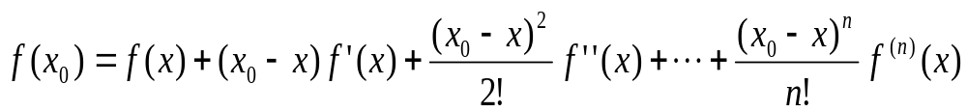
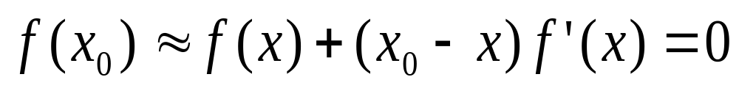
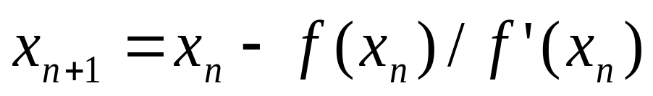
We may use the root finding methods discussed in section 3 to undertake this refinement.
1 Newton-Raphson
Setting the quadratic and higher terms to zero and solving the linear approximation of f(x) = 0 for x gives

Slide 39

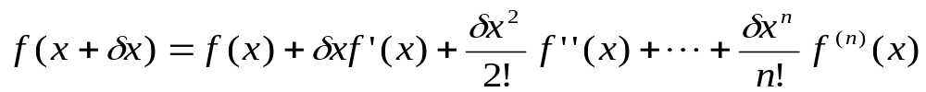





2. Secant method (chord)

Slide 40
y"= - π² (y+1)/4
y(0)=0, y’(0)=1
y(0)=0, y(1)=1
y’(1)=0, y’(0)=0
y’(0)=0, y(1)=0
y_{δ} (1)
y’(0)=δ
Here δ is a parameter to be adjusted in order to have
y(1)=1
|F(δ )|= |y_{δ} (1) - 1|< Δ

Slide 41

Secant + Runge-Kutta methods
y(0)=0, y(1)=1
y"=- π² (y+1)/4
x₁=t, x₂=y, x₃=y’
x₁’ =1
x₂’ = x₃
将x₁(0), x₂(0) 和x₃(0)代入Runge-Kutta x_{2 δ}(1 ) =f₀
x₃’ = -π²(x₂+1)/4
|F(δ )|= |x_{2 δ}(1 )-1|< Δ
x₁(0)=0, x₂(0)=0, x₂(1)=1
将x₁(0), x₂(0) 和x₃(0)+h代入Runge-Kutta x_{2 δ’}(1 ) =f_{n}
x₃(0)= δ
x₃(0)=( x₂(1)- x₂(0))/(1.-0.)
X30=(YU-YL)/ (XU-XL)
X31=X30+DX

Slide 42
SUBROUTINE secant(DL,X30,DX,ISTEP)
X31=X30+DX
ISTEP=0
DO WHILE(ABS(DX).GT.DL)
D= F(X31)- F(X30)
X32=X31-(X31-X30)* F(X31)/D
X30=X31
X31=X32
DX=X31-X30
|F(δ )|= |x_{2 δ}(1 )-1|< Δ
ISTEP=ISTEP+1
ENDDO
RETURN
END

Slide 43
dimension y0(3), y(3)
data n/3/,t/0.0/,y0/0.0,0.0,1.0/,nstep/100/ ,NMAX/10/
tol=1.0E-06
XL=0.0
XU=1.0
DX=0.01
|F(δ )|= |y ₂ _{δ} (1 ) - 1|
H=(XU-XL)/(NSTEP-1)
YL=0.0
YU=1.0
X0=(YU-YL)/ (XU-XL)
X1=X0+DX

Slide 44
DO K=1, NMAX
ELSE
X2=X1-(X1-X0)* F1/D
y=y0
y(3)=X0
X0=X1
X1=X2
call rk4(n,t,y,h,nstep)
ENDIF
F0=y(2)-1.0
ENDDO
y=y0 y(3)=X1
END
call rk4(n,t,y,h,nstep)
F1=y(2)-1.0
D=F1-F0
IF (ABS(D).LT.TOL)THEN
WRITE(*,*)Y
STOP

Slide 45
x₁’ =1
x₂’ = x₃
x₃’ = -π²(x₂+1)/4
SUBROUTINE XPSYS ( X, F)
DIMENSION X(3), F(3)
PI=4.0*ATAN(1.0)
F(1)=1.0
F(2)= X(3)
F(3)=-PI*PI*(X(2)+1.0)/4.0
RETURN
END

Slide 46
y"=- π² (y+1)/4
y(0)=0, y(1)=1
Y(X)=COS(πx/2)+2SIN(πx/2)-1
y" = f(t, y, y’)
subject to y(0) = c0 and y(1) = c1
y’(1)=0, y’(0)=0
y’(0)=0, y(1)=0

Slide 47
8.2.2.2 Linear equations
The alternative is to rewrite the equations using a finite difference approximation with step size
Δt = (t1–t0)/N to produce a system of N+1 simultaneous equations. Consider the second order linear system
y" + ay ' + by = c,
with boundary conditions y(t0) = α.
and y(t1) + y'(t1) = β.

Slide 48
y" + ay ' + by = c,
If we use the central difference approximations
y'_{i} ≈ (Y_{i+1} – Y_{i-1})/2Δt,
Δt = (t1–t0)/N
i = 1–---N-1
y"_{i} ≈ (Y_{i+1} – 2Y_{i} + Y_{i-1})/Δt²
Substitution into
y" + ay ' + by = c,
Gives
(Y_{i+1} – 2Y_{i} + Y_{i-1})/Δt²+a(Y_{i+1} – Y_{i-1})/2Δt + b Y_{i}= c
(1-1/2aΔt)Y_{i-1} + (bΔt²–2)Y_{i} + (1+1/2aΔt)Y_{i+1} = cΔt²,

Slide 49
(1-1/2aΔt)Y_{i-1} + (bΔt²–2)Y_{i} + (1+1/2aΔt)Y_{i+1} = cΔt²,
(1-1/2aΔt)Y₀ + (bΔt²–2)Y₁ + (1+1/2aΔt)Y₂ = cΔt²,
(1-1/2aΔt)Y₁ + (bΔt²–2)Y₂ + (1+1/2aΔt)Y₃ = cΔt²,
…
(1-1/2aΔt)Y_{n–2} + (bΔt²–2)Y_{n–1} + (1+1/2aΔt)Y_{n} = cΔt²,
i = 1–---N-1
y(t0) = α and y(t1) + y'(t1) = β.
and we may write the boundary condition at
as t = t0,
Y₀ = α.
Y_{n} + Y '_{n}= β ,

Slide 50



0 1 2 3 n-1 n
t0
t1

Slide 51
For t = t1 we must express the derivative in the boundary condition in finite difference form using points that exist in our mesh. The obvious thing to do is to take the backward difference so that the boundary condition becomes
y(t1) + y’(t1) = β.
Y_{n} + Y ' _{n}= β ,
Y_{n} + (Y_{n} – Y_{n-1})/Δt= β ,
but as we shall see, this choice is not ideal.
The above strategy leads to the system of equations

Slide 52
Y₀ = α,
(1-1/2aΔt)Y₀ + (bΔt ²–2)Y₁ + (1+1/2aΔt)Y₂ = cΔt ²,
(1-1/2aΔt)Y₁ + (bΔt ²–2)Y₂ + (1+1/2aΔt)Y₃ = cΔt ²,
…
(1-1/2aΔt)Y_{n–2} + (bΔt ²–2)Y_{n–1} + (1+1/2aΔt)Y_{n} = cΔt ²,
−Y_{n-1} + (Δt + 1) Y_{n} = βΔt
This tridiagonal system may be readily solved using the method discussed in section 4.5.

Slide 53

Tridiagonal matrices

Slide 54
There is one problem with the scheme outlined above: while the Y" and Y' derivatives within the domain are second order accurate, the boundary condition at t = t₁ is imposed only as a first-order approximation to the derivative.
y'_{i} ≈ (Y_{i+1} – Y_{i-1})/2Δt,
y"_{i} ≈ (Y_{i+1} – 2Y_{i} + Y_{i-1})/Δt²
y(t1) + y’(t1) = β.
Y_{n} + (Y_{n} – Y_{n-1})/Δt= β ,

Slide 55
We have two ways in which we may improve the accuracy of this boundary condition.
0 1 2 n-2 n-1 n
t1
The first way is the most obvious: make use of the Y_{n-2} value to construct a second-order approximation to Y’

Slide 56

so that we have
Y_{n} ' ≈ ( 3Y_{n} -4Y_{n-1} +Y_{n-2})/2Δt,
y(t1) + y’(t1) = β.
Y_{n-2} − 4Y_{n-1} + (2Δt + 3) Y_{n} = 2βΔt

Slide 57
Y0 = α,
(1-1/2aΔt)Y₀ + (bΔt²–2)Y₁ + (1+1/2aΔt)Y₂ = cΔt²,
(1-1/2aΔt)Y₁ + (bΔt²–2)Y₂ + (1+1/2aΔt)Y₃ = cΔt²,
…
(1-1/2aΔt)Y_{n–2} + (bΔt²–2)Y_{n–1} + (1+1/2aΔt)Y_{n} = cΔt²,
Y_{n-2} − 4Y_{n-1} + (2Δt + 3) Y_{n} = 2βΔt
The problem with this is that we then loose our simple tridiagonal system.

Slide 58

The second approach is to artificially increase the size of the domain by one mesh point and impose the boundary condition inside the domain. The additional mesh point is often referred to as a dummy(虚拟的) mesh point or dummy cell.
0 1 2 3 n-1 n n+1
t0
t1

Slide 59


0 1 2 3 n-1 n n+1
t0
t1
y(t1) + y’(t1) = β.
−Y_{n-1} + 2Δt Y_{n} +Y_{n+1}= 2βΔt

Slide 60
Y0 = α,
(1-1/2aΔt)Y₀ + (bΔt²–2)Y₁ + (1+1/2aΔt)Y₂ = cΔt²,
(1-1/2aΔt)Y₁ + (bΔt²–2)Y₂ + (1+1/2aΔt)Y₃ = cΔt²,
…
(1-1/2aΔt)Y_{n–2} + (bΔt²–2)Y_{n–1} + (1+1/2aΔt)Y_{n} = cΔt²,
(1-1/2aΔt)Y_{n–1} + (bΔt²–2)Y_{n} + (1+1/2aΔt)Y_{n+1} = cΔt²,
−Y_{n-1} + 2Δt Y_{n} +Y_{n+1}= 2βΔt
The attraction of this approach is that we maintain our simple tri-diagonal system.

Slide 61
Clearly the same tricks can be applied if we have a boundary condition on the derivative at t0.
Higher order linear equations may be catered for in a similar manner and the matrix representing the system of equations will remain banded, but not as sparse as tridiagonal.
The solution may be undertaken using the modified LU decomposition introduced in section 4.4.

Slide 62

用差分法解边值问题的主要步骤是：
（1）将区间[a, b]离散化；
将[a, b]区间用节点
分成N等分，其中x₀ = a与x_{N} = b 称为边界点，
而x₁, x₂, …, x_{N-1}称为内点。
（2）在这些节点上，将导数差商化，从而把微分
方程化为差分方程；
(3) 解差分方程――实际上就是解线代数方程组。

Slide 63




例 试用差分法解方程
解 将[0, 1]划分为四等分，即取 ，得五个节点
差分方程为

Slide 64


将它改写成
在每个内点列方程得
由追赶法公式解得：
y₃ = 1.4855 y₂ = 1.2802 y₁ = 0.7753

Slide 65
Nonlinear equations may also be solved using this approach.
but will require an iterative solution of the resulting matrix system Ax = b as the matrix A will be a function of x. In most circumstances this is most efficiently achieved through a Newton-Raphson algorithm, similar in principle to that introduced in section 3.4 but where a system of linear equations requires solution for each iteration.

