Slide 1
热物（第二周）
Sharpness of Multiplicity Function
Most Probable Configuration

Slide 2
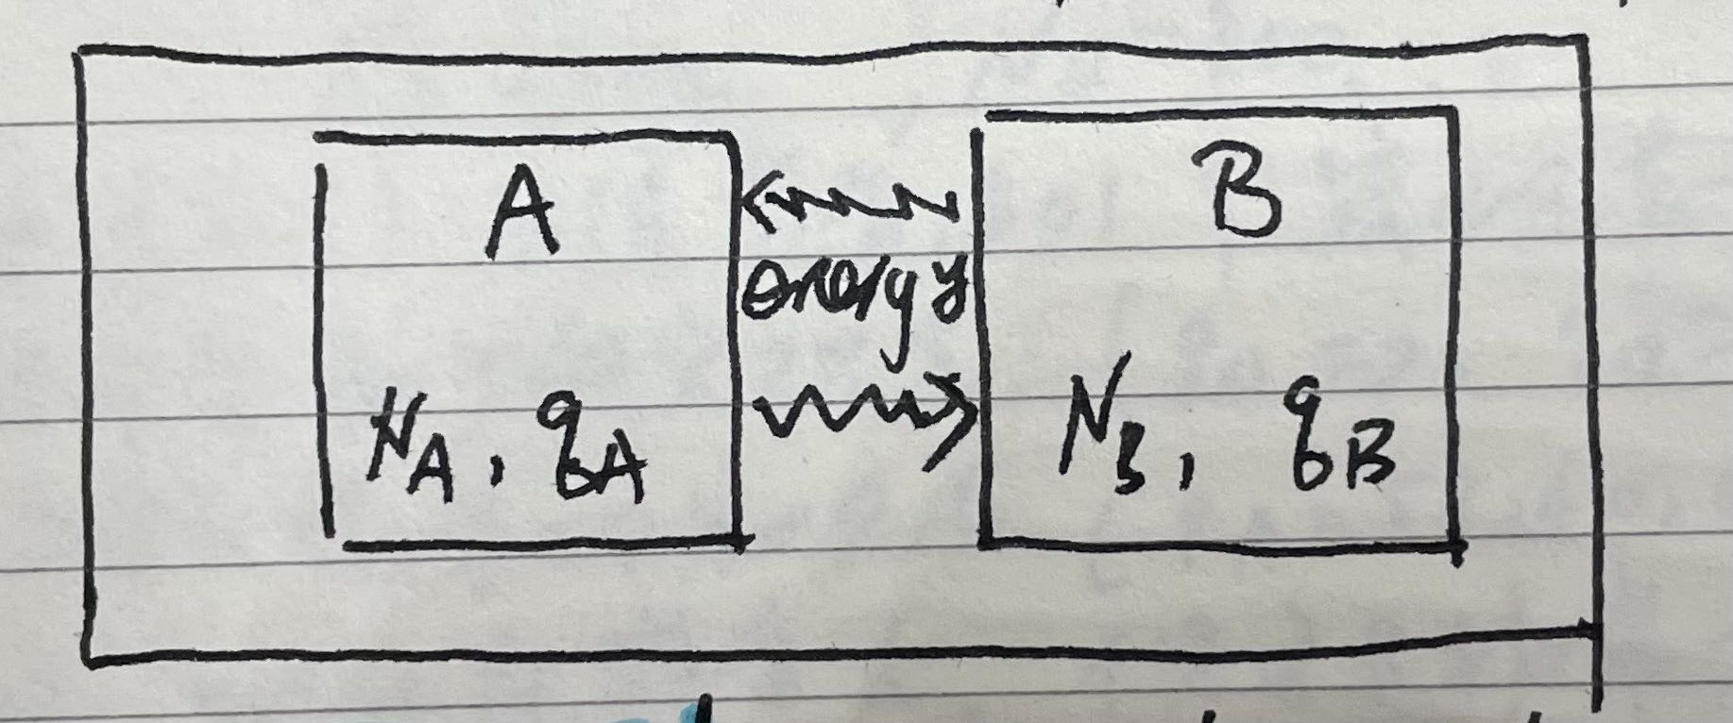

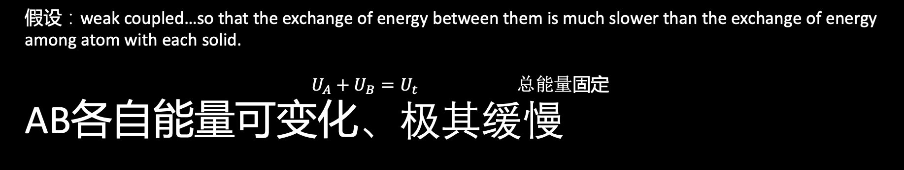
以爱因斯坦固体为例（ $g\left[N,q\right]=\frac{\left(q+N−1\right)!}{q!\left(N−1\right)!}$）
N谐振子数；q能量
A+B system closed
假设：weak coupled…so that the exchange of energy between them is much slower than the exchange of energy among atom with each solid.
$U_{A}+U_{B}=U_{t} 总能量$固定
AB各自能量可变化、极其缓慢

Slide 3
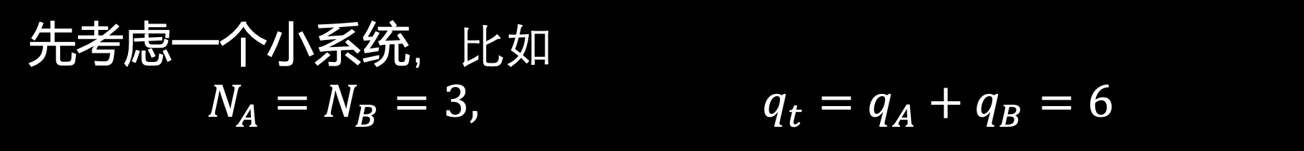
以爱因斯坦固体为例（ $g\left[N,q\right]=\frac{\left(q+N−1\right)!}{q!\left(N−1\right)!}$）
先考虑一个小系统，比如
$$N_{A}=N_{B}=3, q_{t}=q_{A}+q_{B}=6$$

Slide 4
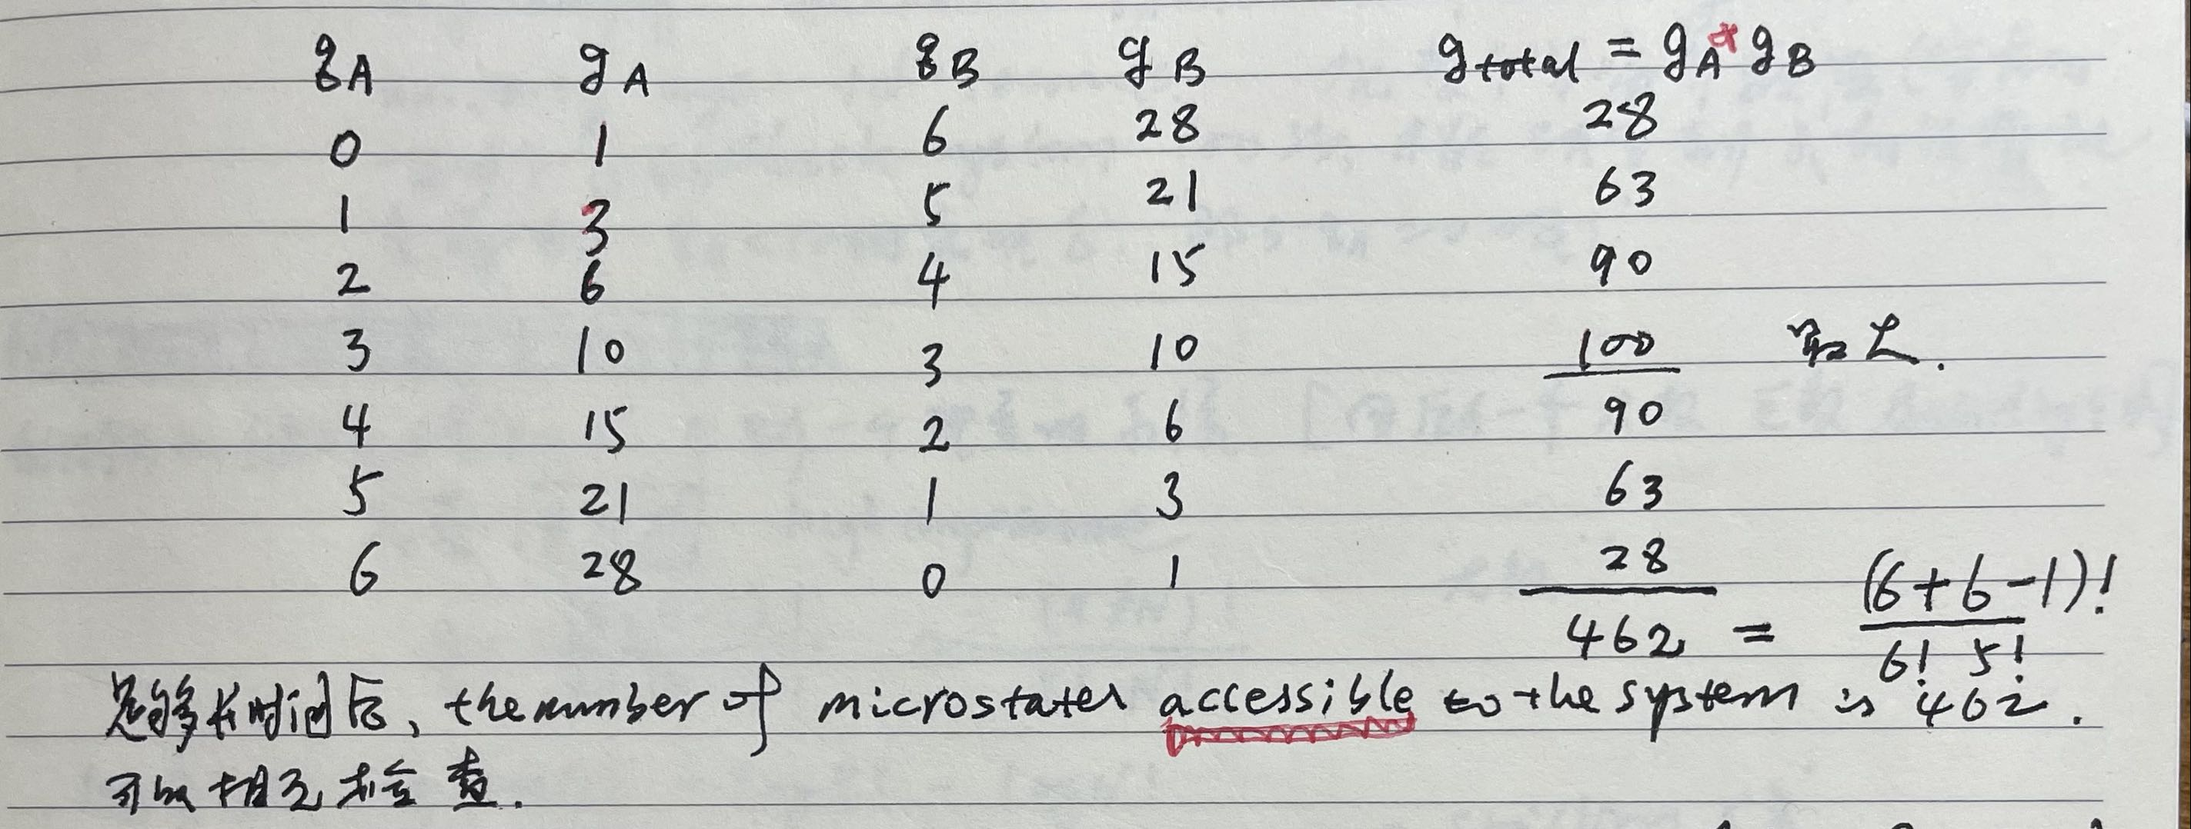
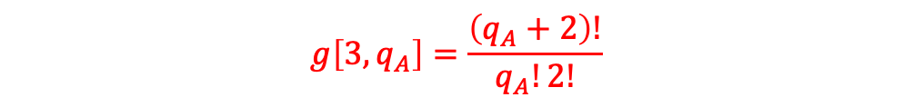
先考虑一个小系统，比如
$$N_{A}=N_{B}=3, q_{t}=q_{A}+q_{B}=6$$
$$g\left[3,q_{A}\right]=\frac{\left(q_{A}+2\right)!}{q_{A}!2!}$$
+

Slide 5
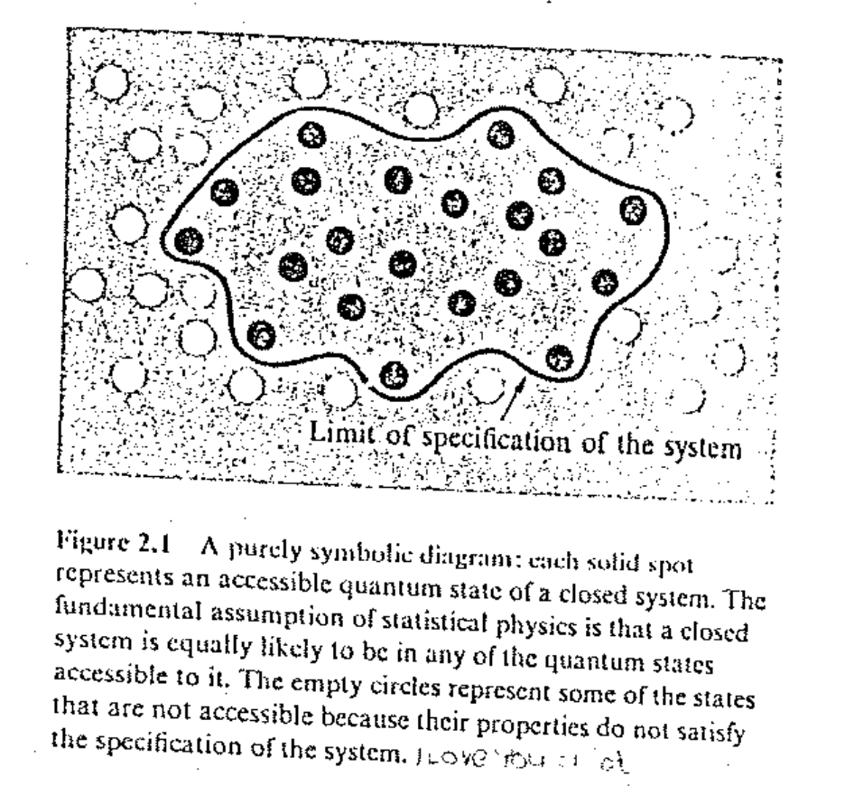
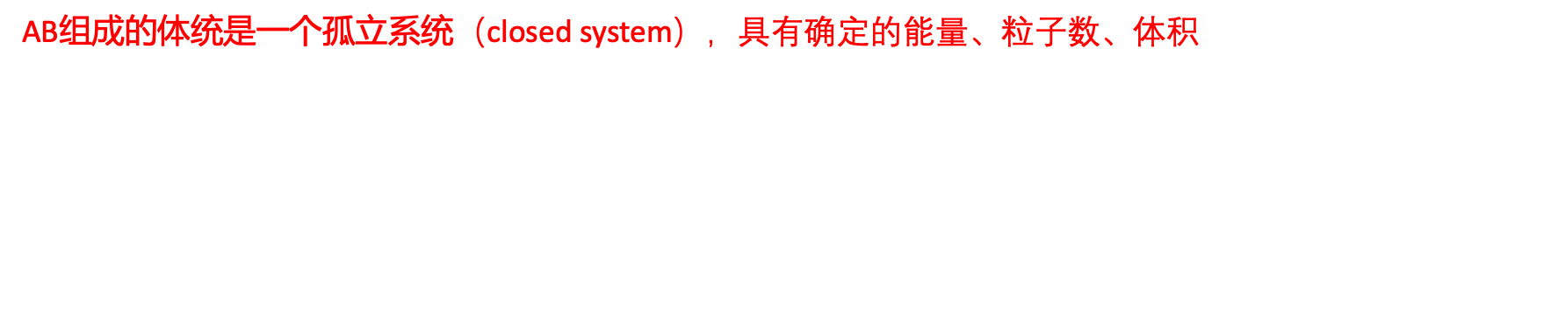
术语：
AB组成的体统是一个孤立系统（closed system），具有确定的能量、粒子数、体积。And constant values of all external parameters that may influence the system, including gravitational, electric, and magnetic fields.
A quantum state is accessible if its properties are compatible with the physical specification of the system: the energy of the state must be in the range within which the energy of the system is specified, and the number of particles must be in the range within which the number of particles is specified. With large systems we can never know either of these exactly, but it will suffice to have $δU/U≪1$ and $δN/N≪1$.
Accessible（可及的） microstates=those(many) microstates consistent with fixed values of N,V,U.

Slide 6
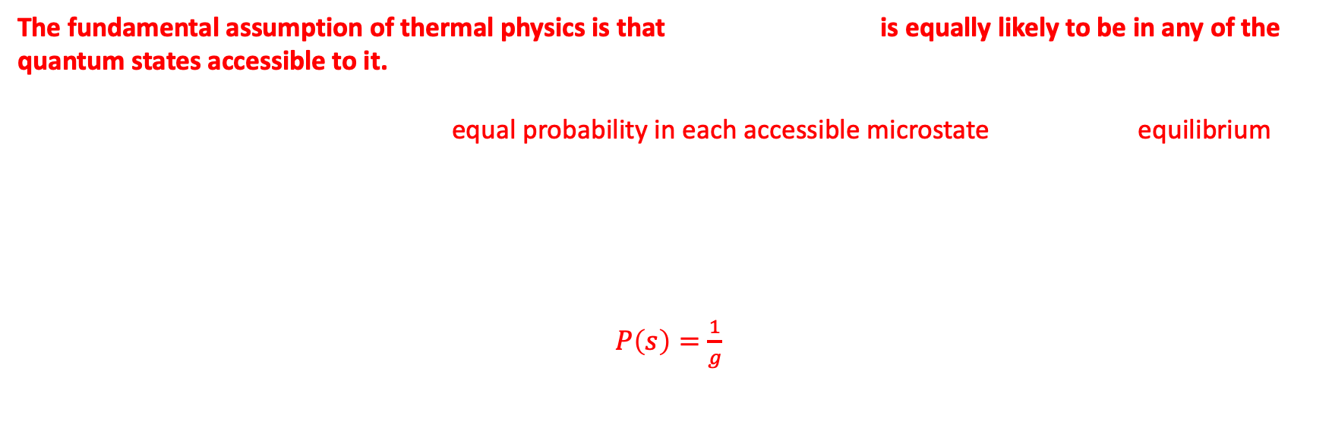
如何理解微观态/宏观态出现的概率？
Probability
The fundamental assumption of thermal physics is that a isolated system is equally likely to be in any of the quantum states accessible to it.
If an isolated system is found with equal probability in each accessible microstate, then it is in equilibrium.
If an isolated system is not found with equal probability for each accessible microstate, it is not in equilibrium. It then evolves to equilibrium.
Suppose we have a isolated system that we know is equally likely to be in any of the g accessible quantum states. Let s be a general state label. The probability P(s) of finding the system in this state is
$P\left(s\right)=\frac{1}{g}$
if the state s is accessible and P=0 otherwise.
非常重要！

Slide 7
回到一个小系统
可及的微观态有462个，每个微观态的概率为1/462
由qA标记的宏观态的概率不一样，和其Multiplicity有关，比如qA=3时，概率为100/462（最多）；qA=0时，概率为28/462

Slide 8
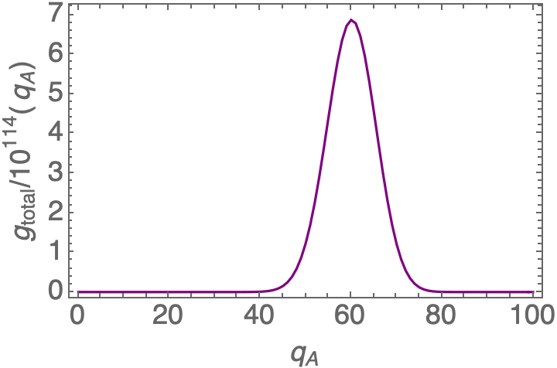
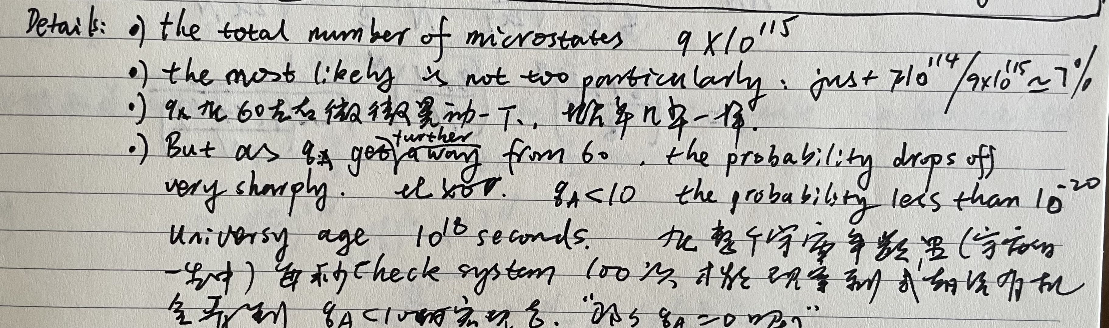
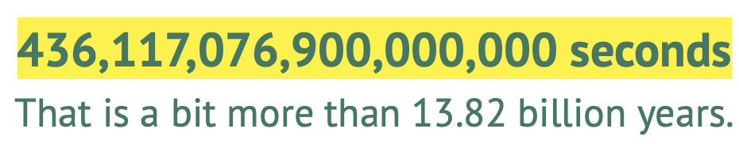
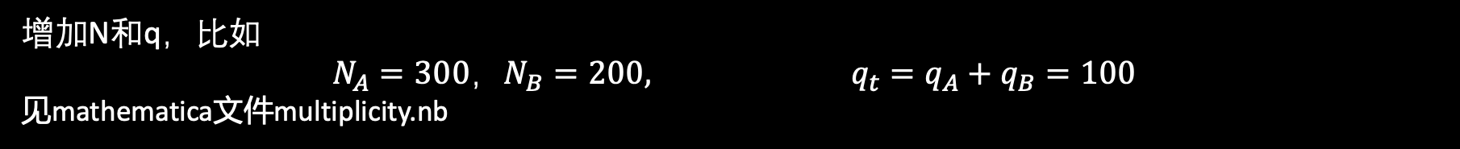
增加N和q，比如
$$N_{A}=300，N_{B}=200, q_{t}=q_{A}+q_{B}=100$$
见mathematica文件multiplicity.nb
以qA表征宏观态
概率最少的宏观态(qA=0 or qA=100) Multiplicity=2.8*10⁸¹
概率最多的宏观态(qA=59,60,61…) Multiplicity=7*10¹¹⁴
(各自都很大，但这里重要的是比值，The most likely macrostates is more than 10²³ times more probable than the least likely macrostates)

Slide 9
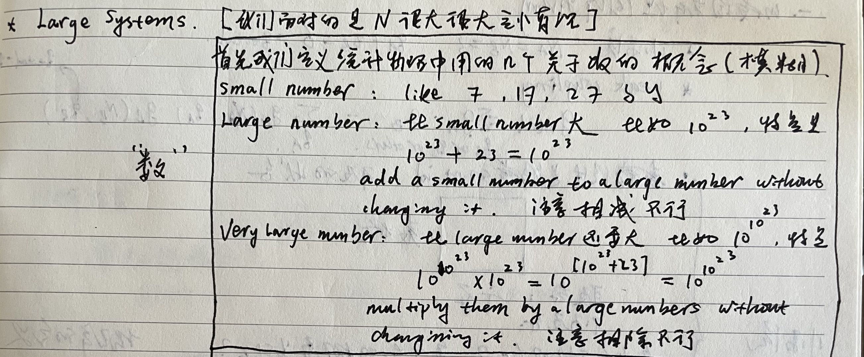
1，先考虑一个小系统，比如
$$N_{A}=N_{B}=3, q_{t}=q_{A}+q_{B}=6$$
2，增加N和q，考虑较大系统，比如
$$N_{A}=300，N_{B}=200, q_{t}=q_{A}+q_{B}=100$$
3，非常大系统系统？？？（回到mathematica）

Slide 10
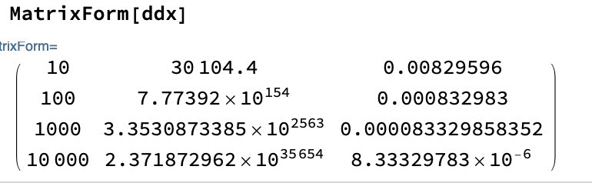

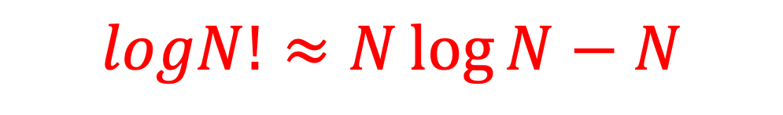
Stirling’s approximation
$$N!≈N^{N}e^{−N}\sqrt{2πN}=S(N)$$
N N!-S(N) (N!-S(N))/N!
S(N)是N!的“渐近”近似，之差增加（无界），相对差趋于零！
If N is large number, then N! is a very large number, and often the correction factor $\sqrt{2πN}$(which is only a large number) can be omitted.
$$logN!≈N\log{N−N}$$

Slide 11
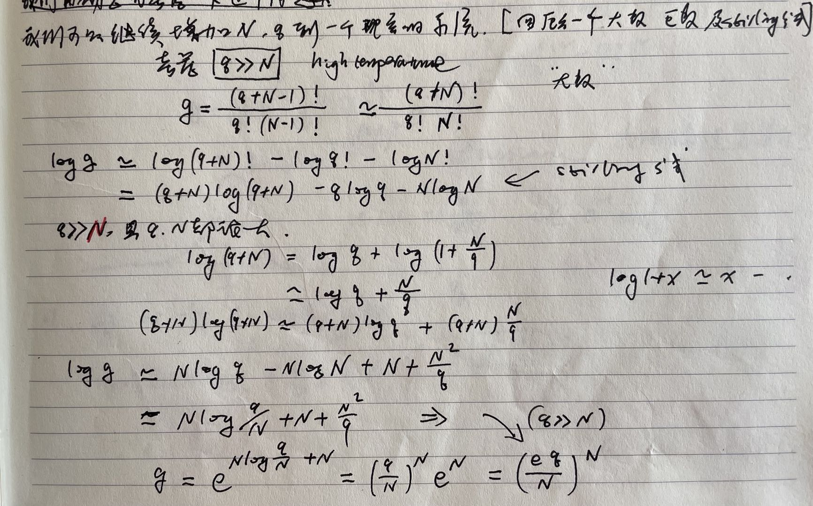
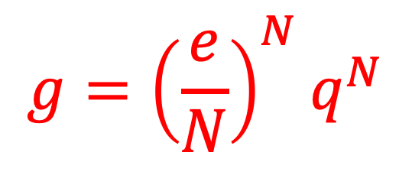
考虑一个爱因斯坦固体 $g\left[N,q\right]=\frac{\left(q+N−1\right)!}{q!\left(N−1\right)!}$ and N,q are large number and $q≫N$
$$g={\left(\frac{e}{N}\right)}^{N}q^{N}$$

Slide 12
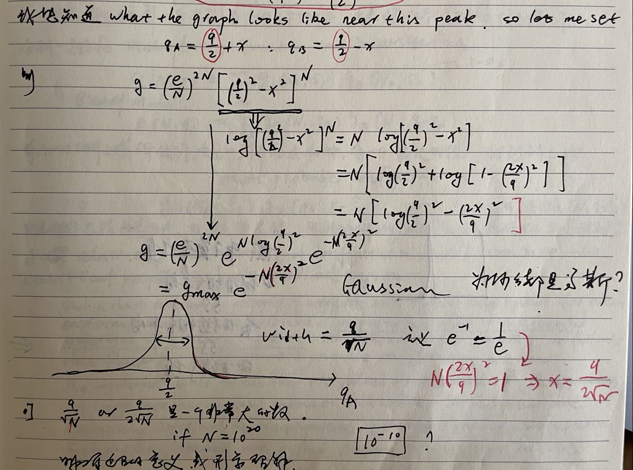
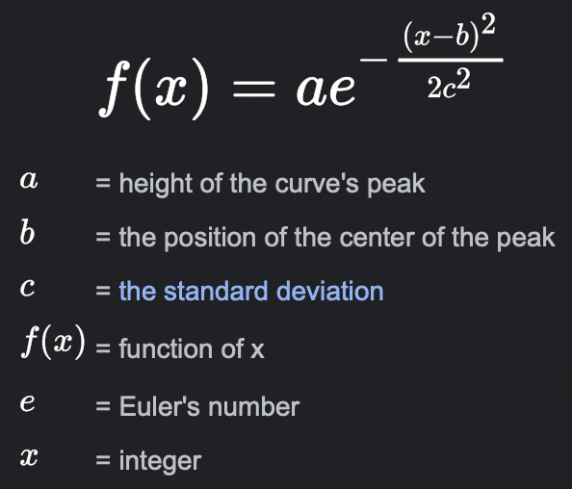
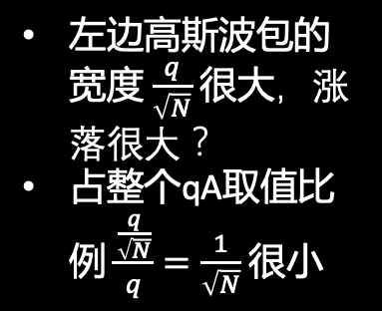
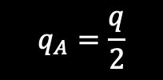


Consider $g\left[N,q\right]=\frac{\left(q+N−1\right)!}{q!\left(N−1\right)!}$ $→g={(\frac{eq}{N})}^{N}$suppose N_{A}=N_{B}=N,
左边高斯波包的宽度 $\frac{q}{\sqrt{N}}$ 很大，涨落很大？
占整个qA取值比例 $\frac{\frac{q}{\sqrt{N}}}{q}=\frac{1}{\sqrt{N}}$ 很小
$$g=g_{A}g_{B}={(\frac{e}{N})}^{2N}{( q_{A}(q−q_{A}) )}^{N}$$
$$q_{A}=\frac{q}{2}$$
Peak $g_{max}={(\frac{e}{N})}^{2N}{(\frac{q}{2})}^{2N}$

Slide 13
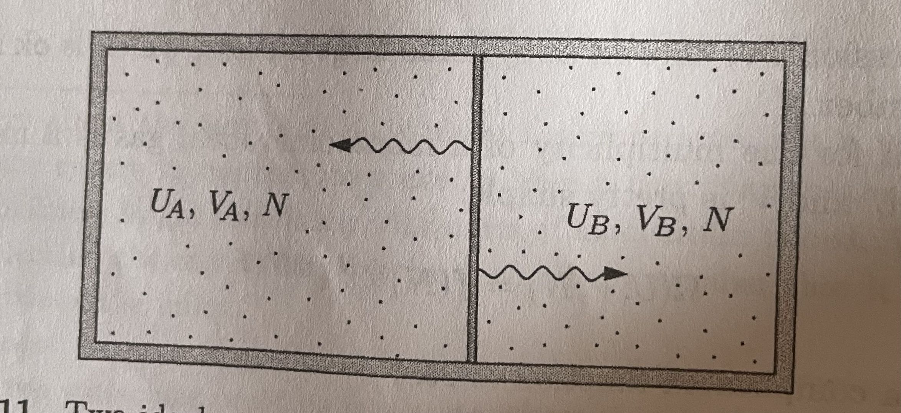
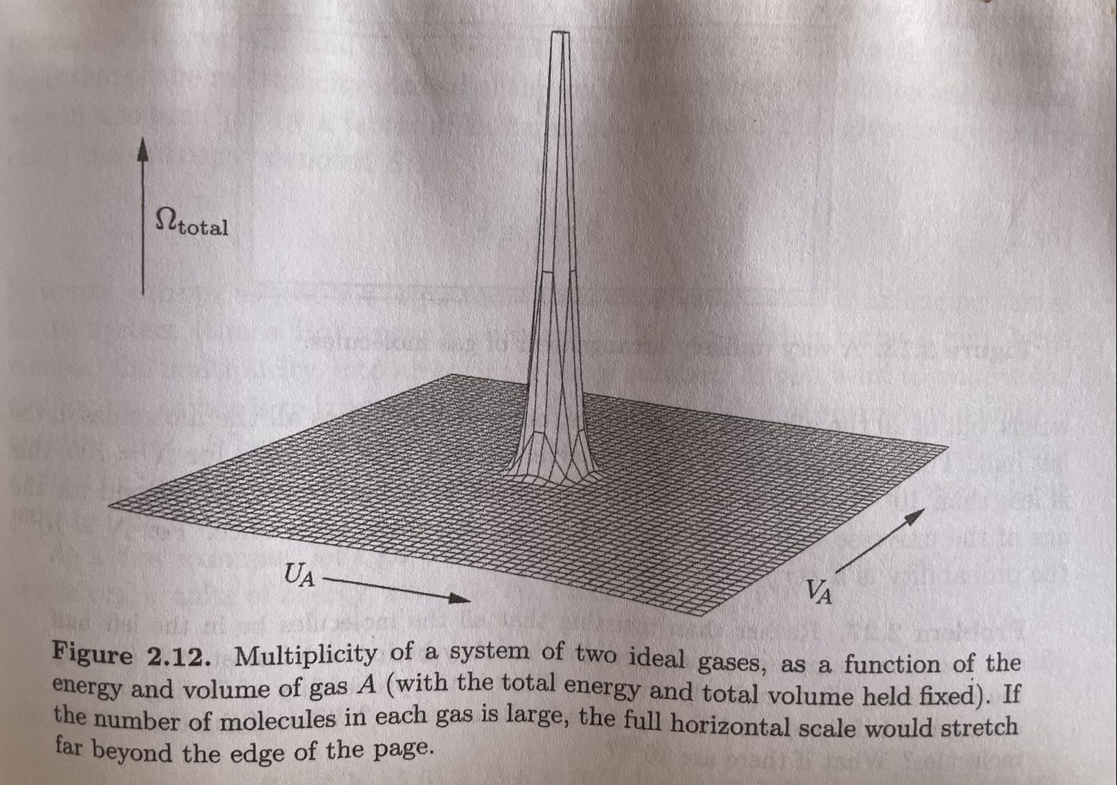
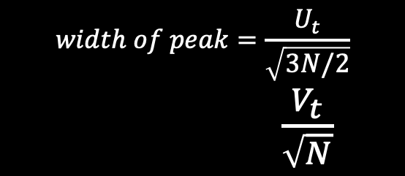
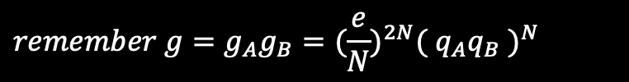
Interacting Ideal Gasses
补遗一
$$g_{t}={(f(N))}^{2}{(V_{A} V_{B} )}^{N} {(U_{A} U_{B} )}^{3N/2}$$
$$remember g=g_{A}g_{B}={(\frac{e}{N})}^{2N}{( q_{A}q_{B} )}^{N}$$
$$width of peak=\frac{U_{t}}{\sqrt{3N/2}}$$
$\frac{V_{t}}{\sqrt{N}}$

Slide 14
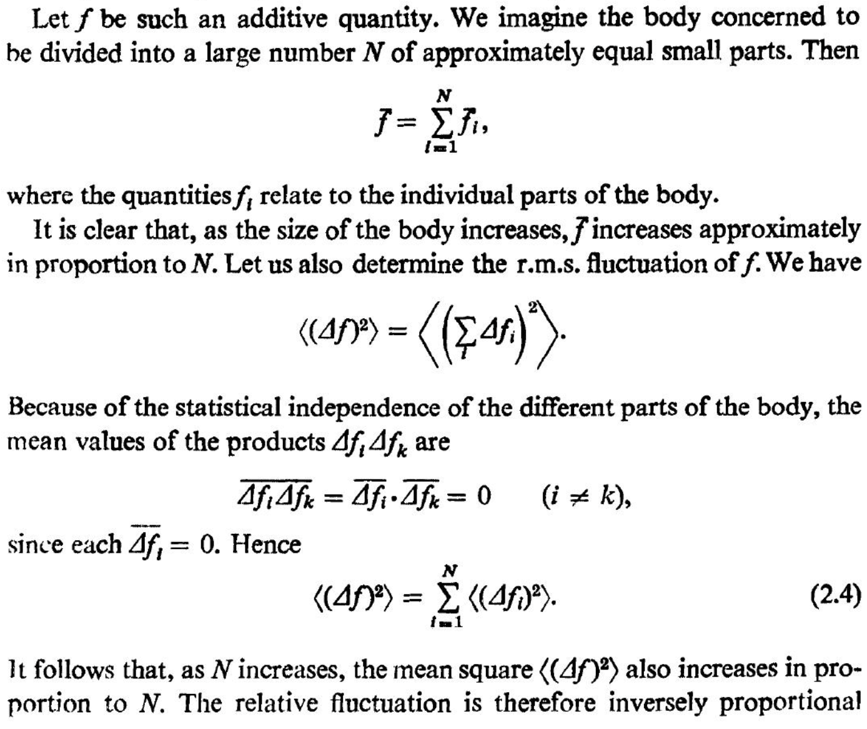
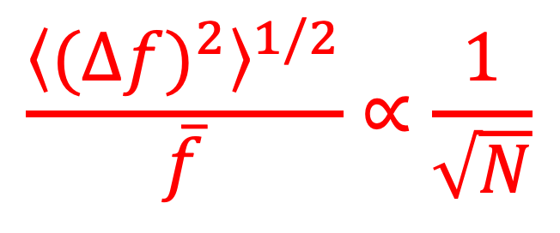
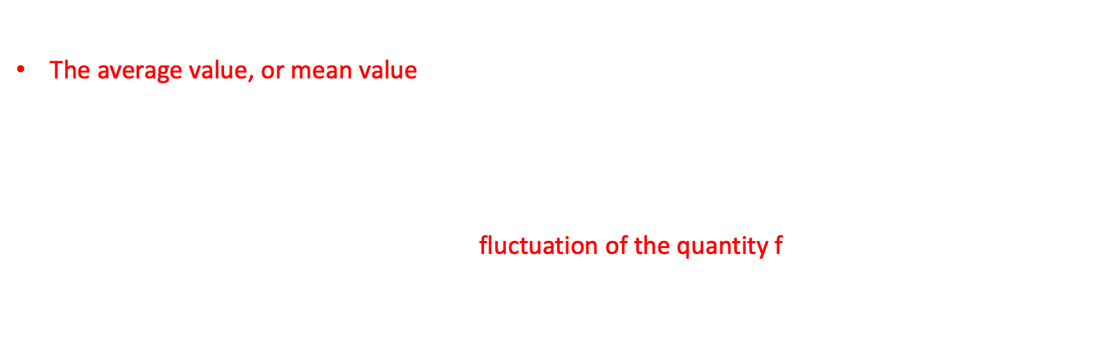
统计平均值（扩展一下）
The average value, or mean value, of a function f(s) taken over a probability distribution function P(s) is defined as
$$\overline{f}=\left\langle f\right\rangle =\sum_{s}{f\left(s\right)P(s)}$$
provided that the distribution function is normalized to unity.
The root-mean-square(r.m.s，均方根) fluctuation of the quantity f
$${\left\langle {\left(∆f\right)}^{2}\right\rangle }^{1/2}={\left(\overline{f^{2}}−{\left(\overline{f}\right)}^{2}\right)}^{1/2}$$
$$\frac{{\left\langle {(∆f)}^{2}\right\rangle }^{1/2}}{\overline{f}}∝\frac{1}{\sqrt{N}}$$
？？
参考Landau统计力学书的一般性说明

Slide 15
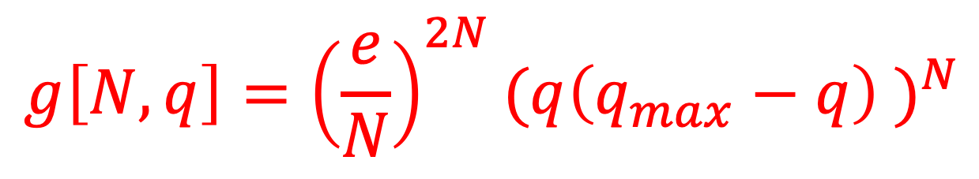

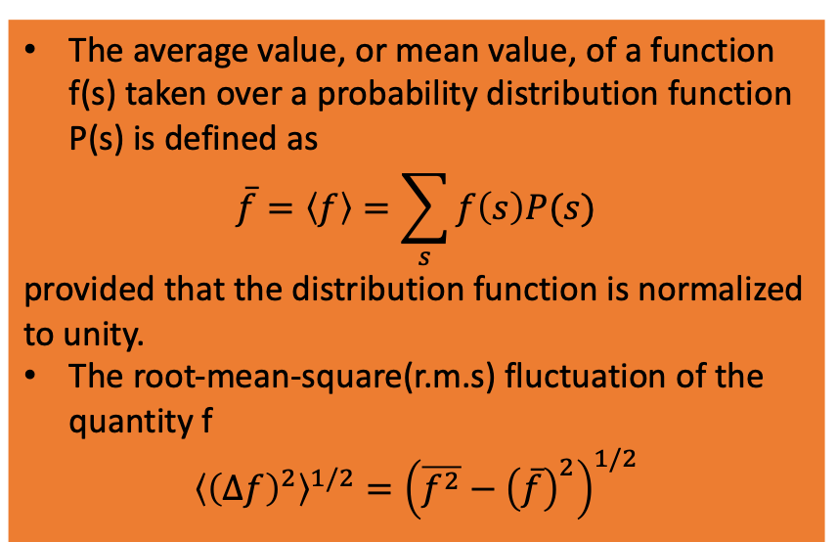
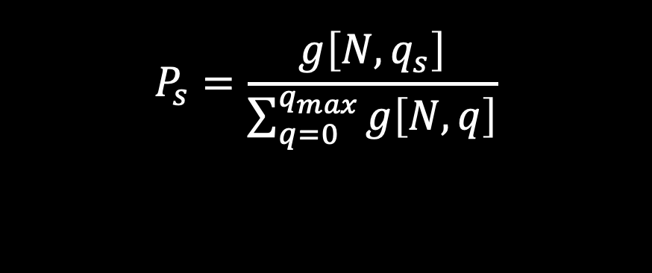
$$g\left[N,q\right]={\left(\frac{e}{N}\right)}^{2N}{(q\left(q_{max}−q\right) )}^{N}$$
系统能量 $q_{max} hf, and q∈[0,q_{max},1]$
处于宏观态s的概率
$$P_{s}=\frac{g\left[N,q_{s}\right]}{\sum_{q=0}^{q_{max}}{g\left[N,q\right]}}$$
The average value, or mean value, of a function f(s) taken over a probability distribution function P(s) is defined as
$$\overline{f}=\left\langle f\right\rangle =\sum_{s}{f\left(s\right)P(s)}$$
provided that the distribution function is normalized to unity.
The root-mean-square(r.m.s) fluctuation of the quantity f
$${\left\langle {\left(∆f\right)}^{2}\right\rangle }^{1/2}={\left(\overline{f^{2}}−{\left(\overline{f}\right)}^{2}\right)}^{1/2}$$
q的平均值？
涨落？
$$\frac{{\left\langle {(∆f)}^{2}\right\rangle }^{1/2}}{\overline{f}}∝\frac{1}{\sqrt{N}}$$

Slide 16
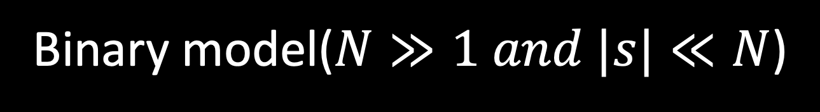
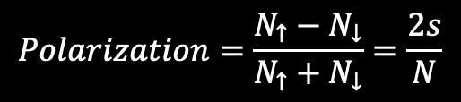
Binary model($N≫1 and |s|≪N$)
补遗二
$$g=\frac{N!}{N_{↑}!N_{↓}!}→g\left[N,0\right]e^{−2 \frac{s^{2}}{N}}$$
$$Polarization=\frac{N_{↑}−N_{↓}}{N_{↑}+N_{↓}}=\frac{2s}{N}$$
见Binary.nb

Slide 17
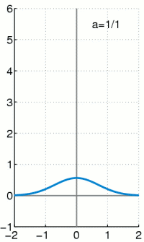
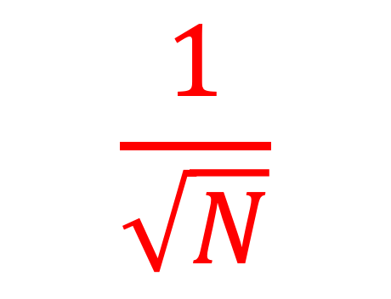
Sharpness!!!
$$\frac{1}{\sqrt{N}}$$

Slide 18
Most Probable Configuration
当两个非常大的两个爱因斯坦固体进行热接触，存在一个最概然的宏观态，任何随机偏离该宏观态的涨落都utterly unmeasurable. 如果我们想看到这些涨落，需要使观测到不可思议的精度。
对于AB两系统，所有微观态等概率=热平衡=最概然态
A relatively small number of configurations will dominate the statistical properties of the combined system.
The limit where a system become infinitely large, so that measurable fluctuations away from the most like microstate never occur, is called the thermodynamic limit.

Slide 19
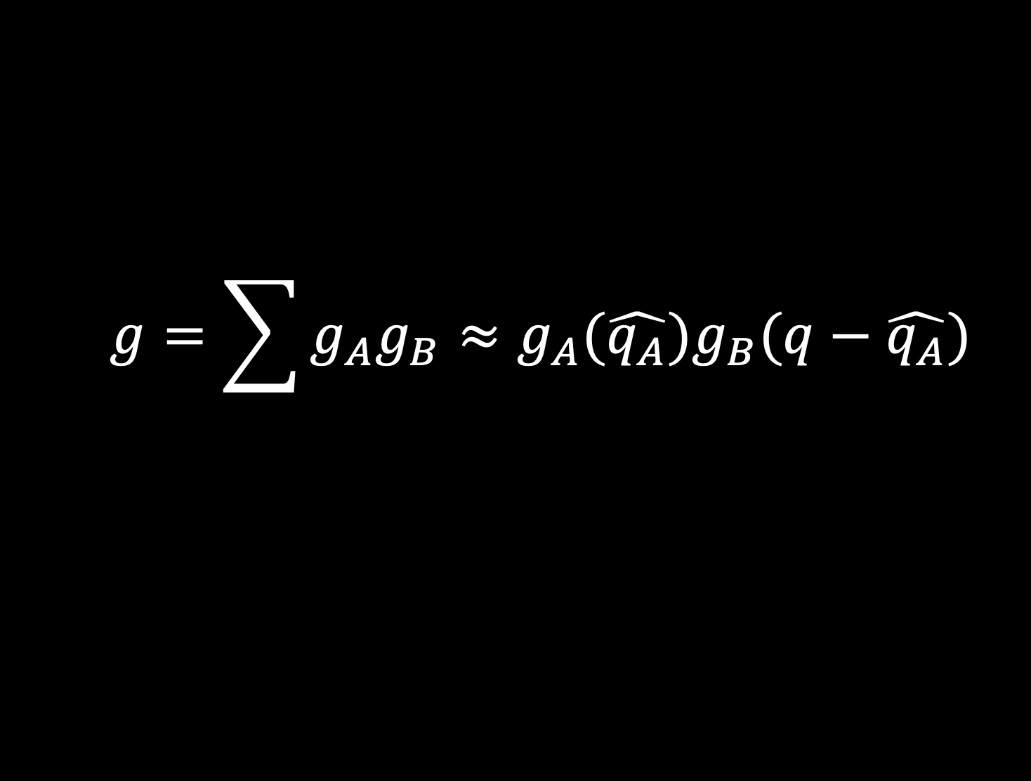
Most Probable Configuration
Such a sharp maxium is property of every realistic type of large system for whih exact solutions are available: We postulate that it is a general properties of all large system. From the sharpness property it follows that fluctuation about the most probable configuration are small. The important result follows that the values of the average physical properties of large system in thermal contact with another large system are accurately described by the properties of the most probable configuration. Such average values are called thermal equilibrium values.
$$g=\sum{g_{A}g_{B}≈g_{A}(\hat{q_{A}})g_{B}(q−\hat{q_{A}})}$$

Slide 20

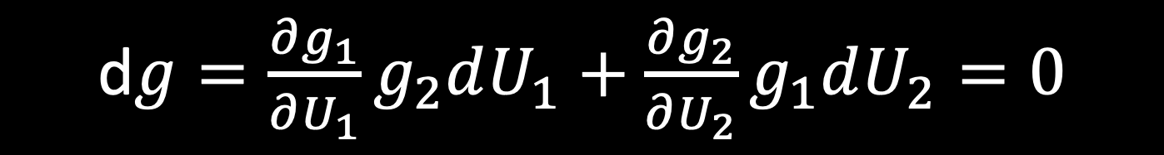

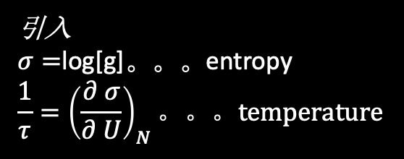
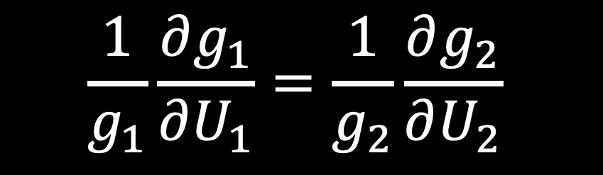
Most Probable Configuration
d$g=\frac{∂g_{1}}{∂U_{1}}g_{2}dU_{1}+\frac{∂g_{2}}{∂U_{2}}g_{1}dU_{2}=0$
Note: $dU=dU_{1}+dU_{2}==0$
热平衡条件
$$\frac{1}{g_{1}}\frac{∂g_{1}}{∂U_{1}}=\frac{1}{g_{2}}\frac{∂g_{2}}{∂U_{2}}$$
$$τ_{1}=τ_{2}$$
引入
$σ=$log[g]。。。entropy
$$\frac{1}{τ}={\left(\frac{∂ σ}{∂ U}\right)}_{N}。。。temperature$$

Slide 21
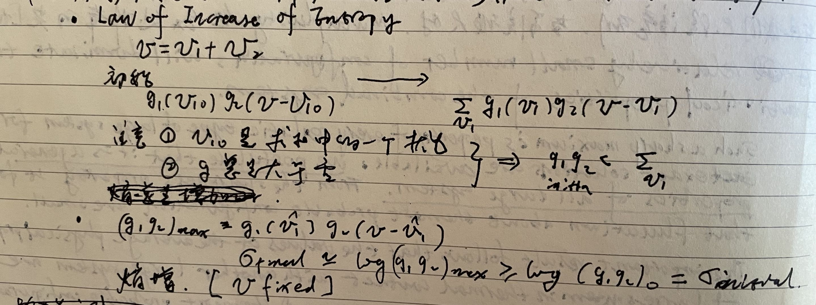

Entropy
Any large system in equilibrium will be found in the macrostate with the greatest multiplicity(aside from fluctuations that are normally too small to measure)…Multiplicity tends to increase.
Any large system in equilibrium will be found in the macrostate with the greatest entropy(aside from fluctuations that are normally too small to measure)…Entropy tends to increase.
$σ=$log[g]
热力学第二定律

Slide 22
Why log?
大变小
相乘变相加
不敏感（Kittel书介绍，请大家自行阅读）

Slide 23
Laws of Thermodynamics
大变小
相乘变相加
不敏感（Kittel书介绍，请大家自行阅读）
Zeroth law. If two systems are in thermal equilibrium with a third system, they must be in thermal equilibrium with each other.
First law. Heat is a form of energy(the rpinciple of conservation of energy).
Second law. (the statistical statement) If a closed system is in a configuration that is not the equilibrium configuartion, the most probalbe consequence will be that the entropy of the system will increase monotonically in successive instants of time.
Third law. The entropy of a system approaches a constant values at the temperature approaches zero.

Slide 24
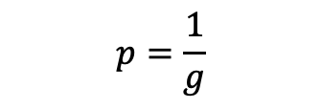
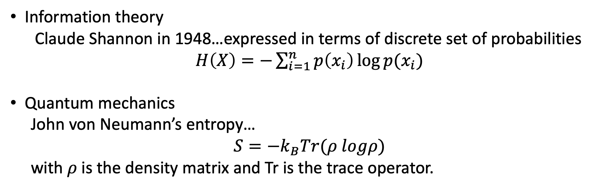
推荐推广
Information theory
Claude Shannon in 1948…expressed in terms of discrete set of probabilities
$H\left(X\right)=−\sum_{i=1}^{n}{p\left(x_{i}\right)\log{p(x_{i})}}$
Quantum mechanics
John von Neumann’s entropy…
$$S=−k_{B}Tr(ρ logρ)$$
with $ρ$is the density matrix and Tr is the trace operator.
$$p=\frac{1}{g}$$

