Slide 1
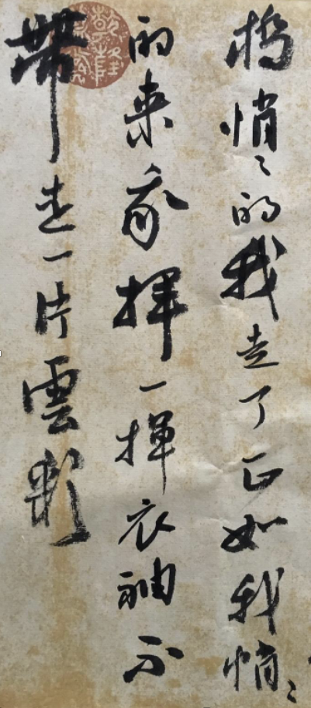
热物（第十七周）
复习
感悟
学生报告

Slide 2
热物（第十七周）
复习
感悟
学生报告

Slide 3
热物教学
对象：物理（伯苓班）、应用物理、光信专业学生，一点儿其他专业学生
原则：（一）以尽可能简单的方式引入概念
（二）尽可能多元化地、从各个角度补充阐述概念
（三）自成体系，不乱（争取）
（四）避免“高深”的数学、“抽象”的表达
（五）读原著、追历史，科学前沿进课堂
目标：（一）让学生系统掌握热物基本知识、推演逻辑
（二）让大部分学生能喜欢这门课、至少不排斥，能自主学习
（三）着重物理思维的训练，追求知识点忘掉后剩下的印记
（四）培养学生能欣赏物理的美、且利用基础知识解决实际问题的能力

Slide 4
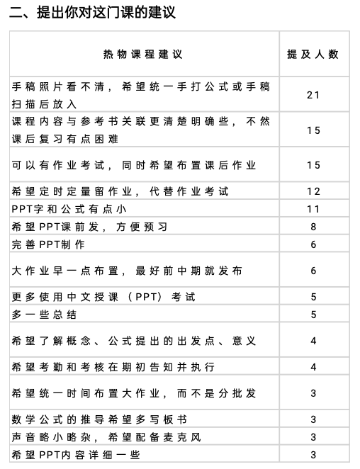
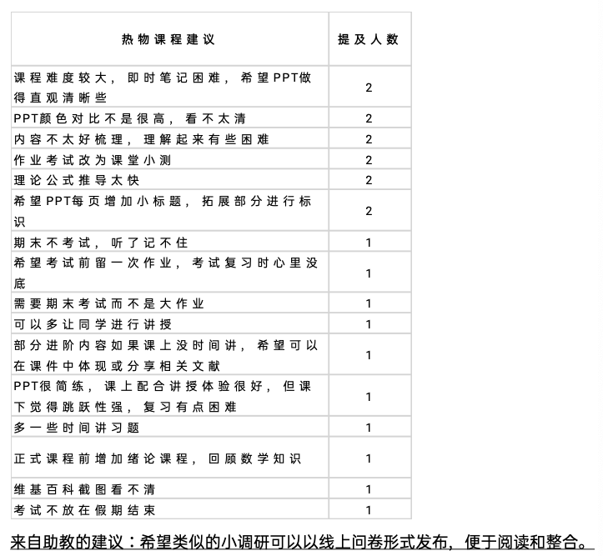
效果：
问题：（一）PPT格式（改正目标：离开上课能看懂的）
（二）平时作业考
（三）参考资料
（四）大作业
（五）其他授课相关
感谢助教

Slide 5
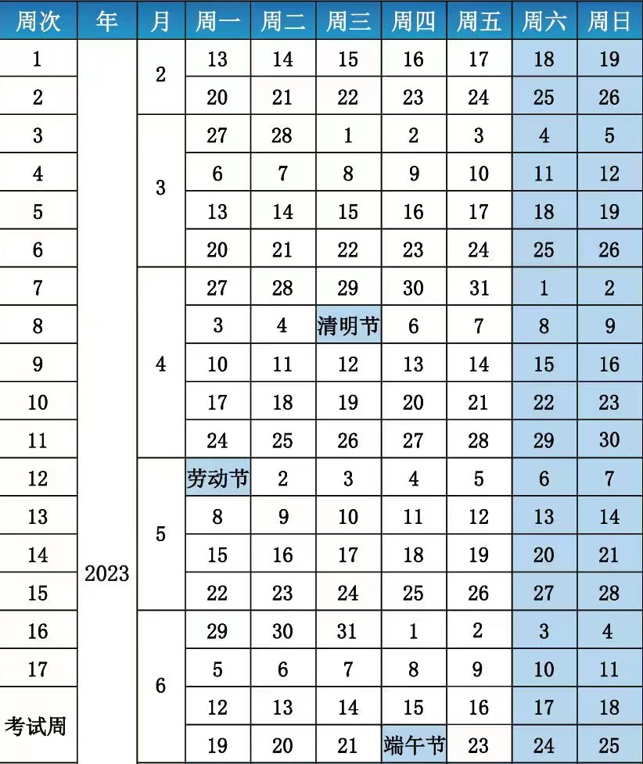
授课内容
统计物理基础知识（Multiplicity，熵，
温度，Boltzman因子，化学势，
Gibbs sum。。。Ansemble）
量子统计（费米，玻色）
相互作用系统
相变
科学前沿进课堂
潘雷霆 复杂系统之美
李峣 熵致有序
王荣 最大熵
董校 特殊函数
胡金牛 星星
付伟杰 重整化群

Slide 6
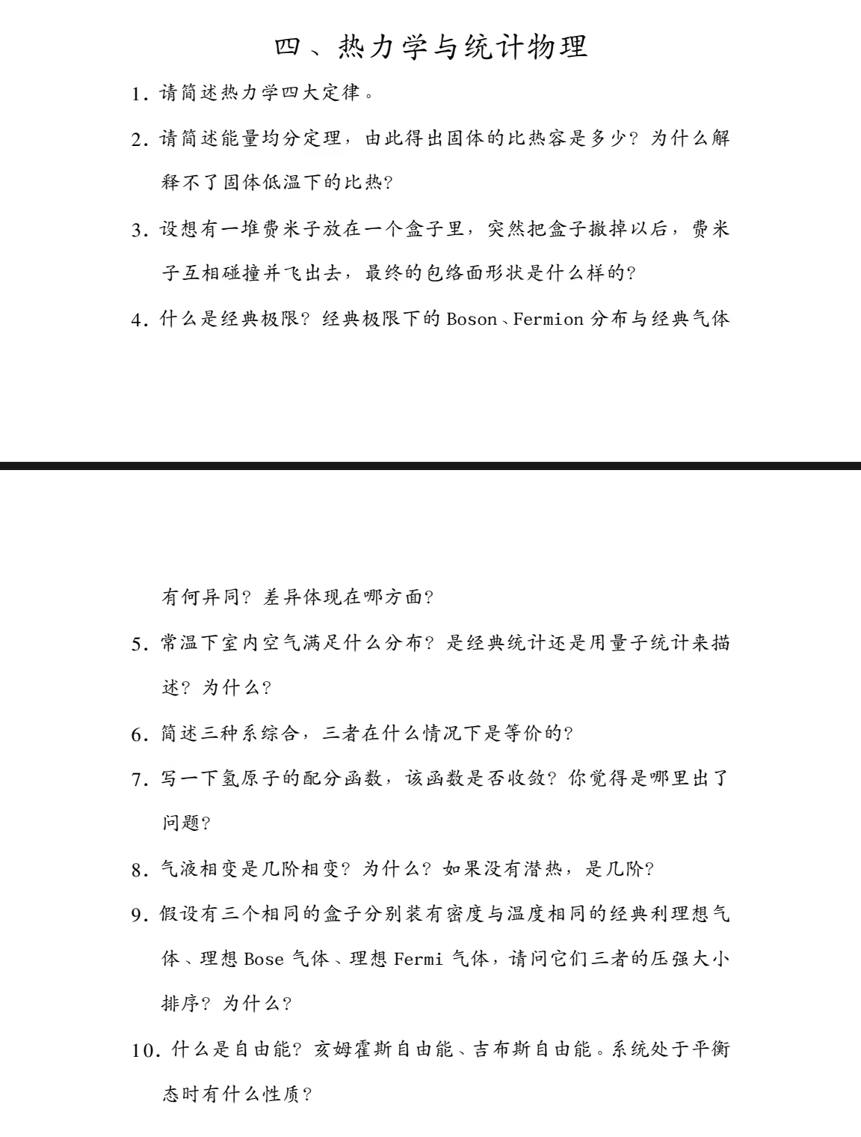
授课内容
统计物理基础知识（Multiplicity，熵，
温度，Boltzman因子，化学势，
Gibbs sum。。。Ansemble）
量子统计（费米，玻色）
相互作用系统
相变
覆盖了吗？
掌握了吗？
忘记了吗？
潘磊

Slide 7
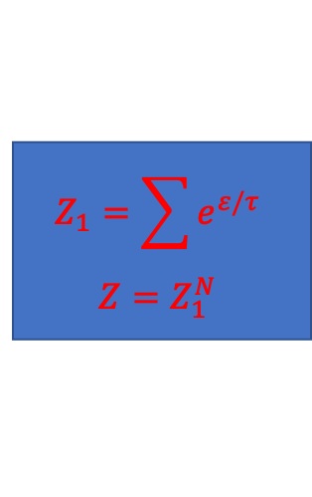

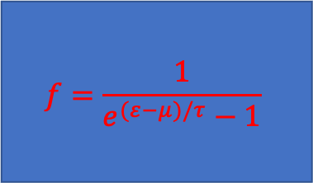
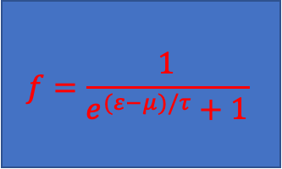
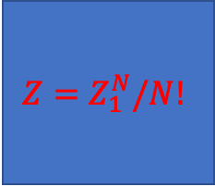
课程图(consider particles in V at tau)
Is $n≪n_{Q}$?
Bosons!
Do they interact with each other?
No
Are they localized?
Fermion?
No
No
No
Is the number fixed?
Yes
Yes
Yes
Yes
No
Photon/Phonon
Ising
$$Z_{1}=\sum{e^{ε/τ}}$$
$$Z=Z_{1}^{N}$$
$$Z=Z_{1}^{N}/N!$$
$$f=\frac{1}{e^{(ε−μ)/τ}+1}$$
Yes
$$f=\frac{1}{e^{(ε−μ)/τ}−1}$$
Fermi pressure
BE condensate

Slide 8
Part-I 微正则系统
Part-II 正则系统
Part-III 巨正则系统
Part-IV 量子统计
Part-V 相互作用

Slide 9
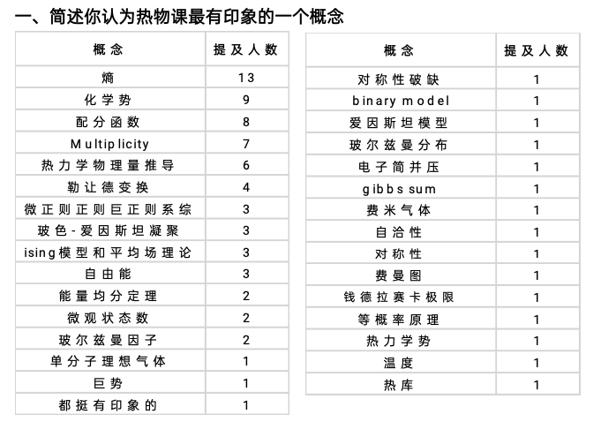
Part-I
Part-II
Part-III
Part-IV
Part-V

Slide 10
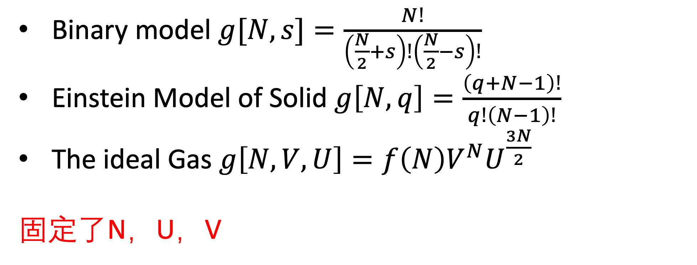
Part-I
我们是如何打开热物学习第一步的？
Multiplicity
In statistical mechanics, multiplicity(also called statistical weight) refers to the number of microstates(微观态) corresponding to a particular macrostate(宏观态)of a thermodynamic system.
Binary model $g[N,s]=\frac{N!}{\left(\frac{N}{2}+s\right)!\left(\frac{N}{2}−s\right)!}$
Einstein Model of Solid $g\left[N,q\right]=\frac{\left(q+N−1\right)!}{q!\left(N−1\right)!}$
The ideal Gas $g\left[N,V,U\right]=f\left(N\right)V^{N}U^{\frac{3N}{2}}$
固定了N，U，V

Slide 11
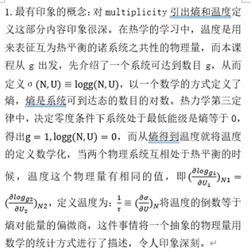
Part-I
我们是如何打开热物学习第一步的？
学生感悟

Slide 12
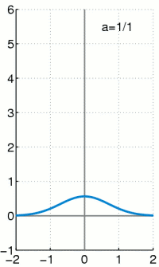
Part-I
基本假设
The fundamental assumption of thermal physics is that a isolated system is equally likely to be in any of the quantum states accessible to it.（等概率原理）
Sharpness of Multiplicity Function
Most Probable Configuration

Slide 13
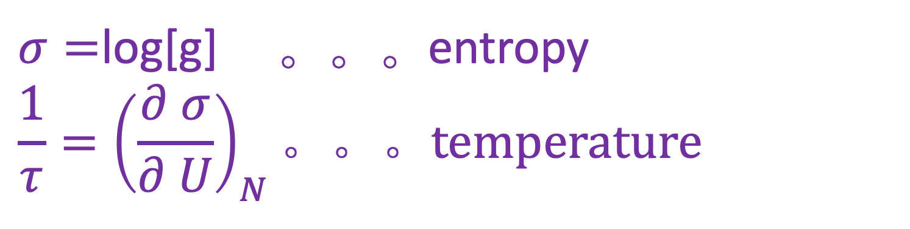
Part-I
$σ=$log[g] 。。。entropy
$$\frac{1}{τ}={\left(\frac{∂ σ}{∂ U}\right)}_{N}。。。temperature$$

Slide 14
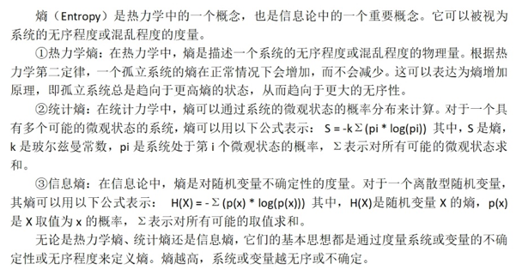
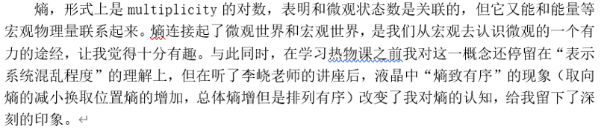
学生感悟

Slide 15
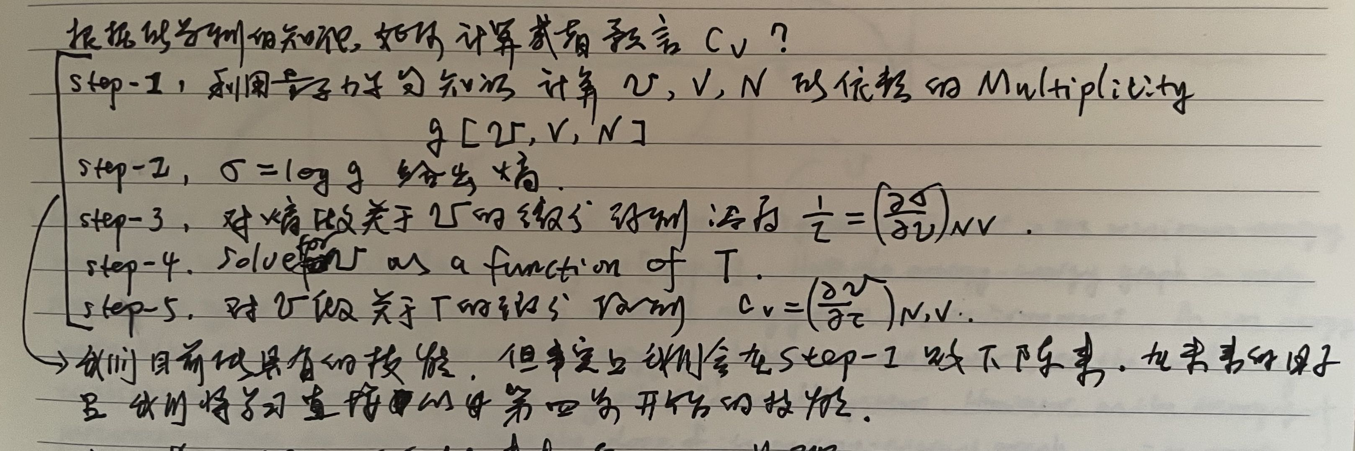
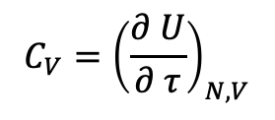
Part-I
我们拥有的第一套计算热物问题的本领（热容为例）
学生意见！！！
$$C_{V}={\left(\frac{∂ U}{∂ τ}\right)}_{N,V}$$

Slide 16
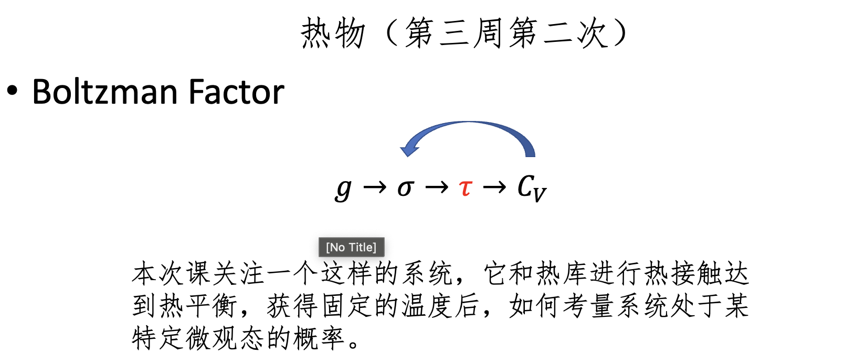
Part-II

Slide 17
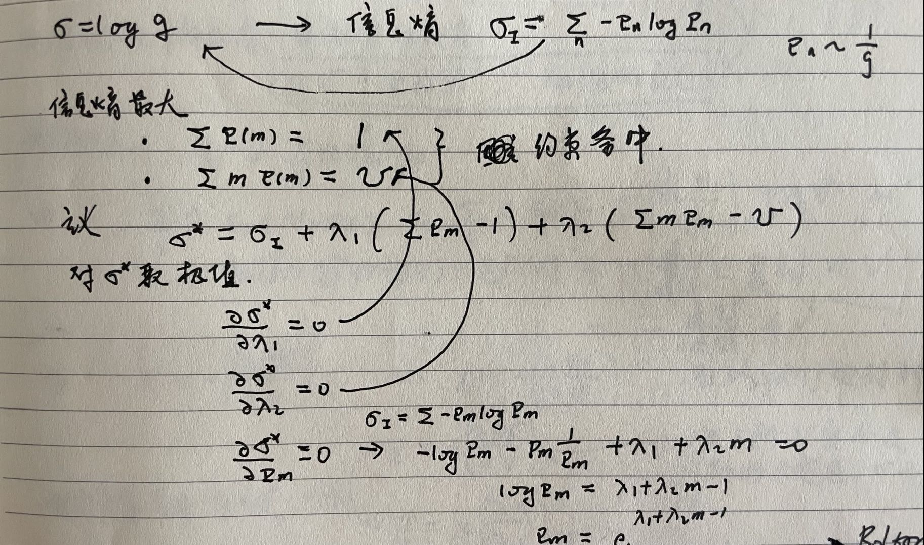
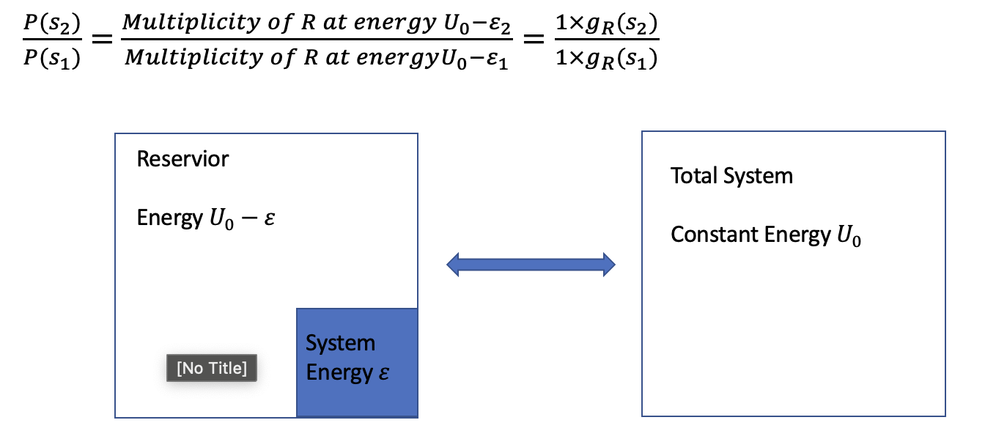
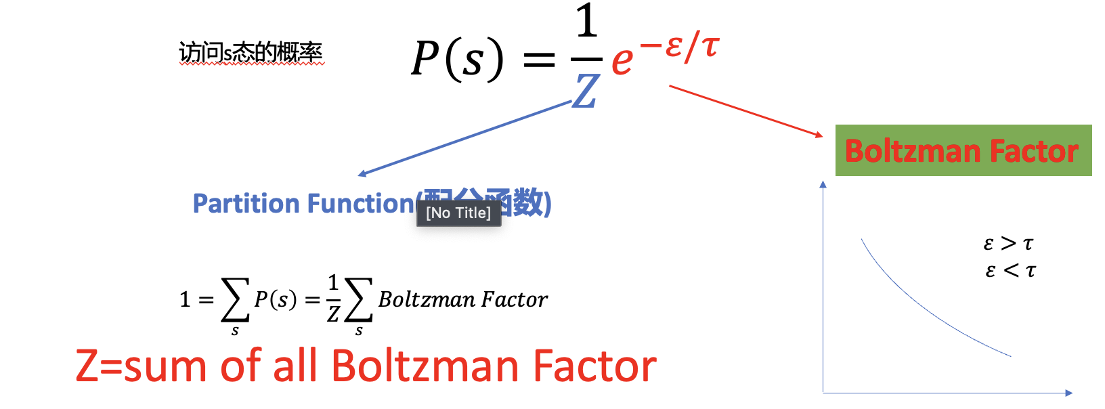
Part-II
平均值
能量均分定理
麦克斯韦速率分布

Slide 18
Part-II
平均值
能量均分定理
麦克斯韦速率分布

Slide 19
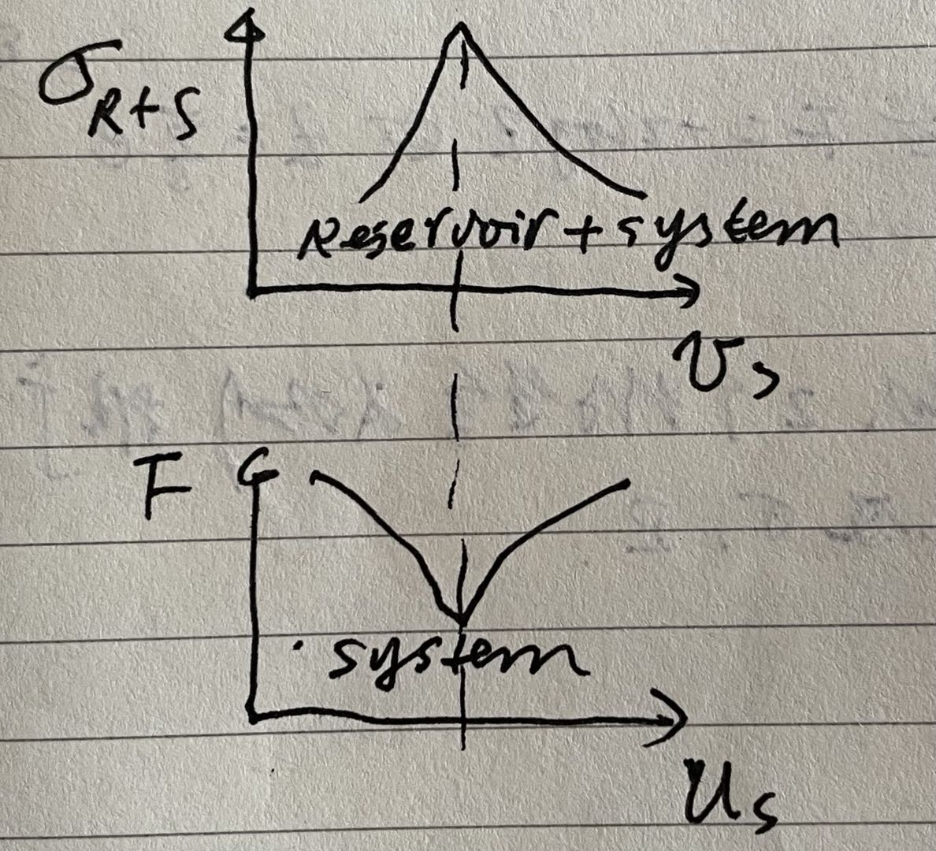
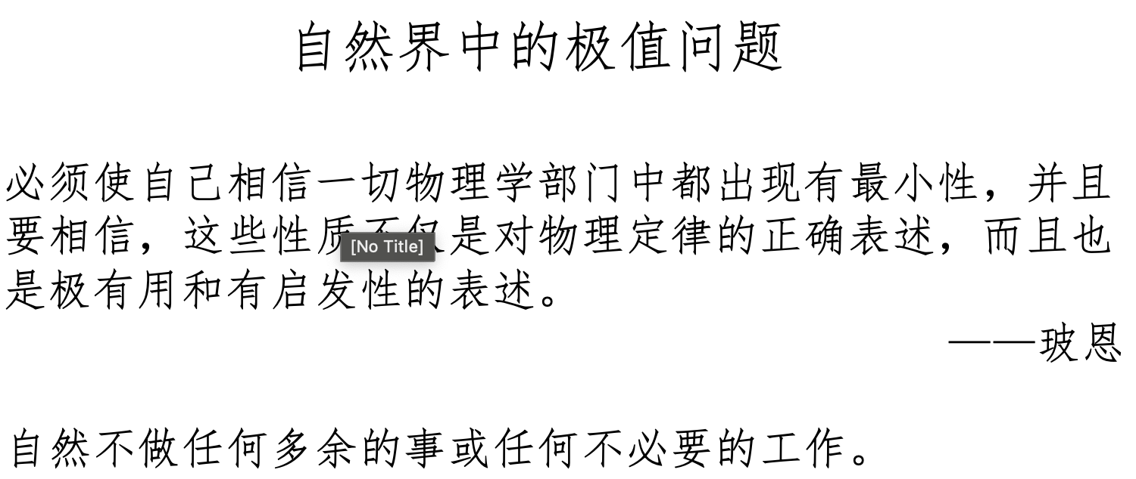

Part-II
Helmholtz自由能
把内能、熵、温度组合了一下
$$F=U−σ τ$$

Slide 20
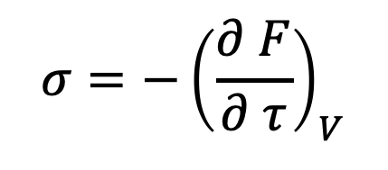
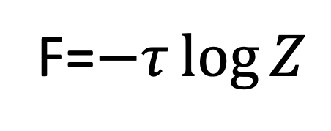
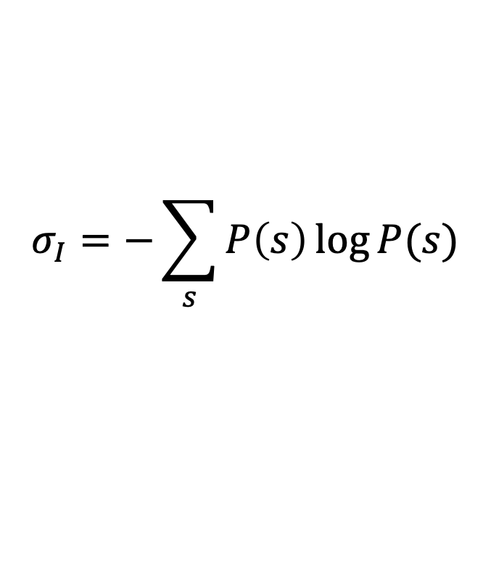
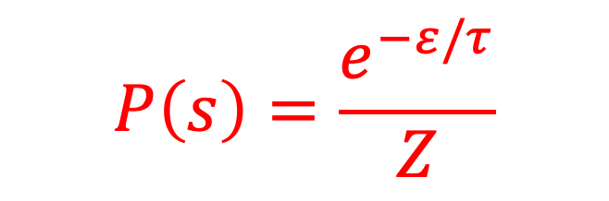
Part-II
$$P\left(s\right)=\frac{e^{−ε/τ}}{Z}$$
$$σ_{I}=−\sum_{s}{P\left(s\right)\log{P(s)}}$$
$${σ=−\left(\frac{∂ F}{∂ τ}\right)}_{V}$$
F=$−τ\log{Z}$

Slide 21
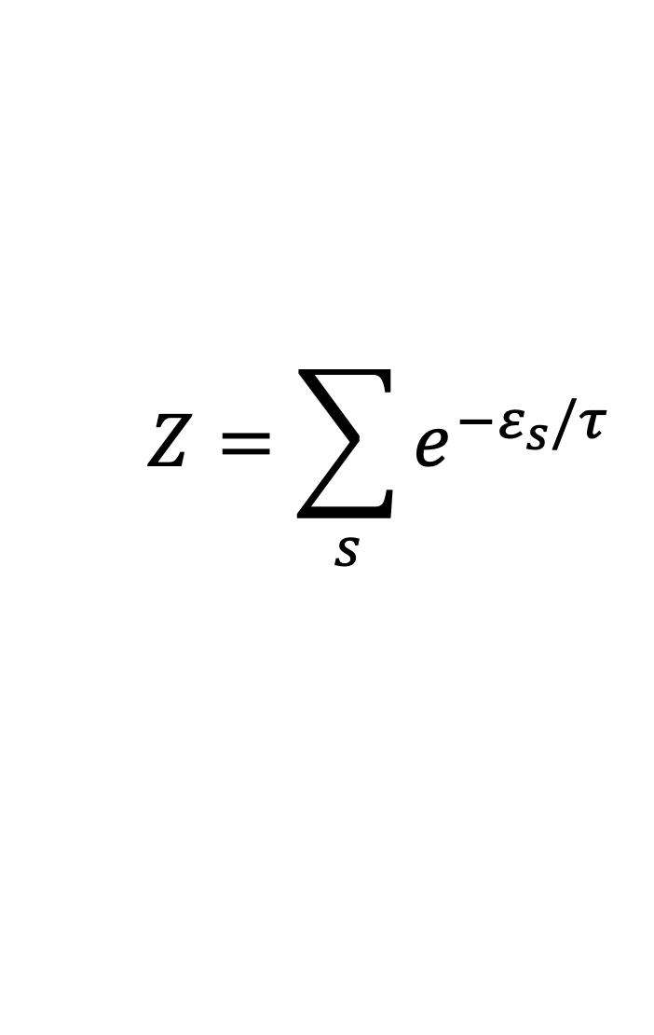
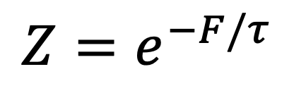
Part-II
$$Z=\sum_{s}{e^{−ε_{s}/τ}}$$
$$Z=e^{−F/τ}$$

Slide 22
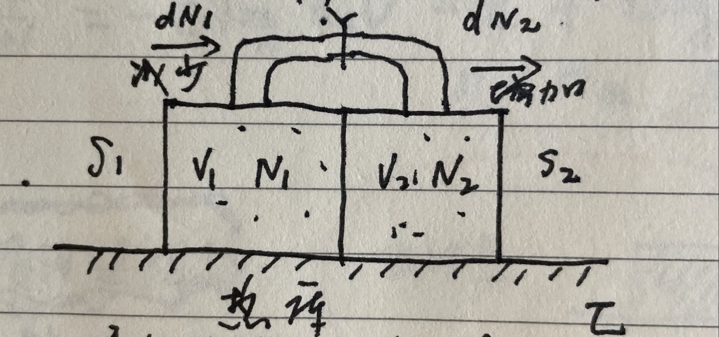
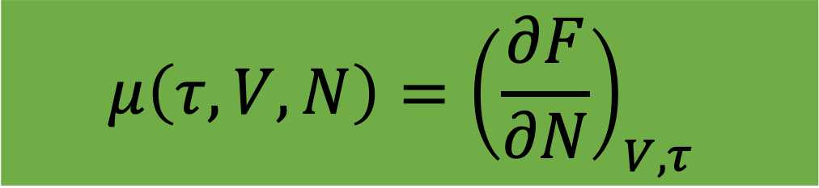
Part-III
让粒子数变起来
$$μ\left(τ,V,N\right)={\left(\frac{∂F}{∂N}\right)}_{V,τ}$$

Slide 23
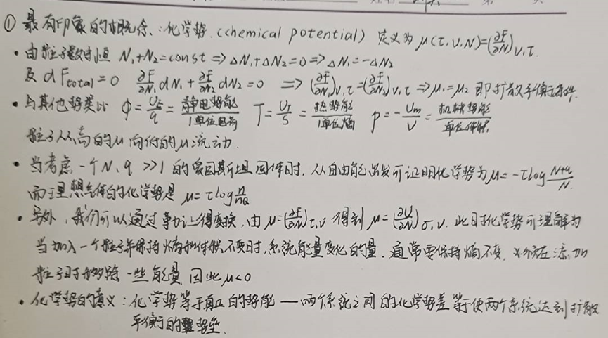



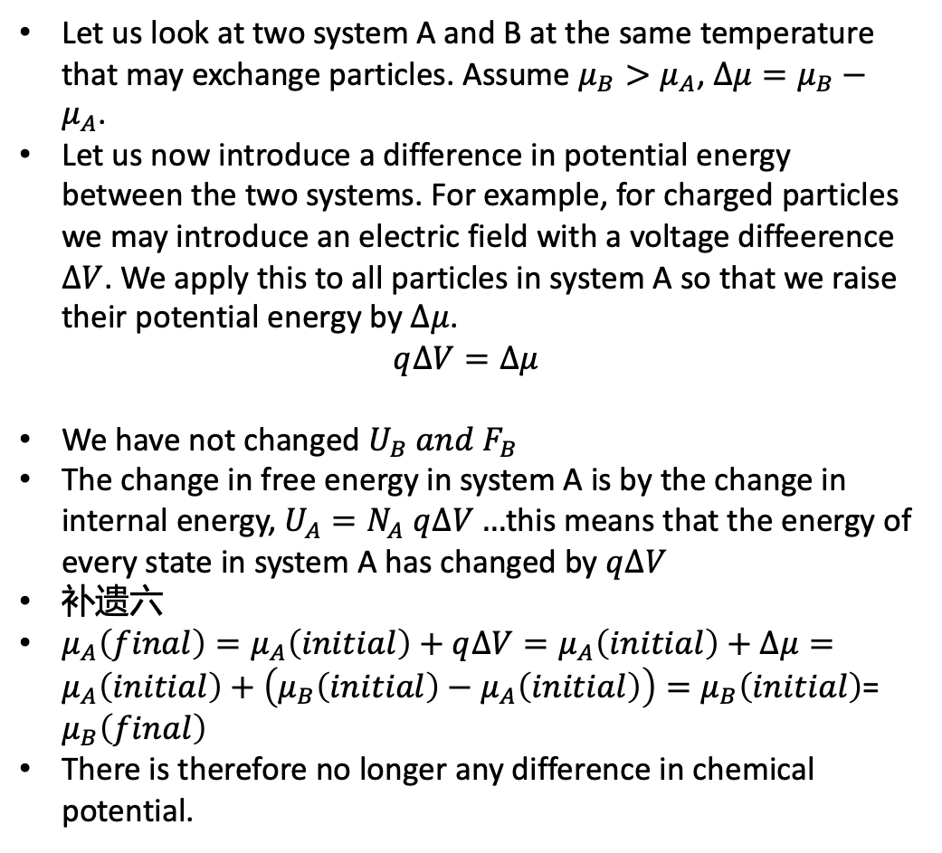
化学势的意义
The chemical poential is equivalent to a true potential energy: the difference in chemical potential between two system is equal to the potential barrier that will bring the two system into difffusive equilibrium.
Let us look at two system A and B at the same temperature that may exchange particles. Assume $μ_{B}>μ_{A}$, $∆μ=μ_{B}−μ_{A}$.
Let us now introduce a difference in potential energy between the two systems. For example, for charged particles we may introduce an electric field with a voltage diffeerence $∆V$. We apply this to all particles in system A so that we raise their potential energy by $∆μ$.
$$q∆V=∆μ$$
We have not changed $U_{B} and F_{B}$
The change in free energy in system A is by the change in internal energy, $U_{A}=N_{A} q∆V…$this means that the energy of every state in system A has changed by $q∆V$
补遗六
$μ_{A}\left(final\right)=μ_{A}\left(initial\right)+q∆V=μ_{A}\left(initial\right)+∆μ=μ_{A}\left(initial\right)+\left(μ_{B}\left(initial\right)−μ_{A}\left(initial\right)\right)=μ_{B}\left(initial\right)$= $μ_{B}\left(final\right)$
There is therefore no longer any difference in chemical potential.
$$μ_{B}$$
$$μ_{A}$$
Adding a potential energy per particle therefore corresponds to adding a potential energy to the chemical potential.
$$μ_{total}=μ_{ext}+μ_{int}$$

Slide 24
化学势的意义
The chemical poential is equivalent to a true potential energy: the difference in chemical potential between two system is equal to the potential barrier that will bring the two system into difffusive equilibrium.
Let us look at two system A and B at the same temperature that may exchange particles. Assume $μ_{B}>μ_{A}$, $∆μ=μ_{B}−μ_{A}$.
Let us now introduce a difference in potential energy between the two systems. For example, for charged particles we may introduce an electric field with a voltage diffeerence $∆V$. We apply this to all particles in system A so that we raise their potential energy by $∆μ$.
$$q∆V=∆μ$$
We have not changed $U_{B} and F_{B}$
The change in free energy in system A is by the change in internal energy, $U_{A}=N_{A} q∆V…$this means that the energy of every state in system A has changed by $q∆V$
补遗六
$μ_{A}\left(final\right)=μ_{A}\left(initial\right)+q∆V=μ_{A}\left(initial\right)+∆μ=μ_{A}\left(initial\right)+\left(μ_{B}\left(initial\right)−μ_{A}\left(initial\right)\right)=μ_{B}\left(initial\right)$= $μ_{B}\left(final\right)$
There is therefore no longer any difference in chemical potential.
$$μ_{B}$$
$$μ_{A}$$
Adding a potential energy per particle therefore corresponds to adding a potential energy to the chemical potential.
$$μ_{total}=μ_{ext}+μ_{int}$$

Slide 25
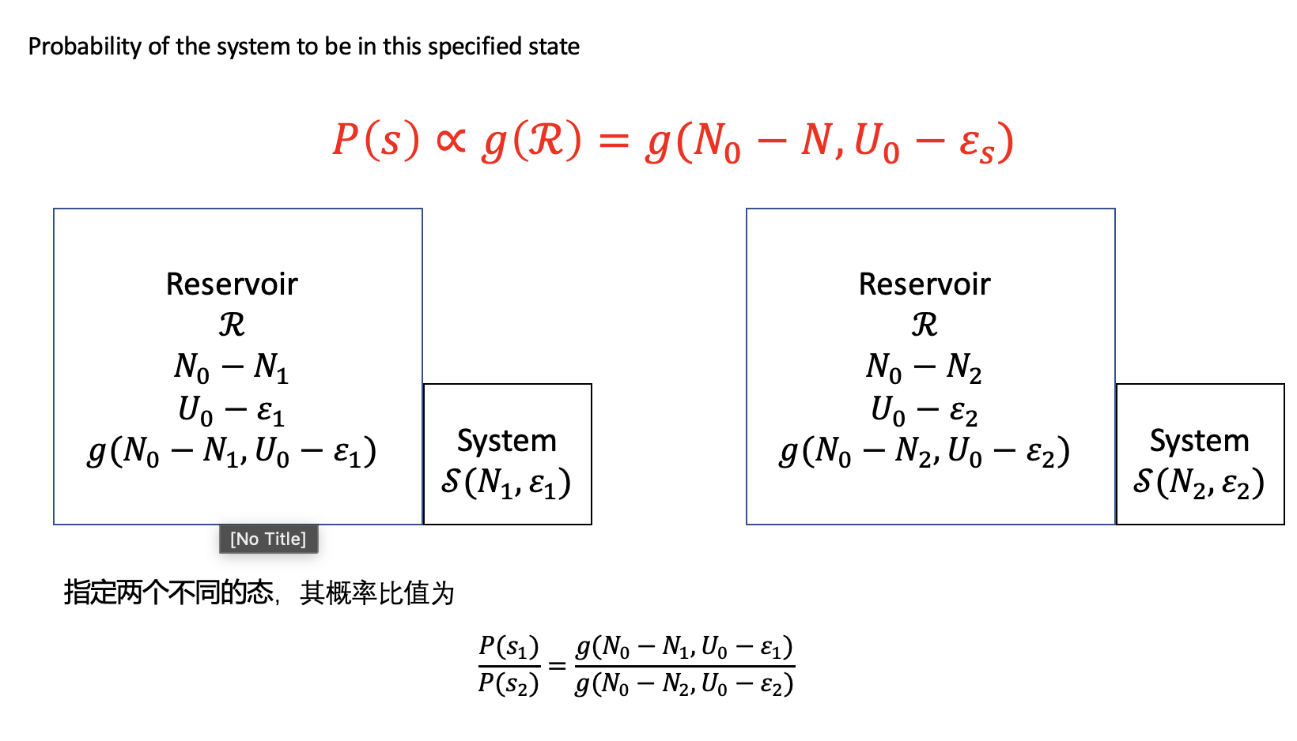
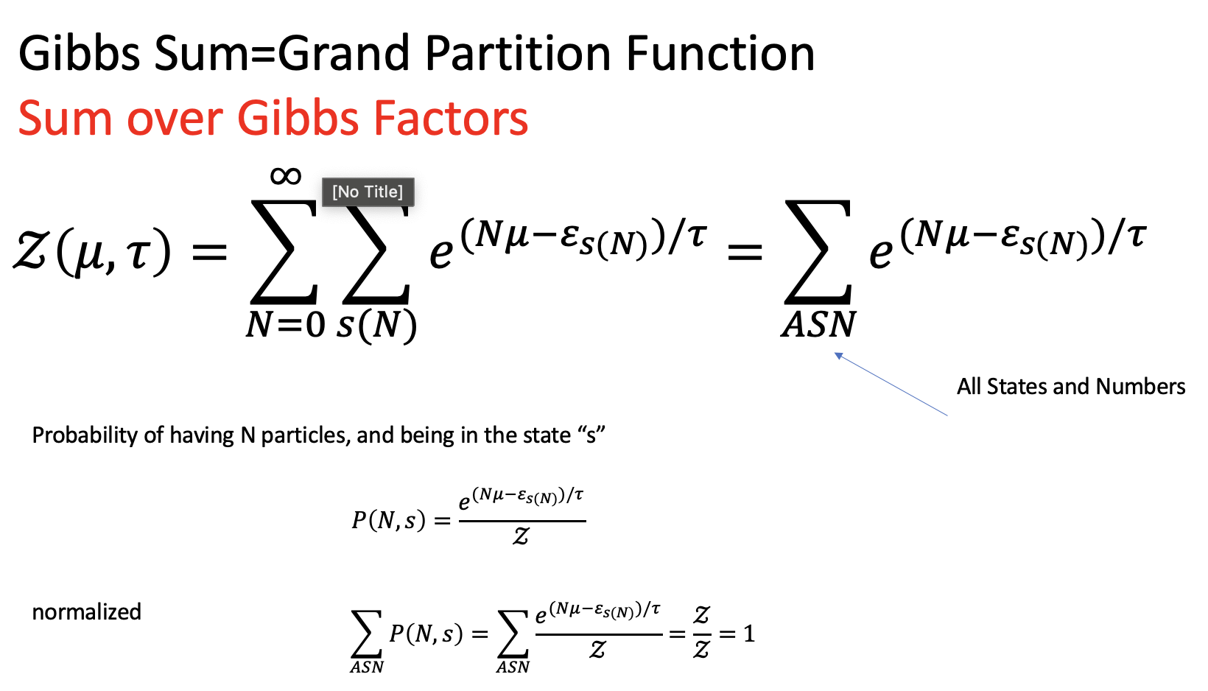
Part-III

Slide 26
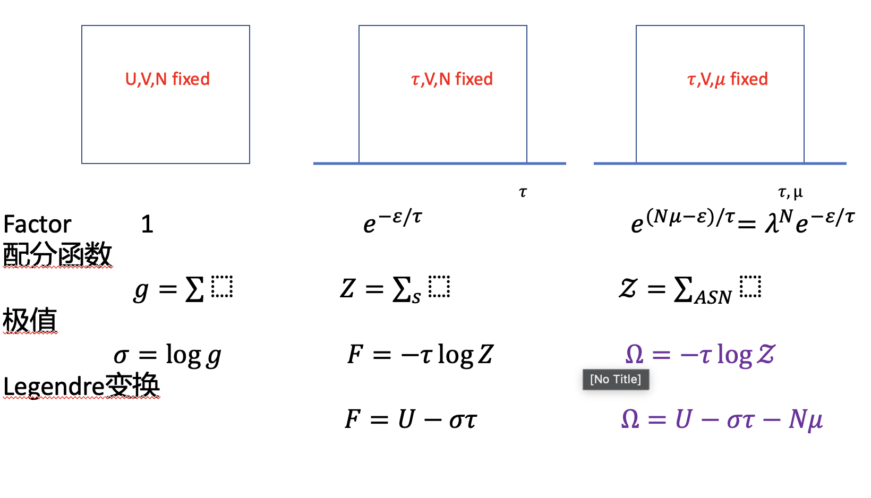
Part-III
一张图总结

Slide 27
Part-IV
量子统计(绪论)
费米简并气体的基本性质
黑体辐射
Debye固体
BEC

Slide 28
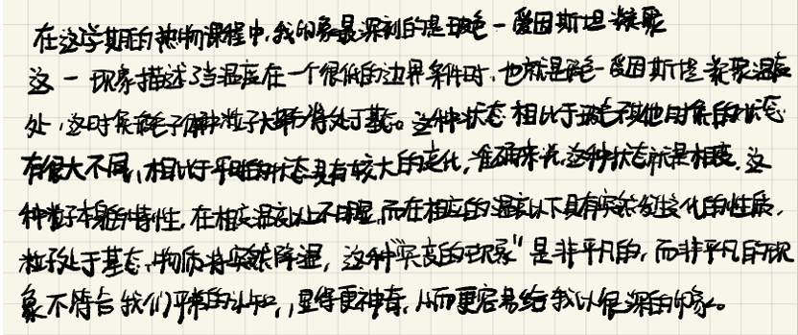
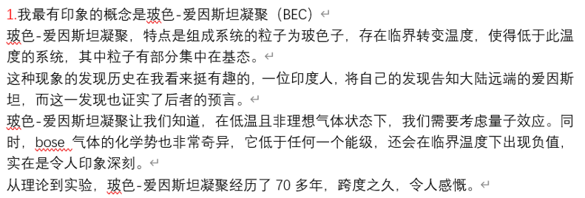
Part-IV

Slide 29
Part-V
相互作用系统
弱耦合（集团展开）
Ising模型
一维严格解
平均场近似
关联长度
重整化群大意

Slide 30
热物（第十七周）
复习
感悟
学生报告

Slide 31
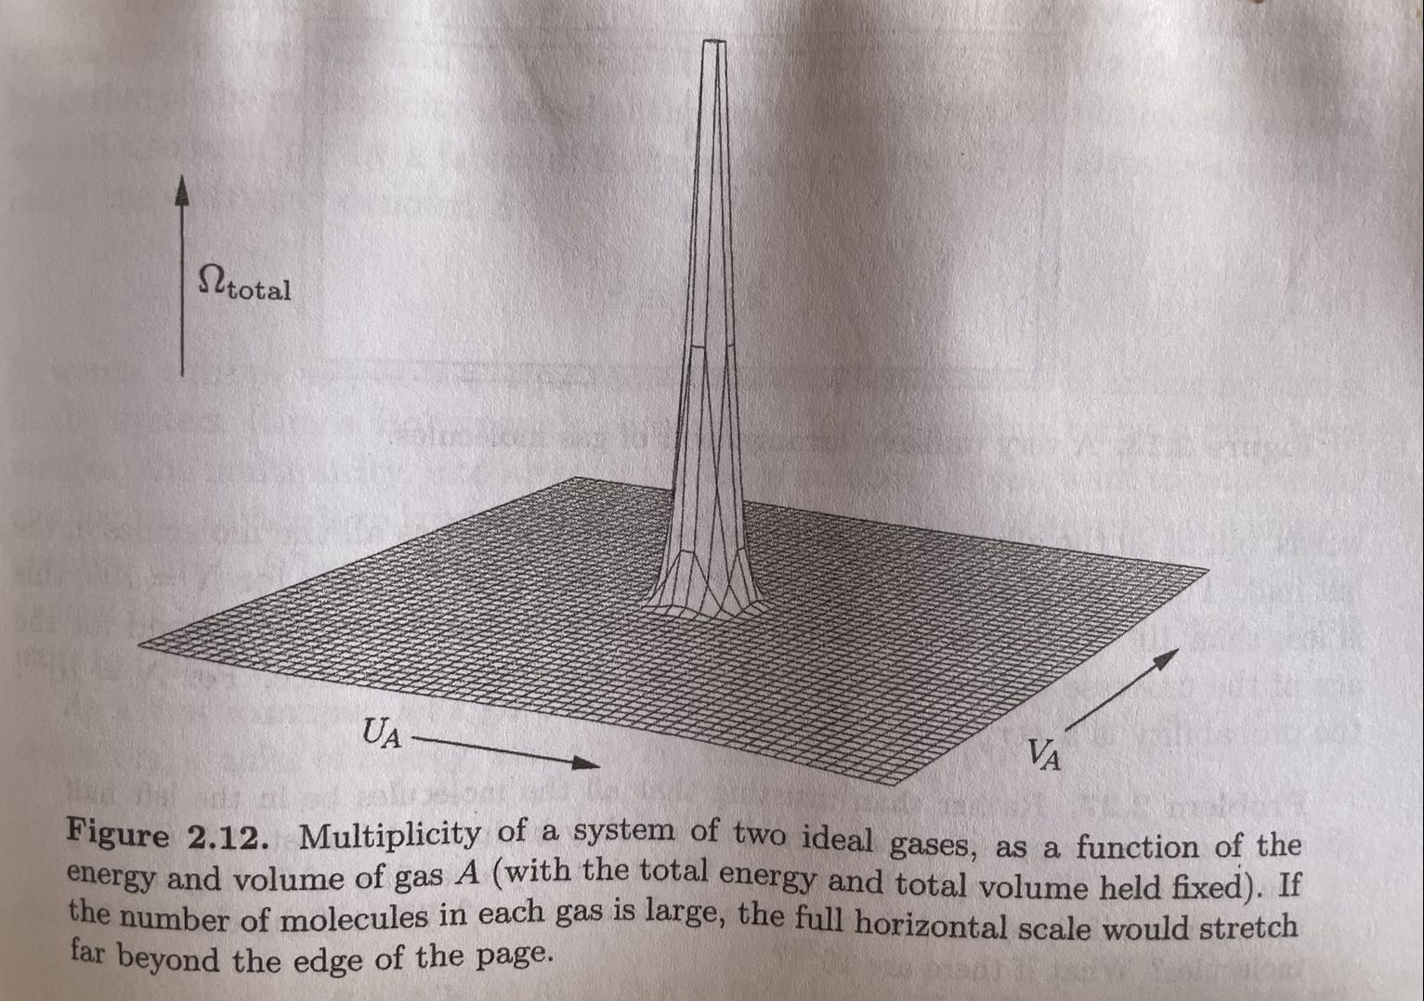

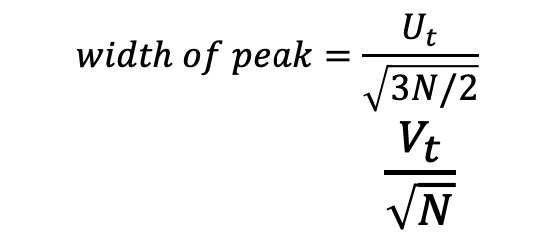
$\sqrt{N}$ -rule
$$width of peak=\frac{U_{t}}{\sqrt{3N/2}}$$
$\frac{V_{t}}{\sqrt{N}}$

Slide 32
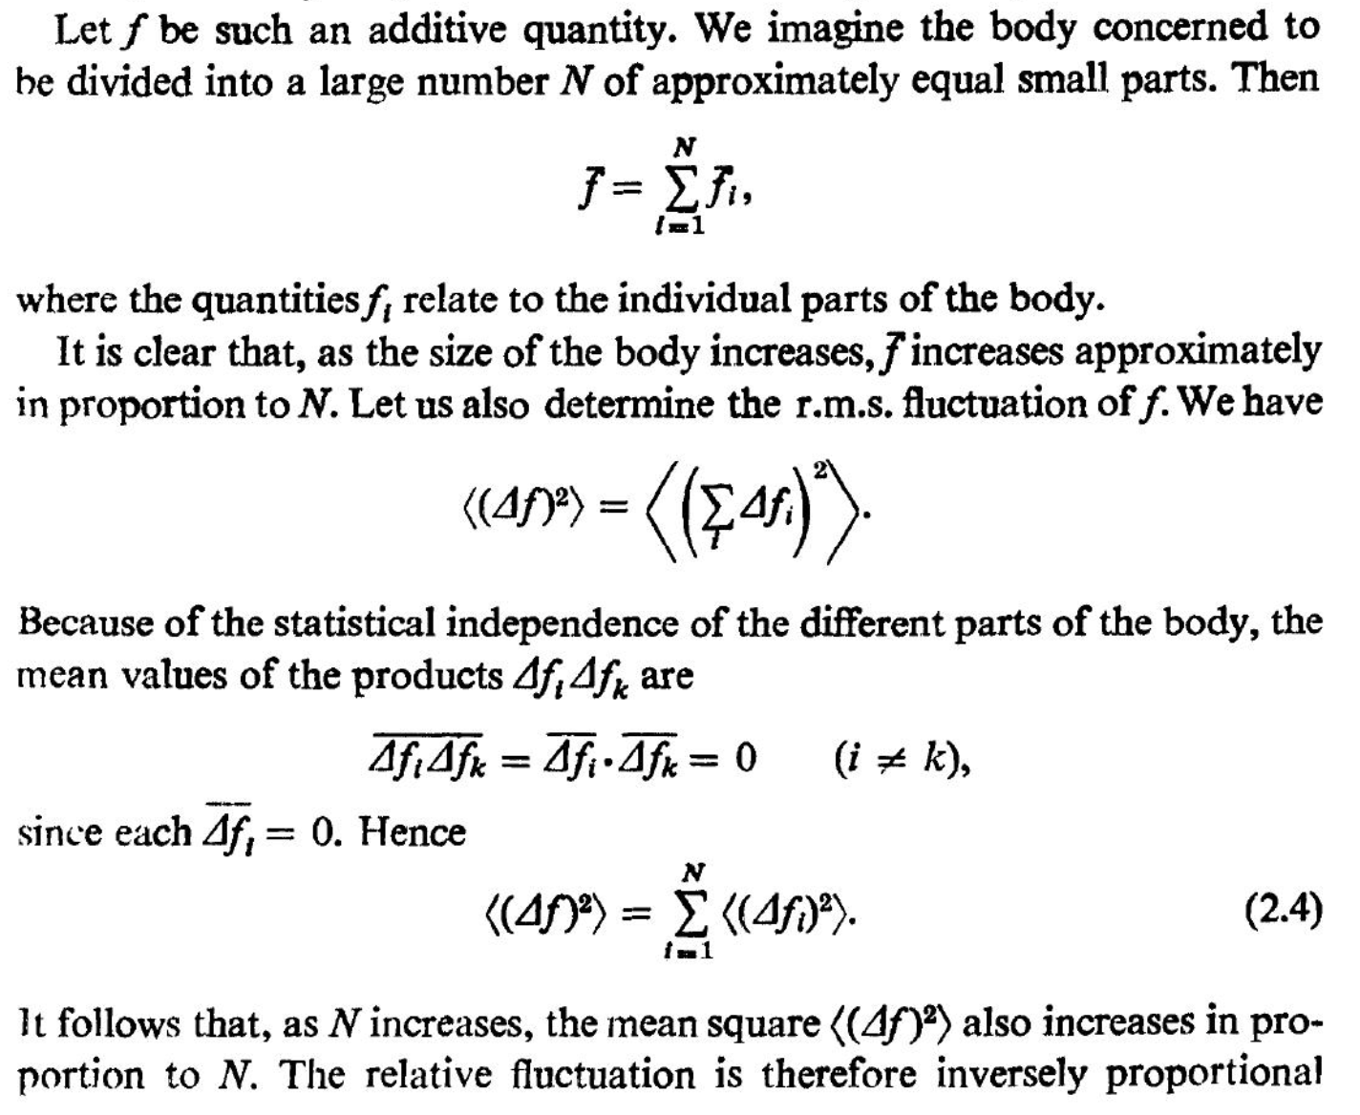
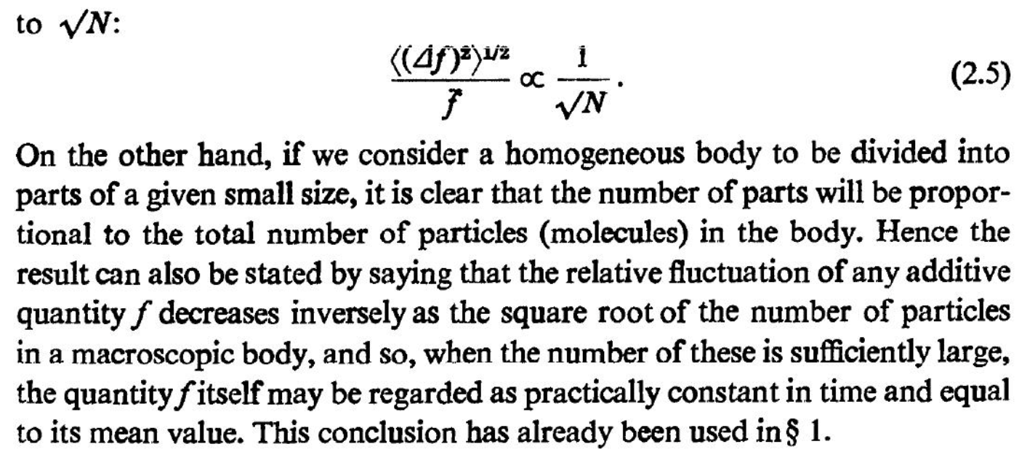
$\sqrt{N}$ -rule

Slide 33

$\sqrt{N}$ -rule

Slide 34
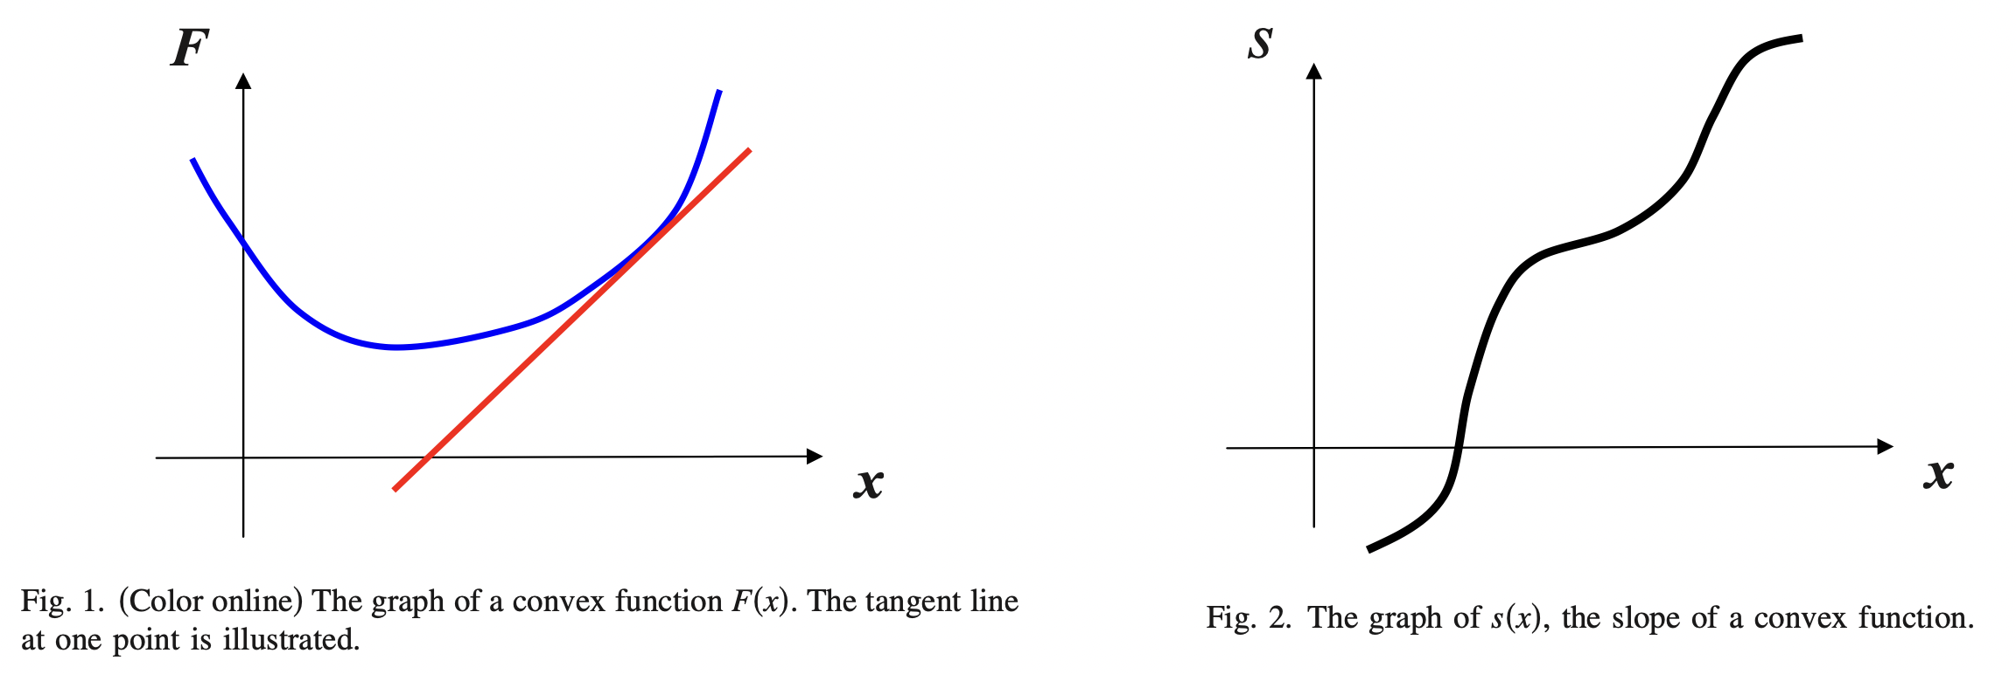



The Legendre Transform as an alternative way to display information
$$s\left(x\right)=F′(x)$$

Slide 35
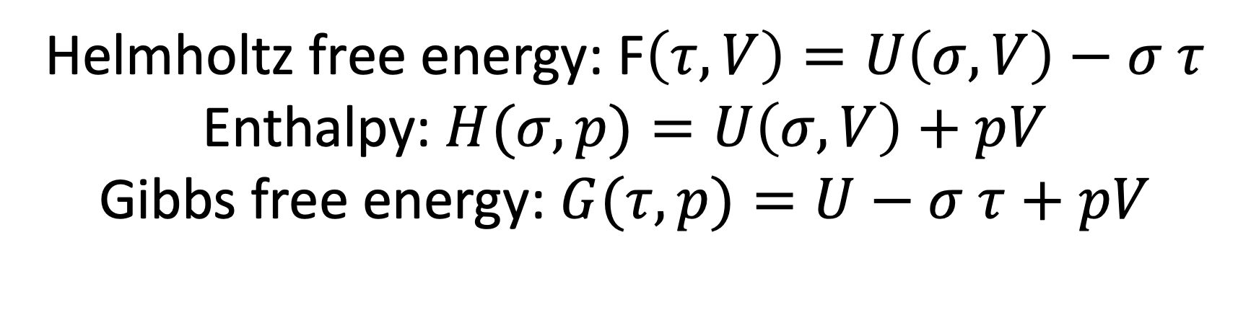
The Legendre Transform as an alternative way to display information
Helmholtz free energy: F$\left(τ,V\right)=U\left(σ,V\right)−σ τ$
Enthalpy: $H(σ,p)=U\left(σ,V\right)+pV$
Gibbs free energy: $G(τ,p)=U−σ τ+pV$

Slide 36
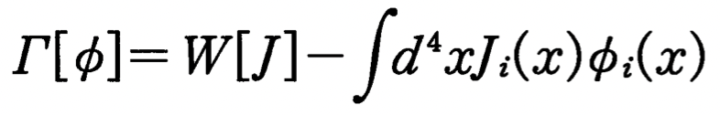
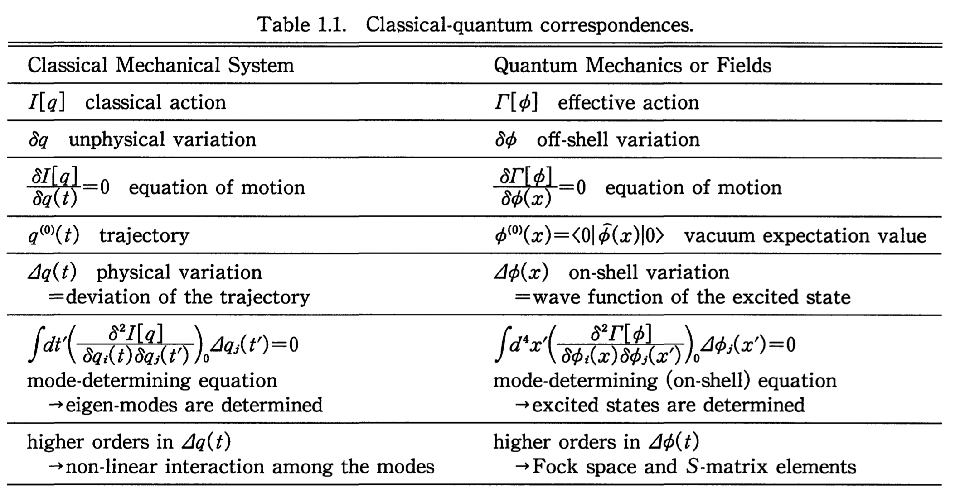
The Legendre Transform as an alternative way to display information

Slide 37
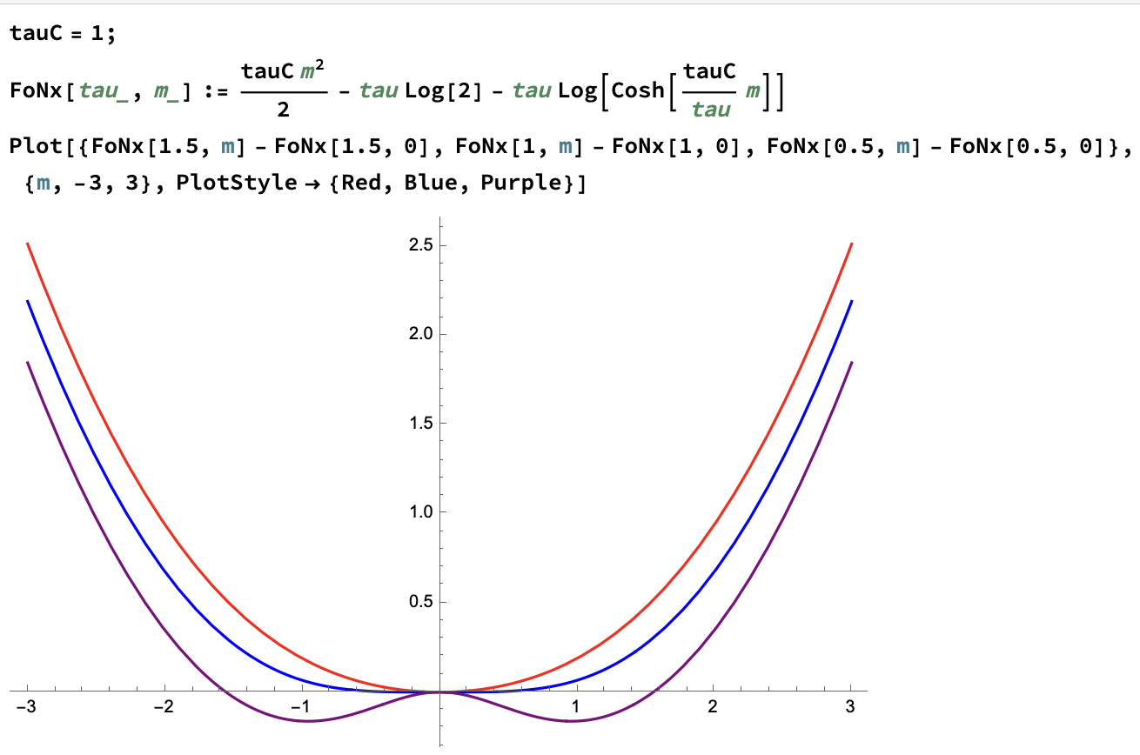
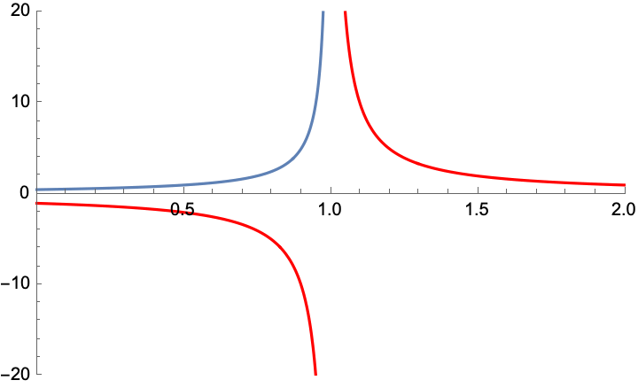
Phase transition
Thermal Potential
Susceptibility

Slide 38
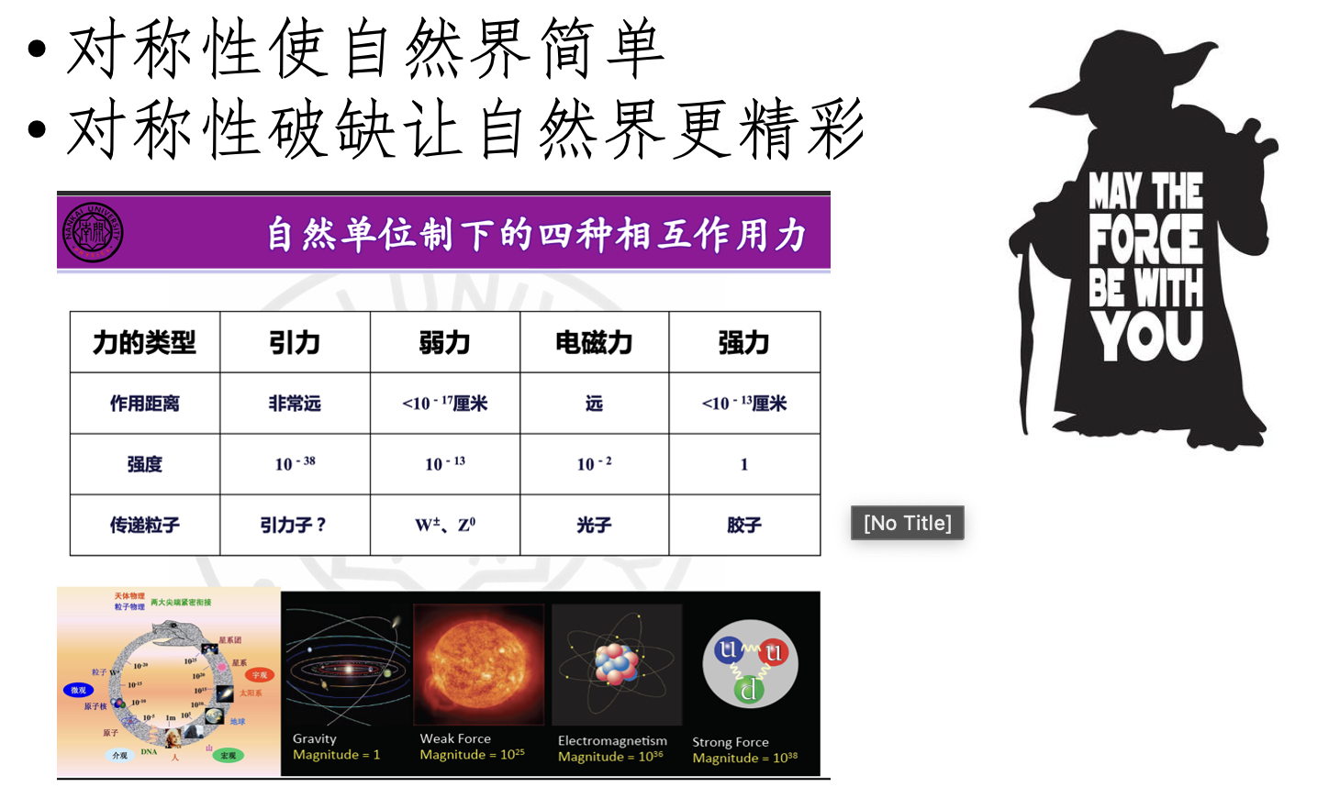
Nature is organized by
Symmetry
scale

Slide 39
热物（第十七周）
复习
感悟
学生报告
2023.06.05

