Slide 1
DATA SCIENCE
Customer Churn
Analysis
Predicting, Understanding & Reducing Customer Churn
Using the Telco Dataset
Telco Customer Churn • 7,043 customers • XGBoost + SHAP • PR-AUC 0.25 • 4.19x Lift
Notes:
Welcome. Today I'll walk you through a complete churn analysis — from raw data to a deployed model and actionable segments. The goal is to give you a decision-ready view of who is about to leave and what we can do about it.

Slide 2
Agenda
Business Problem
Data & EDA
01
02
Why churn costs 5× more than retention
7,043 customers, key risk drivers
Model Results
SHAP Interpretation
03
04
XGBoost vs baseline — PR-AUC, lift, recall
What actually drives churn decisions
3 Actionable Segments
Recommendations
05
06
Who to target and why
Estimated $42K/yr revenue impact
Notes:
Six sections, roughly 3 minutes each.

Slide 3
The Business Problem
5×
26.5%
$74
MORE EXPENSIVE
CHURN RATE
AVG MONTHLY ARPU
to acquire a new customer
than to keep one
of our 7,043 customers
have already left
per customer — every
churn point costs revenue
Objective: Build a model that identifies who is likely to leave, explain why, and quantify the revenue we can save.
Notes:
Acquiring a new customer costs 5× more than retaining one — this is industry consensus. At 26.5% churn we're leaking serious revenue. The goal of this project is to turn that from a lagging metric into a leading one.

Slide 4
Dataset & Pipeline
7,043
customers
1
ETL
CSV → clean → feature store (parquet + DuckDB)
21
raw features
2
EDA
Cohort analysis, segment charts, correlation heatmap
3
Modeling
46
engineered features
Logistic baseline → XGBoost + Optuna (50 trials)
4
Interpretation
26.5%
churn rate
SHAP TreeExplainer — global + per-customer drivers
5
Dashboard
Streamlit app with What-If simulator
Notes:
The IBM Telco Churn dataset gives us 7,043 customers with 21 features. We engineered 25 more — including avg monthly charges, charges per active service, a high-value flag, and tenure buckets. The full pipeline runs reproducibly via make all.

Slide 5
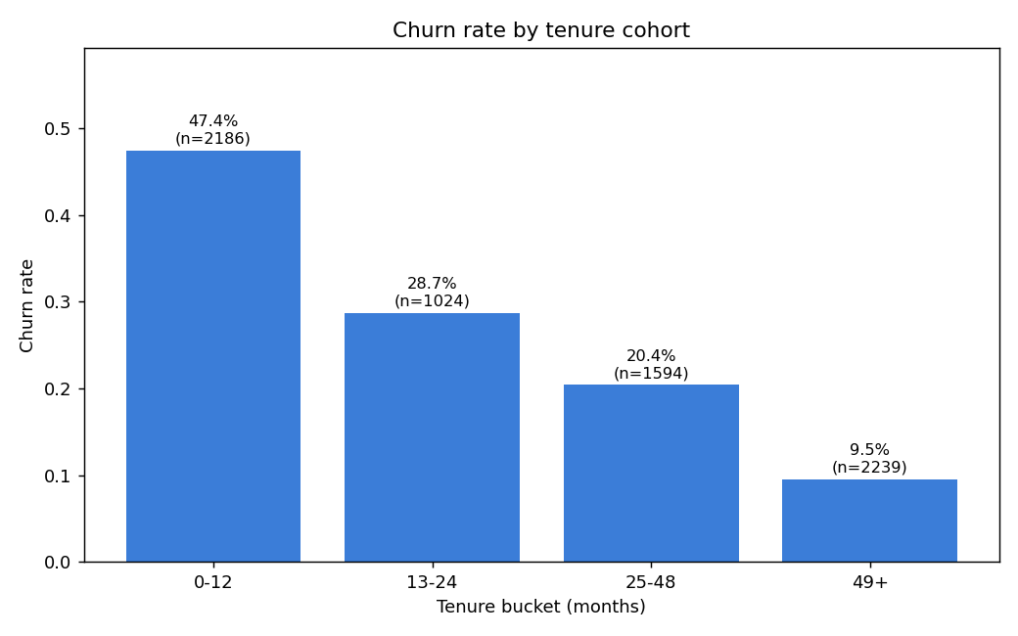
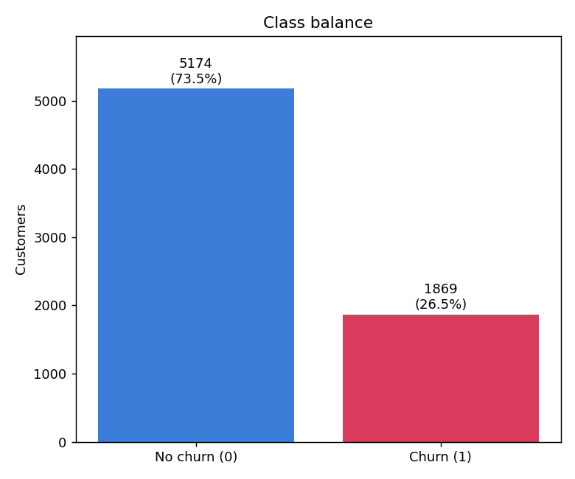
EDA: What the Data Tells Us
Churn Rate by Tenure Cohort
Class Imbalance (73.5% retained / 26.5% churned)
Key insight: Early-tenure customers (0–12 months) churn at >3× the rate of long-tenure customers — and they represent the single largest growth cohort.
Notes:
The left chart is the critical finding: churn collapses dramatically as customers age. The first 12 months are make-or-break. The class imbalance (right) guided our modeling choices — we used scale_pos_weight in XGBoost to handle the 3:1 ratio.

Slide 6
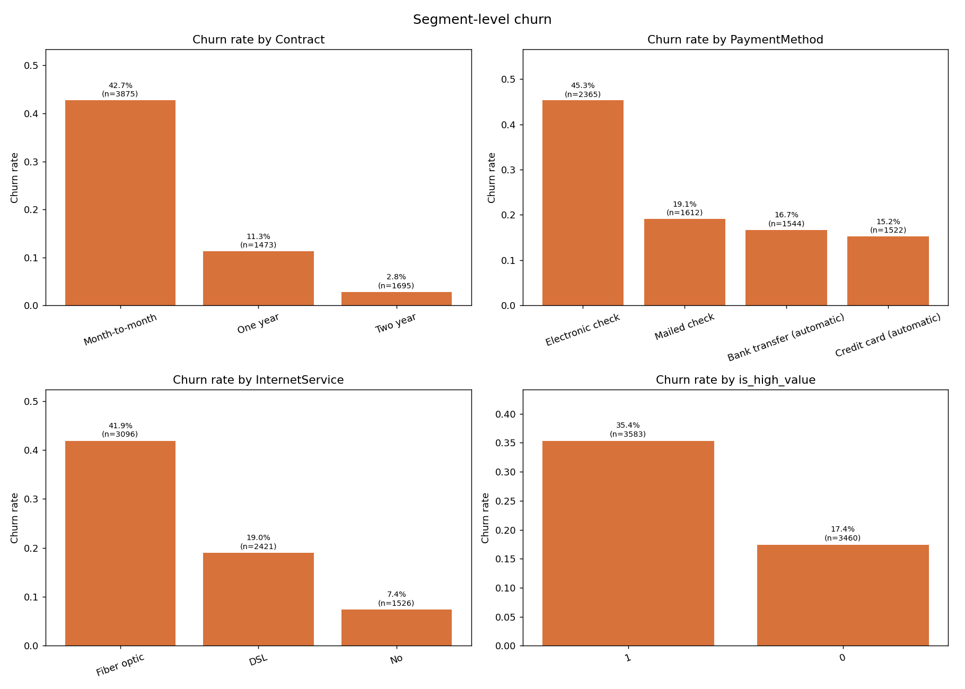
High-Risk Customer Profile
Classic high-risk combo:
A
Month-to-month contract
43% churn vs 11% avg
B
Electronic check payment
45% churn vs 16% avg
C
Fiber optic internet
42% churn vs 19% avg
D
Tenure < 12 months
50% churn vs 26% avg
Notes:
The worst-case customer profile: month-to-month, pays by electronic check, has fiber optic internet, and is new. We see churn rates of 40–50% in this group versus 26% overall.

Slide 7
Model Performance
0.25
0.80
41.9%
4.19×
PR-AUC
ROC-AUC
Recall @ Top 10%
Lift @ Top 10%
XGBoost (tuned)
Strong discrimination
of all churners caught
vs. random targeting
Metric | Baseline (LR) | XGBoost Tuned
PR-AUC | 0.2316 | 0.2503 ▲
ROC-AUC | 0.8148 | 0.8043
Recall @ Top 10% | 0.3763 | 0.4194 ▲
Lift @ Top 10% | 3.76× | 4.19× ▲
Best F1 | 0.3254 | 0.3470 ▲
Notes:
XGBoost outperforms logistic regression on every precision-recall metric. The key business number is the 4.19× lift — contacting the top 10% of customers by predicted risk captures 42% of all who would have churned.

Slide 8
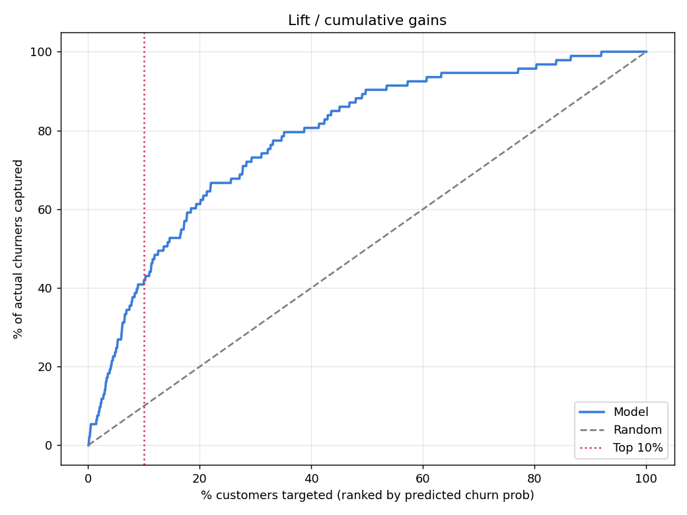
Cumulative Lift — Targeting Efficiency
Top 10%
Contact only 141 customers and catch 41.9% of all churners — vs. 10% at random.
4.19×
Lift factor — every dollar of outreach goes 4× further than random selection.
~$142
Revenue protected per customer reached (at 30% save rate × $74 ARPU × 12 mo).
Notes:
The lift chart shows cumulative gains. The red dotted line is top-10% — we capture 42% of actual churners there. The model curve bows well above the random diagonal, confirming real predictive power.

Slide 9
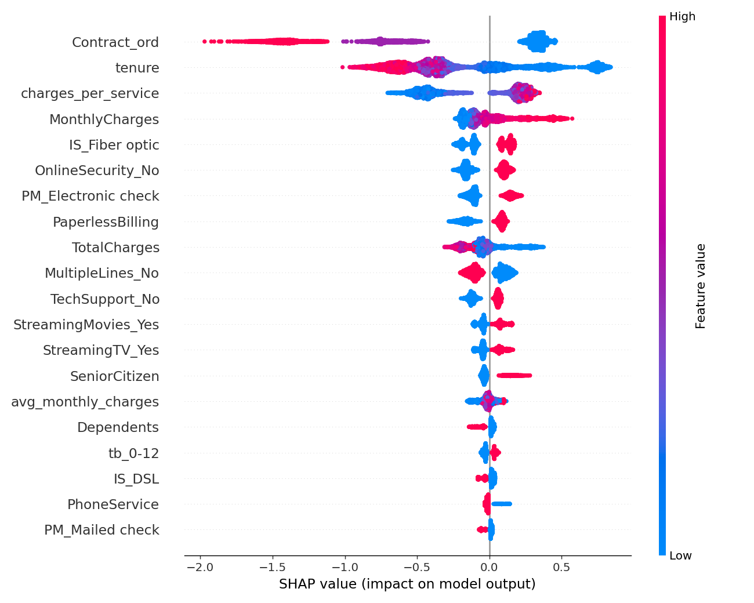
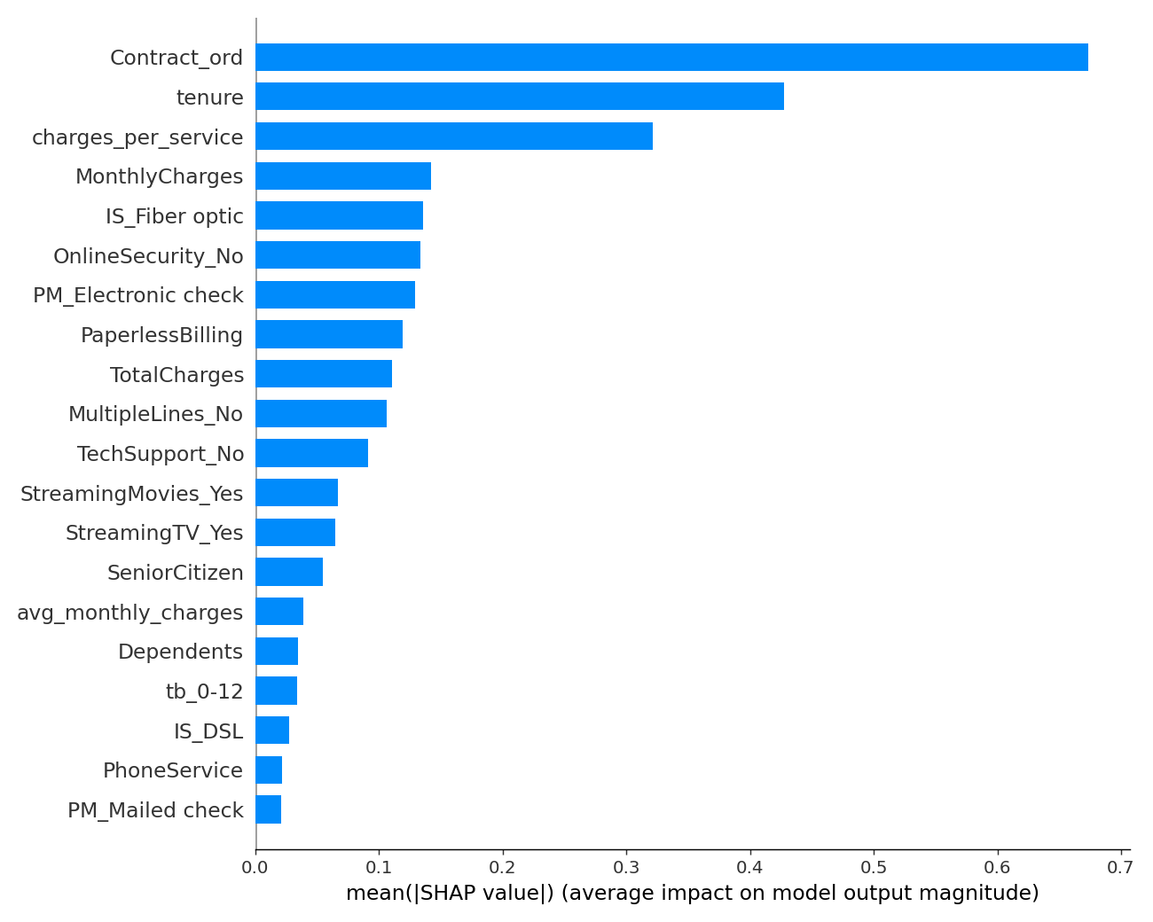
What Drives Churn — SHAP Analysis
SHAP Beeswarm — each dot is a customer
Mean |SHAP| — global importance
Contract type is the #1 driver — month-to-month customers have very high SHAP values | Tenure is #2 — recent joiners show consistently positive (churn) SHAP scores | Charges per service is #3 — high charges relative to services used predict churn
Notes:
SHAP gives us model-agnostic feature attribution. Red dots = pushes toward churn, blue = away. Contract type dominates — a customer on a month-to-month plan is far more likely to churn than anything else we measure.

Slide 10
3 Actionable Segments
Top features by mean |SHAP| — each split at median, churn rates compared
Contract Type
42.7% vs 6.8%
Month-to-month customers churn at 42.7% — nearly 9× the rate of those on annual contracts (6.8%). This is the single most actionable lever.
01
6.32×
3,875 customers
churn rate high vs low group
Offer discounted annual plans to month-to-month customers
more likely
to churn
Tenure < 29 months
39.5% vs 13.2%
New and mid-tenure customers churn at 39.5% vs 13.2% for long-tenure. The first 2 years are the critical retention window.
02
2.98×
3,569 customers
churn rate high vs low group
Onboarding program + check-in at 3, 6, 12 months
more likely
to churn
Charges per Service
43.4% vs 9.7%
Customers paying more per active service (above $13.97/service) churn at 43.4%. They perceive low value for the price.
03
4.45×
3,520 customers
churn rate high vs low group
Bundle services or offer add-ons to improve value perception
more likely
to churn
Notes:
These three segments are derived directly from SHAP values — they're not just correlations, they're model-confirmed drivers. Together they cover roughly 50% of our customer base. The good news: all three have concrete, low-cost interventions.

Slide 11
Recommendations
01
Weekly Top-10% Risk List
Low
02
Annual Contract Conversion
Low
Score all customers weekly. Contact the top 141 highest-risk customers — this targets 42% of upcoming churners with minimal outreach cost.
Offer month-to-month customers a discounted annual plan. Even a 10% conversion rate saves significant MRR at the highest-risk cohort.
03
New Customer Onboarding
Medium
04
Service Bundling
Medium
Structured check-ins at 3, 6, and 12 months for new customers. Target tenure <12 mo — the 50% churn cohort. Early intervention is 3× cheaper than win-back.
Customers with high charges-per-service feel poor value. Offer bundles (e.g., security + backup + support) to spread cost perception across more services.
Notes:
Four recommendations in order of effort. The risk list and contract conversion require no product changes — just process and a promotion budget. Onboarding is a CX investment. Bundling is a pricing/packaging conversation with product.

Slide 12
Estimated Revenue Impact
$42,818
estimated annual revenue retained
Model assumptions:
1. Top-10% targeting captures 41.9% of churners per scoring run
2. 30% save-rate from targeted outreach (industry benchmark — replace with A/B test result)
3. Average ARPU of saved customers = $74.44/month × 12 months
! Caveats: SHAP = correlation, not causation. Validate save-rate with a randomized holdout. Re-validate model on rolling-window holdouts before production deployment.
Notes:
The $42K figure is conservative — it uses a 30% save rate which is a widely cited industry baseline. If your actual outreach converts at 40–50%, the number scales linearly. The real lever is measuring the holdout group from day one.

Slide 13
Thank You
Questions & Discussion
Model: XGBoost • PR-AUC 0.25 • 4.19× lift • 41.9% recall@top-10%
Top drivers: Contract type, Tenure, Charges per service
Estimated impact: ~$42,818/yr at 30% save rate
Next step: Deploy weekly risk list + A/B test retention outreach
Data Science Team • Customer Churn Analysis • Telco Dataset • June 2026
Notes:
Wrap up with the four key numbers and the single clearest next step: get the weekly risk list running and set up a holdout group to measure actual save rate. That measurement is what turns this from a model into a business program.

