Slide 1
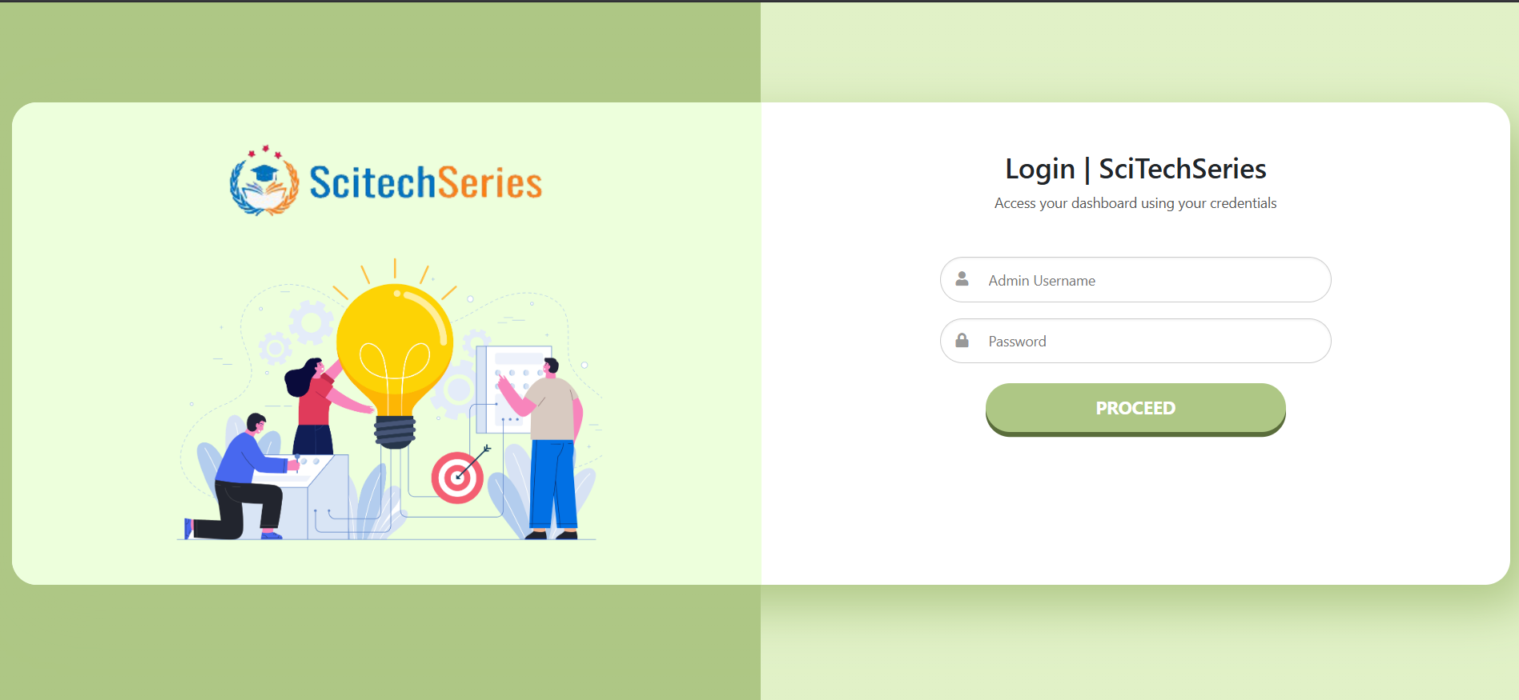
Login Page
Secure access for users to log in and manage journal data.

Slide 2
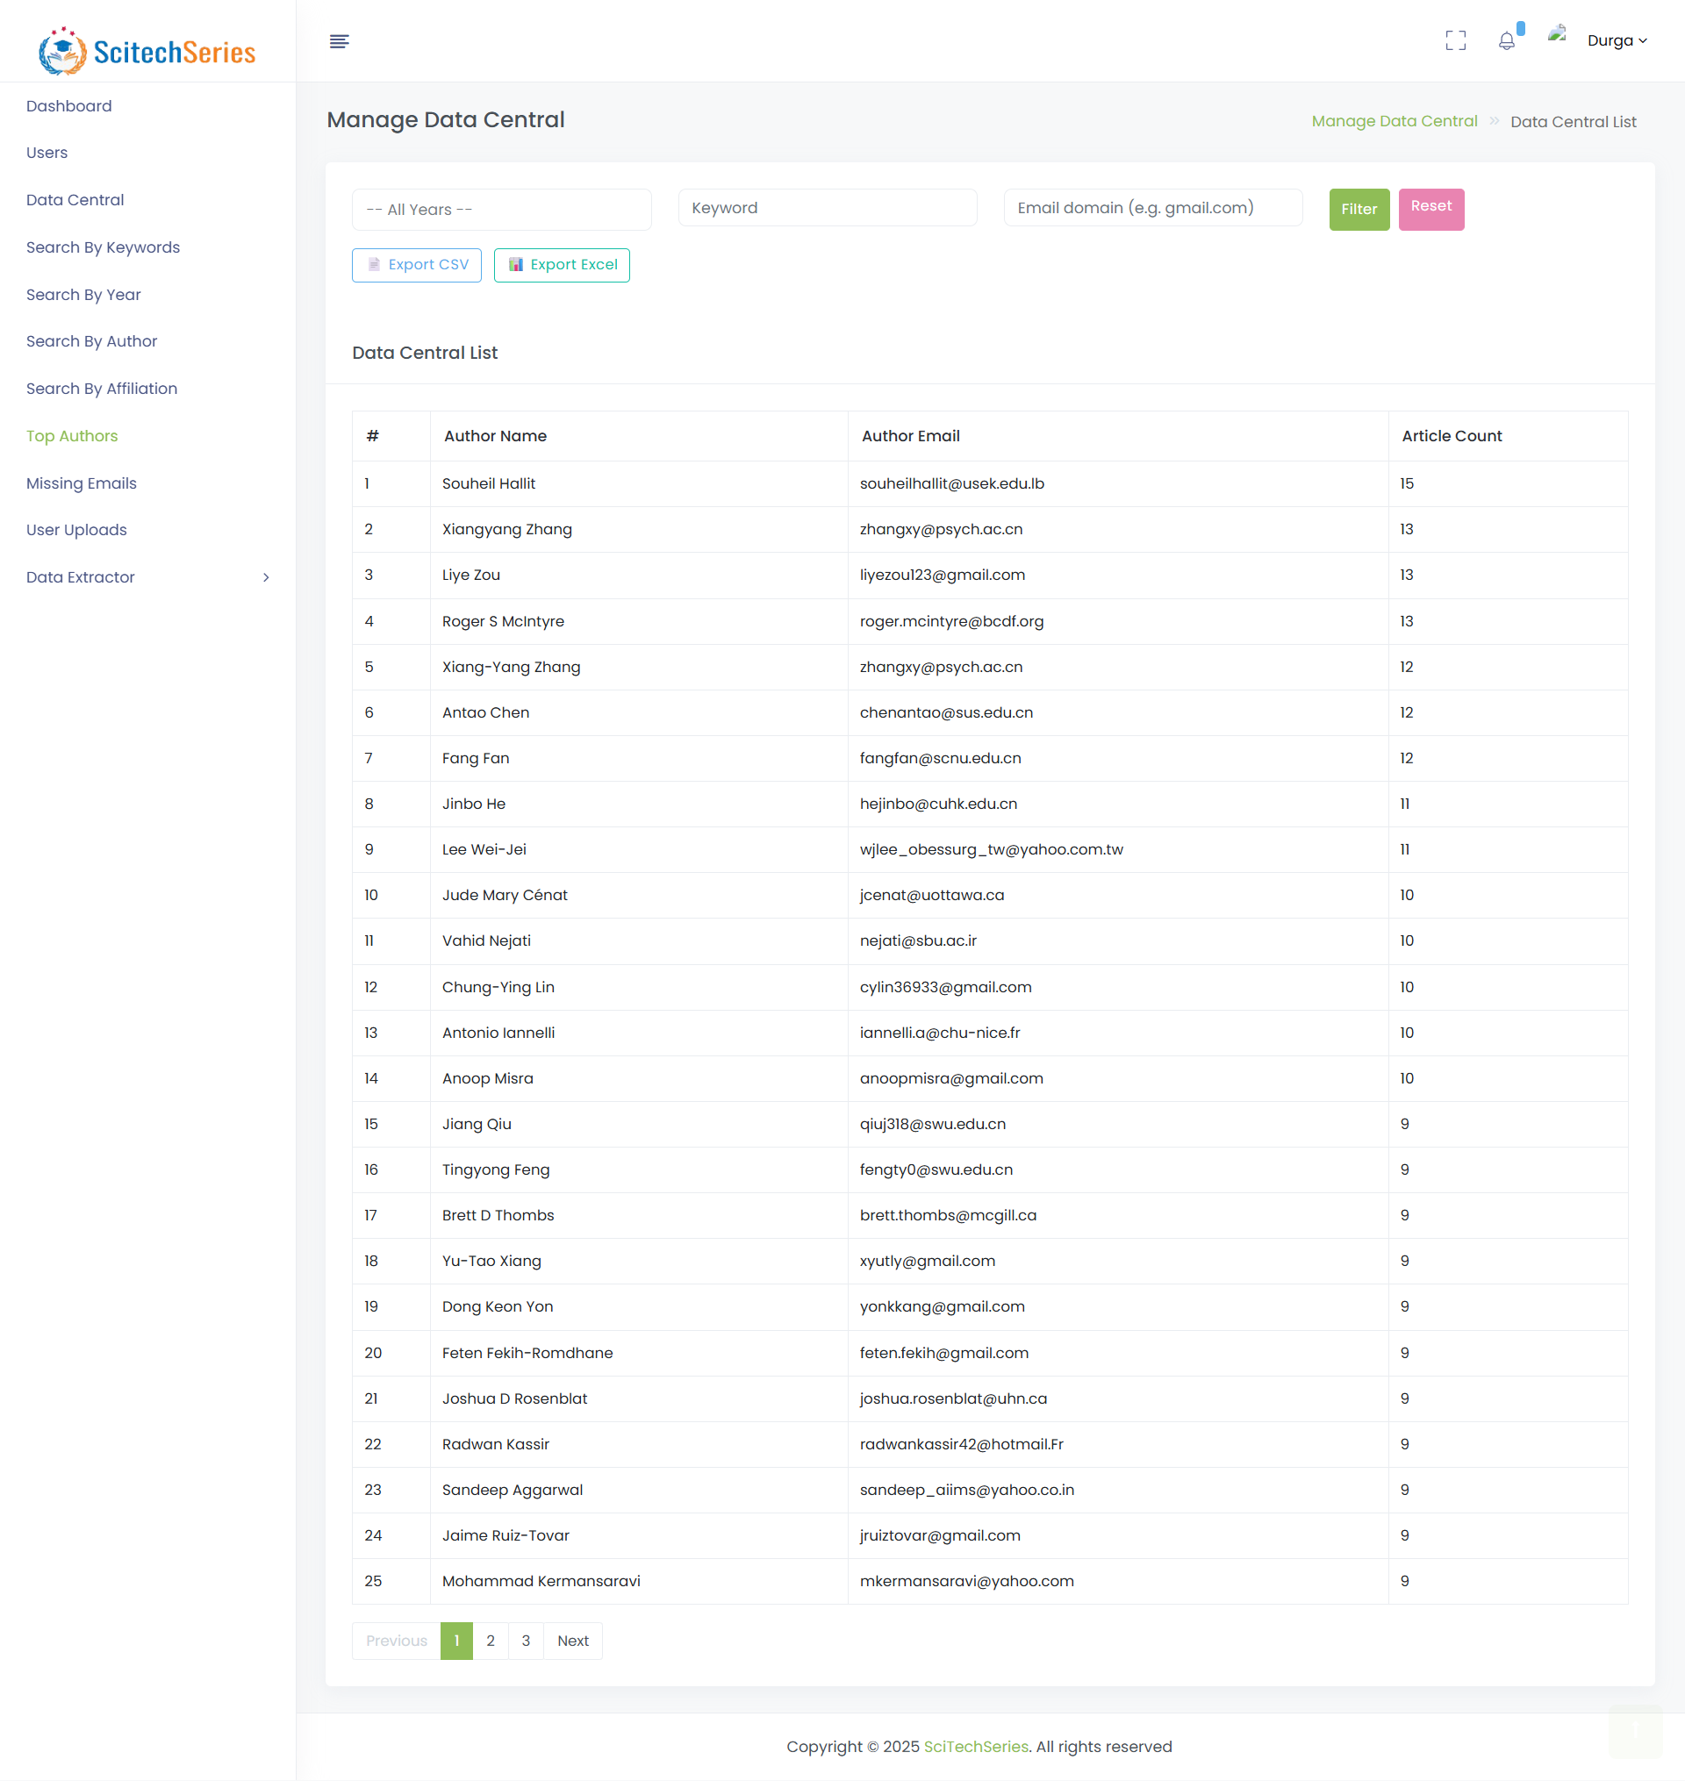
Dashboard
Visual overview of journal metrics and activity.

Slide 3
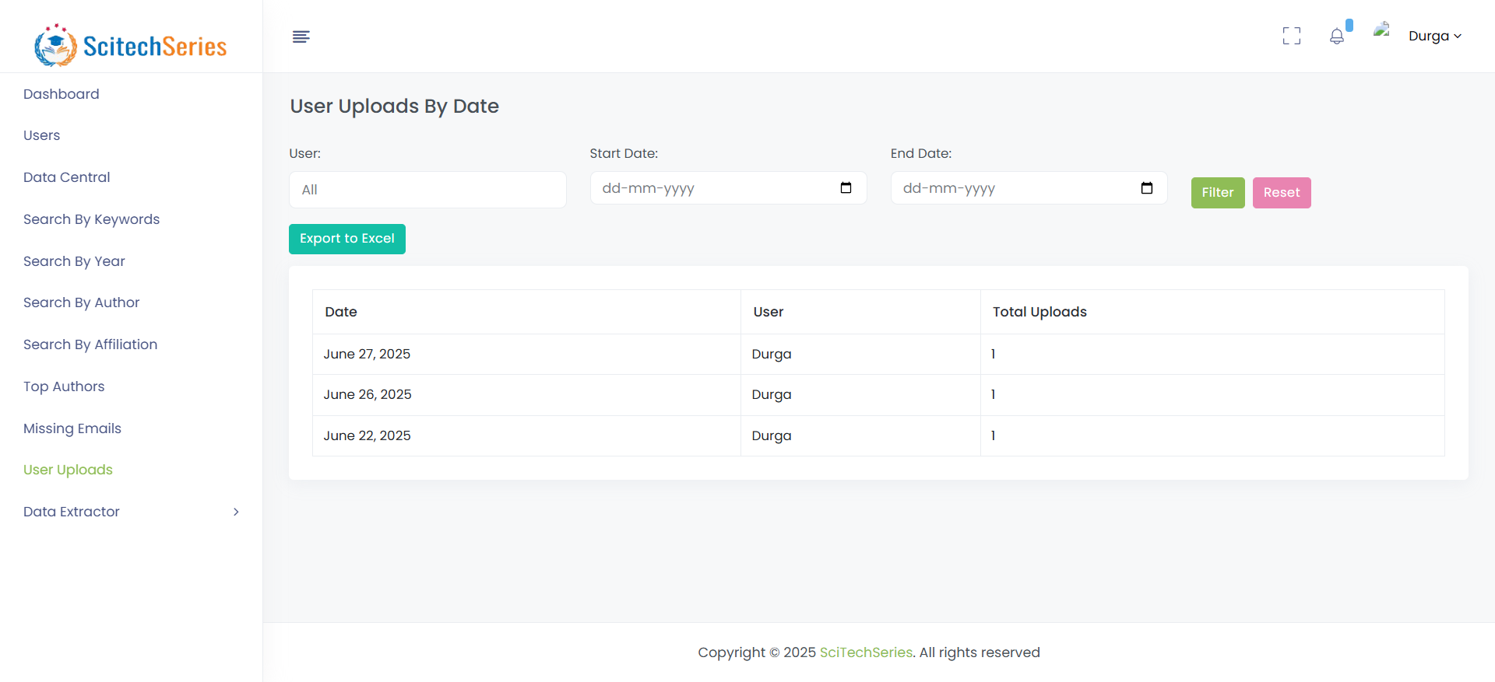
Users List
Displays all registered users with roles and statuses.

Slide 4
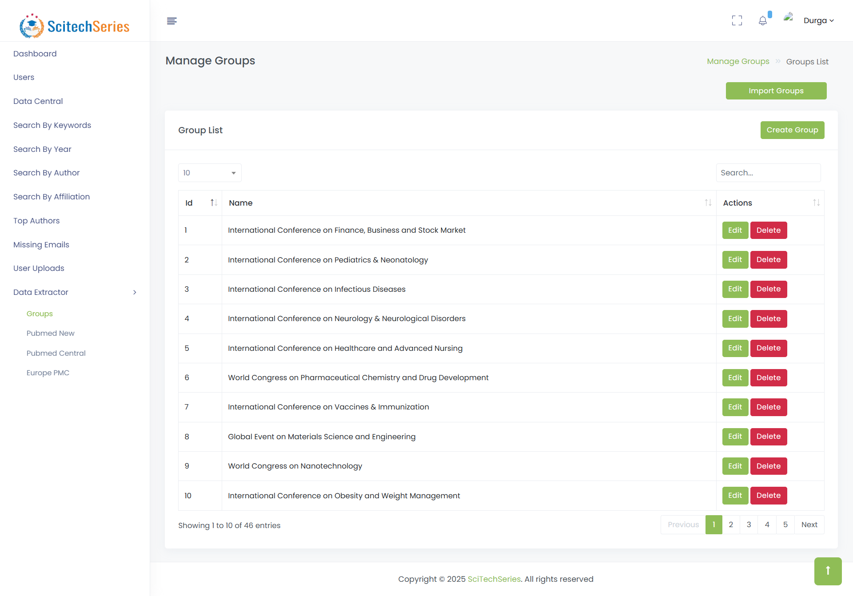
Create User
Form to add a new user with specific role and permissions.

Slide 5
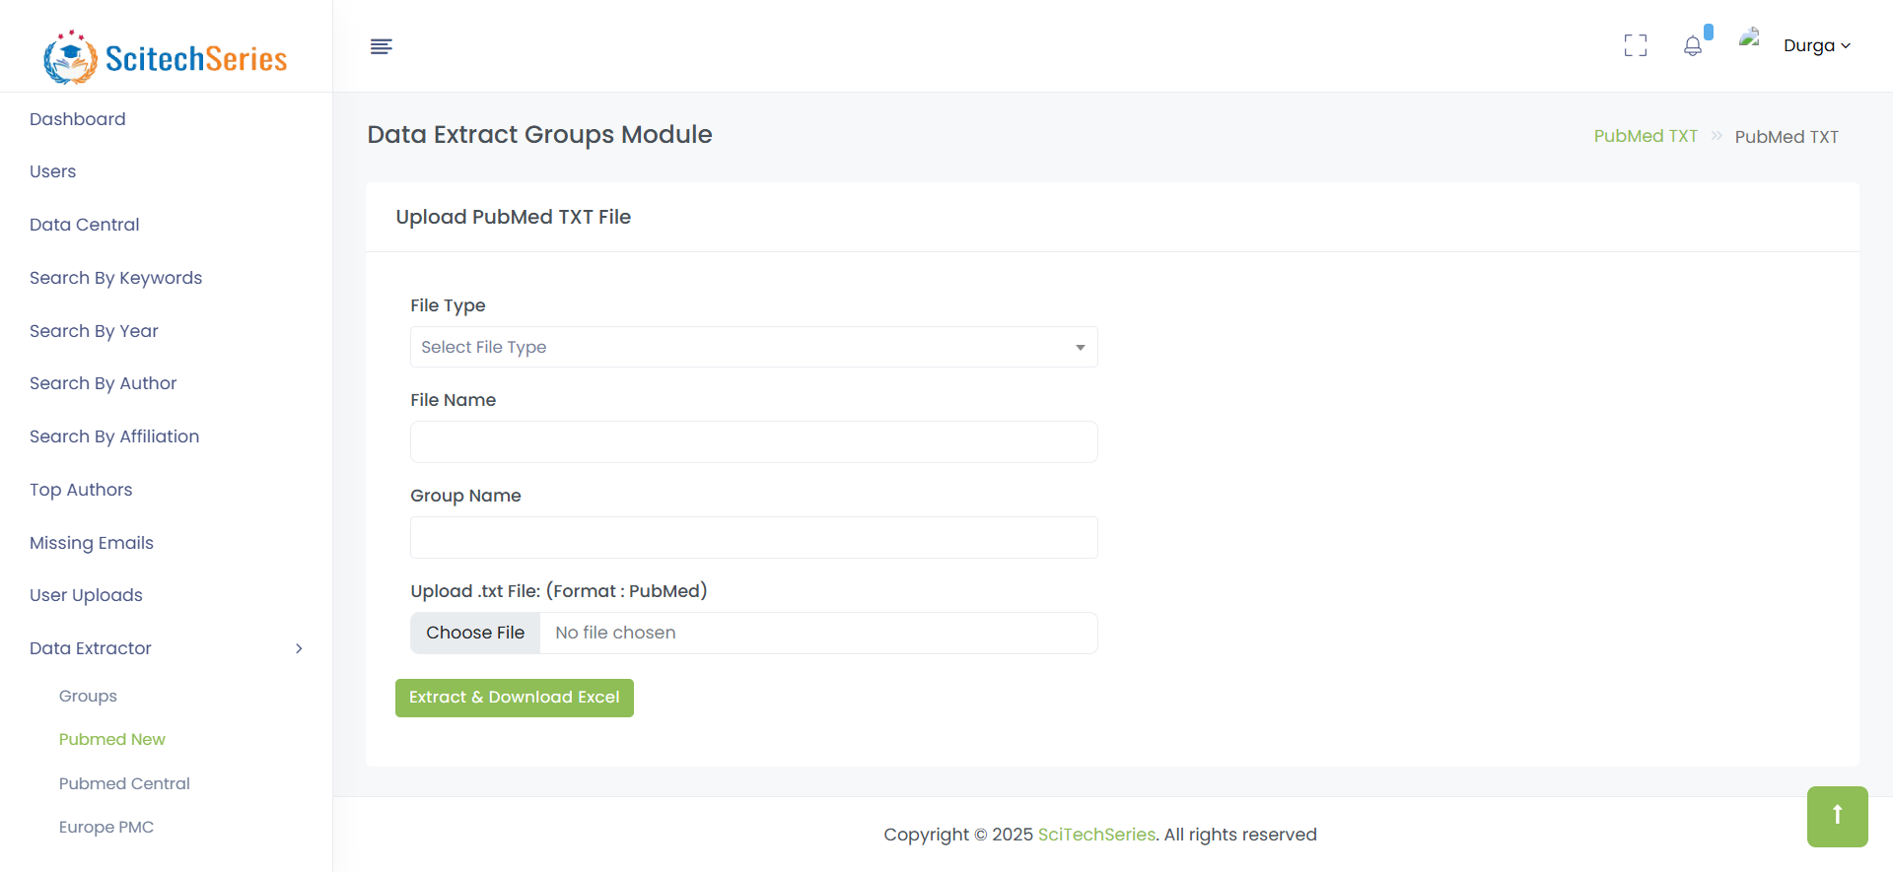
Data Central
Main hub to navigate different data extraction tools.

Slide 6
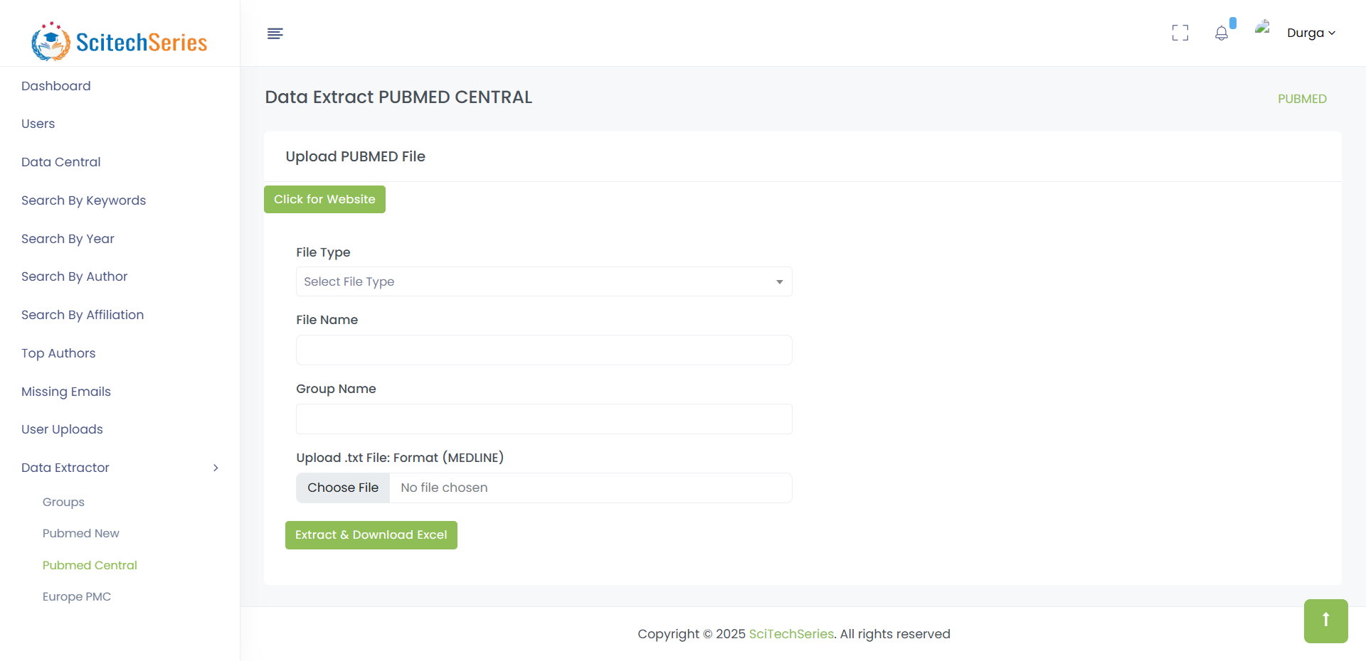
Search by Keywords
Filter authors/articles using specific keywords.

Slide 7
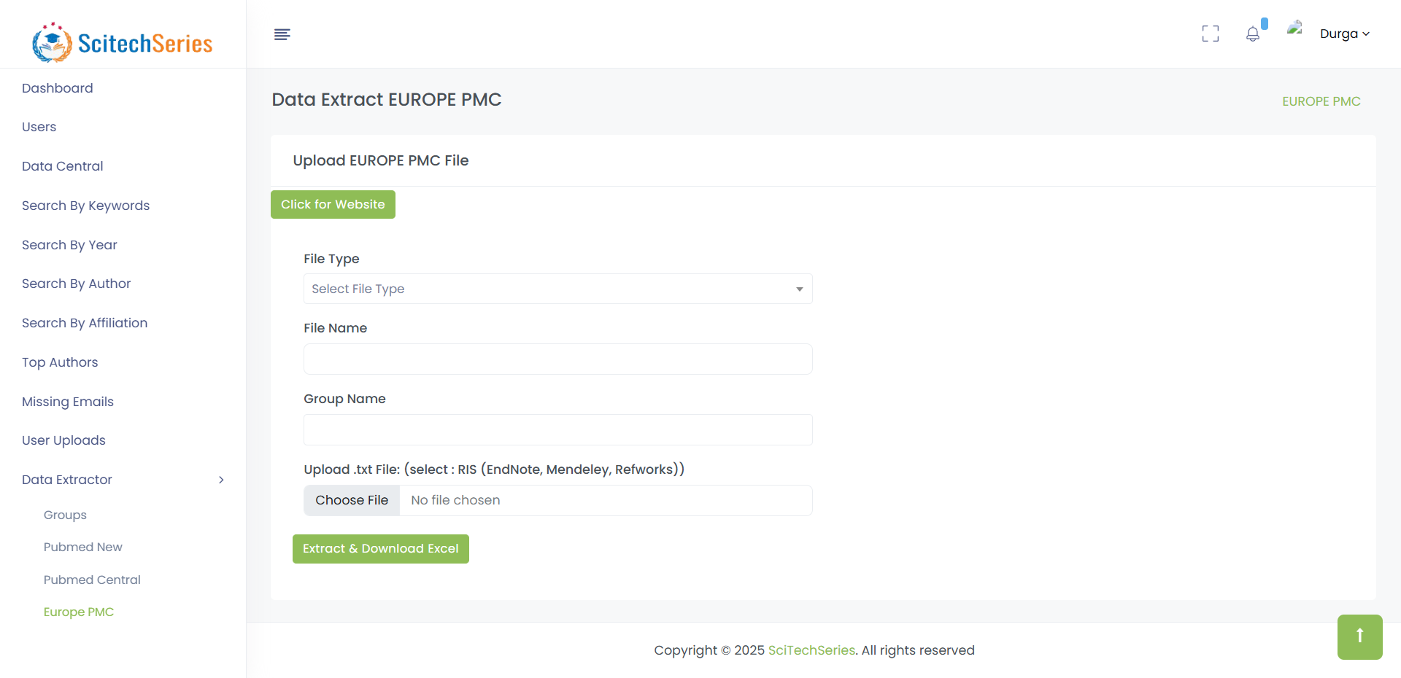
Search by Year
Retrieve articles by filtering a particular publication year.

Slide 8
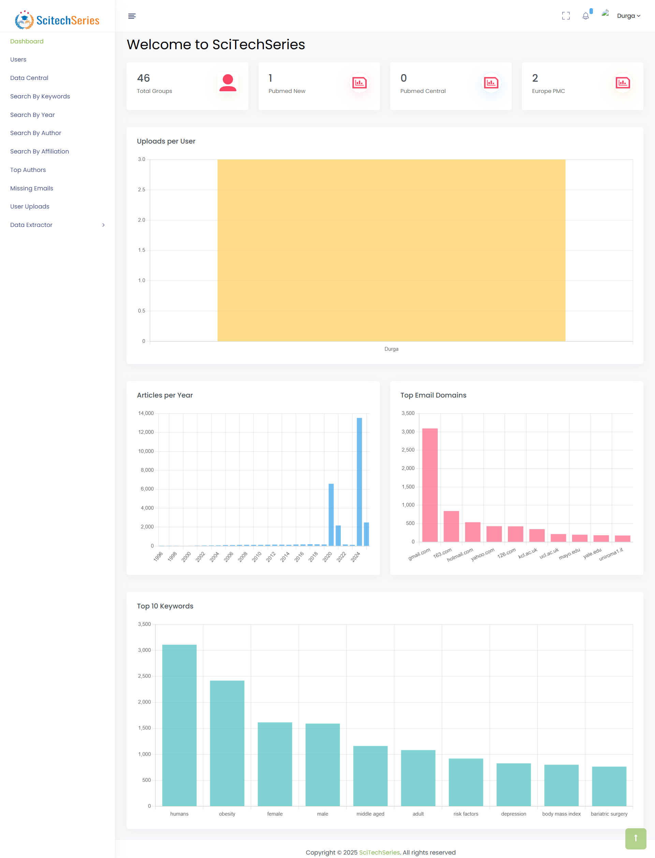
Search by Author
Look up author-specific records and related data.

Slide 9
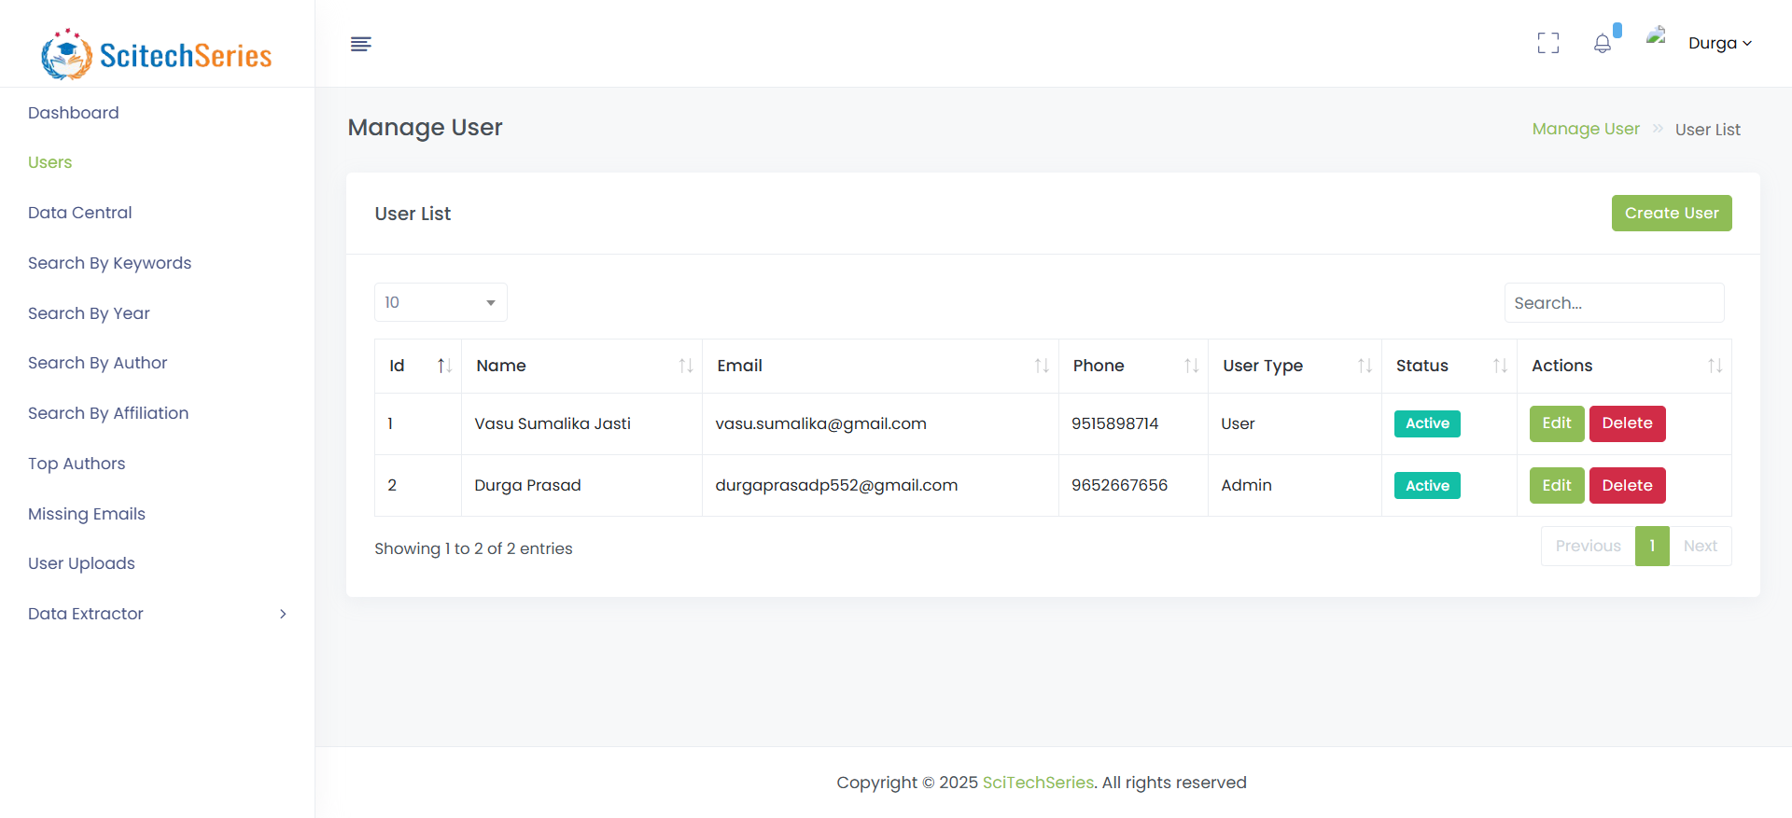
Search by Affiliation
Identify researchers based on institutional affiliation.

Slide 10
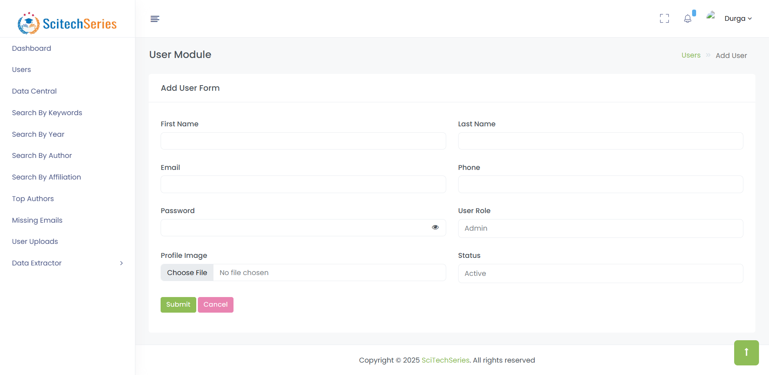
Top Authors
Report highlighting most frequent contributing authors.

Slide 11
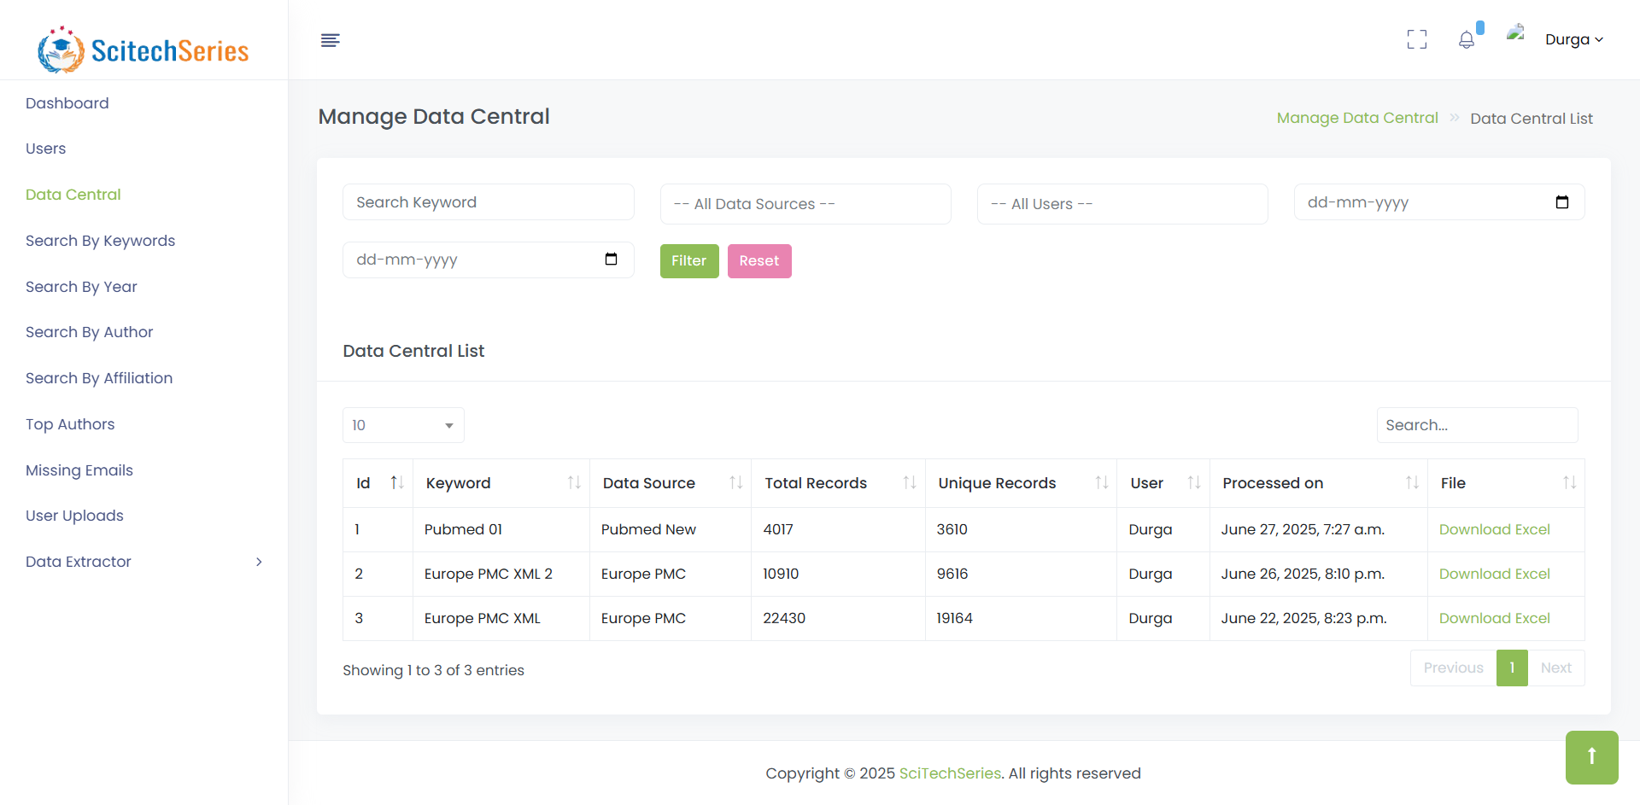
User Uploads
Displays uploads grouped by each user.

Slide 12
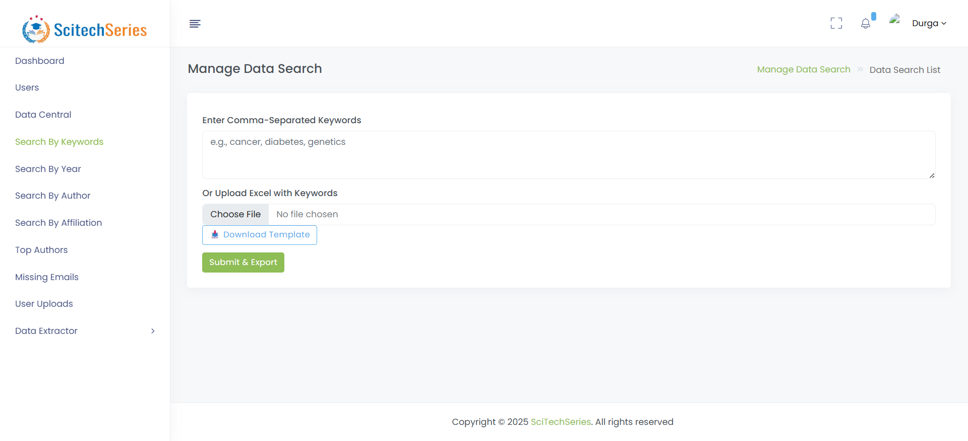
Data Extractor: Groups
Extract data by journal groups with filtering options.

Slide 13
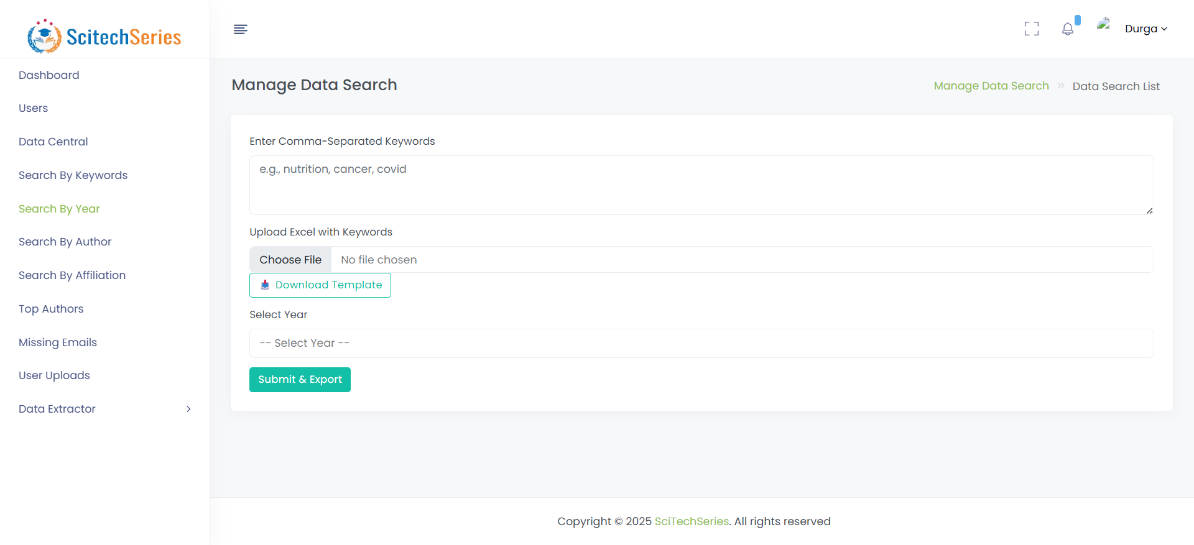
Data Extractor: PubMed
Interface for extracting articles from PubMed.

Slide 14
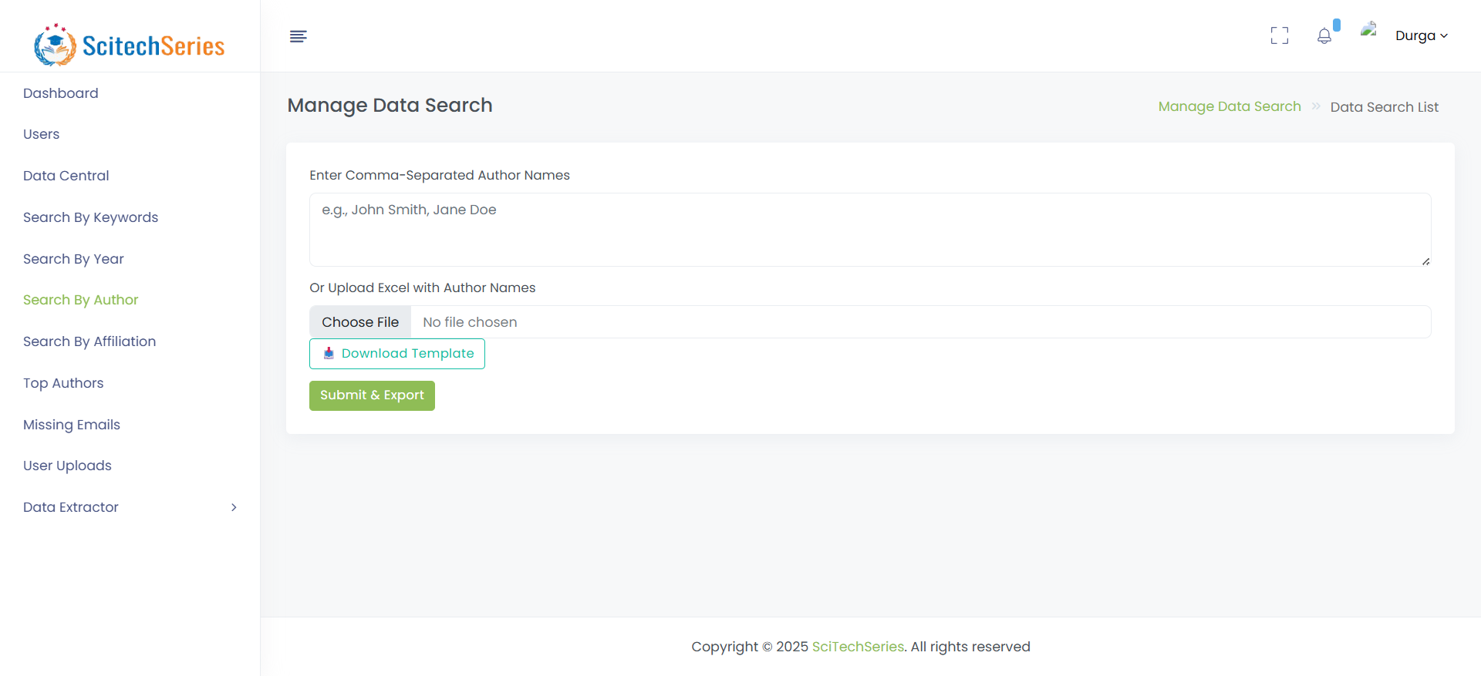
Data Extractor: PubMed Central
Access and parse XML data from PubMed Central.

Slide 15
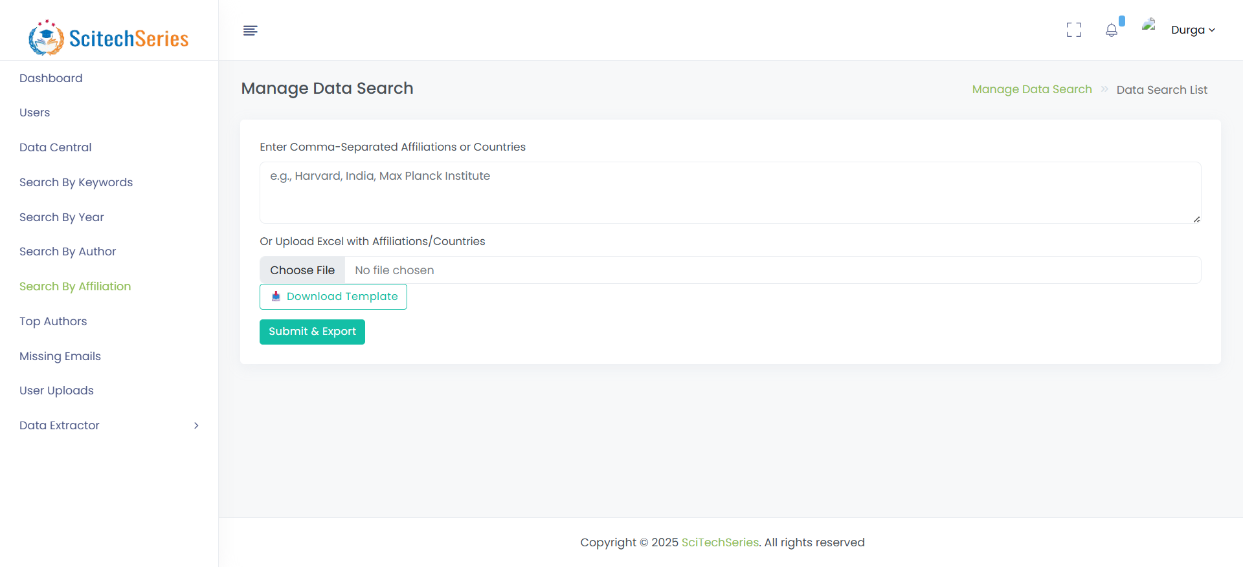
Data Extractor: Europe PMC
Download and process research from Europe PMC.

