Slide 2
ABSTRACT In the modern era, storage and transfer of data has become increasingly important. Data encryption is vastly used to ensure security everywhere. Security is an essential factor in every field such as Government Organization, Data Centers, E-commerce, Defense etc. where and so forth wherever internet is being utilized. Different types of data have their own distinct attributes so we need a diverge set of techniques to safeguard data from unapproved access. A system which anchor information on a set-up from an unapproved client is known as Cryptography. To safeguard data it is essential to know that which algorithm provides better security, efficiency and effectiveness. This project introduces analysis of various symmetric and asymmetric key encryption algorithms like RSA, AES, DES, SHA256, MD5 etc. based on different parameters. There is not a single tool available that provides us with the feature of encrypting the data based on different parameters (maximum speed, minimum vulnerabilities and maximum efficiency) so we are trying to make an effort to develop a platform where the user can encrypt the data as per their requirements.

Slide 3
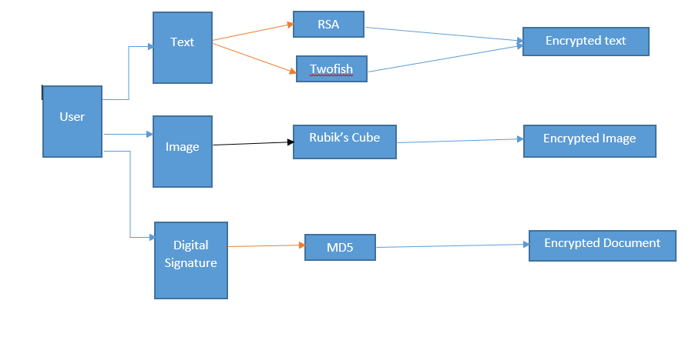
AES CTR block Algorithm
SHA256

Slide 4
Text Based Algorithms:

Slide 5
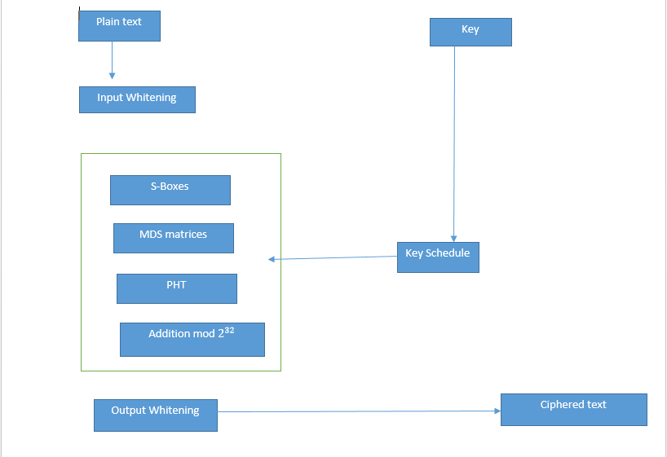
Two fish

Slide 6
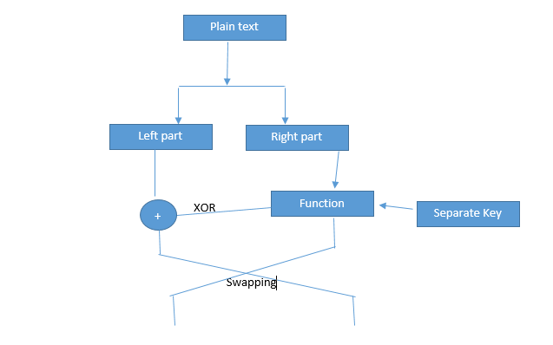
Feistel structure

Slide 7
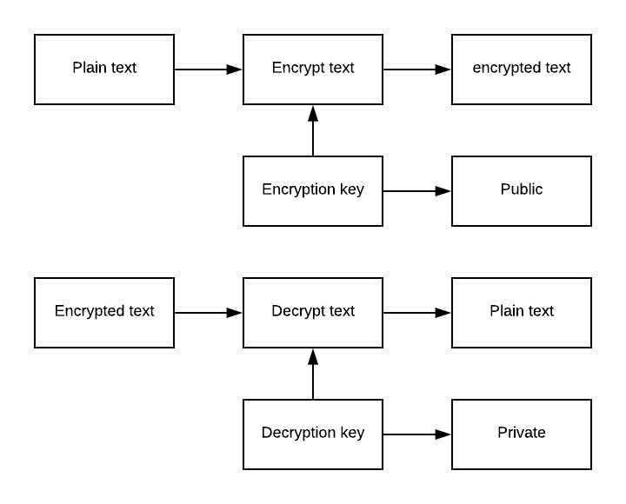
RSA Algorithm:
Encryption and Decryption:

Slide 8
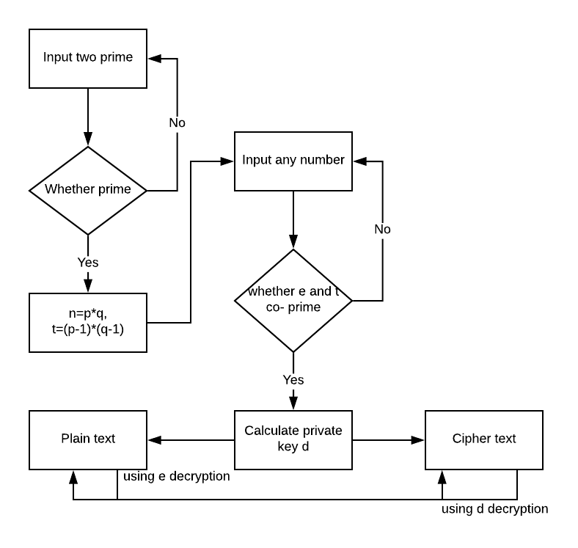
Flow Diagram:

Slide 9
Comparative Analysis of Text Based Algorithms

Slide 10
Digital Signature Based Algorithms:

Slide 11
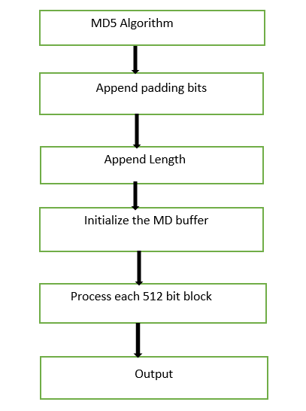
MD5 Algorithm:

Slide 12
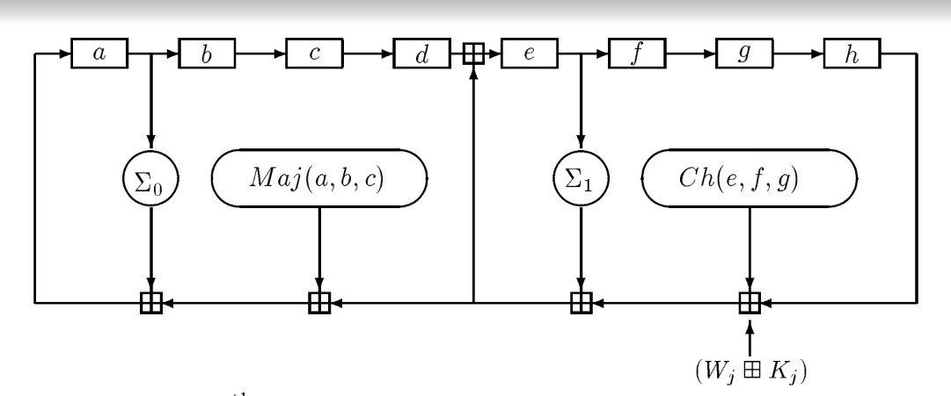
SHA256

Slide 13
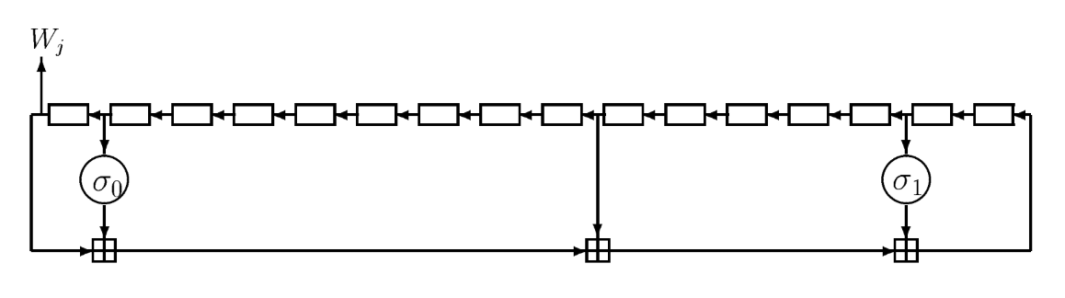

Slide 14
Comparative Analysis Of Digital File Signature :

Slide 16
Image based Encryption Algorithms:

Slide 17
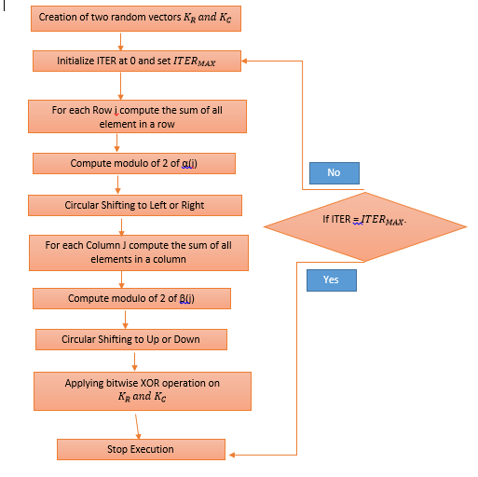
Rubik’s Cube Algorithm
Encryption Algorithm:

Slide 18
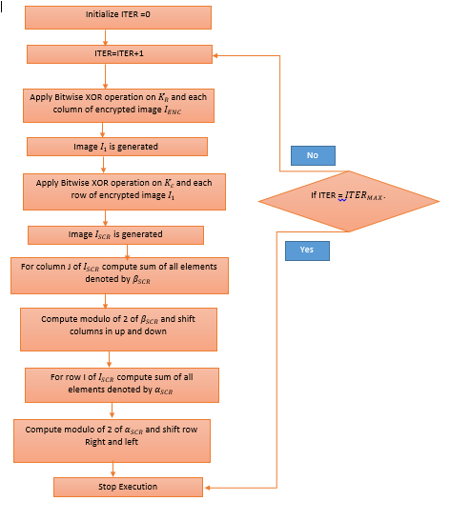
Decryption Algorithm:

Slide 19
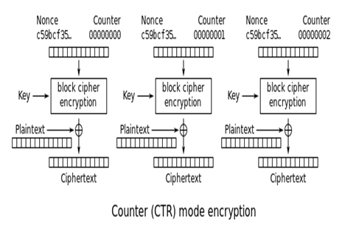
AES CTR Block

Slide 20
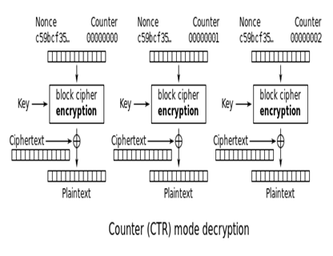

Slide 21
Comparative Analysis Of Image Based Algorithm:

