Slide 2
ULRENA – Simplifying Automation

Slide 3
Problem Statement
In office and work places, people find it difficult to install a service or software’s.
They find it difficult as they have to complete the entire process manually due to which the process becomes hectic and time taking.
All this process also requires lots of things to be configured and many changes to be made manually which is a bigger task.
It also costs a lot for a company for time as well as maintenance and services.

Slide 4
Objective
To create a tool which solves the problem for the IT companies to complete the tasks as per requirements and install the service and software’s.
With our project a user can completely deploy any service across ‘n’ number of computers with different configuration at once with a single cli-command or web-based working.
Our project aims to solve these problems. It’s a utility tool for automated deployment of infrastructure software services.
Ulrena can help work by its own and complete the task of automation without the use of any manpower.

Slide 5
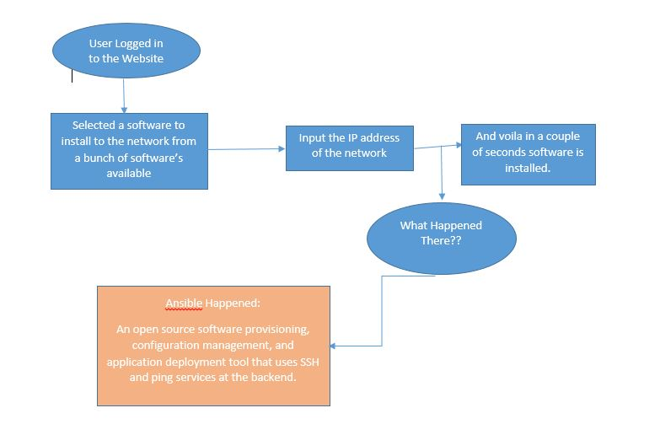
Flow Chart - Working

Slide 6
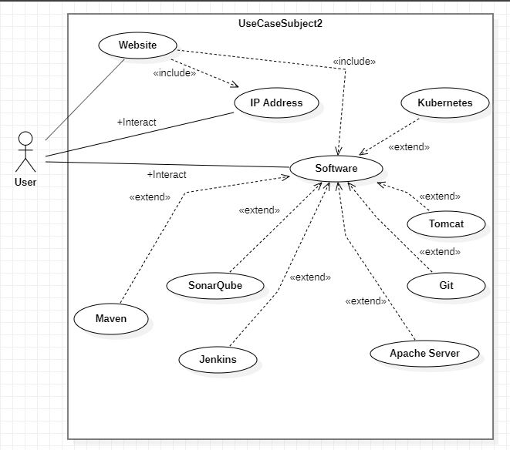
Use Case Diagram

Slide 7
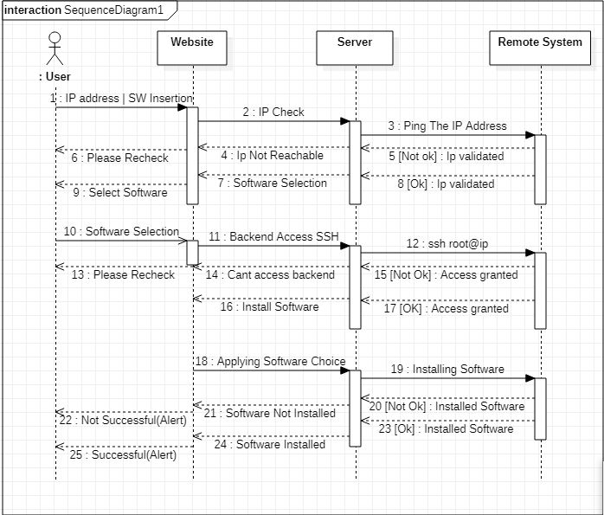
Sequence Diagram

Slide 8
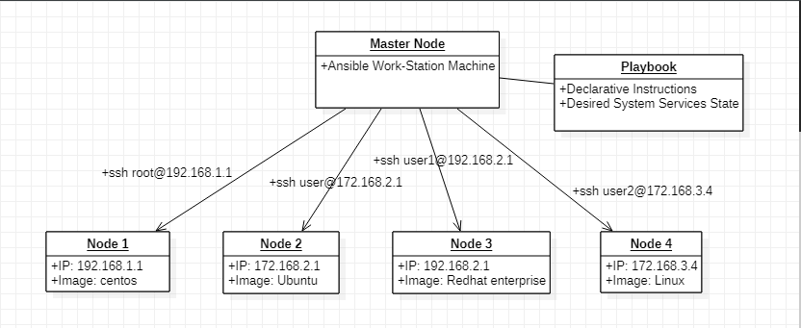
Object Diagram - Ansible

