Slide 1
Solar Radiation and Measurement
Module I

Slide 2
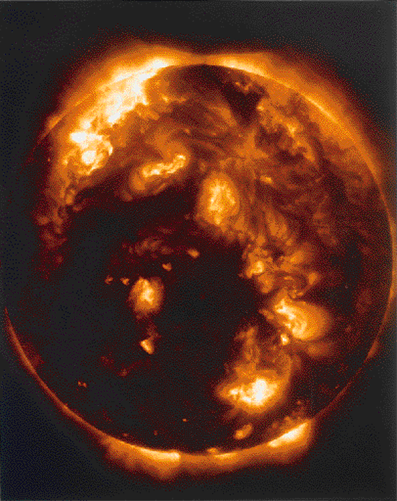
Sun
Radius - 70,0000 km
Mass - 2.0 x 10³⁰ kg
Temperature - 5500 C
Distance between sun and earth – 150 million km

Slide 3
Modes of heat transfer
Conduction
Convection
Radiation

Slide 4
Stefan–Boltzmann law
Total energy emitted by a black body

Slide 5
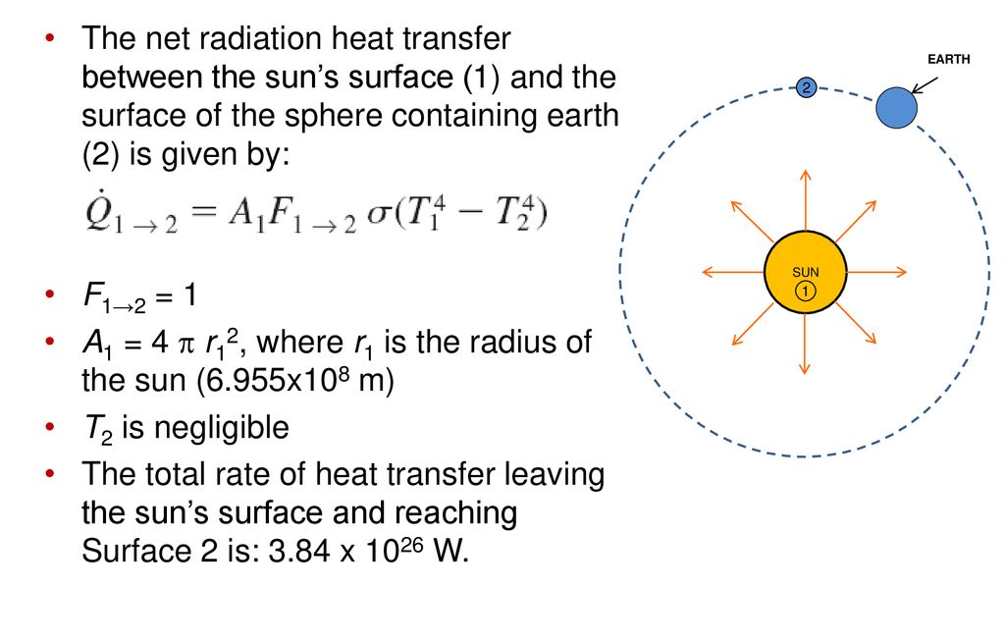
Radiation from sun

Slide 6
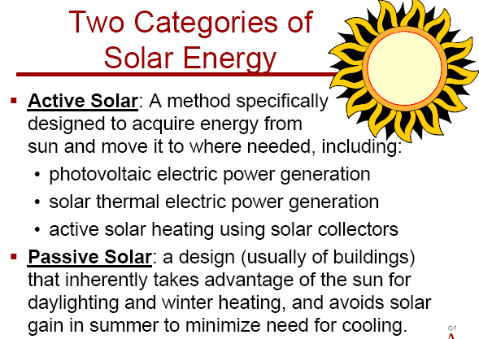

Slide 7
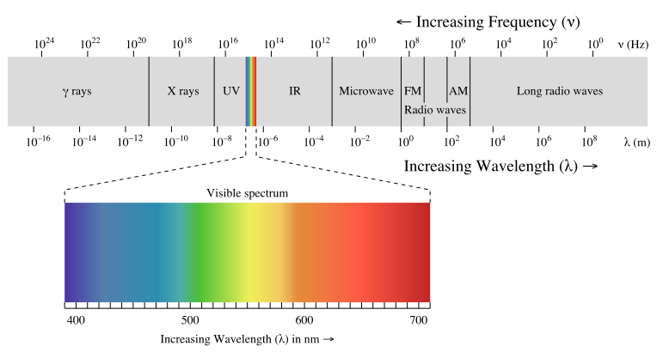
Electro magnetic spectrum

Slide 8
Solar constant
Average solar energy received per unit area at earth’s atmosphere.
Solar constant – 1361 W/m²

Slide 9
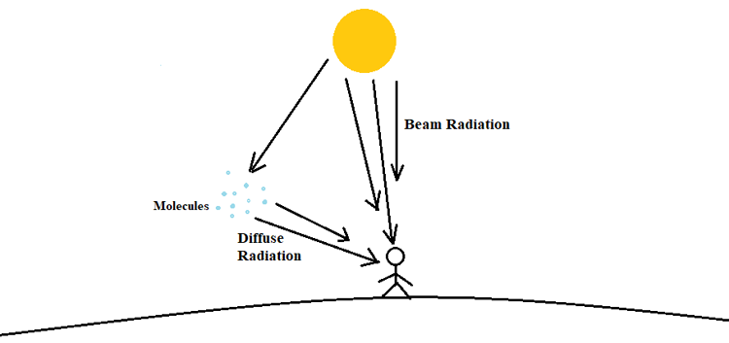
Solar Radiation measurement
Beam Radiation
Diffuse radiation
Global or total radiation

Slide 10
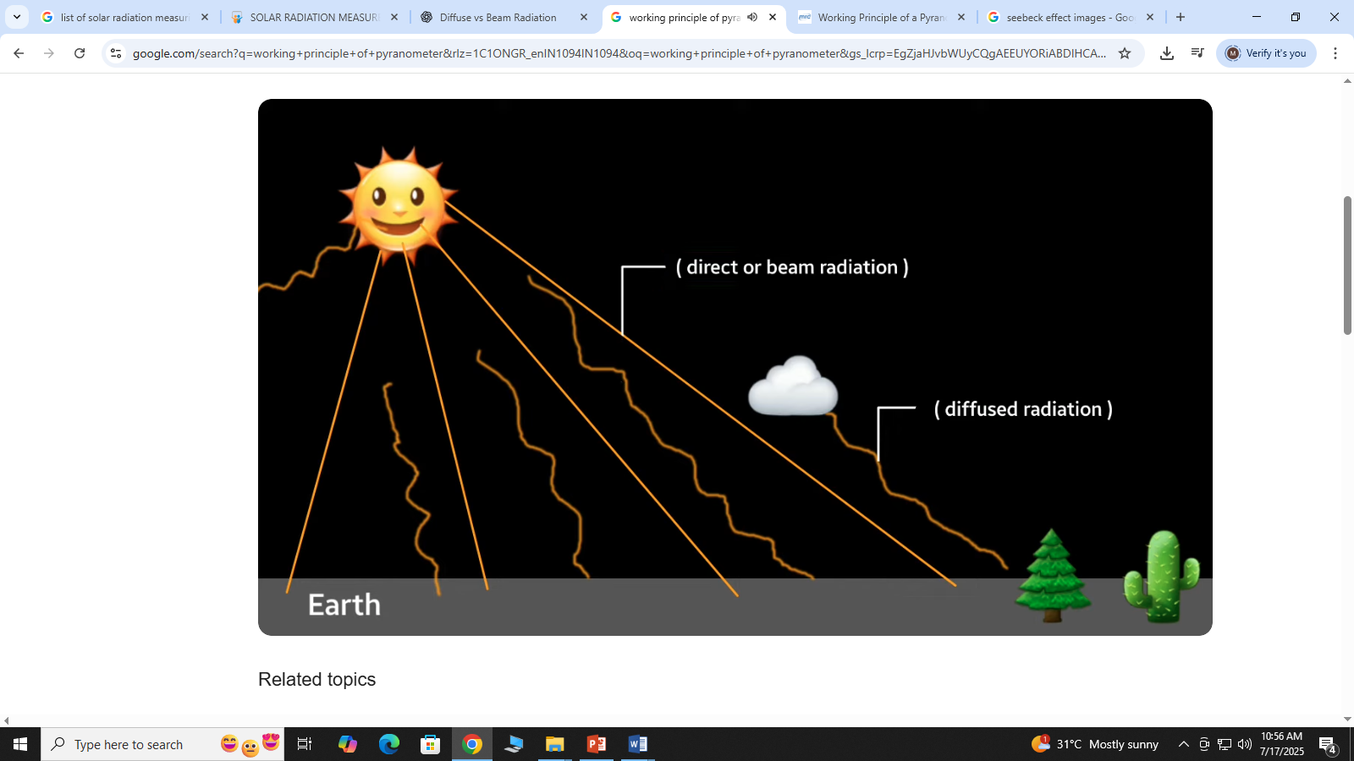

Slide 11
Solar Radiation measurement
Pyranometer - Beam and diffuse radiation
Pyrheliometer - Beam Radiation

Slide 12
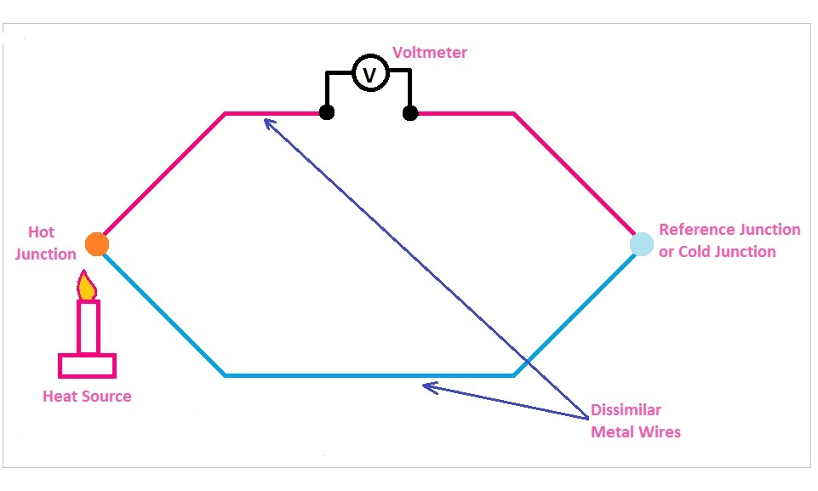
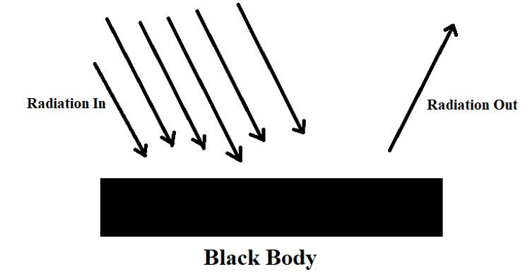
Principle of thermocouple
Solar Radiation measurement
Black body radiation
V α ΔT

Slide 13
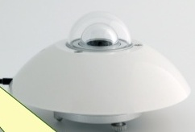
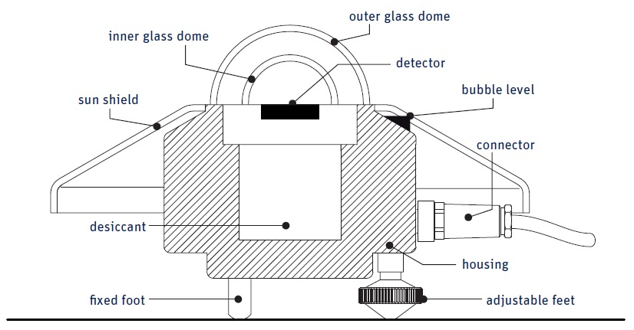
Pyranometer

Slide 14
Wavelength Range Measured
Region | Approximate Wavelength | Frequency (Hz)
Ultraviolet (UV) | 300 – 400 nm | ~10¹⁵ Hz
Visible Light | 400 – 700 nm | ~4.3 × 10¹⁴ to 7.5 × 10¹⁴ Hz
Near Infrared (NIR) | 700 – 2800 nm | ~10¹⁴ Hz

Slide 15
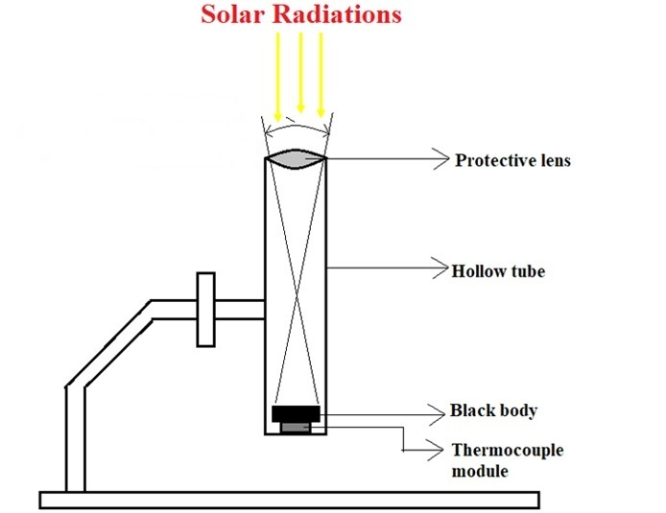
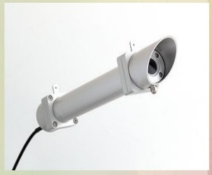
Pyrheliometer

Slide 16
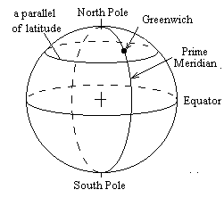
Coordinates of Earth

Slide 17
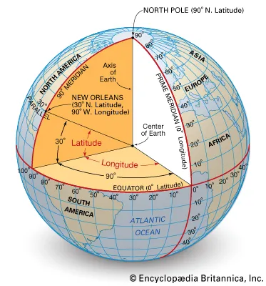
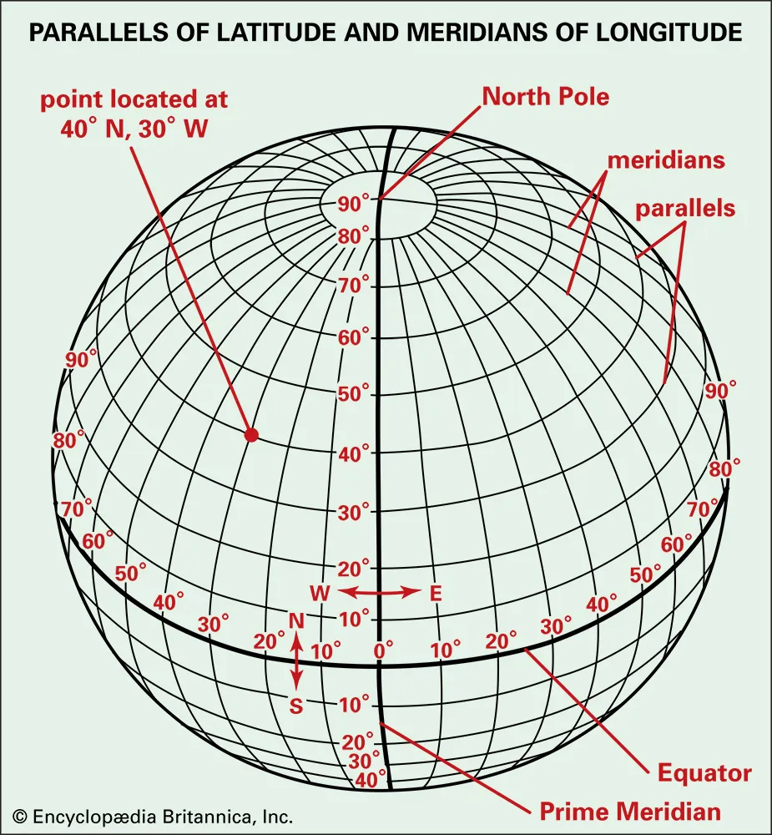
Coordinates of Earth

Slide 18
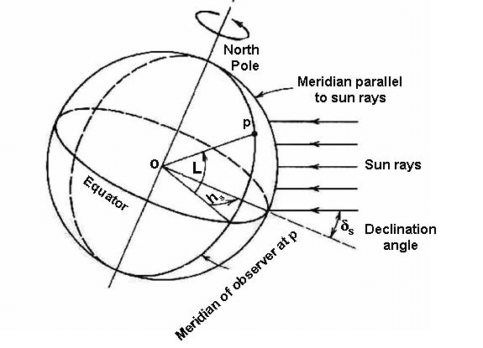
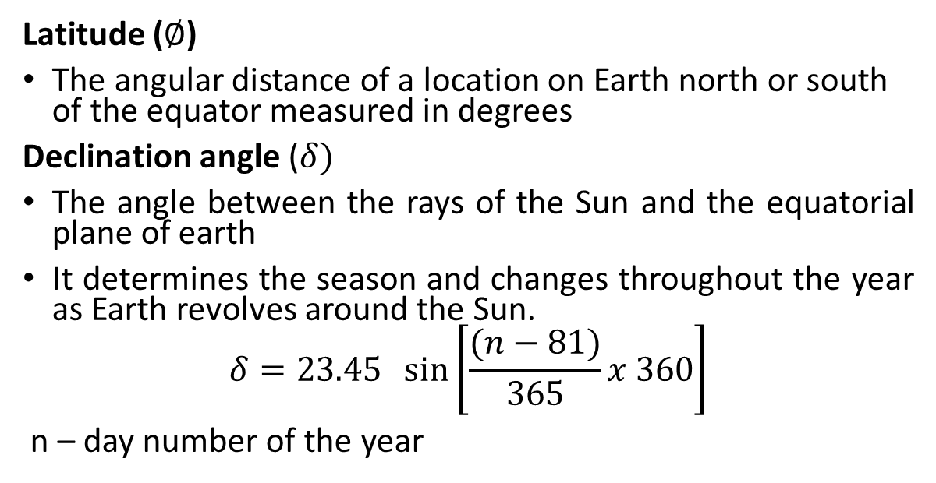
Basic Earth Sun angles
Latitude ($∅$)
The angular distance of a location on Earth north or south of the equator measured in degrees
Declination angle ($δ)$
The angle between the rays of the Sun and the equatorial plane of earth
It determines the season and changes throughout the year as Earth revolves around the Sun.
$$δ=23.45 \sin\left[\frac{(n−81)}{365}x 360\right]$$
n – day number of the year

Slide 19
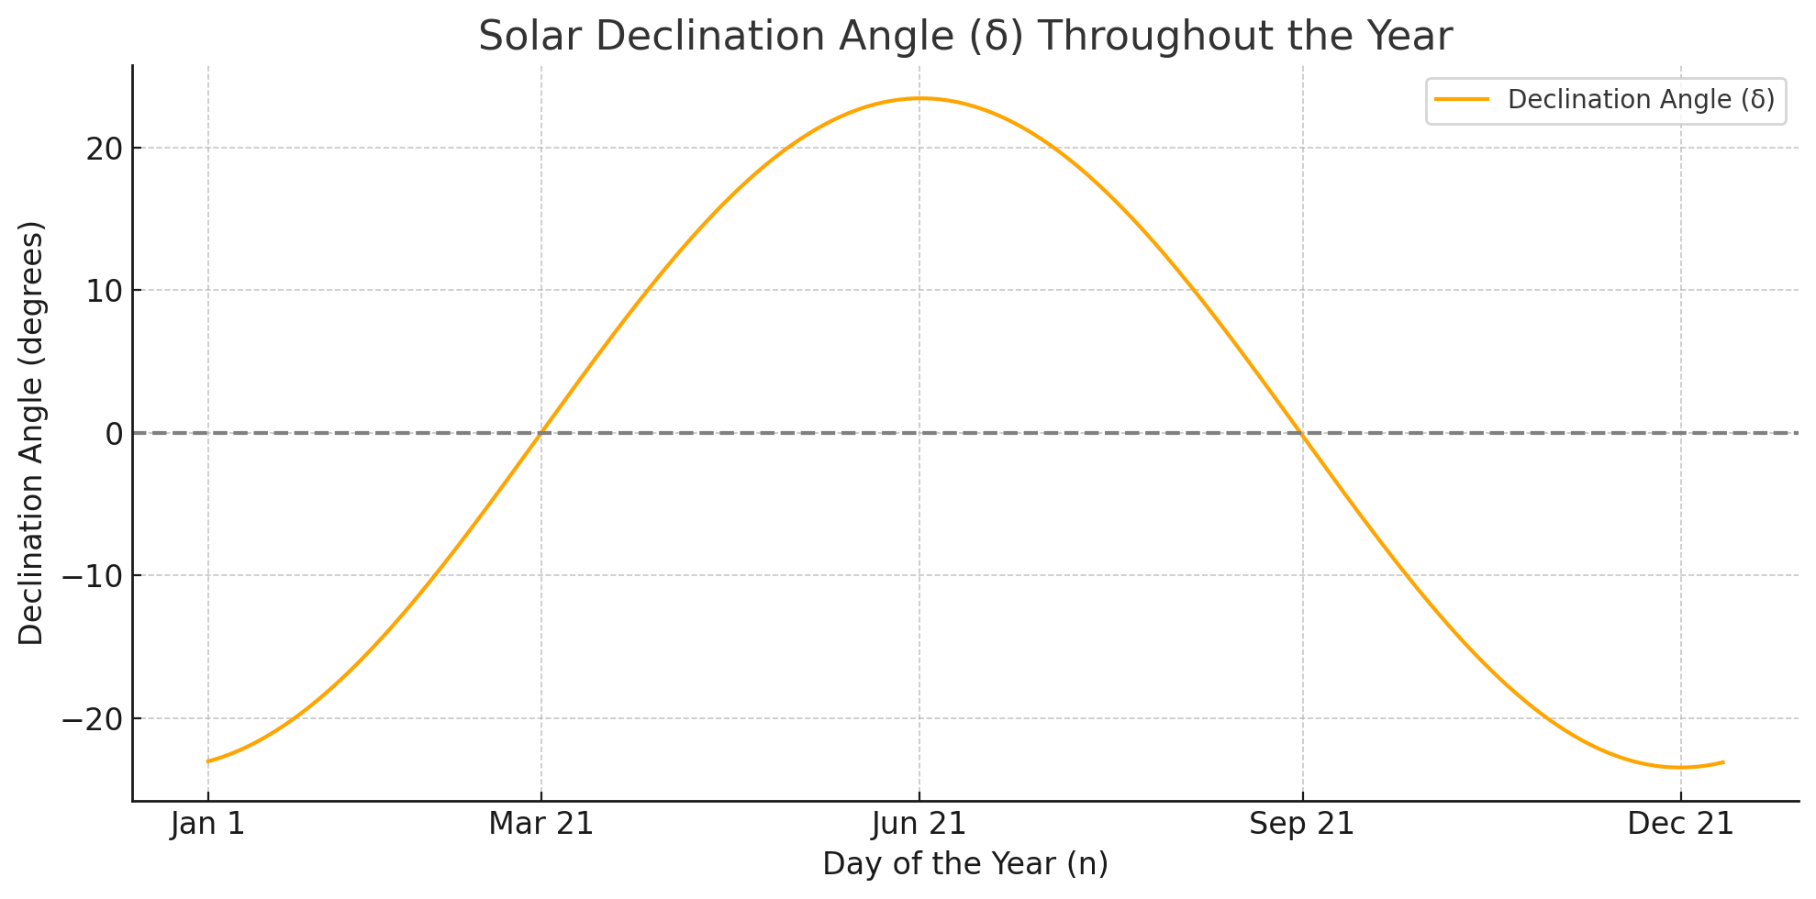
Declination angle

Slide 20
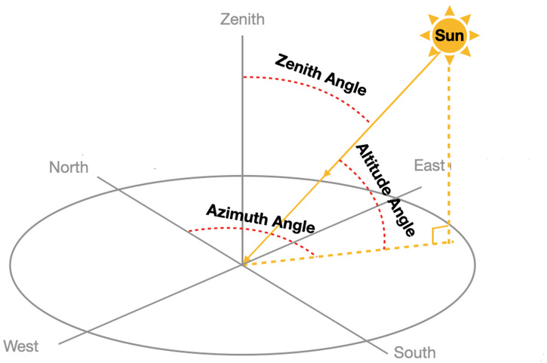
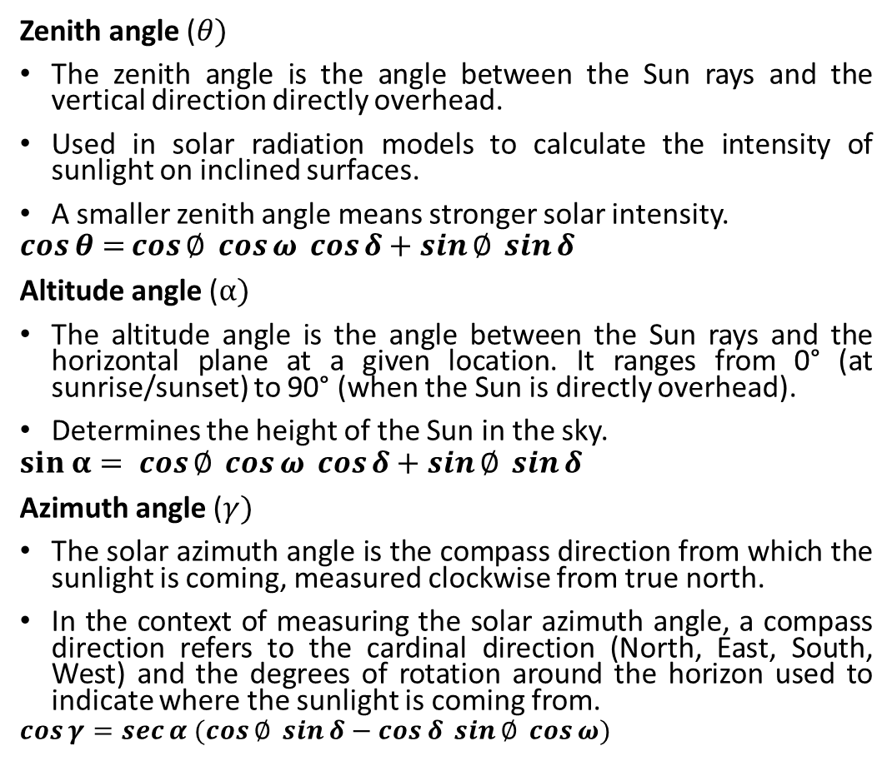
Derived solar angles
Zenith angle ($θ)$
The zenith angle is the angle between the Sun rays and the vertical direction directly overhead.
Used in solar radiation models to calculate the intensity of sunlight on inclined surfaces.
A smaller zenith angle means stronger solar intensity.
$$\cos{θ=}\cos{∅\cos{ω\cos{δ+\sin{∅\sin{δ}}}}}$$
Altitude angle ($α)$
The altitude angle is the angle between the Sun rays and the horizontal plane at a given location. It ranges from 0° (at sunrise/sunset) to 90° (when the Sun is directly overhead).
Determines the height of the Sun in the sky.
$$sin α= cos{∅\cos{ω\cos{δ+\sin{∅\sin{δ}}}}}$$
Azimuth angle ($γ)$
The solar azimuth angle is the compass direction from which the sunlight is coming, measured clockwise from true north.
In the context of measuring the solar azimuth angle, a compass direction refers to the cardinal direction (North, East, South, West) and the degrees of rotation around the horizon used to indicate where the sunlight is coming from.
$$\cos{γ}=\sec{α (\cos{∅\sin{δ−\cos{δ\sin{∅\cos{ω)}}}}}}$$

Slide 21
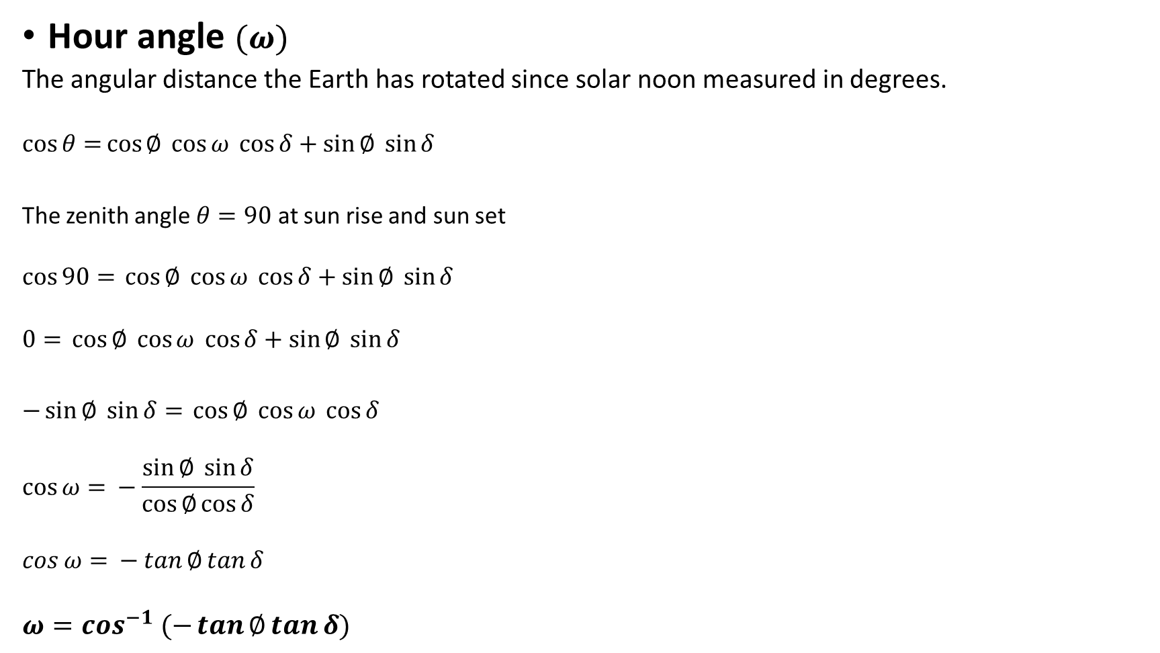
Hour angle $(ω)$
The angular distance the Earth has rotated since solar noon measured in degrees.
$$\cos{θ=}\cos{∅\cos{ω\cos{δ+\sin{∅\sin{δ}}}}}$$
The zenith angle $θ=90$ at sun rise and sun set
$$\cos{90=}\cos{∅\cos{ω\cos{δ+\sin{∅\sin{δ}}}}}$$
$$0{=}\cos{∅\cos{ω\cos{δ+\sin{∅\sin{δ}}}}}$$
$−\sin{∅\sin{δ}}{=}\cos{∅\cos{ω\cos{δ}}}$
$$\cos{ω= }−\frac{\sin{∅\sin{δ}}}{\cos{∅\cos{δ}}}$$
$$\cos{ω= }−\tan{∅\tan{δ}}$$
$$ω=\cos^{−1} (−\tan{∅\tan{δ)}}$$

Slide 22
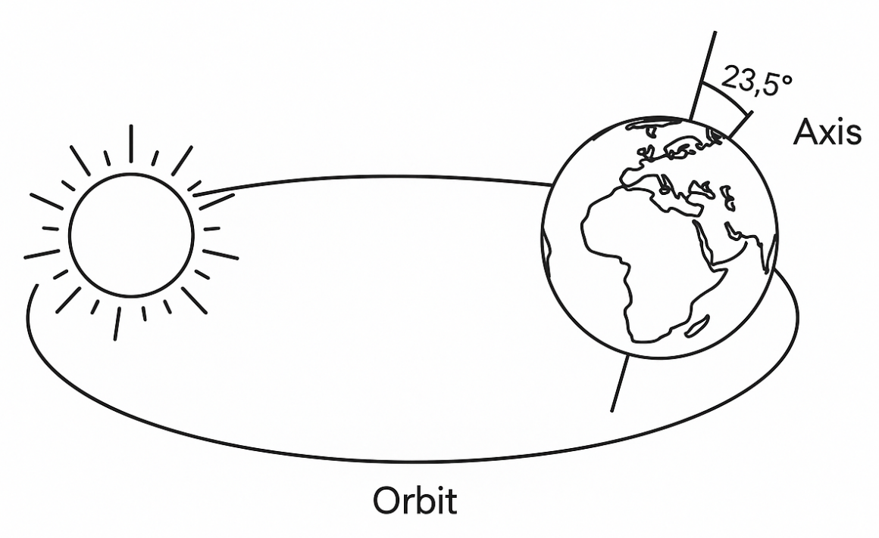
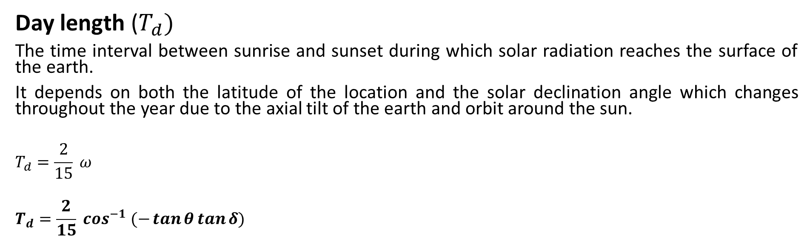
Day length ($T_{d})$
The time interval between sunrise and sunset during which solar radiation reaches the surface of the earth.
It depends on both the latitude of the location and the solar declination angle which changes throughout the year due to the axial tilt of the earth and orbit around the sun.
$$T_{d}=\frac{2}{15} ω$$
$$T_{d}=\frac{2}{15} \cos^{−1} (−\tan{θ\tan{δ)}}$$

