Slide 1
Module -IV
Air Compressors

Slide 2
Air compressor
Pneumatics: A system which uses compressed air is called pneumatics.
It deals with the study of behaviour & application of compressed air
A basic pneumatic system consist of a source of compressed air, control valves, pipelines & pipe fittings and pneumatic accessories like filter, regulator and lubricator

Slide 3
Application of compressed air
For operating pneumatic tools such as drills, screw drivers, hammers, chisels
For pneumatic cranes
For pneumatic brakes of automobiles, railways and presses
For drive of CNC machine tools
For pneumatic conveying of materials
For pneumatic gauging, inspection and low cost automation systems

Slide 4
Introduction to compressors
An air compressor is a mechanical device that increases the pressure of air by reducing volume.
Air is compressible, the compressor reduces the volume of air and induces pressure in the air
An air compressor converts electrical energy into pressure energy in the form of the air
The compressed air is stored in the air receiver and can be used for cleaning under pressure, generating torque and develop force using actuators

Slide 5
Classification of air compressor
Air compressors are classified according to method of energy transfer and pressure generation i.e. positive displacement and (non positive displacement) dynamic compressors
Positive displacement compressors work on the principle of increasing the pressure of air by reducing the volume of air in an enclosed chamber
Dynamic compressors works on the principle of imparting the energy by rotating vanes of impeller on air flowing through casing that increases pressure in air

Slide 6
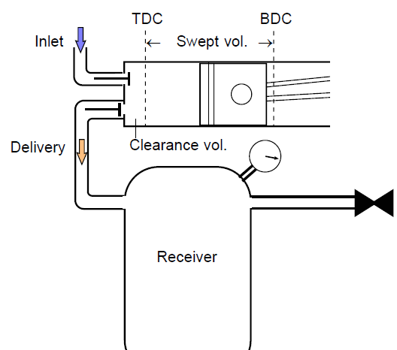
Reciprocating Air compressor

Slide 7
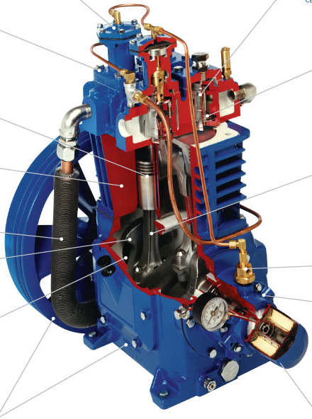
Reciprocating Air compressor

Slide 8
Reciprocating Compressor – Multistage
High Pressure required by Single – Stage :
Requires heavy working parts.
Has to accommodate high pressure ratios.
Increased balancing problems.
High Torque fluctuations.
Requires heavy Flywheel installations.
This demands for MULTI – STAGING…!!

Slide 9
Reciprocating Compressor – Multistage
Series arrangement of cylinders, in which the compressed air from earlier cylinder becomes the intake air for the next cylinder.
L.P. = Low Pressure
Intercooler
I.P. = Intermediate
Pressure
Air Delivery
H.P. = High Pressure
L.P.
Cylinder
I.P.
Cylinder
H.P.
Cylinder
Intercooler :
Compressed air is cooled
between cylinders.
Intercooler
Air Intake

Slide 10
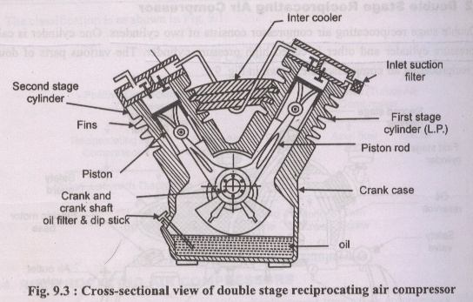
Double stage reciprocating air compressor

Slide 11
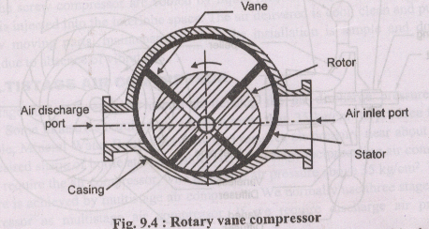
Rotary vane compressor

Slide 12
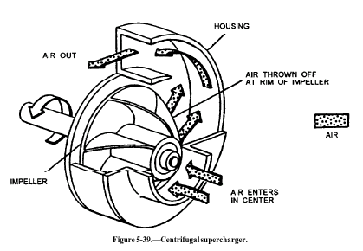
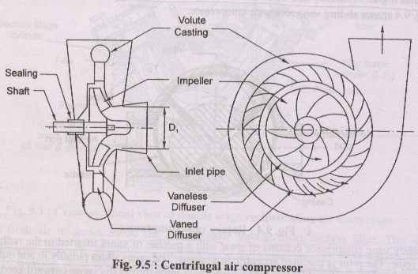
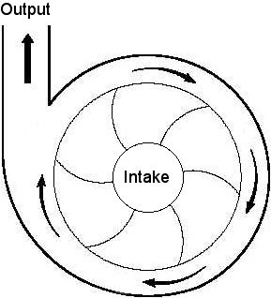
Centrifugal compressor

Slide 13
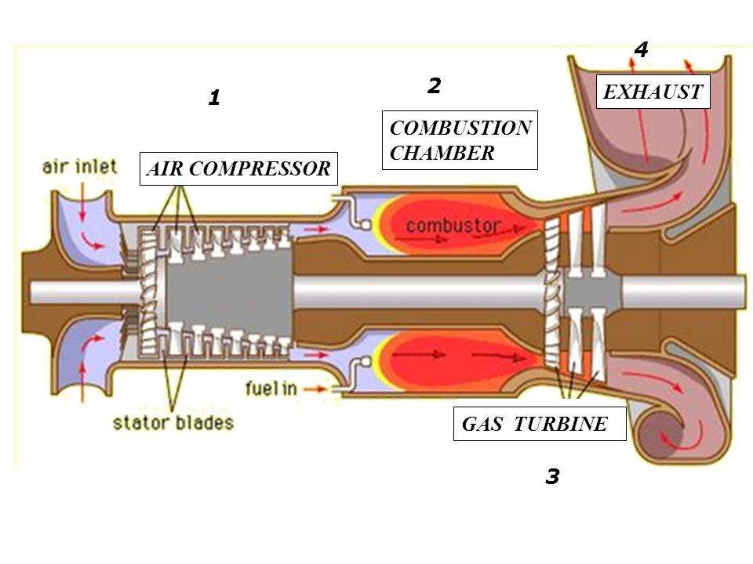
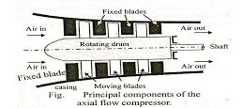
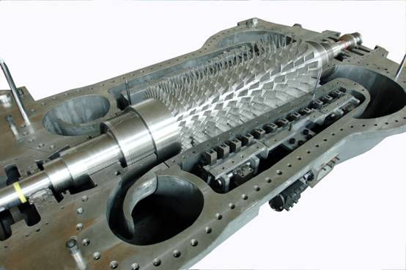
Axial flow compressor

