Slide 1

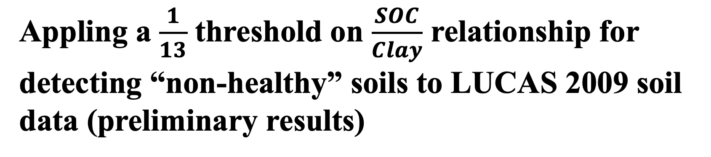
Appling a $\frac{1}{13}$ threshold on $\frac{SOC}{Clay}$ relationship for detecting “non-healthy” soils to LUCAS 2009 soil data (preliminary results)
Raisa Mäkipääª, Lorenzo Menichetti^{a,b,}, Eduardo Martínez-Garcíaª, Tiina Törmänen^{a,c}, Aleksi Lehtonenª
ª Natural Resources Institute Finland (Luke), Latokartanonkaari 9, FI-00790 Helsinki, Finland
^{b} Swedish University of Agricultural Sciences, Sweden
^{c} School of Forest Sciences, University of Eastern Finland, Yliopistokatu 7, 80130 Joensuu, Finland

Slide 2
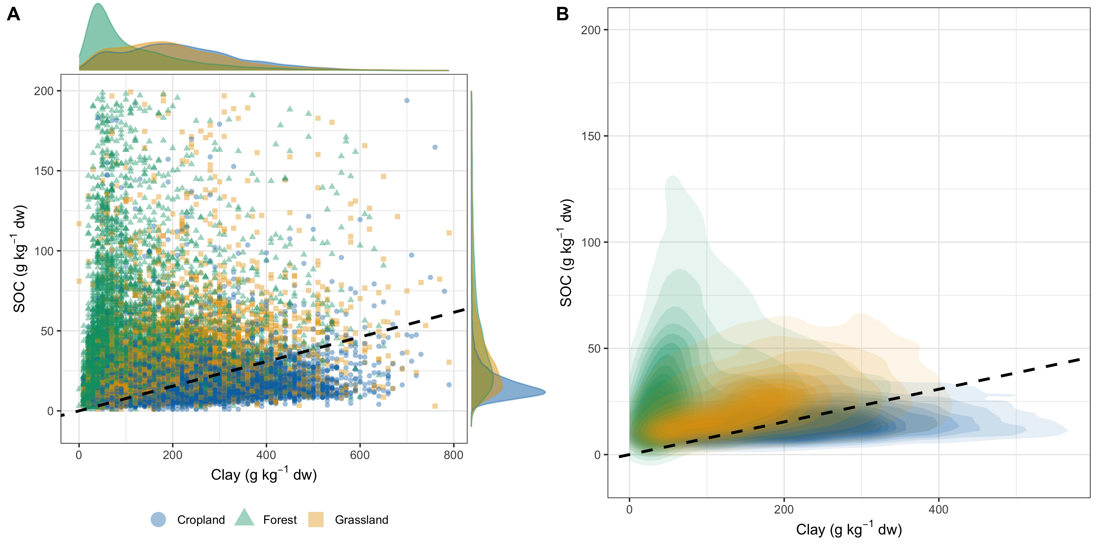
Fig. 1: Distribution of the soil organic carbon (SOC) and clay content for different land uses (cropland, forest, and grassland).
Density plots of SOC and clay contents for each land use are shown in panel a). Panel b) shows the 2-dimension density distribution of the data points in the same space. Dashed line represents the SOC:Clay threshold of 1:13. Less represented land-use classes are not plotted for readability and SOC contents above 200 g kg⁻¹ dry weight (dw) were excluded.

Slide 3
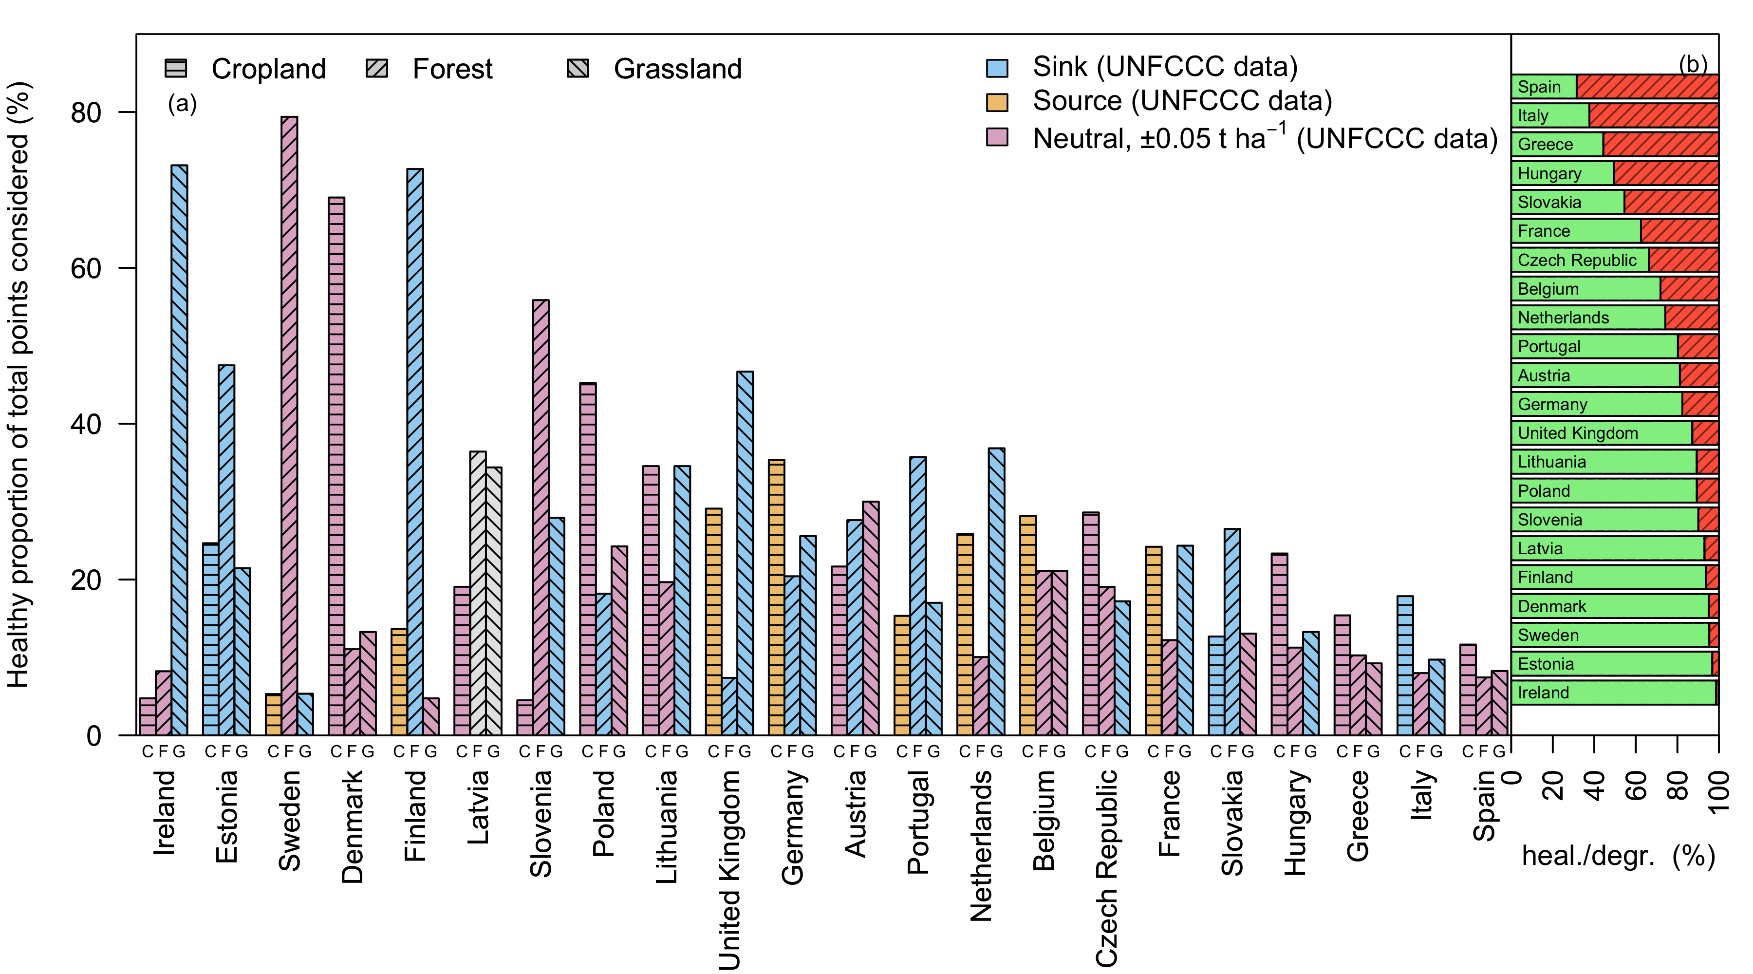
Fig. 2: Proportions of non-degraded (healthy) mineral soils by the three major land use classes and country included in the 2009 LUCAS soil survey (a) and the proportion of total degraded soils by country (b).
The colors in panel (a) shows the carbon stock change for each land use based on GHG reporting (UNFCCC, 2000-2020) for mineral soils. Blue = sink, orange = source. Pink =“neutral” (±0.5 t C ha⁻¹ change). White = missing data.
The small labels under each bar denote the land uses cropland (C), forest (F), and grassland (G). The colors in panel (b) correspond to degraded (red, shaded) and healthy (green) soils.

Slide 4
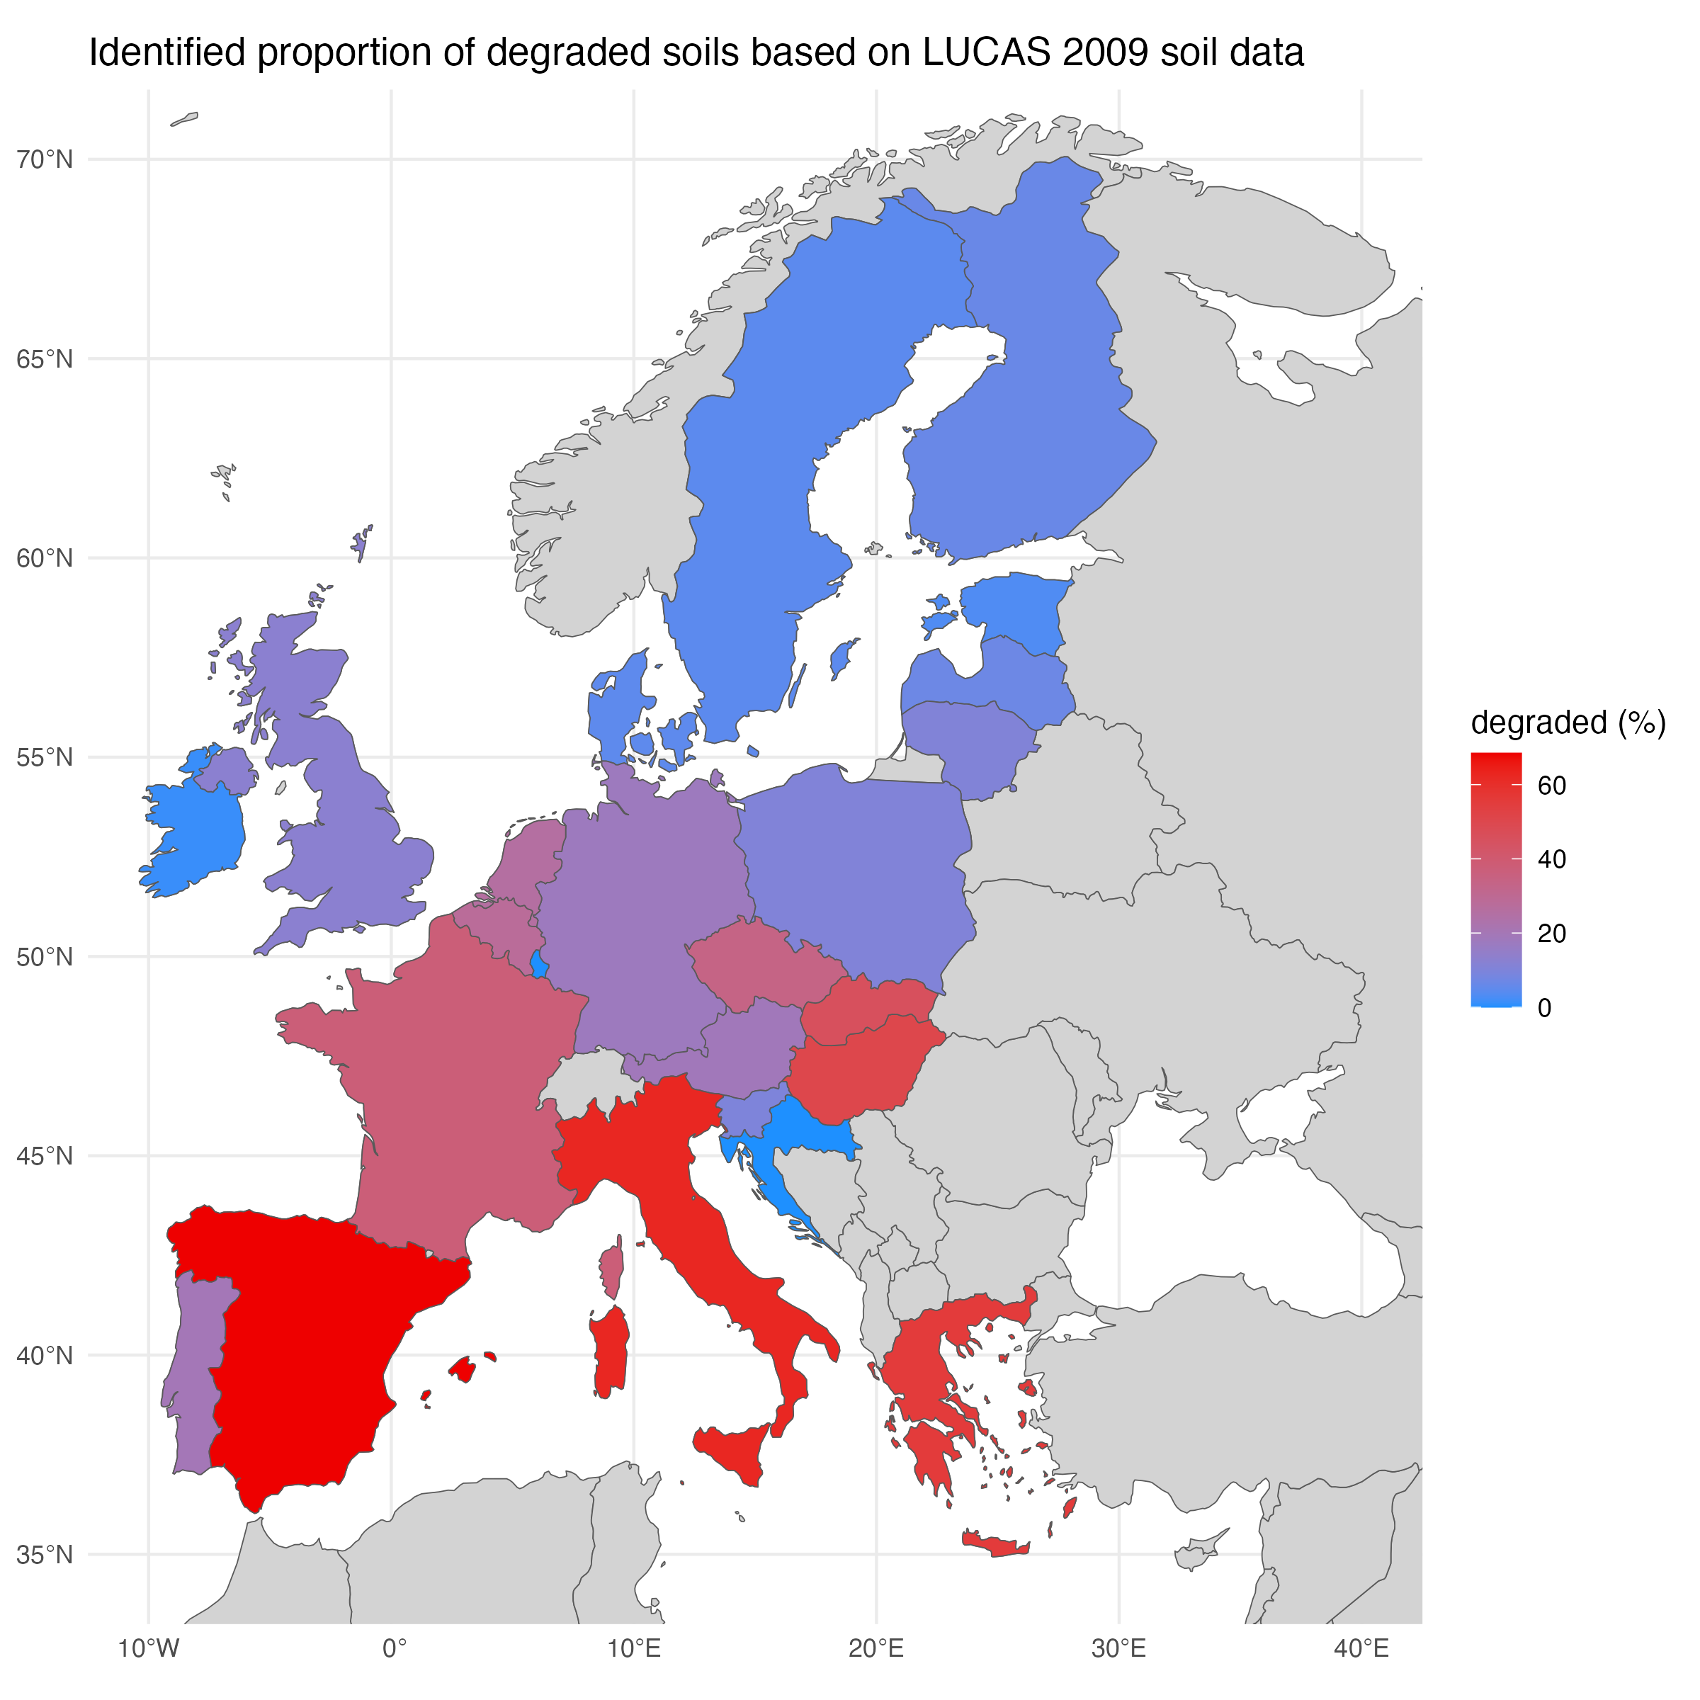
Proportions of non-degraded (healthy) mineral soils by country in EU.
The map is a representation of the same data showed in Fig. 2, panel b. Colors are associated to the proportion (on the total number of sampled points) of degraded soils detected in each country.

