Slide 1
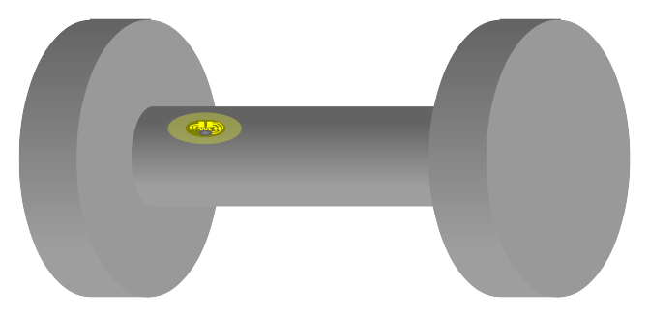
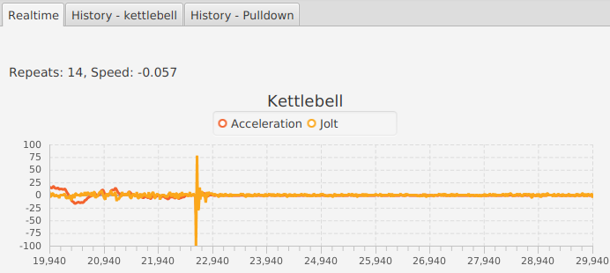
Workout Watch
Ilmo Euro, 24.4.2016, for FutureHack

Slide 2
Workout Watch
A system for monitoring and improving exercise technique
Works with different kinds of exercise equipment – dumbbells, kettlebells, weight machines…
Consists of low-cost accelerometer stickers and a program installed on a PC or tablet computer.

Slide 3
Accelerometer stickers
A flexible sticker attached to exercise equipment
Consists of an accelerometer and a transmitter
Around 2 cm in diameter

Slide 4
Accelerometer stickers
Powers on when equipment is picked up
Powered with a button battery cell
Long battery life
Connects to PC/tablet using Bluetooth/BLE

Slide 5
Monitoring software
A cross-platform desktop application
Can connect to any number of accelerometer stickers
Has both long-term and real-time monitoring
Can provide analysis and tips for technique enhancement

Slide 6
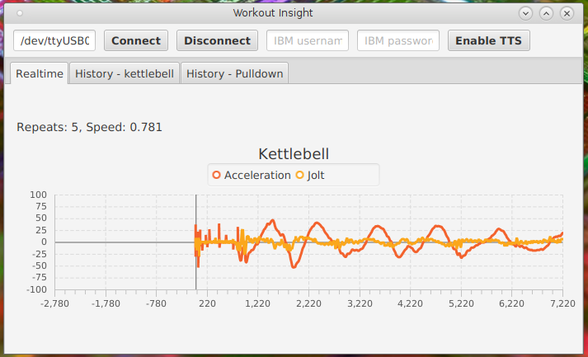
Monitoring software
The top bar is only for development version

Slide 7
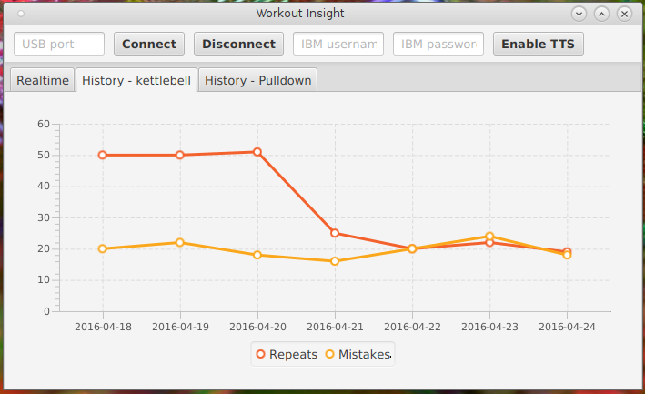
Monitoring software
The data is fake.

Slide 8
Real-time monitoring
Displays information about your current exercise
Information includes:
  Number of repeats
  Repeat speed
  Possible jolts in movement
Can give hints on improving your technique
Both visual and voice interface

Slide 9
Long-term monitoring
Displays your exercise history
Information includes
  Number of repeats with various equipment
  Average speed of repeats each day
  Number of possible technique errors each day
Show information in graph form
Also collects and stores raw sensor data for future processing

Slide 10
Analysis
Plot trends and predict future development
Determine the best and worst days and times of day for exercise
Assess the problems in exercise technique

Slide 11
Applications
Low-cost, non-intrusive ”personal trainer”
A way for patients to share their exercise data with their physicians, physiotherapists and trainers
A basis for personalized gym experience with per-client tracking and personal exercise programs

Slide 12
Current status
Software is functional, but calculates only a few values
Two-day timespan is too short for long-term monitoring and analysis
Accelerometer is attached using wires for rapid prototyping, no sticker form factor yet

Slide 13
Future development options
More measuring and analysis options developed in co-operation with sports professionals
Mobile measurement software for all tablets and most smartphones
Voice input
Options for attaching stickers to exercise bikes, or sewing them to clothing for measuring pushups.

Slide 14
Technobabble, software
JavaFX-based monitoring software
Connects to accelerometer using serial interface
Text-to-speech is powered by Watson
Calculate numbers using statistical and signal processing methods
C++-based sticker firmware

Slide 15
Technobabble, hardware
Components:
  3-axis accelerometer
    In this prototyping stage, only one axis is used
  Microcontroller
  Bluetooth/BLE transmitter
    Another alternative is using a custom radio transmitter/receiver pair
  Shake switch for power on
    You could have a functional unit even without an accelerometer!
  Button cell battery
Flex-PCB enclosed in a sticker

Slide 16
Live Demo
Thanks to Atte Pitkänen for the accelerometer used in prototyping

