Slide 1

FINANCIAL STATEMENT ANALYSIS
GLOBAL AIRLINE INDUSTRY
GAVOILLE Ilona - 2025130852, PARK Chae Young - 2018110287, Kim Gayoung - 2022111406, LARIBI Sonia - 2026130167
Global Airline Industry
Financial Statement Analysis - Group 5

Slide 2


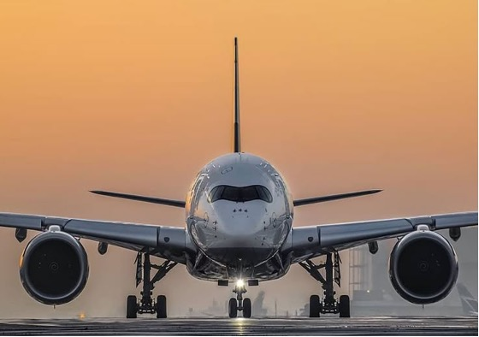


GLOBAL AIRLINE INDUSTRY
Pioneering Beginnings (1909–1914)
Originating with DELAG in 1909 using Zeppelin airships, the industry evolved with CGT's fixed-wing cargo (1911) and the iconic St. Petersburg–Tampa Airboat Line's scheduled flights in 1914.
Privatization & Major Alliances
Post-1980s privatization triggered extensive airline mergers and massive codeshare partnerships. Today, the global market is led by three key alliances: Star Alliance, SkyTeam, and Oneworld.
THE THREE TYPES OF AIRLINES
International: Multibillion-dollar global operations connecting hundreds of hubs using large passenger jets (e.g., Delta, Southwest).
National: Mid-to-large-sized fleets catering to domestic hubs with targeted, demand-driven international networks.
Primary Revenue & Fleet Operations
Operations center on scheduled passenger routes and belly-space cargo transport. Core revenue streams rely on direct ticket sales augmented by seat selections, baggage fees, and in-flight services.
Regional: Smaller specialized carriers covering low-demand locations, frequently acting as feeder affiliates for major airlines.
Global Airline Industry
Financial Statement Analysis - Group 5
Notes:
this industry has evolved rapidly—from the early 1910s. This evolution wasn't just about better planes; it was about moving from simple transport to a multi-billion-dollar global infrastructure.
Today, the global airline industry operates on three distinct tiers: International giants, National networks, and Regional carriers. But regardless of the size, they all face the same core challenge: High Capital Intensity. Whether it is a big carrier or a smaller regional carrier, the cost to build and maintain these fleets is immense, and this attributs specific o our industry will impact our ratios as well

Slide 3
US PREMIUM AND MEDIUM AIRLINES
AIRLINE | CLASSIFICATION | PRIMARY HUBS | OPERATIONAL SCALE | STRATEGIC HIGHLIGHTS
American Airlines AAL / Alliance Oneworld | PREMIUM AIRLINE | Dallas/Fort Worth (DFW) | Over 6,700 daily flights servicing, 350 and more destinations | Retains its position as the world’s largest airline following the US Airways merger.
Delta Air Lines DAL / Alliance SkyTeam | PREMIUM AIRLINE | Atlanta (ATL - Principal), JFK, LAX | Mainline fleet of 951 aircraft, 260M passengers | Ranked number 1 globally by revenue with $55B generated in top operational efficiency.
United Airlines UAL / Alliance Star Alliance | PREMIUM AIRLINE | Chicago O'Hare (ORD) | Massive workforce of 86,852 and 1,262 aircraft | Serves over 1,000 destinations globally across 170 countries worldwide.
Alaska Air Group ALK / Alliance Oneworld | MEDIUM AIRLINE | Seattle-Tacoma (SEA), | Mainline fleet connecting 140 and more destinations | Acquired Virgin America and Hawaiian Airlines to secure total West Coast dominance.
Global Airline Industry
Financial Statement Analysis - Group 5
Notes:
First amercian, delta and united are part of the 4 biggest airlines in the US, with Soutwhest as the 4th. They are massive domestic and international network carriers, with around 1000 thousands aircraft each
Southwest is the efifiency master ., with their low-cost model, part of the big floor
The 4 of them represent more than 75% of the US domestic airline capacity
Alaska Airlines (ALK): The Regional Stabilizer

Slide 4
US LOW-COST AND ULTRA LOW-COST AIRLINES
AIRLINE | CLASSIFICATION | PRIMARY HUBS | OPERATIONAL SCALE | STRATEGIC HIGHLIGHTS
Southwest Airlines LUV / NYSE LISTED | LOW-COST | Dallas Love Field (DAL) | Pioneering fleet of 685 and more Boeing 737s | Executing 15% workforce downside to lock in $300M in savings by 2026.
JetBlue Airways JBLU / NASDAQ LISTED | LOW-COST | New-York (JFK), Boston | Active order book of 60 Airbus A220s | Pioneered cabin Wi-Fi, terminated $3.6B Spirit merger due to regulatory pressure.
Allegiant Air ALGT / NASDAQ LISTED | ULTRA LOW-COST | Las Vegas (LAS) | Serves 124 destinations across the US | Finalized the $1.5B acquisition of Sun Country Airlines on May 15, 2026
Frontier Airlines ULCC / INDIGO PARTNERS | ULTRA LOW-COST | Denver (DEN) | All A320/A321 fleet to 74 destinations | Withdrew $2.9B Spirit bid after JetBlue presented a superior competitive offer.
Global Airline Industry
Financial Statement Analysis - Group 5
Notes:
The Financial DNA: JetBlue occupies a difficult middle ground. They have high fixed costs but lack the massive scale of the "Big Three" or the ultra-low costs of the budget carriers
Allegiant Air (ALGT): The "niche" volume carrier., also have hospitality service focusing on leisure passengers with low-cost modlek
Frontier (ULCC): The Ultra-Low-Cost Fighter
A pure-play low-cost carrier.
They live and die by volume.

Slide 5
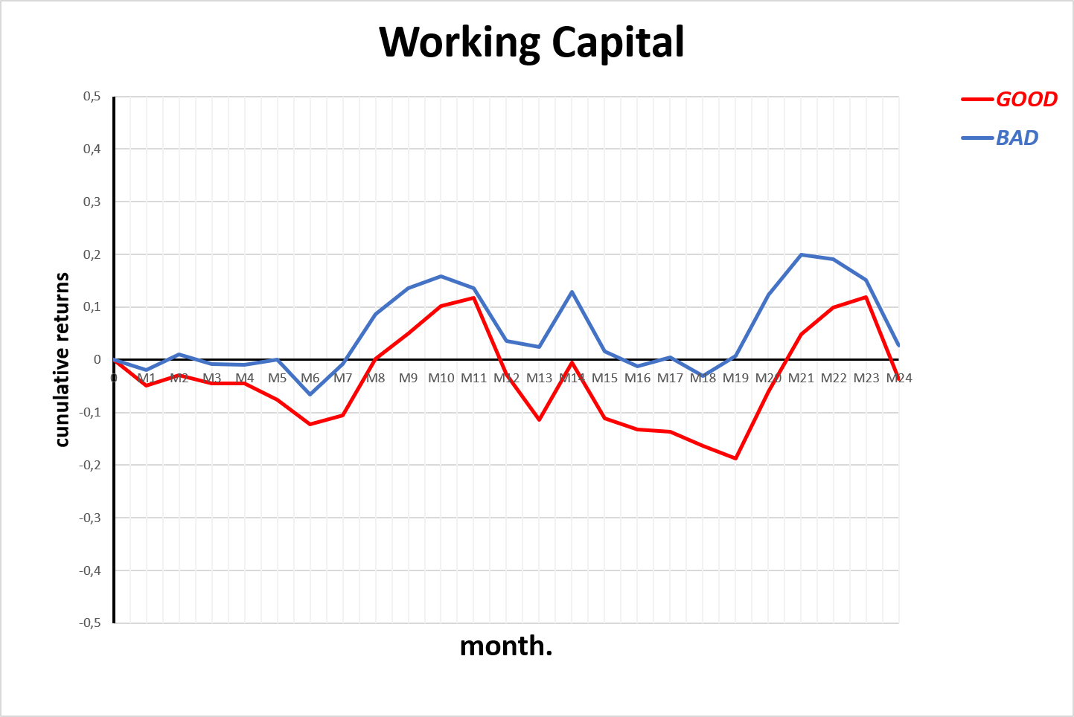
WORKING CAPITAL RATIO
Short-term financial flexibility
Paradoxically, the BAD portfolio outperforms the GOOD portfolio
→ Need to consider airlines scale of operation
Global Airline Industry
Financial Statement Analysis - Group 5
Notes:
Let’s start with the short-term liquidity ratios
The working capital is the difference between a company’s current assets and current liabilities. It shows how much short-term cash a company has to run its daily operations .so it is preferreabily positive
Paradoxically here, the BAD portfolio with lower working capital concistently outperforms the GOOD portfolio over the 24 months
This inversion happens because working capital is mesured in raw dollar amounts. SO huge legacy airlines like delta or american can distort the numbers just because they operate at a much larger scale

Slide 6
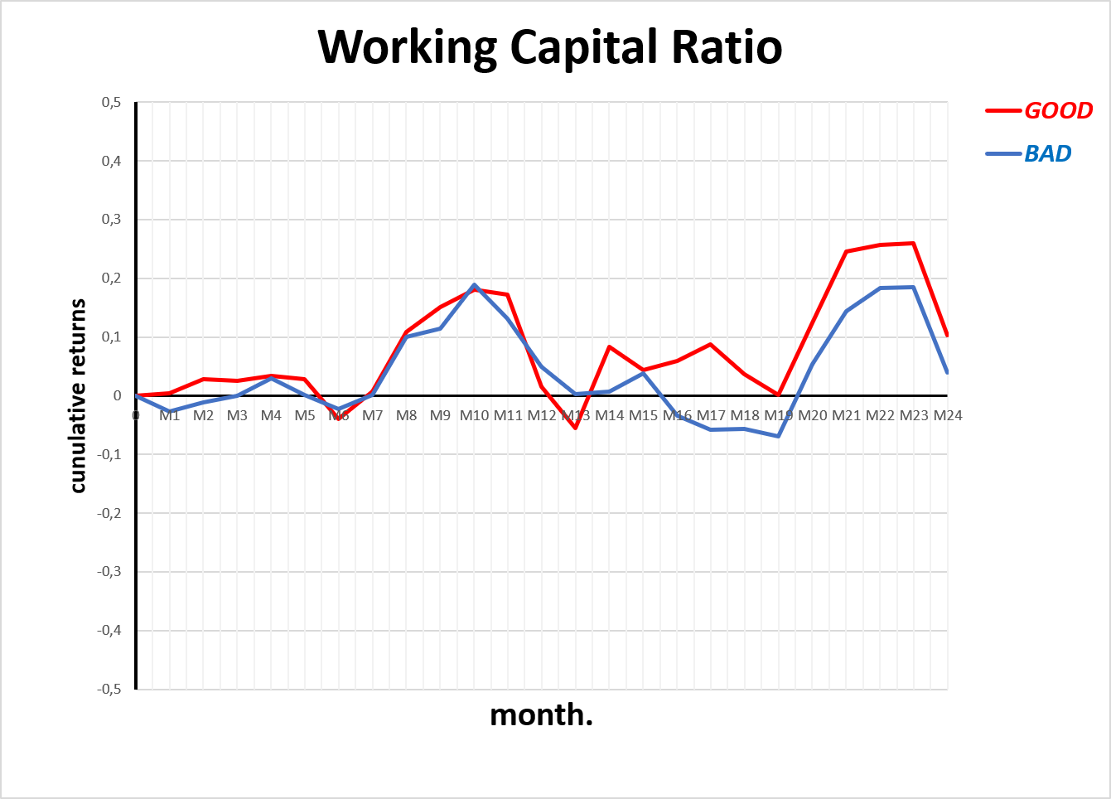
WORKING CAPITAL RATIO
Need to eliminate the size impact
Now, the GOOD portfolio outperforms the BAD portfolio
→ Better liquidity drives superior returns
Global Airline Industry
Financial Statement Analysis - Group 5
Notes:
That is why, we look at the Working Capital Ratio, which is working capital divided by Total Assets, in order to eliminate this size bias.
So we can see a clear difference now, since GOOD portfolio clearly outperfoms the BAD portfolio, especially after the month 14
So it proves that liquidity is a factor that drives superior returns, more on the long run

Slide 7
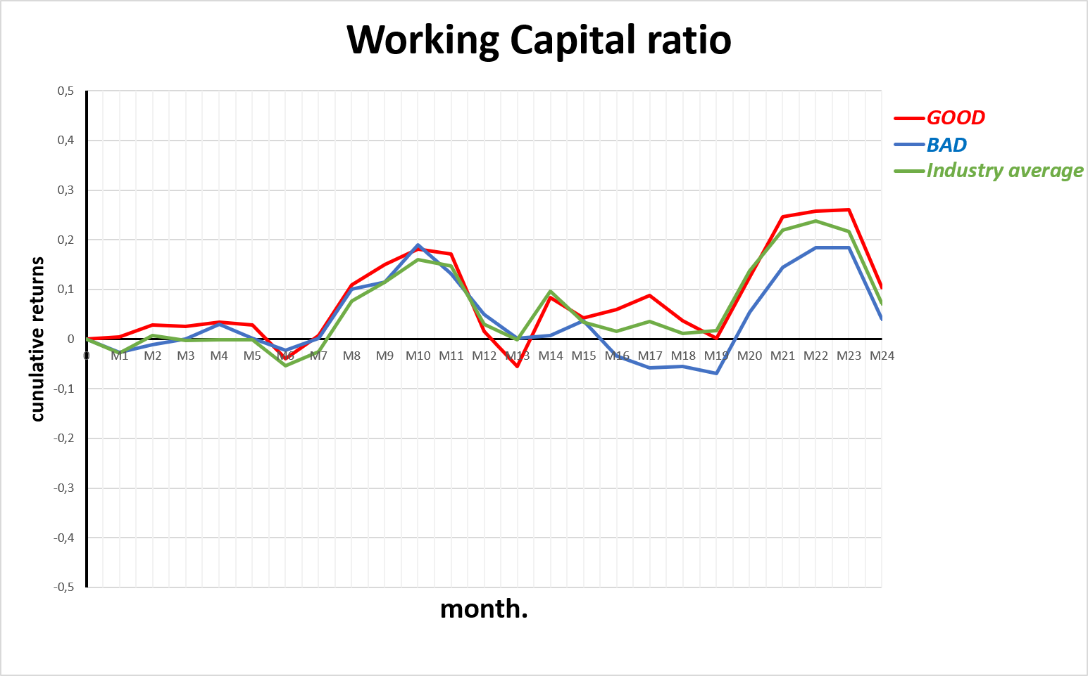
WORKING CAPITAL RATIO
GOOD group tracks the Industry Index line
BAD group stays below
Industry Index rewards airlines with higher working capital
Global Airline Industry
Financial Statement Analysis - Group 5
Notes:
And looking at the Industry Average, here in green, it seems that airlines with strong working capital closely track or sometimes even beat the the Industry Average, while the BAD group stays clearly behind/under the market

Slide 8
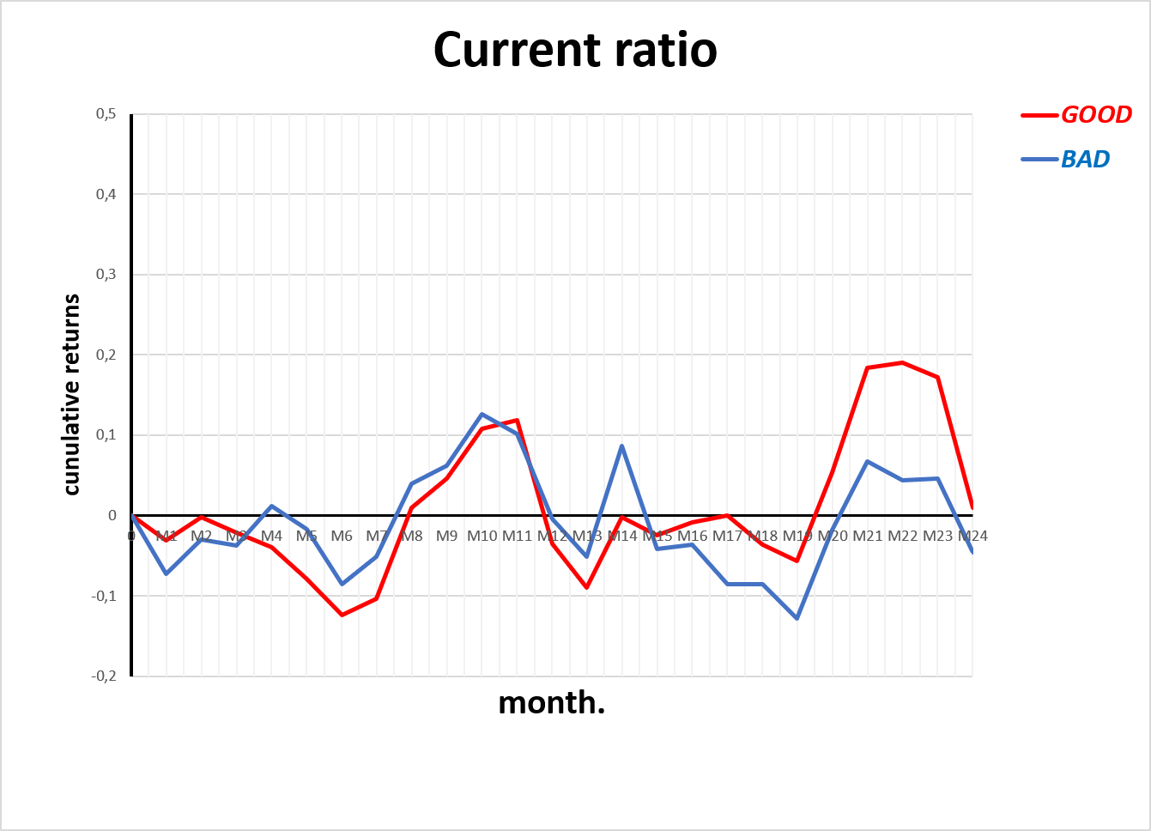
CURRENT RATIO
Ratio usually very low in the airline industry
Shows sensitivity to price and demand variations
GOOD group clearly wins in the long run
→ Higher current ratio shows long-term structural resilience
Global Airline Industry
Financial Statement Analysis - Group 5
Notes:
So current Ratio evaluates whether a company can cover its short-ter obligations with its short-term resources.
In the airline industry, this ratio is usually very low, often below 1, because passengers pay for tickets months in advance, so it generates a lot of short-term liabilities until planes actually fly
As a result, returns can be very low, even below 0, as we can see in month 6, 15, 19, because when prices suddenly increase, because of inflation or macroeconomics events like the war in Iran, or when demand slows down, airlines have to use more cash, so it draggs down stock returns
But Even SO, the GOOD group clearly wins in the long run, as we can see in the yellow circle, because a stronger/higher current ratio acts as a safety cushion againts fixed operational costs, so investors clearly preferred that stability
Besides, looking at the ranking, there is no actual correlation, for example Ultra low-cost like frontier and a giant delta are ranked at the bottom while a big carrier like Southwest and Allegiant on the top, so it is more about individual management strategy, company’s philosophy than just business model

Slide 9
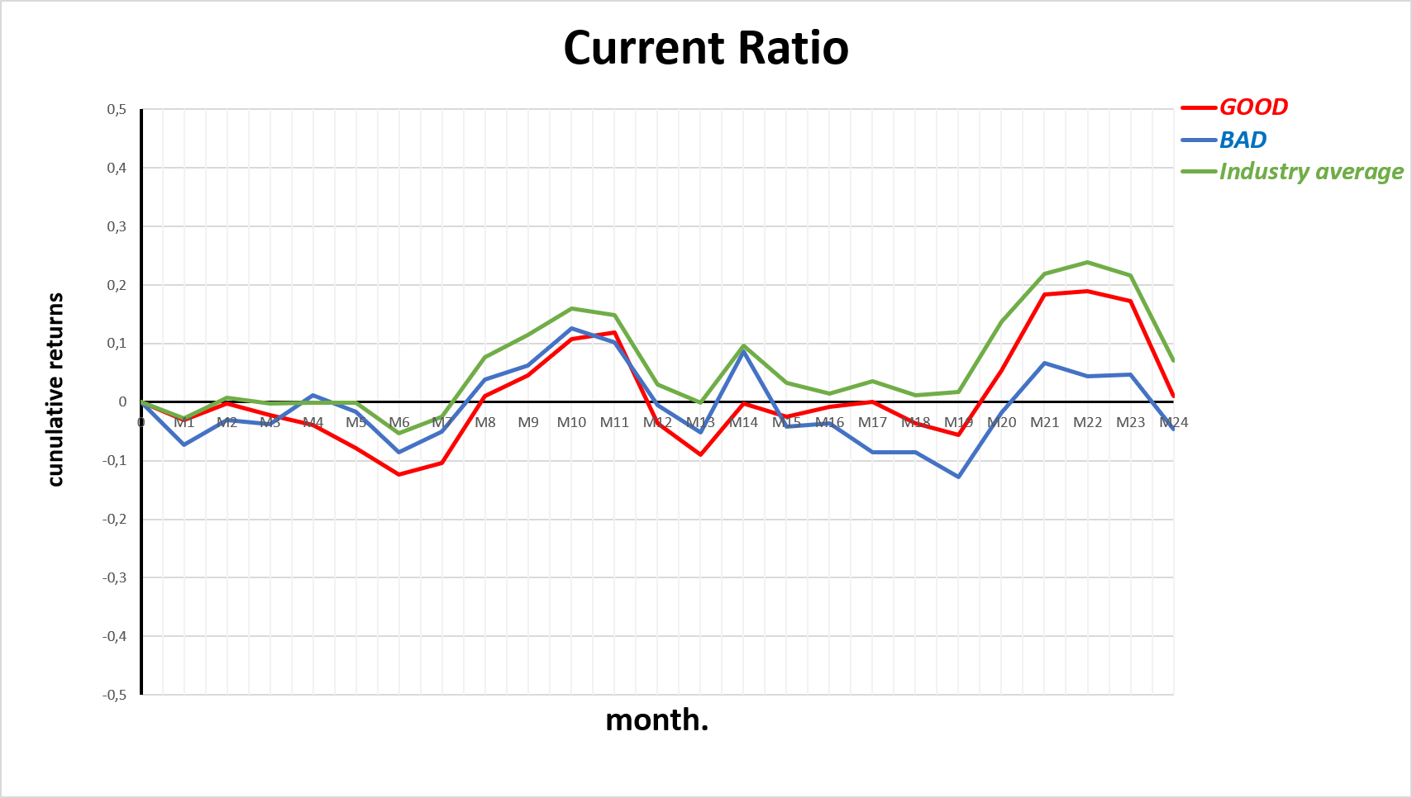
CURRENT RATIO
Industry index outperforms the GOOD and BAD groups
Too high or too low current ratio is not optimal; balance is preferred
Global Airline Industry
Financial Statement Analysis - Group 5
Notes:
Industry index outperforms the GOOD and BAD groups, so it means that
The market generally preferres balanced, optimized industry averages over extremes groups

Slide 10
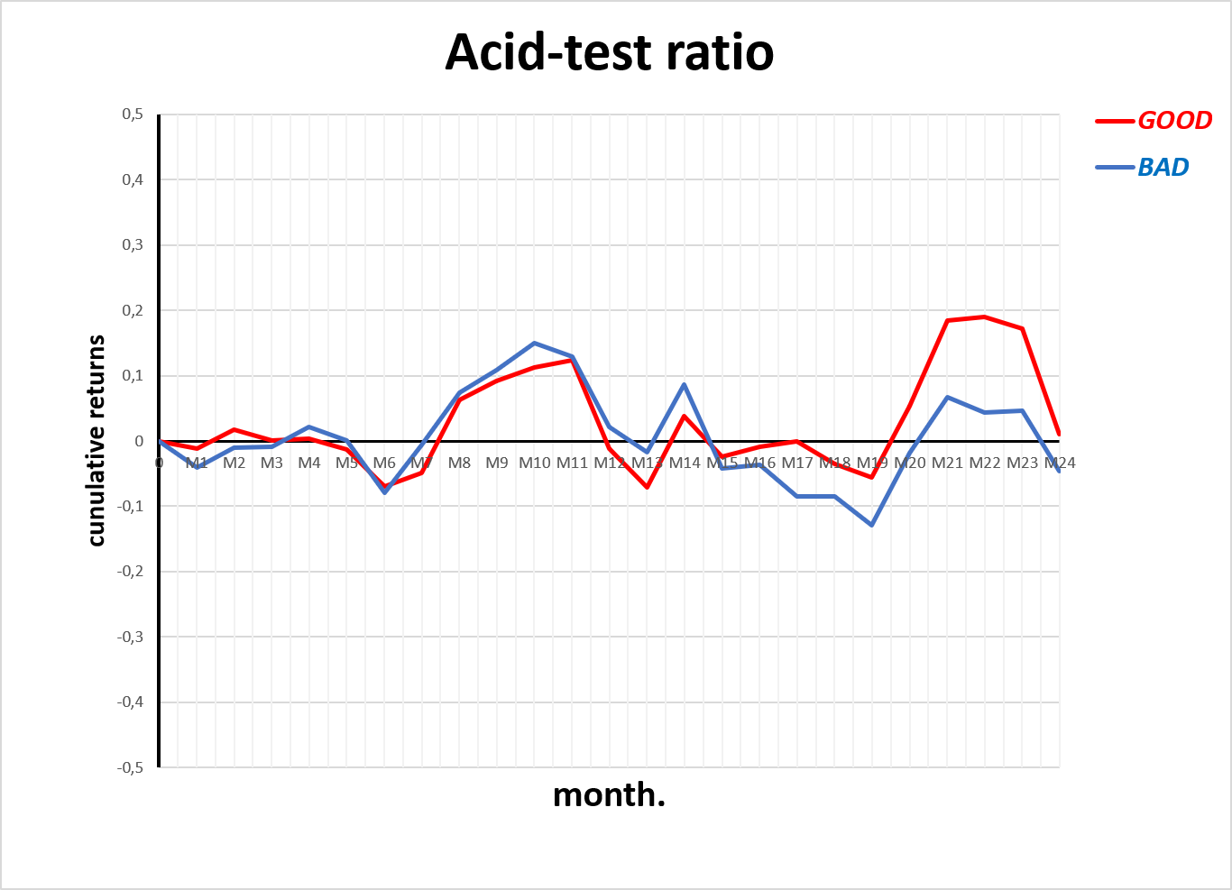
ACID-TEST RATIO
Industry index outperforms the GOOD and BAD groups
Too high or too low current ratio is not optimal; balance is preferred
Global Airline Industry
Financial Statement Analysis - Group 5
Notes:
Moving on to the Acid-test ratio, this metric is similar to current ratio but it ecludes inventory and focuses only on cash and receivable
This is especially important in the airline industry, where inventory and aircraft parts cannot be sold quickly to cover short-term debt
Rankings and results are nearly identical to the Current ratio we just discussed

Slide 11
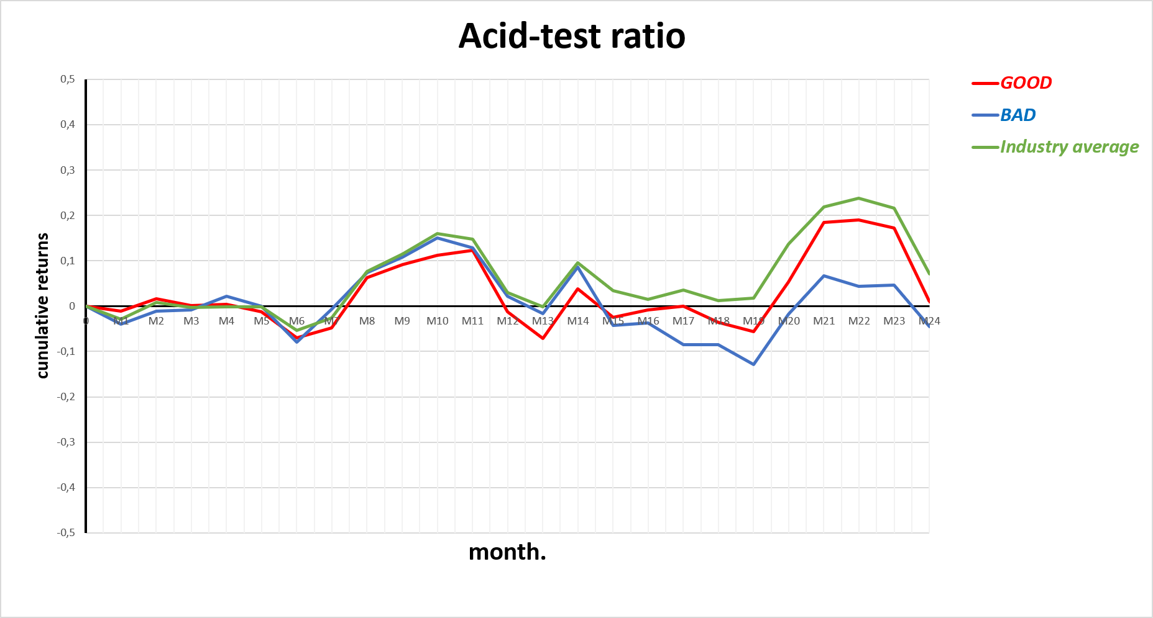
ACID-TEST RATIO
Similar to current ratios
Having high short-term liquidity ratios is rewarded in the long run
Global Airline Industry
Financial Statement Analysis - Group 5
Notes:
Ultimately, this confirms our previous takeaway—immediate market returns are noisy, but having high-quality, instant cash liquidity is what secures long-term structural resilience against industry turbulence

Slide 12
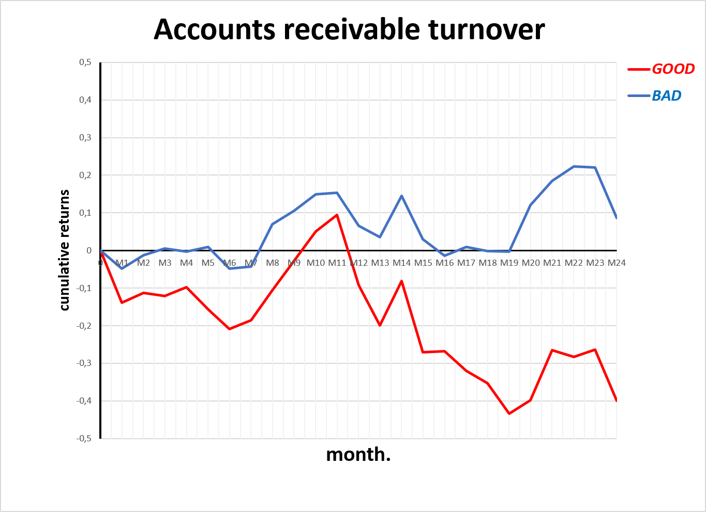
ACCOUNTS RECEIVABLE TURNOVER
BAD group completely outperforms the GOOD group
Difference in business models
High turnover signals reliance on high-volume, low-margin passengers
Low turnover reflects a stable model with high-value coporate customers
Global Airline Industry
Financial Statement Analysis - Group 5
Notes:
Accounts Receivable Turnover measures how many times per year an airline collects its outstanding credit accounts from travel agencies, corporate clients, and cargo partners.
Usually, from our textbook, it is better to have a high turnover, but here the BAD group with lower turnover completly outperforms the GOOD group, and by almost 40% cumulative returns around month 22, why is that?
This happens because of the difference in between the business model of airlines.
Looking at The ultra low-cost carrier Frontier, which is ranked 1st, this ariline requires instant cash at booking to operate, whereas legacy giant like DELTA or Southwest are ranked bottom because they are able to extand flexible credit to highvalue corporate travel accounts
For investors, a high turnover ratio usually means the airline relies more on short-term, low-margin leisure travelers.
A lower turnover ratio suggests more stable, higher-value corporate customers, which can lead to stronger and more consistent long-term returns.

Slide 13
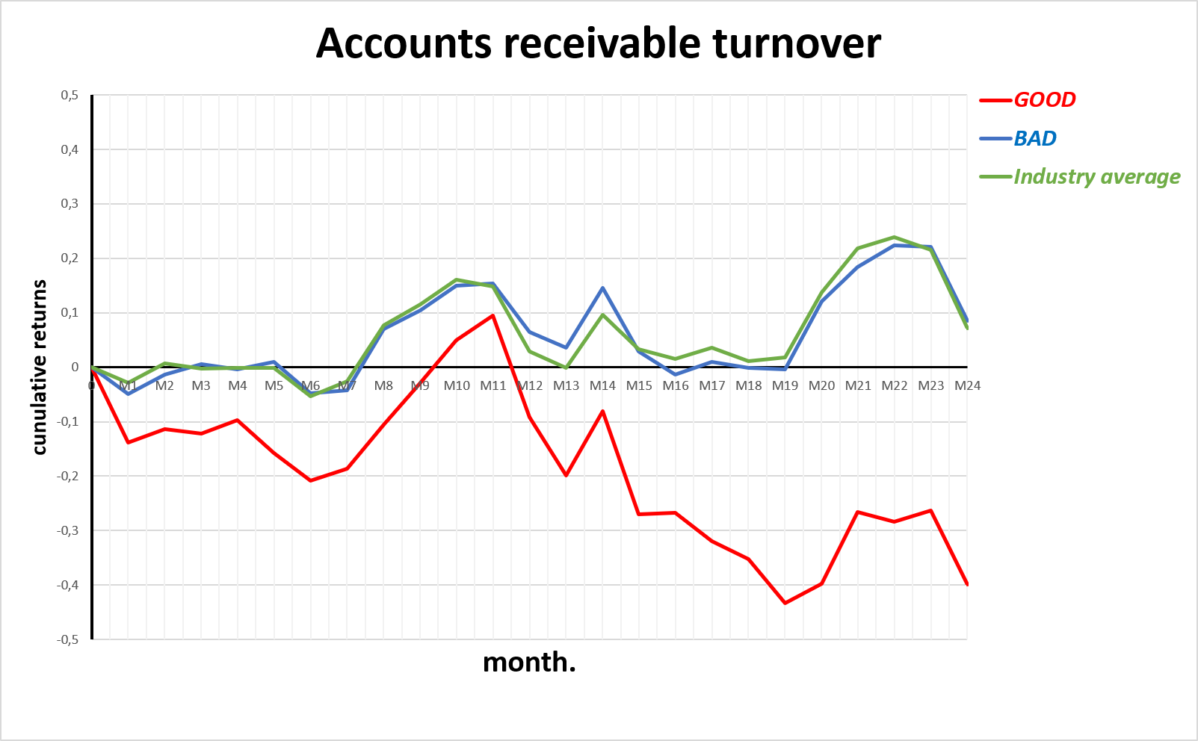
ACCOUNTS RECEIVABLE TURNOVER
BAD group follows the Industry Index
→ Extending credit is the standard, a driver for airline performance
Global Airline Industry
Financial Statement Analysis - Group 5
Notes:
BAD group line is following the Industry Index, so it proves taht that extending credit to secure sticky corporate revenue is the standard, a driver for airline performance.

Slide 14
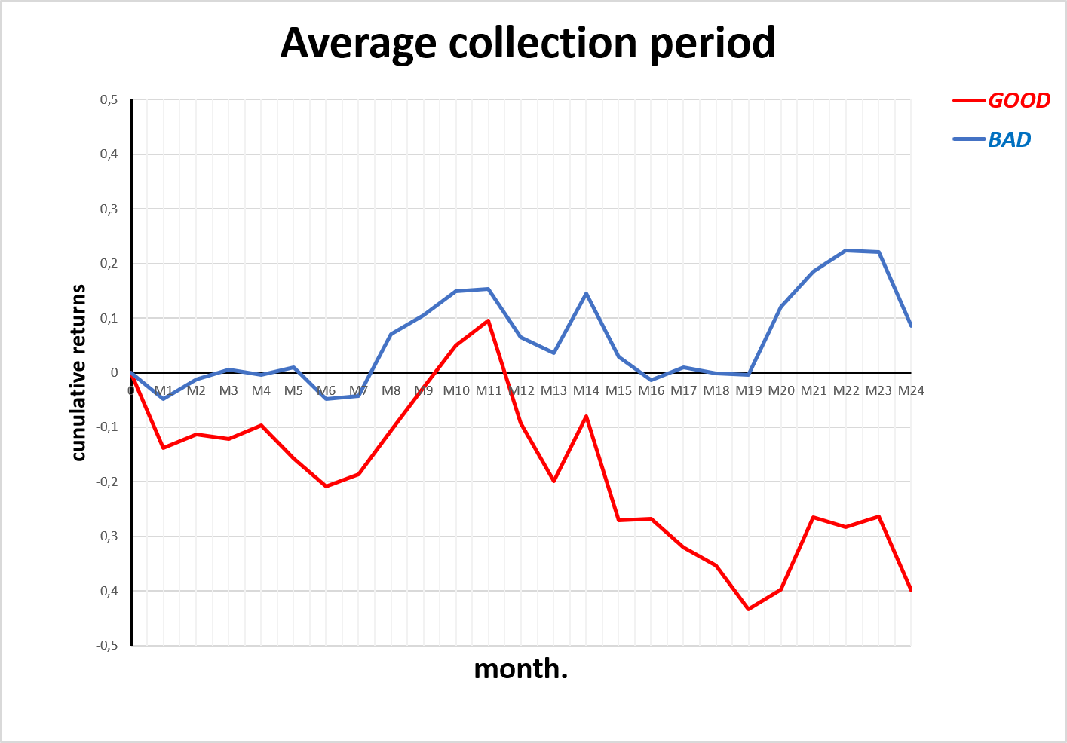
AVERAGE COLLECTION PERIOD
Similar to AR turnover, but in days
Global Airline Industry
Financial Statement Analysis - Group 5
Notes:
Now looking at the Average Collection Period, so we are changing account recveiable turnover into actual numbers of days
Rankings has not changed and graph is almost identical, so conclusion is the same

Slide 15
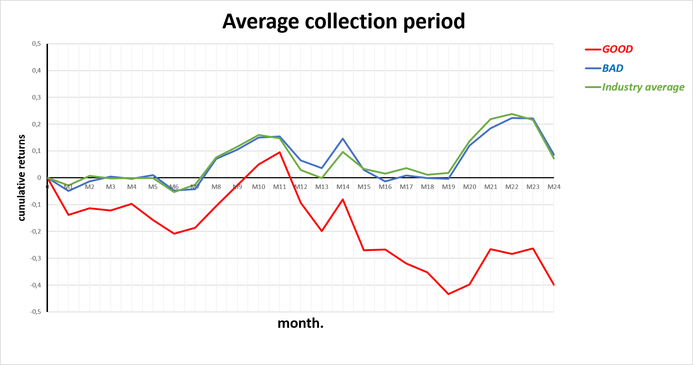
AVERAGE COLLECTION PERIOD
→ Preference for delayed, yet stable revenues of big carriers
Global Airline Industry
Financial Statement Analysis - Group 5
Notes:
Now with the Industry average, this tells us that investors clearly prefer the stable coportae revenue of legacy airlines like delta or southwest, over the low-margin model of ultra low caost carriers.

Slide 16
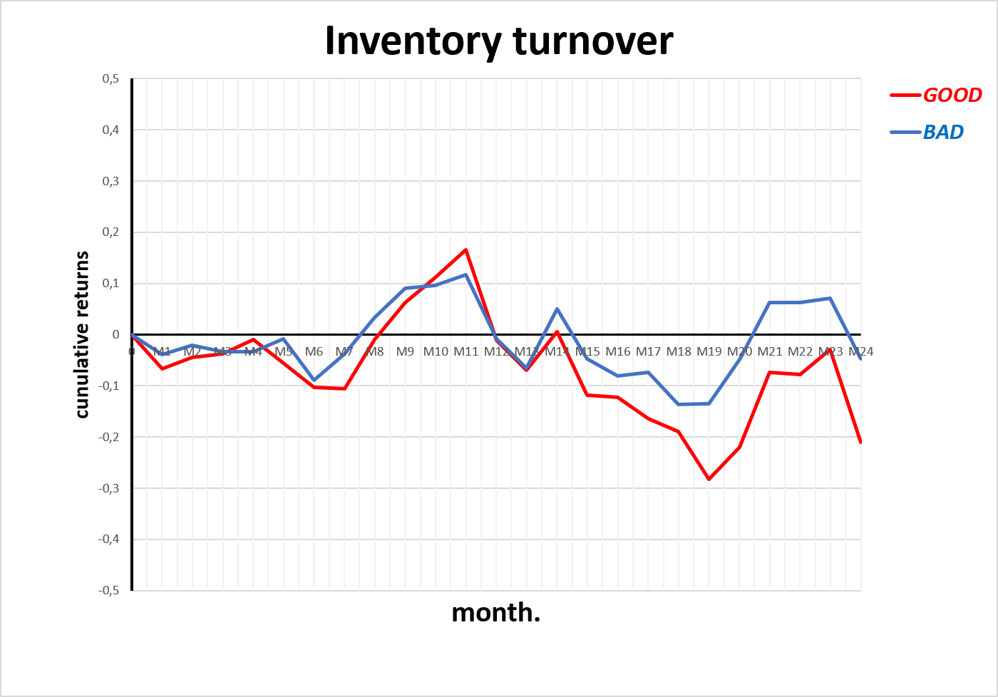
INVENTORY TURNOVER
BAD group is doing better than the GOOD group on the long run
→ Slower turnover: a garantee for smooth operations
Global Airline Industry
Financial Statement Analysis - Group 5
Notes:
Moving on to Inventory Turnover, in the airline industry, inventory consists almost entirely of aircraft spare parts, maintenance components, and other supplies.
A high turniver means they keep very little stocks on hand, and use it fast, while a low turnoevr means they hold onto a large amount of stock for a long time before using it
Usually, high turnover is good, but here it shows the exact opposite with BAD group doing better than GOOD group on the long run,
As a result, the market still prefer the safety cushion of slower inventory turnover because investors want airlines to keep their operations running smoothly wit enough spare parts to handle repairs quickly, without cancelling or delaying flights

Slide 17
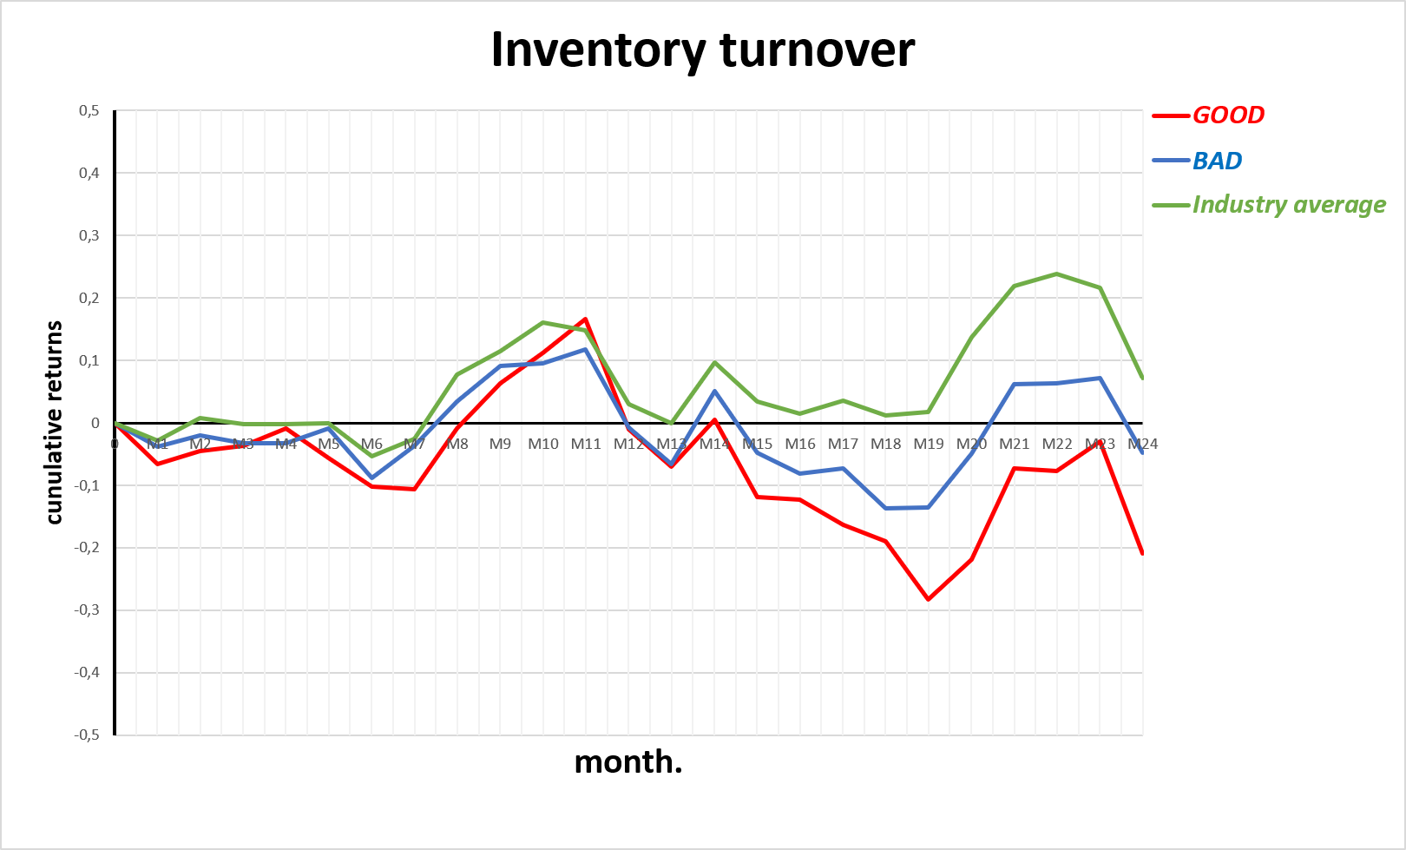
INVENTORY TURNOVER
GOOD and BAD groups underperforms the industry index
→ Having an optimized, balanced inventory management is the key
Global Airline Industry
Financial Statement Analysis - Group 5
Notes:
both GOOD and BAD are completely crushed by the green Industry Average line, which stays firmly positive.
This happens because if you choose very fast turnover, it means that you gave almost no safety stocks in case of maintenance or repair necessity, but you choose very slow turnover it means you keep huge quantity of stocks, which burns cash
As a result, balancing inventory management is the key

Slide 18
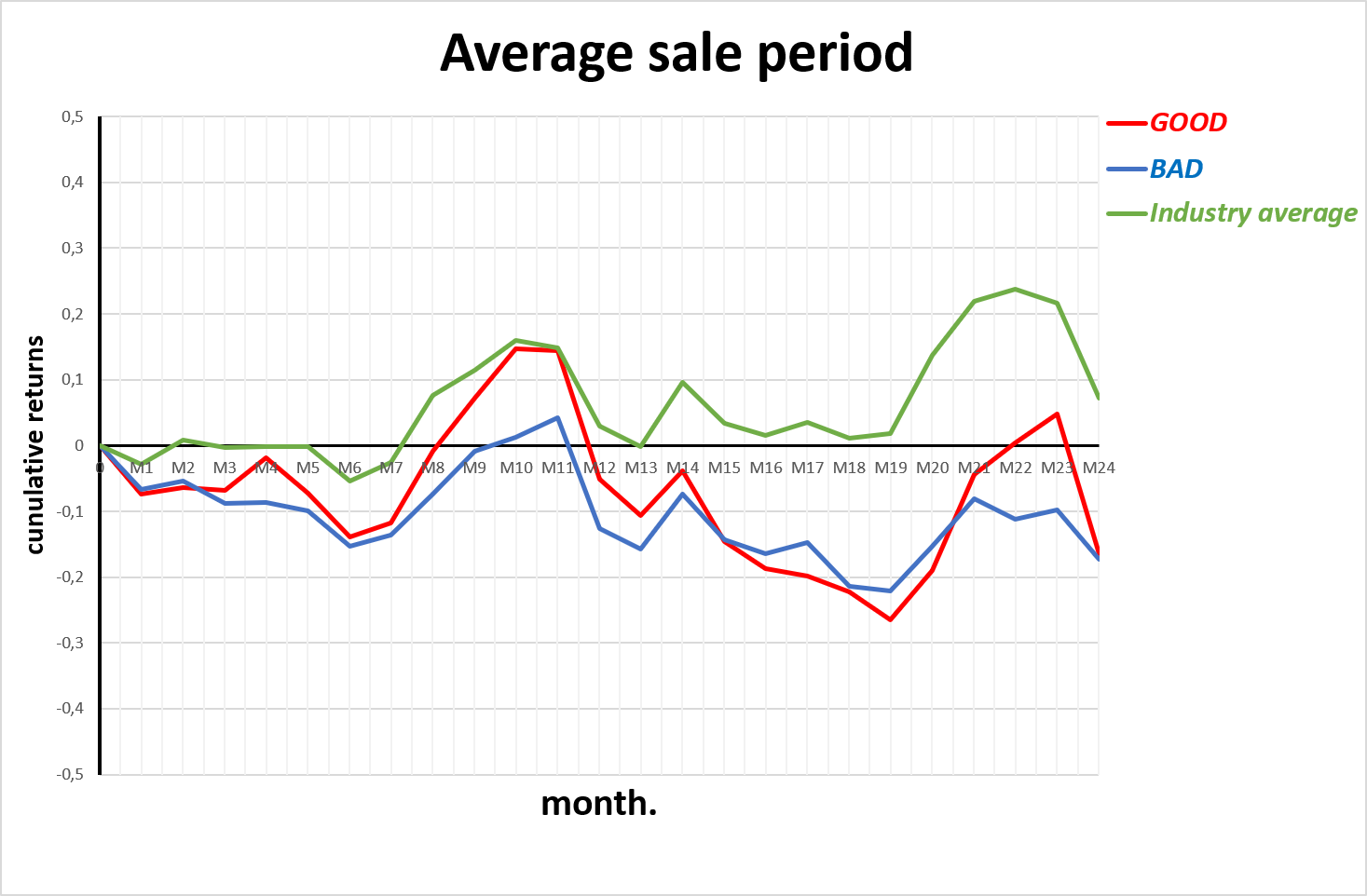
AVERAGE SALE PERIOD
Similar to Inventory Turnover
→ Having an optimized, balanced inventory management is the key
Global Airline Industry
Financial Statement Analysis - Group 5
Notes:
And following that logic, the avaergae sale period turns the annual turnover into exact numbers of days
Again it shows us that the best inventory strategy is one that minimizes time spent sitting in a hangar, while still keeping just enough operational buffer to ensure the daily flight schedule remains perfectly protected."

Slide 19
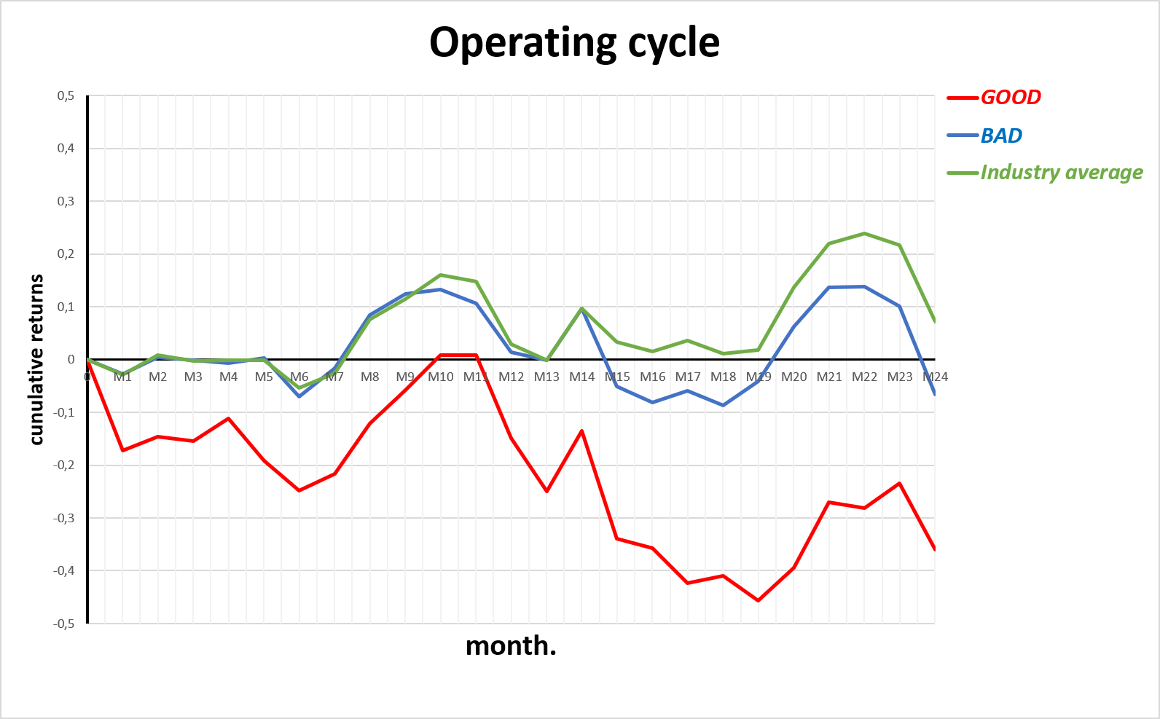
OPERATING CYCLE
Preference for slower operating cycle
Fast operating cycle is a sign of strucural vulnerability
Investors prefer operational resilience
Global Airline Industry
Financial Statement Analysis - Group 5
Notes:
Now we arrive at the Operating Cycle, which brings everything we have said before
This ratio tell us how fast an airlines can turn asset into cash
Once Again the BAD groups outperfomrs the GOOD group, which reach negative 40% returns
Ultra-low-cost carriers like Frontier (ULCC) and Allegiant (ALGT) rank at the top because they hold very little inventory and collect cash quickly. However, this makes them more vulnerable to maintenance delays and keeps them focused on lower-margin leisure passengers.
On the other hand, legacy airlines like American Airlines (AAL) and Delta (DAL) rank lower because they keep large spare-parts inventories and offer more flexible payment terms to corporate customers.
→ this proves that in the airline industry, an ultra-fast operating cycle is actually a sign of structural vulnerability. That’s why investors prefer slower operating cycle of big carriers

Slide 20
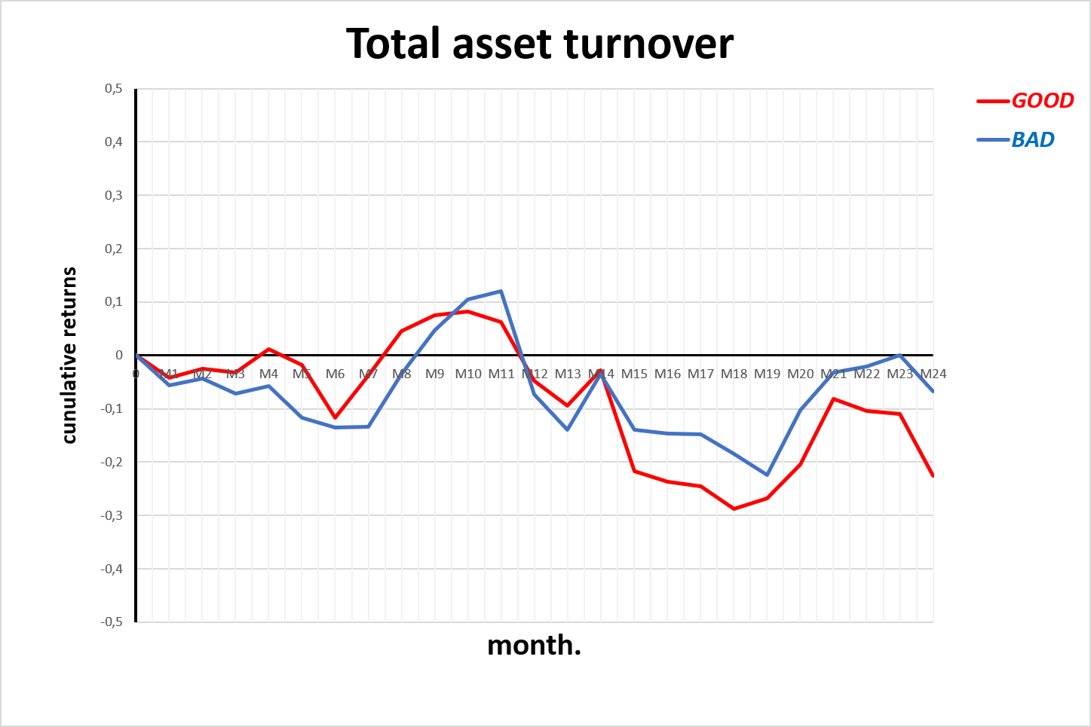
TOTAL ASSET TURNOVER
Ratio < 1 because it is airlines is a capital-intensive industry
Too low asset turnover means assets are not used efficiently
Too high asset turnover might signal risk-taking by reducing inventory
→ In both case, profitability suffers, which explain negative retuns
Global Airline Industry
Financial Statement Analysis - Group 5
Notes:
To conclude our efficiency ratio analysis, if operating cycle shows us how far airlines can turn assets into cash, now total asset shows how much revenue an airline generates for every dollar invested in its assets,
but if we look at the value table asset turnover for each companys is under 1, which means for $1 of asset, it generates less than $1
Why are these numbers so low? Because airlines are among the most capital-intensive businesses. Their balance sheets are severely weighed down by massive, fixed assets like aircrafst, engines, quipment. Because of that it grads the entire ratio down mathematically
This aspect of the airlines industry als explain the negative retuns here,
When an airline sits in the “BAD” with very low asset turnover (like Allegiant in the 0.40–0.50 range), it means a large portion of its fleet is not being used efficiently. They are not generating enough revenue.
On the other hand, GOOD” extreme by stretching a small or aging fleet creates operational problems like delays, maintenance constraints, and scheduling issues.
n both cases, profitability suffers, which is why returns can end up negative at the extremes.

Slide 21
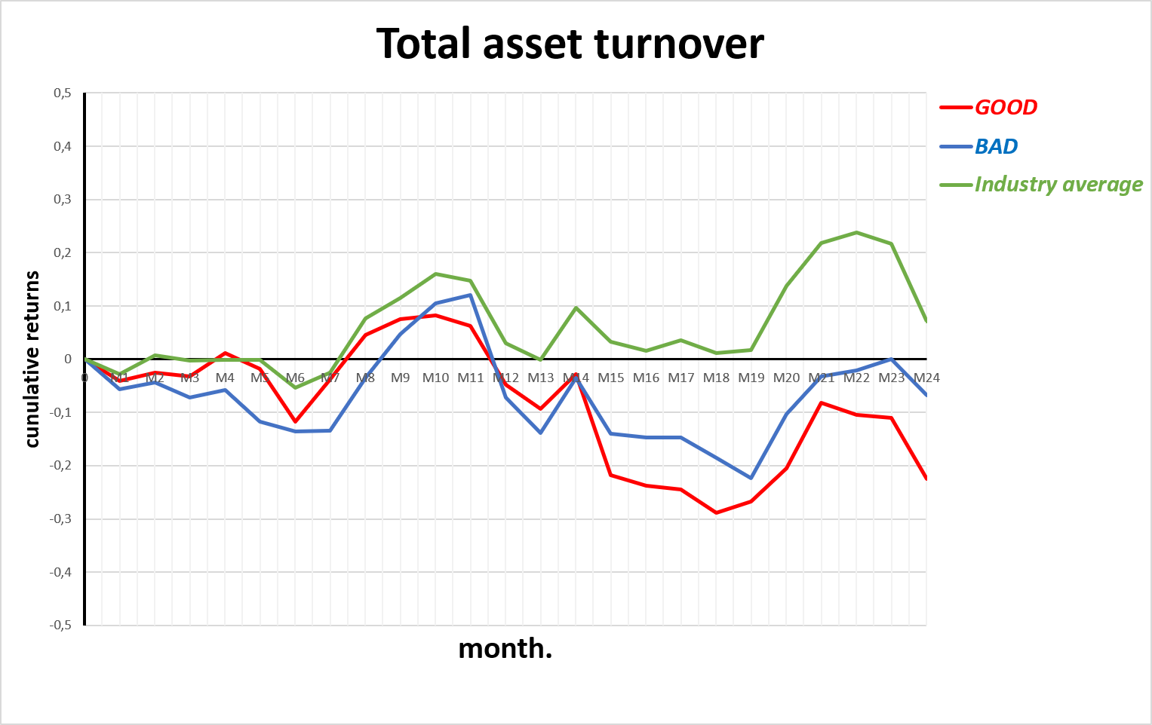
TOTAL ASSET TURNOVER
Too high or too low asset turnover is not the optimal strategy
→ Industry Index proves that once again a better balance is the key
Global Airline Industry
Financial Statement Analysis - Group 5
Notes:
At the end of the day, investors penalize both extrem strategies, they reward those who matching fleet capacity better with consumer demand to maximize revenue without drowning in fixed-asset overhead."

Slide 22
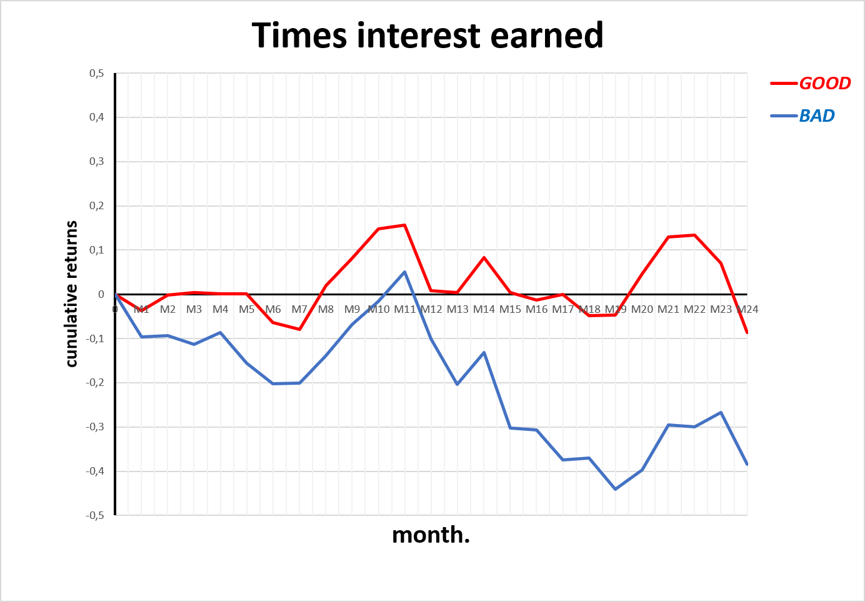
TIMES INTEREST EARNED
Low-cost model carriers are failing to generate positive EBIT
They cannot absorb rising fixed costs
→ Solvency risk is highly punished by the market
Global Airline Industry
Financial Statement Analysis - Group 5
Notes:
Okay now let’s move on with the leverae ratios, starting with times interest earned, which evaluates solvency by calculating how many times over an airline operating profit can cover its fixed interest expenses
Looking at the value, many ratios are dangerously low, but we see multiple negative values too such as Frontier with -3.24 in 2025, and even Jeetblue for consécutives years. Usually in textbook, solvency risk like that is agressively punished by the market, and we can see it here with the blue line showing retuns reaching negative 40%
Here low-cost models like frontier and jetblue are failing to generate positive operting profit to cover their obligations, proving that this model is unable to absorb rising fixed costs, thereby impacting their profitability
On the oposite Delta is performing at the top being able to pay confortably its dept eight time over.
- the market has zero tolerance for solvency issues. A high, positive Times Interest Earned ratio is an absolute prerequisite for corporate survival, and investors heavily rewarded carriers like Delta

Slide 23
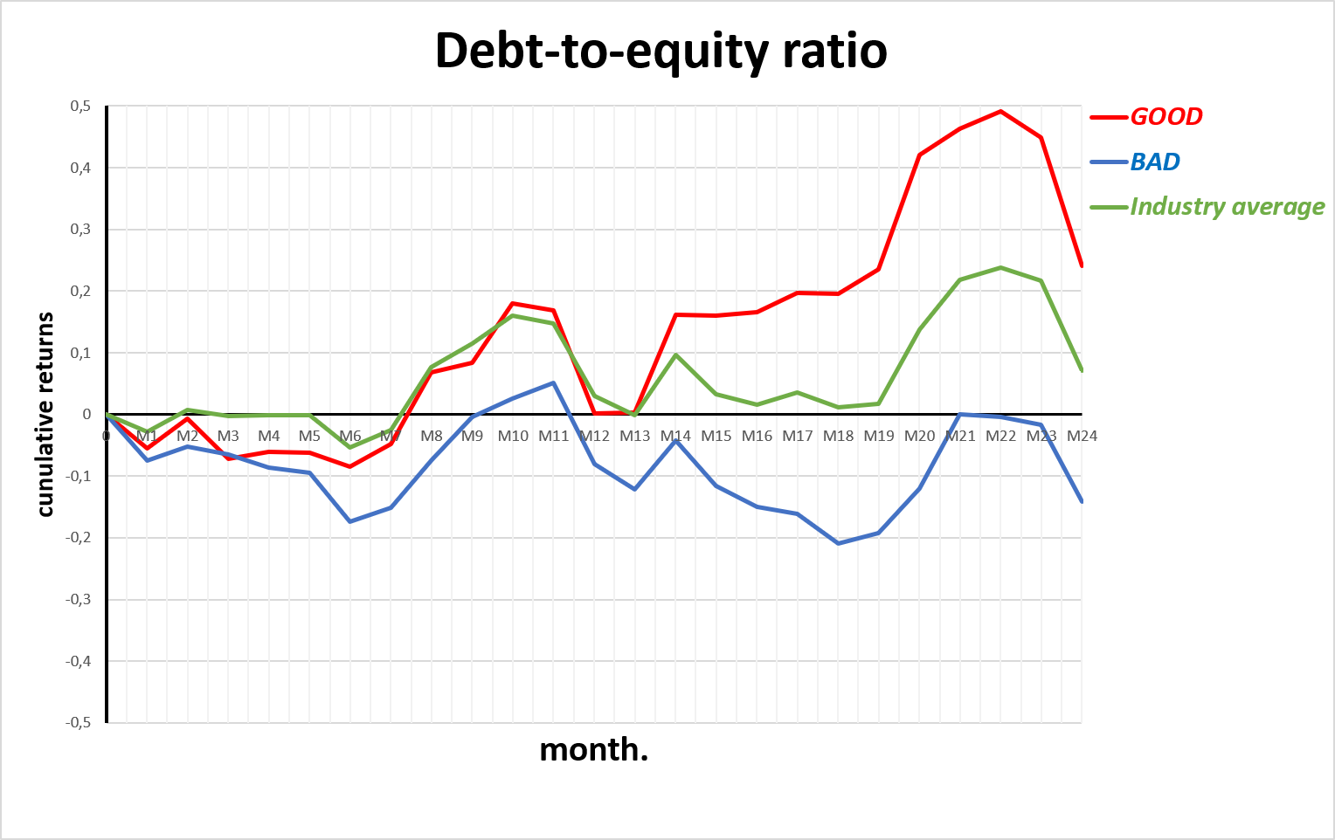
DEBT-TO-EQUITY RATIO
Highly financially leveraged airlines are rewarded
GOOD group is highly profitable models like Delta and United
→ Investors envourage aggressive asset expansion
Global Airline Industry
Financial Statement Analysis - Group 5
Notes:
Now we look at the debt to equity raito. This metric measures how much debt an airline uses compared to the shareholders’ equity financing the company.
Rank 1 represents the highest Debt-to-Equity ratios, and the graph reveals a fascinating trend: the market heavily rewards high financial leverage
Looking at the performance: : The GOOD group that showcare big carrier like DELTA and United, reaches a dominant 50% cumulative return.
In the Case of Delta it is understandable when they can pay their interest eight times over
n a capital-intensive industry, debt is the primary fuel for growth, as long as the airline has the strong revenue to back it up

Slide 24
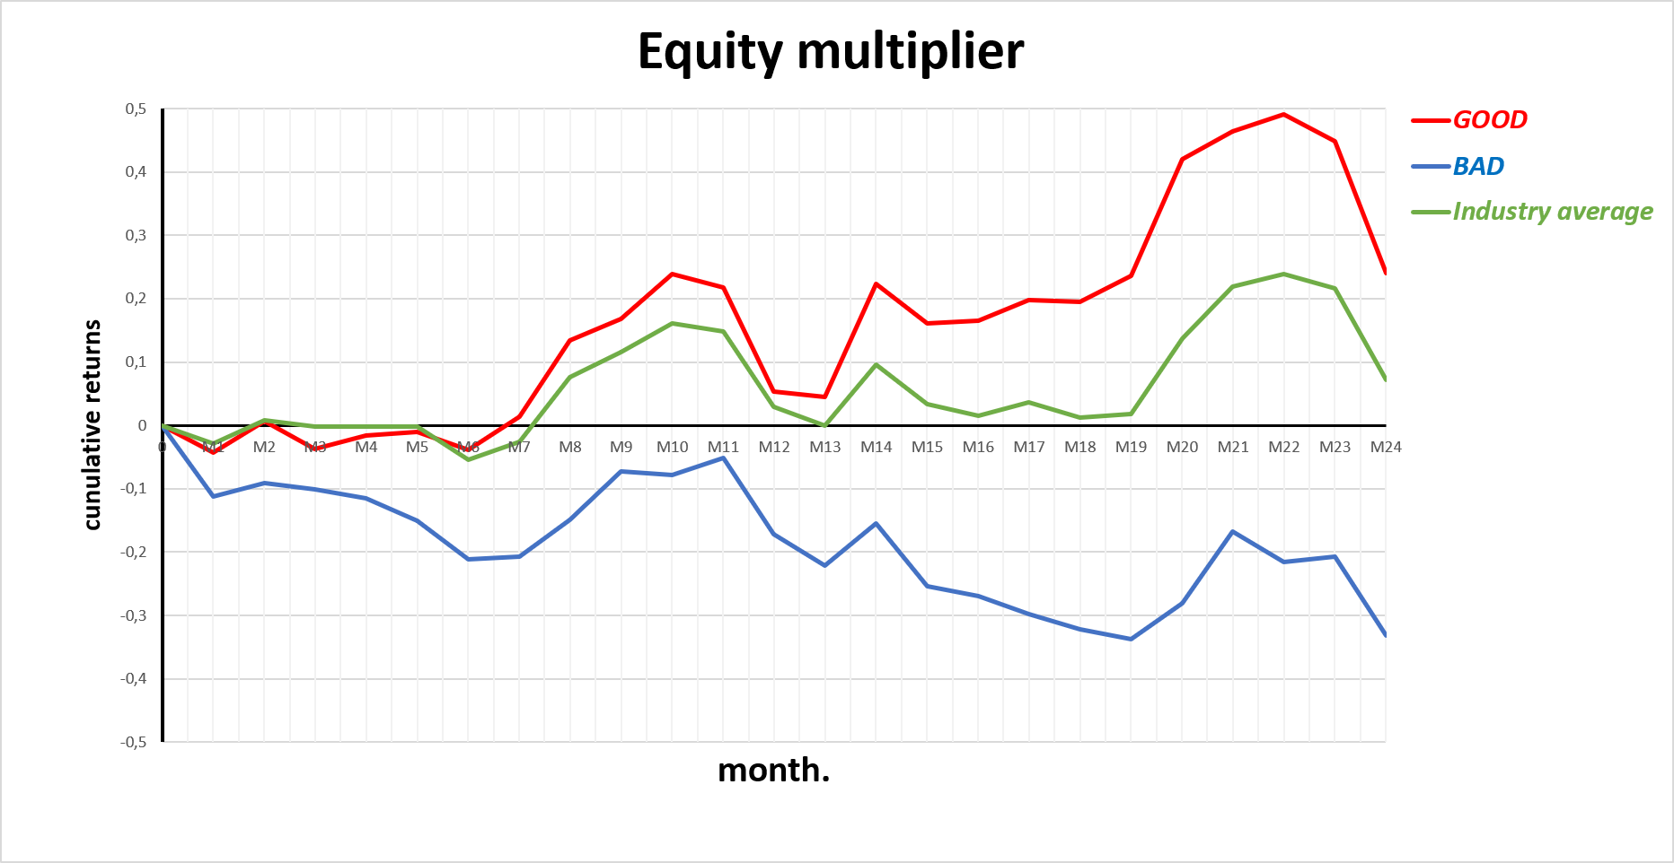
EQUITY MULTIPLIER
Highly financially leveraged airlines are rewarded
GOOD group is highly profitable models like Delta and United
→ Investors envodemand agressive leverage but require stable equity
Global Airline Industry
Financial Statement Analysis - Group 5
Notes:
Equity Multiplier measure how much of an airline’s asser are backed by its shareholders versus how much relies on debt.
Here Rank 1 represnts the highest multipliers, signaling agressive asset leverage
On the flip side, the market penalizes passivity and distress. JetBlue sits near a 1-to-1 asset-to-equity ratio, which investors views as under-leveraged and stagnant.
. Meanwhile, American Airlines is stuck dead last at Rank 8 every year because its massive debt load completely wiped out its shareholders' equity into deep negative return
The key takeways : investors demand aggressive financial leverage to expand assets, but they require a positive, stable equity cushion to support that growth

Slide 25
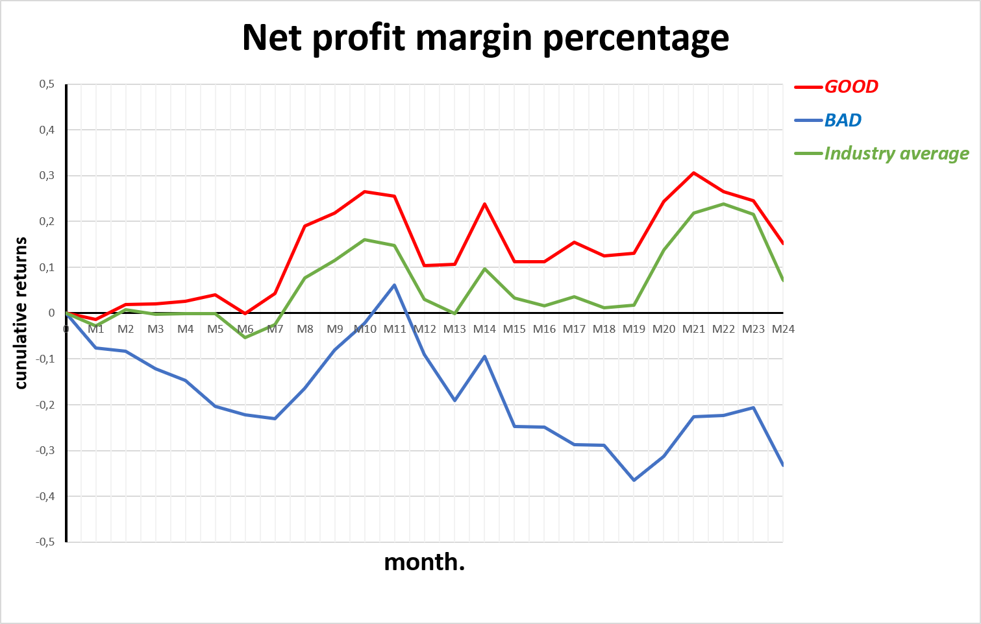
NET PROFIT MARGIN PERCENTAGE
Most profitable airlines are top carriers
Low-cost models without profit cannot generate shareholders returns
→ In capital-heavy sector, strong margins are essential
Global Airline Industry
Financial Statement Analysis - Group 5
Notes:
Now let’s focus on the profitability metrics with the Net Profit Margin.
The rankin table shows that most poritable airlines are usually bit carriers like Delta and United, The red 'GOOD' portfolio tracks the high-margin winners, yielding an upward trend of nearly 30% cumulative returns
In a capital-heavy sector, strong margins are the only way to fund asset expansion and cover fixed costs without relying on toxic debt
Without a profitable business, the budget models cannot generate shareholder returns,

Slide 26
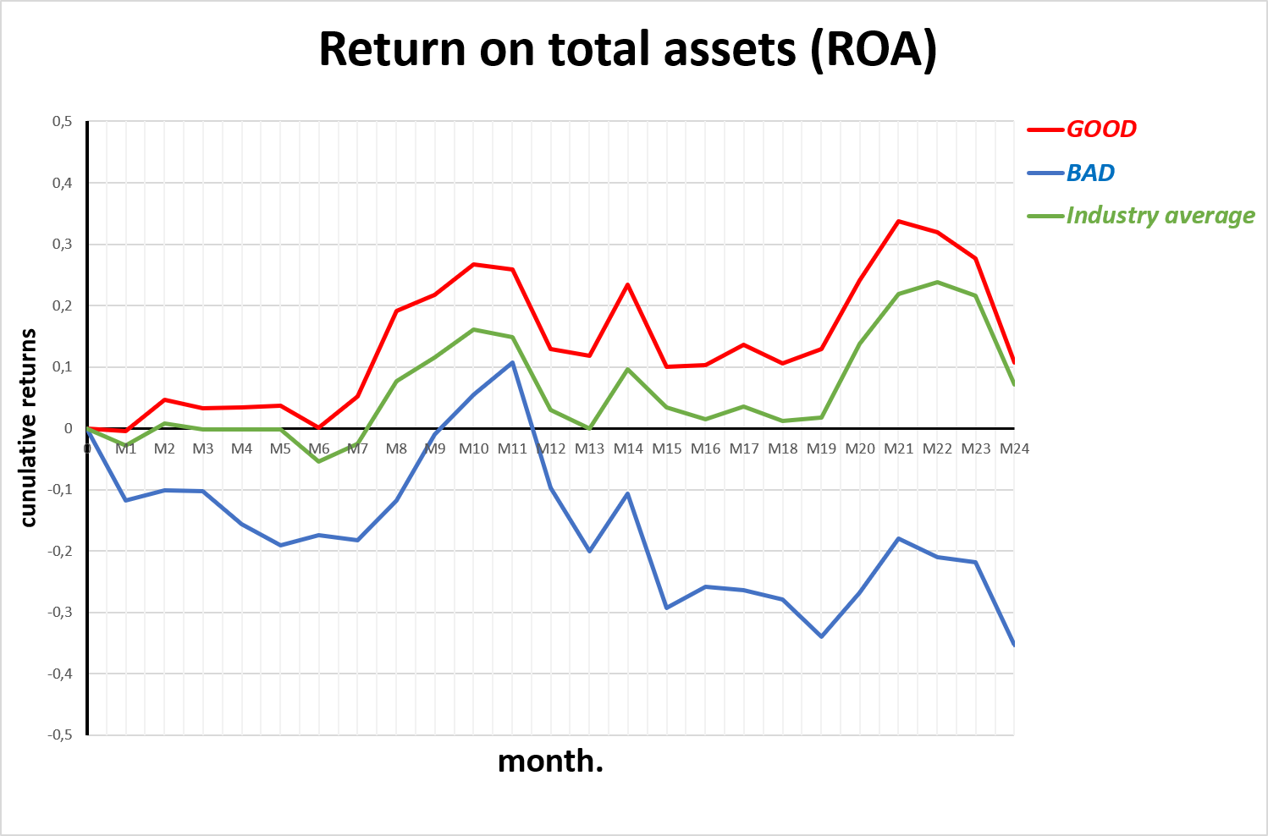
RETURN ON ASSET (ROA)
GOOD protfolio outpaces the BAD group by reaching up to 30%
Market favors greatly profit generating airlines
Further proof that low-cost models are suffering
Global Airline Industry
Financial Statement Analysis - Group 5
Notes:
The Return on Asset tells us exaclty how effieciently manaement turns assets into profits.
Once again legacy carriers with Delta and United are most efficiant asset performers, and investors favors those arilines that can optimize their own profits
Meanwhile, this serves as further definitive proof that low-cost models are suffering heavily. Like Frontier or Jetblue
This proving that superior asset efficiency generates significant extra value, while companies with weak asset utilization heavily destroy investor capital.
For investors, a high ROA proves that an airline isn't just expanding its fleet size blindly; it's actively maximizing the revenue and profit potential of every single aircraft, making it an excellent signal for stock market outperformance.

Slide 27
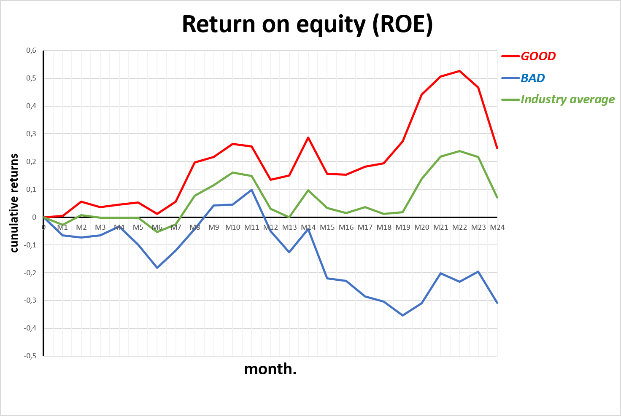
RETURN ON EQUITY (ROE)
High ROE has an even greater impact on returns than high ROA
Investors are especially looking at this ratio
→ They favor airlines with high ROE, mostly big carriers
Global Airline Industry
Financial Statement Analysis - Group 5
Notes:
Moving on the the Return on equity, one of investors favourite ratio because it measures exactly how much profit management generate from shareholder capital.
- The graph reveals that market heavily reward high ROE, with red GOOD group reaching up to 50% cumulative returns
with the same arilines dominating the ranking.
- Hile on the other hand ultra-low-cost carriers like Frontier (ULCC) and Allegiant (ALGT) drop straight into the bottom blue spots in later years, signaling that their low-margin business models struggled to generate meaningful equity returns.

Slide 28
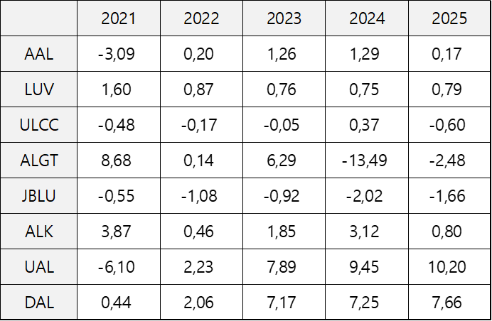
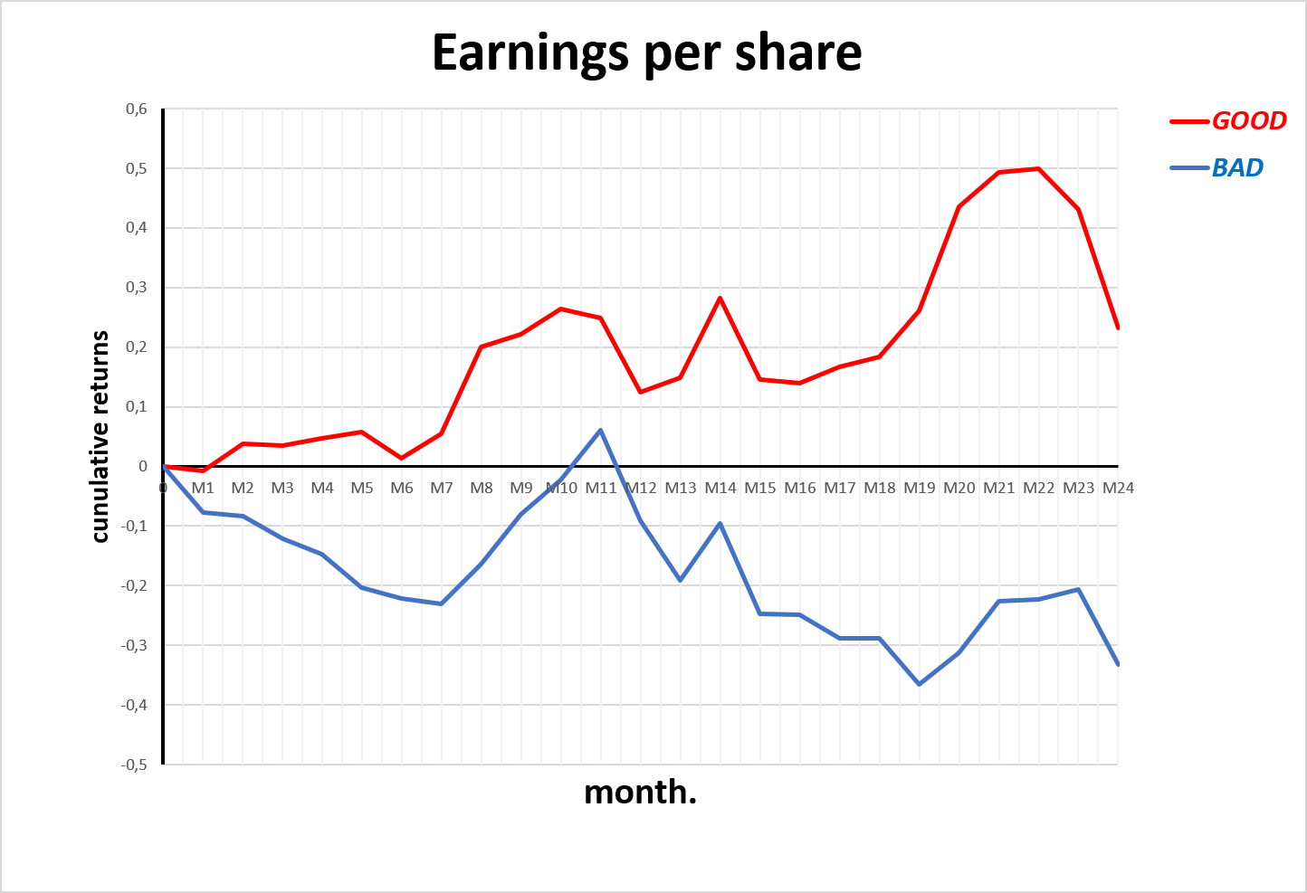
RETURN ON EQUITY (ROE)
Structural shift from low-cost carriers at the top to big carriers
→ EPS a reliable predictor for strong stock performance
Global Airline Industry
Financial Statement Analysis - Group 5
Notes:
Earnings per Share measures an airline's net profitability allocated to each outstanding share of common stock, serving as a primary gauge of bottom-line health.
GOOD group with high EPS completely outperforms the BAD group by a massive 80% gap in cumulative returns around month 22.
Looking at the ranking table, we see a structural shift in 2021 where legacy giants United and American ranked at the very bottom due to massive pandemic fixed costs, while low-cost leisure carriers like Allegiant took the top spots.
However, from 2022 to 2025, United and Delta permanently reclaimed the top 2 spots,
For investors, a consistently positive,and high EPS proves making it a reliable predictor for strong stock performance

Slide 29
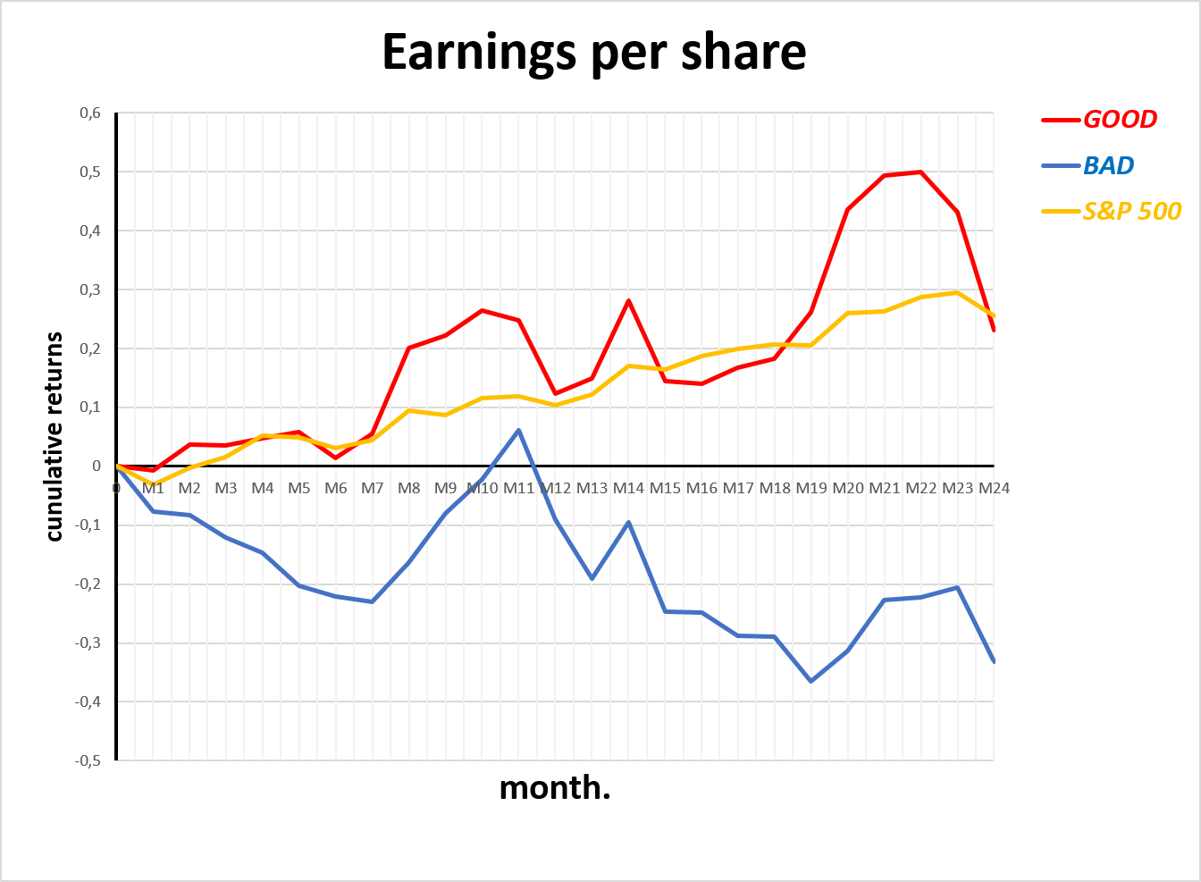
EARNINGS PER SHARE
High EPS Airlines actually beat the market
They generate true market alpha
They outpace the broader index by almot 20% returns in month 22
Global Airline Industry
Financial Statement Analysis - Group 5
Notes:
we've included the yellow S&P 500 benchmark line. This demonstrates that high-EPS airlines—tracked in red—didn't just beat their peers in the same industry; they also beat the market and generated true market alpha, ,thereby outpacing the broader index with returns peaking over 50%

Slide 30
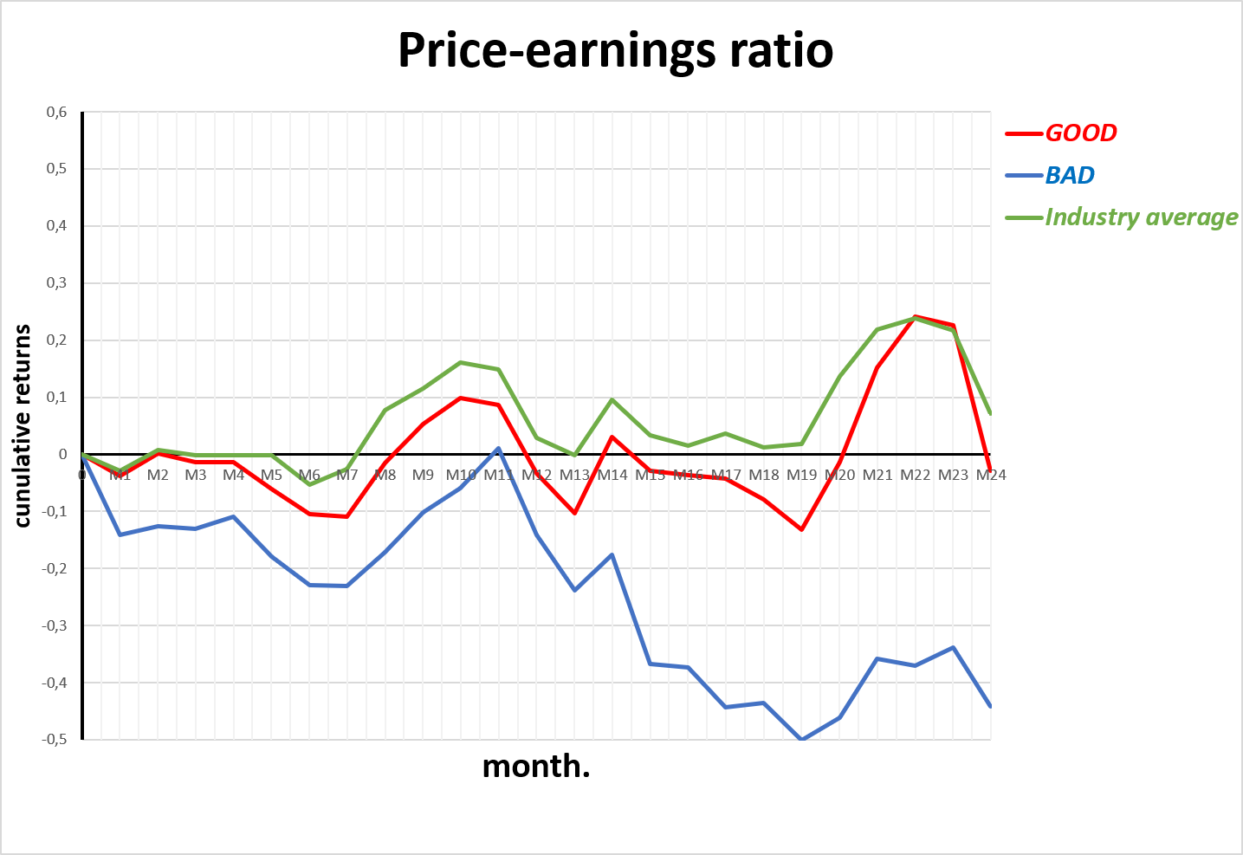
PRICE-EARNINGS RATIO
Low P/E ratios airlines are low-cost carriers
High P/E airlines track the Industry Index
High P/E does not garangee better returns than Industry Index
Low P/E garantee lower returns
Global Airline Industry
Financial Statement Analysis - Group 5
Notes:
Price-earnings ratio measures the market price of an airline's stock relative to its earnings per share, showing how much investors are willing to pay for every dollar of profit.
our graph shows that the BAD group with usually low-cost carriers like Frontier or Jetblue have lower or negative P/Eand they underperforms significantly, lagging behind the GOOD group by a wide 40% margin around month 22.
Considering that Industry Index, companies with a high P/E ratio simply match the general market trend, while airlines with a low or negative P/E destroy investor value.
For investors, a high P/E ratio in this sector does not guarantee market-beating returns, but avoiding the low P/E "value traps

Slide 31
DIVIDEND PAYOUT RATIO
DIVIDEND YIELD RATIO
Global Airline Industry
Financial Statement Analysis - Group 5
Notes:
xplain why airlines didn't give dividend! > Because of government subsidies

Slide 32
DIVIDEND YIELD RATIO
Global Airline Industry
Financial Statement Analysis - Group 5

Slide 33
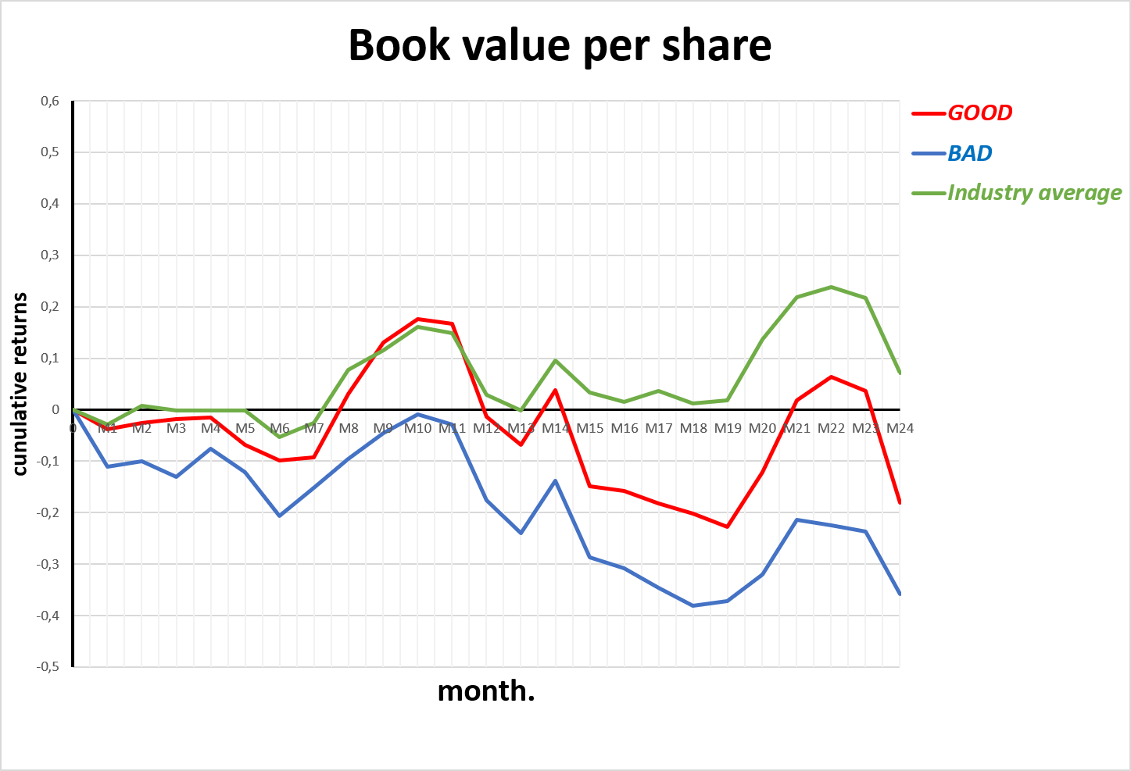
BOOK VALUE PER SHARE
High BPS does not easily translate into market-beating return
→ Caution from investors because high BPS is irrelevant in aviation unless planes actively genereate earnings
Global Airline Industry
Financial Statement Analysis - Group 5
Notes:
Book Value per Share measures the net asset value of an airline on a per-share basis, representing the theoretical amount shareholders would receive if the company liquidated all assets and paid off all debts
Interestingly, the performance graph shows that the market doesn’t blindly reward high book value
The green industry average line actually leads, while the GOOG group underperforms. Investors treat book value with caution because a high paper value is meaningless in aviation unless those planes are actively generating strong forward earnings.“

Slide 34
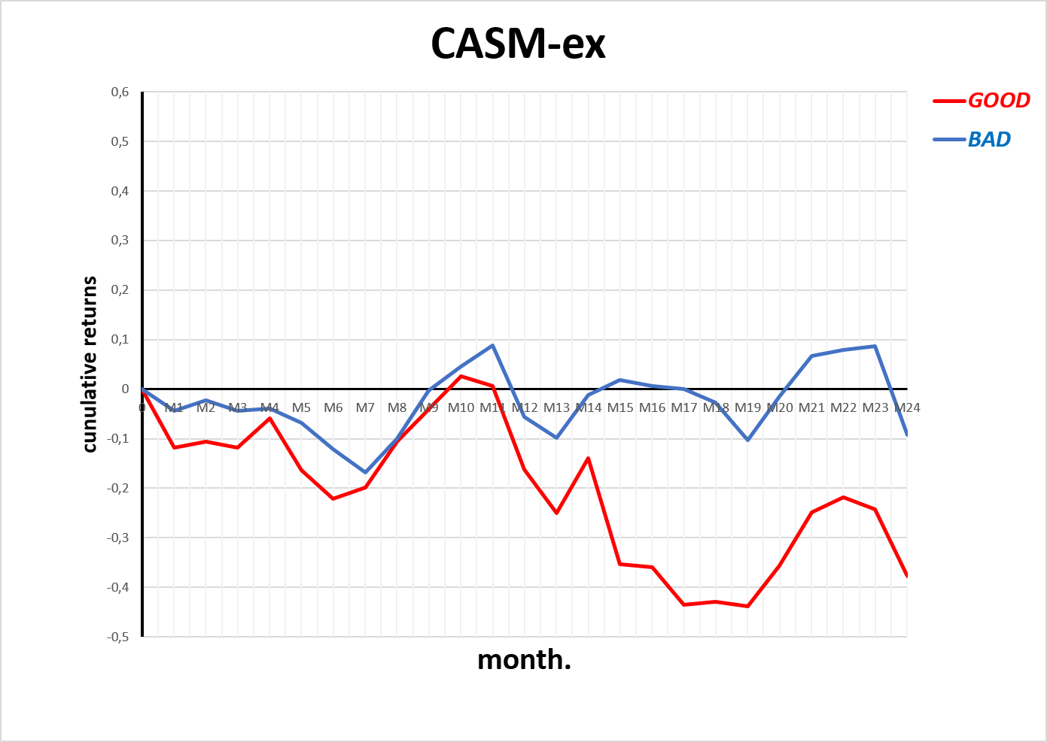
CASM-ex
Reflect the difference between business models
Less cost-efficient airlines are not legacy carriers
→ Investors don’t reward cost-efficient airlines
Global Airline Industry
Financial Statement Analysis - Group 5
Notes:
Now looking on indsutry specific metrics.
CASM-ex (Cost per Available Seat Mile excluding fuel) measures an airline’s core operating efficiency by calculating how much it costs to fly one seat one mile, stripping out highly volatile fuel prices.
This metrics particularly highlights how insensitive investors are toward ultra low cost models that are rank among the GOOD group because our graph shows the high-cost BAD group completely outperformnig the low-cost GOOD group
However, what is interesting to not is that less cost-efficient arilines are not bit legacy carriers contrarly to expectations, but meridum class like alska

Slide 35
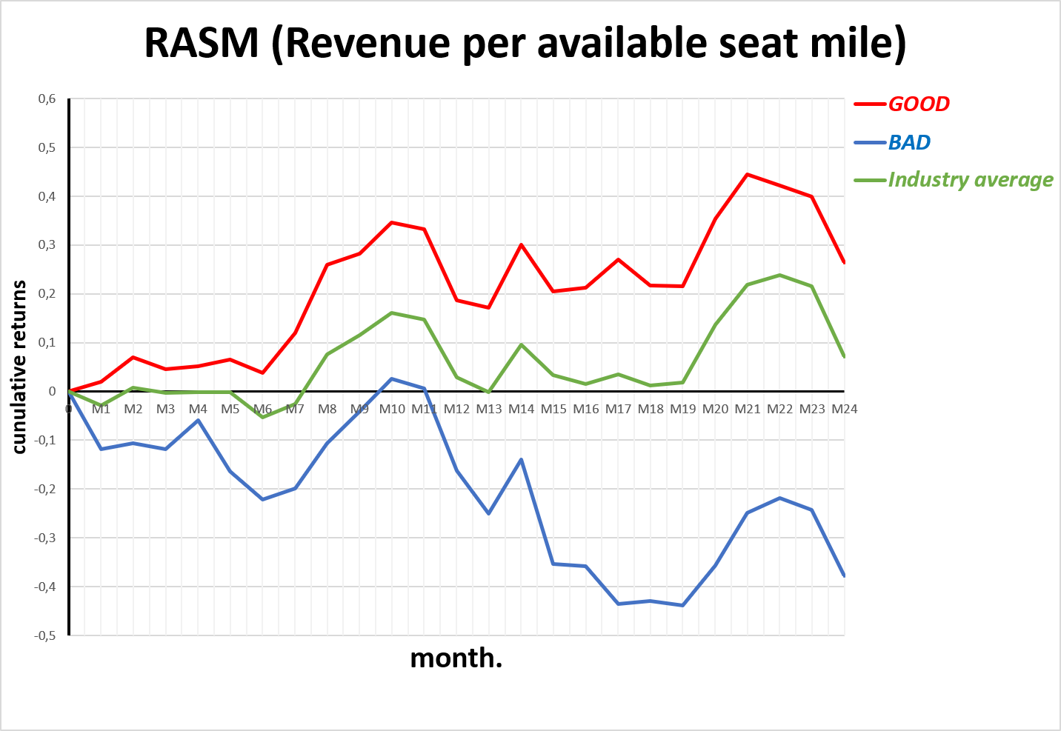
RASM (Revenue per available seat mile)
High RASM airlines outperforms
Primary metric for driving better market returns in this industry
→ ASM is a highly reliable indicator of stock market success
Global Airline Industry
Financial Statement Analysis - Group 5
Notes:
RASM (Revenue per Available Seat Mile) measures an airline's top-line efficiency by calculating the total operating revenue generated per seat flown one mile, capturing both passenger ticket yields and extra fees like baggages.
GOOD group with strong unit revenues completely outperforms the BAD group by a massive 65% around month 22
IT proves that superior unit-revenue generation is the primary engine for driving premium market returns in this sector.
As a result, For investors, a high RASM is a highly reliable indicator of stock market success,

Slide 36
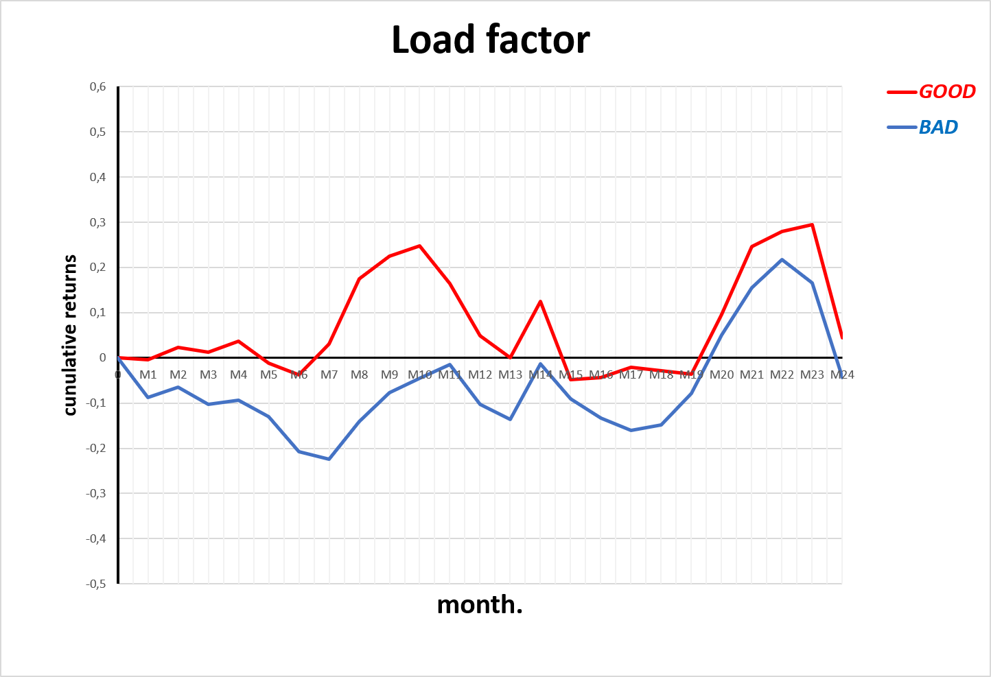
LOAD FACTOR
An advantage for higher load factor airlines
Load Factor alone is an incomplete metric
Global Airline Industry
Financial Statement Analysis - Group 5
Notes:
Load Factor measures the percentage of available seating capacity that an airline actually fills with passengers, serving as a primary indicator of fleet utilization and demand.
GOOD group with higher load factor does hold an advantage,
Looking at the ranking table, we see extreme volatility in the business models:, there is no constant leaders, however (ULCC) consistently rank near the bottom, which sounds alarming since as a ultra low-cost they should seak for full load factor

Slide 37
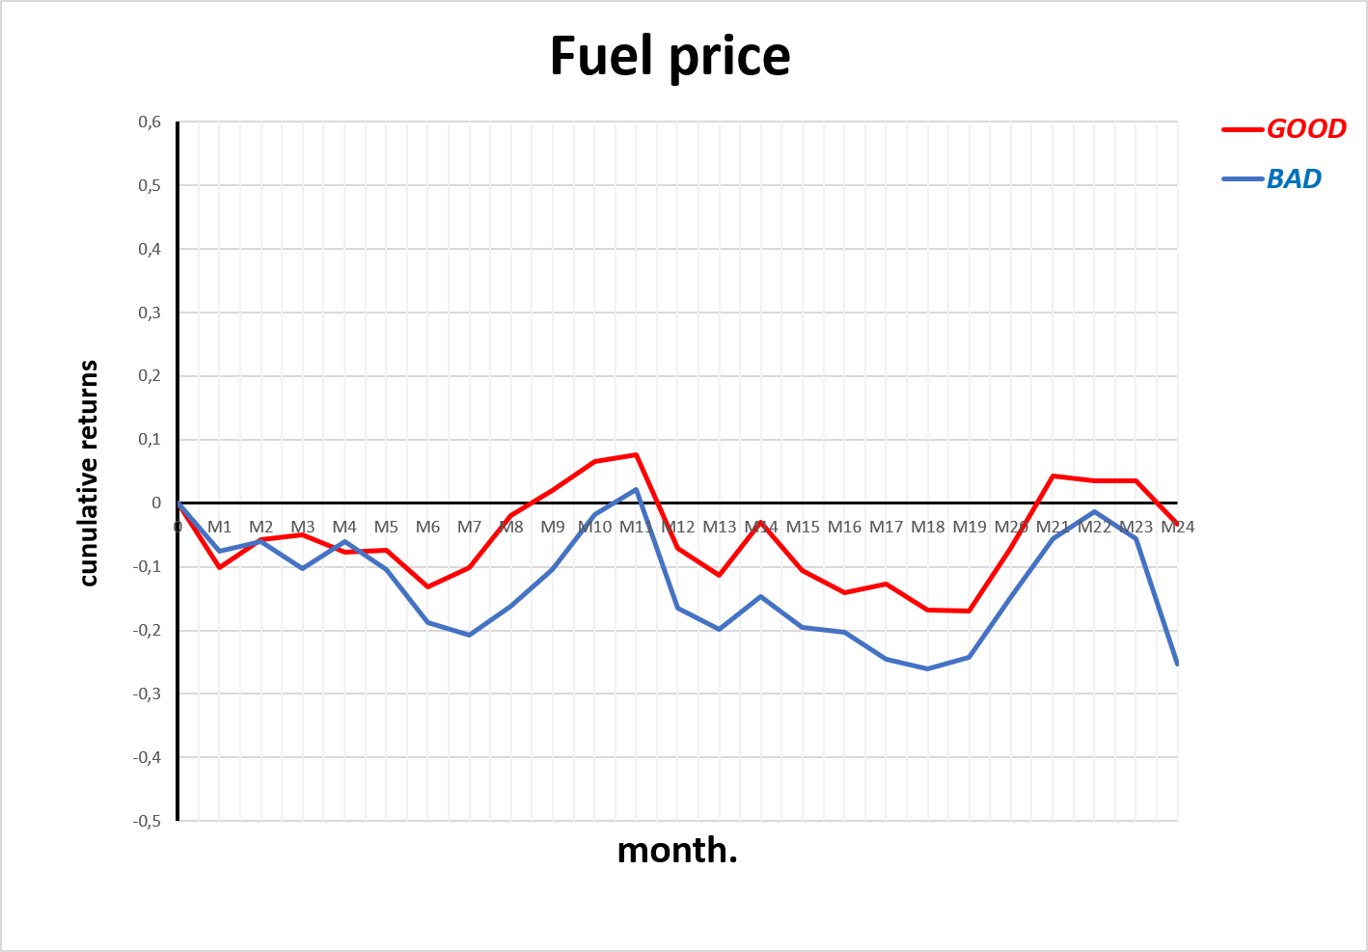
LOAD FACTOR
Buget models airlines struggle to secure best prices
→ Better returns when negociating most competitive fuel price
Global Airline Industry
Financial Statement Analysis - Group 5
Notes:
Fuel Price measures an airline's average cost per gallon of jet fuel consumed, acting as a critical gauge for exposure to the industry's most volatile operating expense.
The graph provides a clear message: being able to negotiate the most competitive price of fuel gives you a better return,
The red 'GOOD' portfolio consistently outperforms the blue line.
Unfortunitel, budget models lack dominance and power to secure best fuel price

Slide 38
CONCLUSION
GAVOILLE Ilona, PARK Chae Young, Kim Gayoung, LARIBI Sonia
Global Airline Industry
Financial Statement Analysis - Group 5

