Slide 1
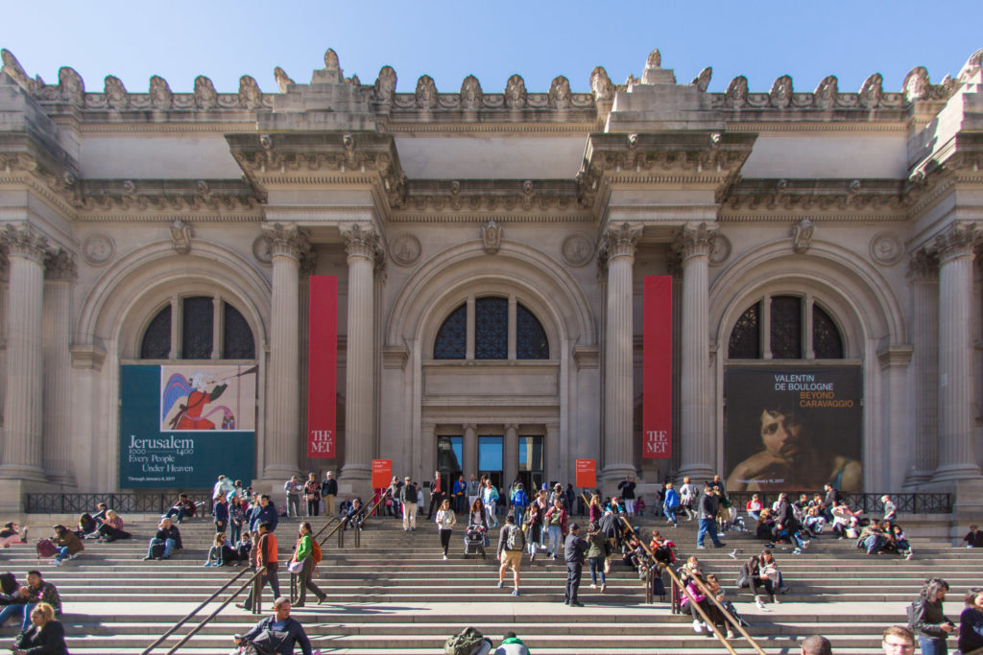
THE MET The Metropolitan Museum

Slide 2
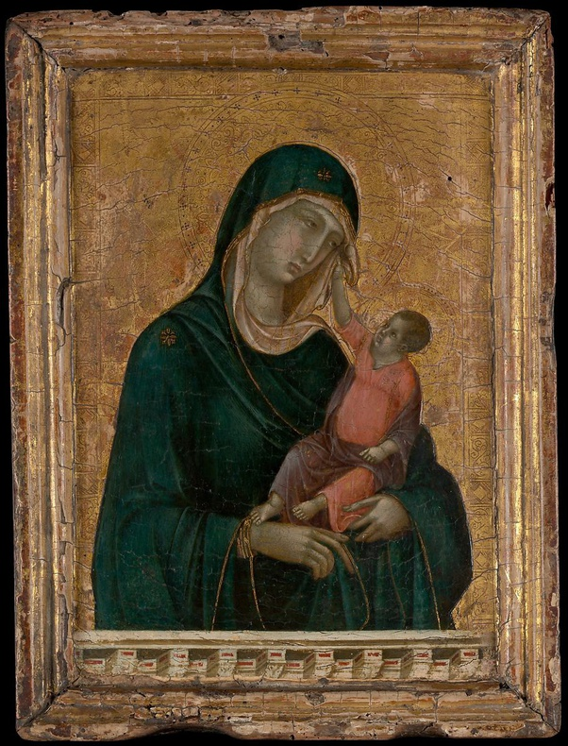
THE MET The Metropolitan Museum
It´s the biggest museum in USA.
Located at 5th Avenue, Mahattan, New York City (with two more branches).
Over 5,000 years of art from around the world.
Was founded on April 13, 1870.
Its permanent collection contains over 2 million works, divided among 17 curatorial departments.
The most expensive piece (more than $45 million) is a painting by the early Renaissance master Duccio di Buoninsegna, no bigger than a sheet of typing paper.
metmuseum.org

Slide 3
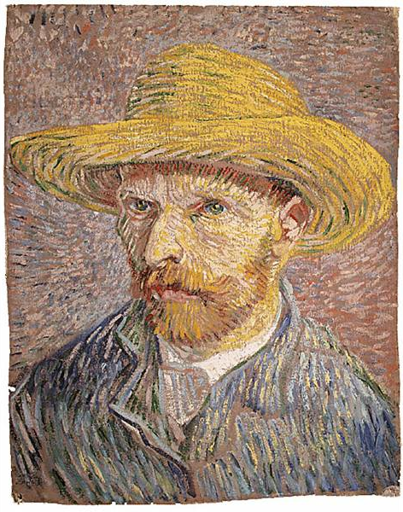
THE PROJECT
QUESTIONS:
How is the MET collection is composed? What are the biggest collections?
When it was acquired?
Where are they from?
Which artist has more objects exposed?
DATA:
https://metmuseum.github.io/ (Documentation and API requests)

Slide 4
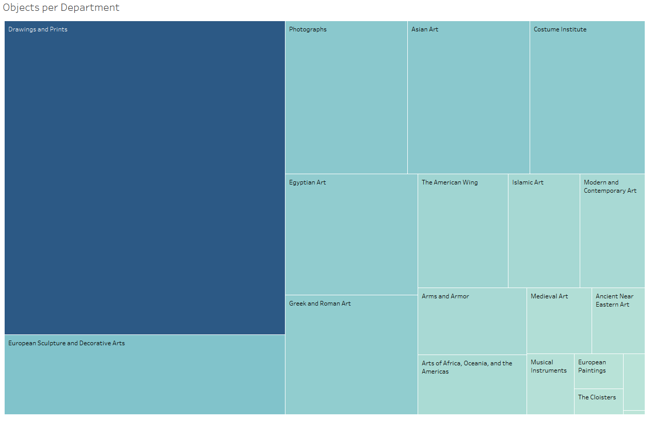
THE MET - The Metropolitan Museum

Slide 5
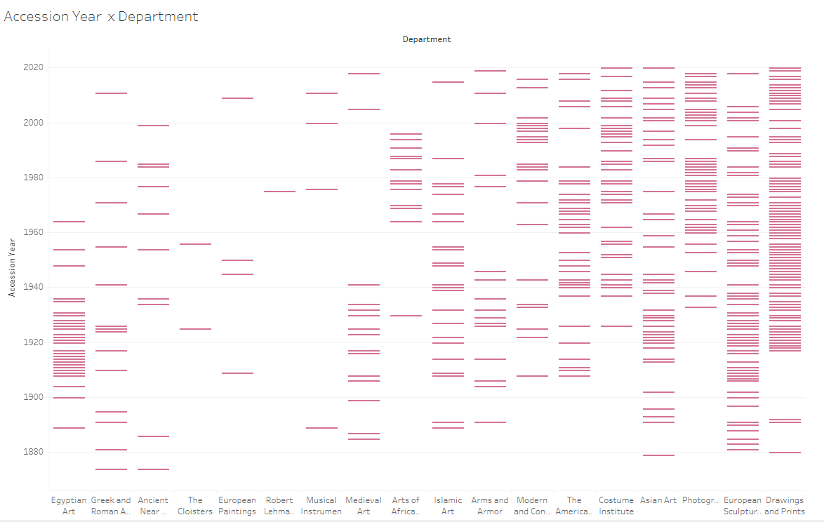
THE MET - The Metropolitan Museum

Slide 6
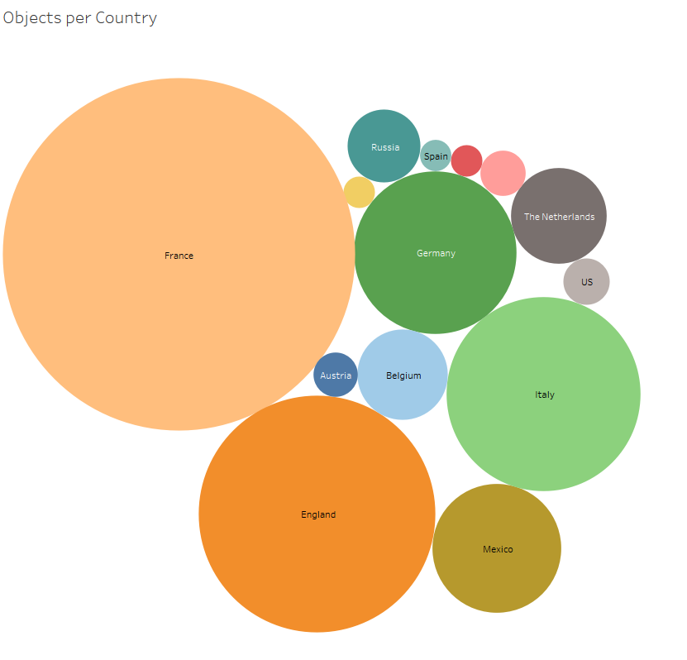
THE MET - The Metropolitan Museum

Slide 7
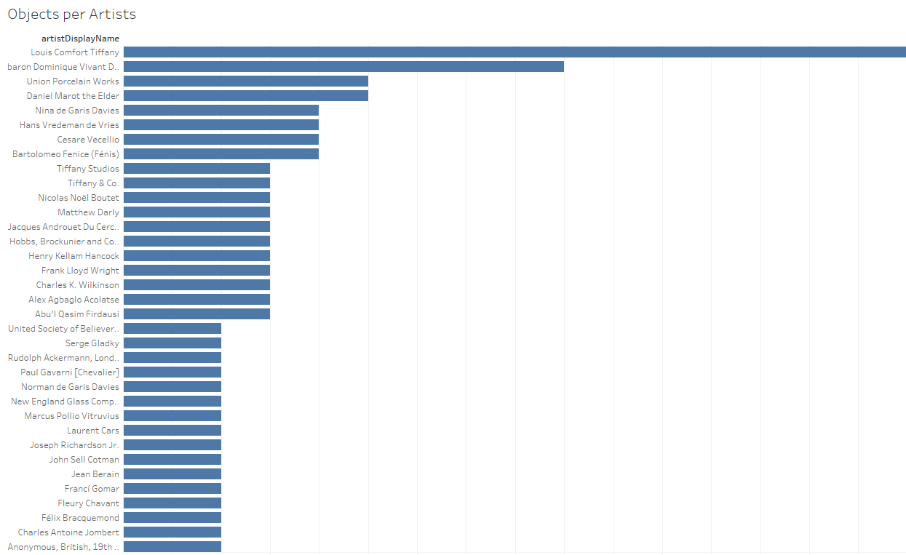
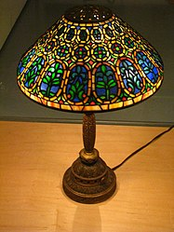
THE MET - The Metropolitan Museum
Louis Comfort Tiffany (February 18, 1848 – January 17, 1933) was an American artist and designer who worked in the decorative arts.
the first design director at his family company, Tiffany & Co., founded by his father Charles Lewis Tiffany.

