Slide 1
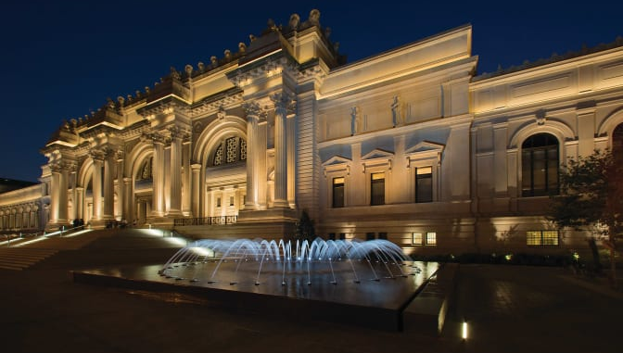
THE MET The Metropolitan Museum

Slide 2
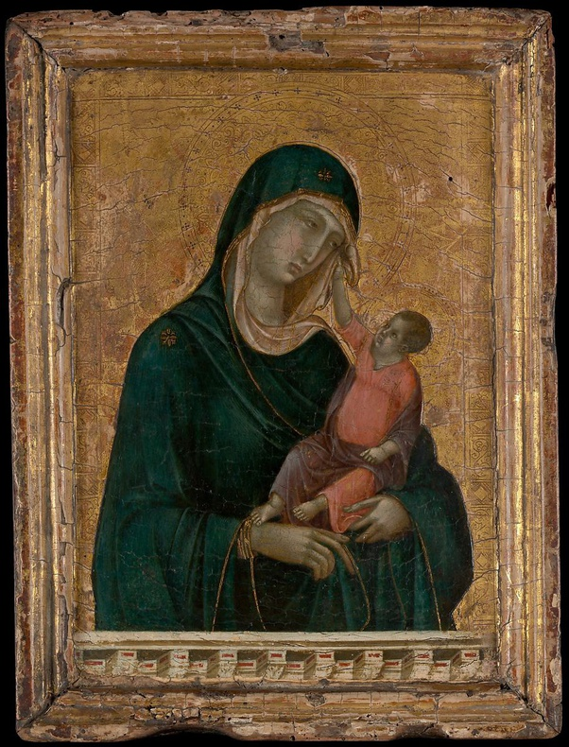
THE MET The Metropolitan Museum
It’s the biggest museum in USA.
Over 5000 years of art from around the world.
Was founded in 1870.
Its permanent collection contains over 2 million works, divided among 17 curatorial departments.
The most expensive piece (more than $45 million) is a painting by the early Renaissance master Duccio di Buoninsegna, no bigger than a sheet of typing paper.
metmuseum.org

Slide 3
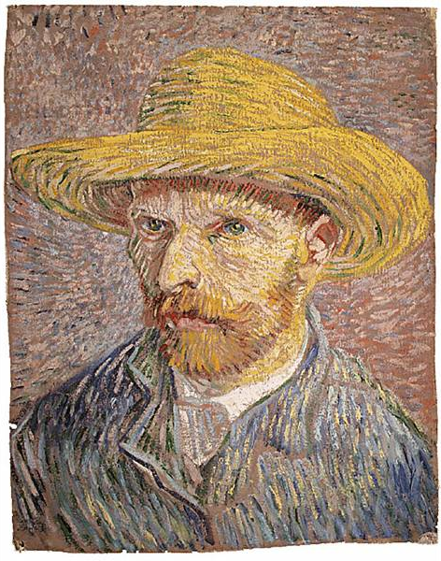
THE MET - The Metropolitan Museum
DATA FROM:
https://metmuseum.github.io/ (Documentation and API requests)
In the first project, I analysed how MET colletion was composed as a whole, what are the biggest collections by department, country and artists. Now, getting deeper in to the data I wanted to identify:
What is the most inspirational theme at MET?
As the collention is too big, I selected only one medium to be analysed: PAINTINGS.
As they are the most “blank” pieces that an artist has to fill with art, I believe it is the type of medium that most demands inspiration from them.

Slide 4
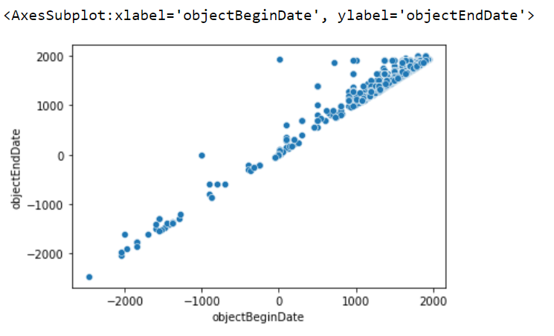
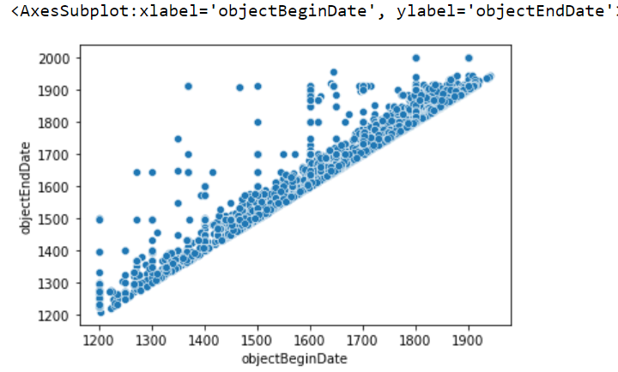
THE MET - The Metropolitan Museum
Total data: Paintings
Total data: Paintings from 1200 to 2021 AD

Slide 5
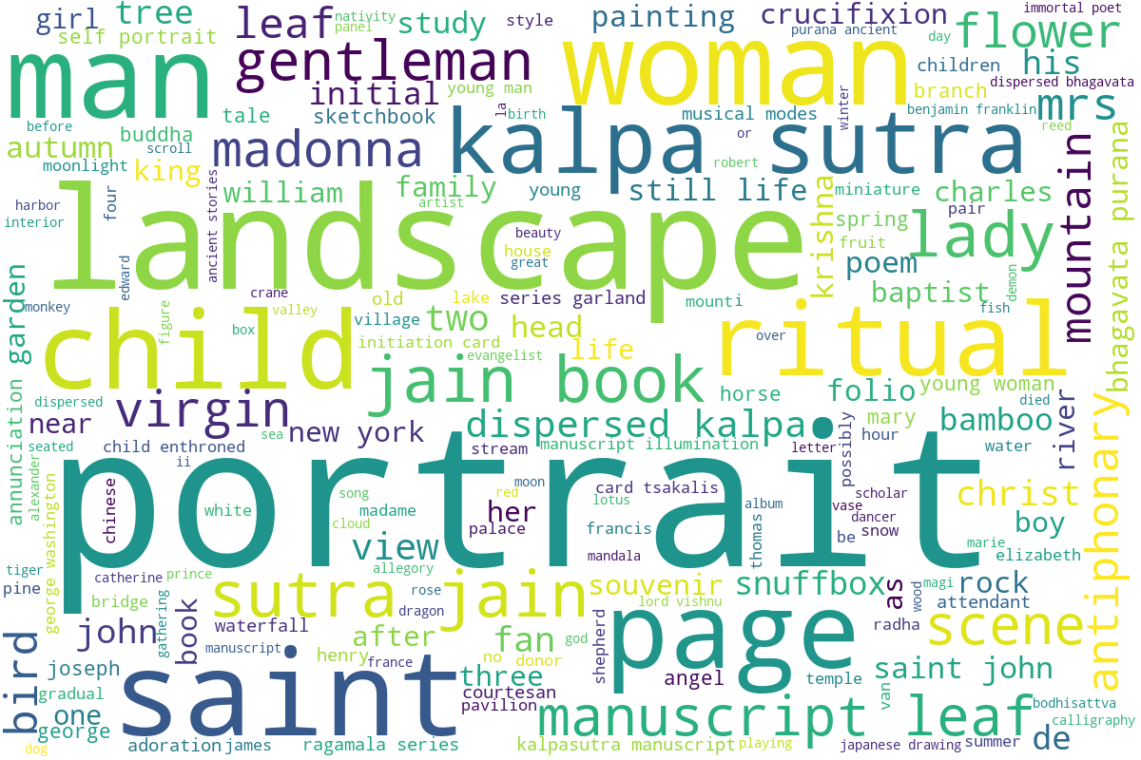
THE MET - The Metropolitan Museum

Slide 6
THE MET - The Metropolitan Museum
The Most Inspirational Themes
Analysed by their title
GROUPS
1º hypothesis: Religion
2º hypothesis: Scum
3º hypothesis: Nature (Fruits, animals, natural elements)
4º hypothesis: Landscapes
5º hypothesis: Female
6º hypothesis: Male
70% of the titles has at least one word in one of the groups.

Slide 7
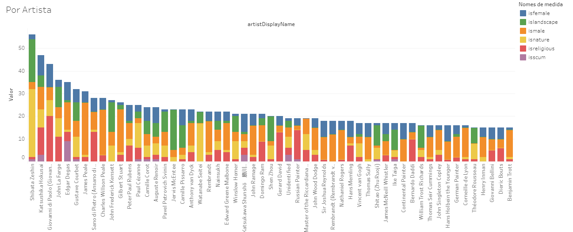
THE MET - The Metropolitan Museum
Words by Artist
Artist Name

Slide 8
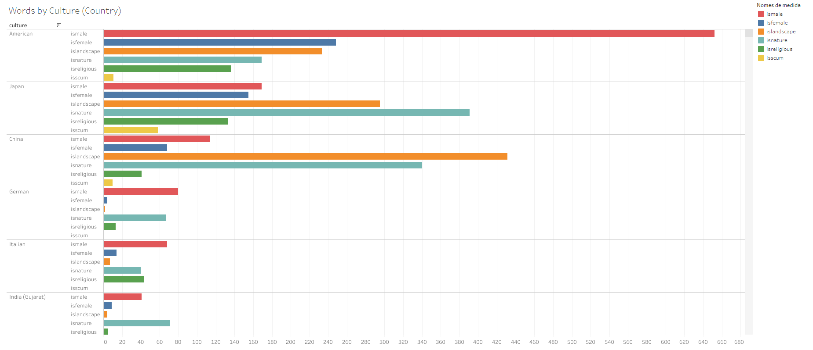
THE MET - The Metropolitan Museum
Words by Culture (Country)

Slide 9
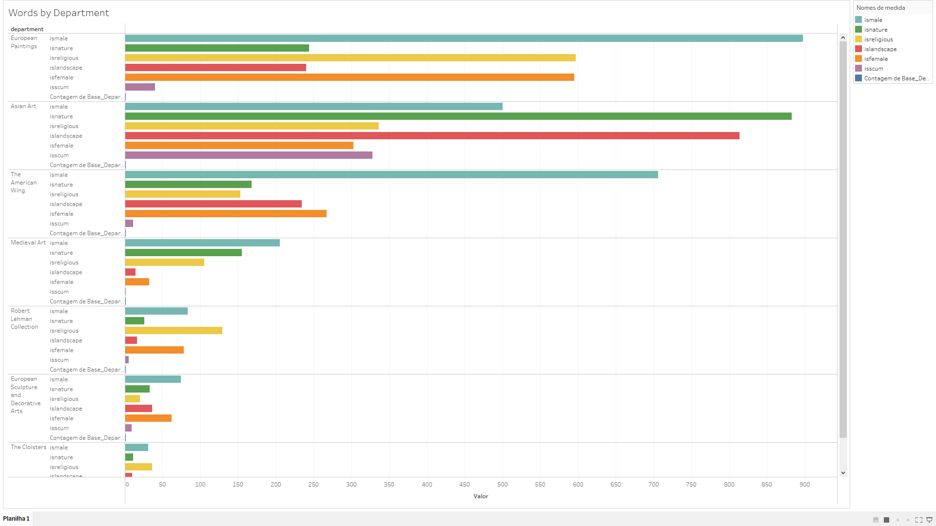
THE MET - The Metropolitan Museum
Words by Department

Slide 10
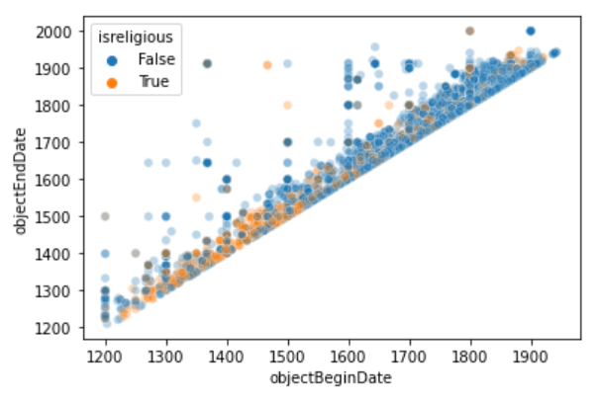
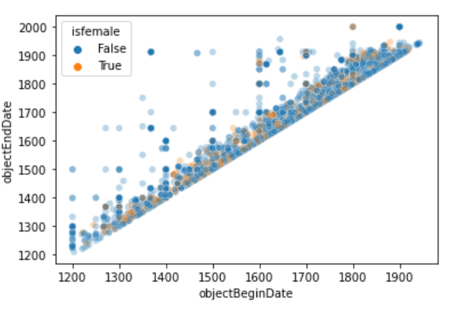
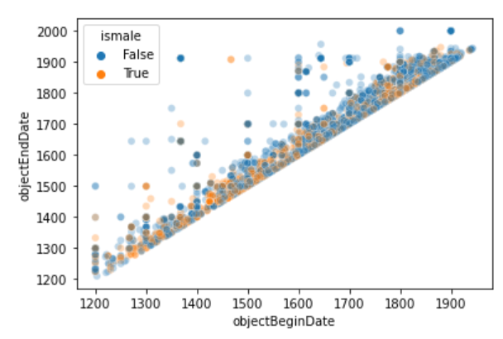
THE MET - The Metropolitan Museum
Is there religious words?
Is there female words?
Is there male words?
Ancient Art
30,000 B.C.–A.D. 400
Medieval
A.D. 500–A.D. 1400
Renaissance
1400-1600
Mannerism
1527–1580
Neoclassicism
1750–1850
Impressionism
1865-1885
>>>
Religious and symbolic imagery, decorations for utilitarian objects, mythological stories
Dark imagery, biblical subjects, Classical mythology, Gothic architecture
Natural elements, individualism, realism, attention-to-detail, precision of human anatomy
Stylized features, exaggerated details, decorative elements
Renewed interest in classical antiquity, harmony, simplicity, and proportion
Short, quick brushstrokes, separation of color, sketch-like finish, modern subject

Slide 11
THE MET The Metropolitan Museum

