Slide 1
Image Compression: JPEG
Multimedia Systems (Module 4 Lesson 1)
Summary:
JPEG Compression
  DCT
  Quantization
  Zig-Zag Scan
  RLE and DPCM
JPEG Modes
  Sequential
  Lossless
  Progressive
  Hierarchical
Sources:
The JPEG website:
http://www.jpeg.org
My research notes

Slide 2
Why JPEG
The compression ratio of lossless methods (e.g., Huffman, Arithmetic, LZW) is not high enough for image and video compression.
JPEG uses transform coding, it is largely based on the following observations:
  Observation 1: A large majority of useful image contents change relatively slowly across images, i.e., it is unusual for intensity values to alter up and down several times in a small area, for example, within an 8 x 8 image block.
  A translation of this fact into the spatial frequency domain, implies, generally, lower spatial frequency components contain more information than the high frequency components which often correspond to less useful details and noises.
  Observation 2: Experiments suggest that humans are more immune to loss of higher spatial frequency components than loss of lower frequency components.

Slide 3
JPEG Coding
C_{r}
C_{b}
F(u, v)
Fq(u, v)
Steps Involved:
Discrete Cosine Transform of each 8x8 pixel array
f(x,y) →_{T} F(u,v)
Quantization using a table or using a constant
Zig-Zag scan to exploit redundancy
Differential Pulse Code Modulation(DPCM) on the DC component and Run length Coding of the AC components
Entropy coding (Huffman) of the final output
Y
f(i, j)
DCT
Quantization
8 x 8
8 x 8
Quant…
Tables
Coding
Tables
Zig Zag
Scan
Header
Tables
Data
Entropy
Coding
DPCM
RLC

Slide 4
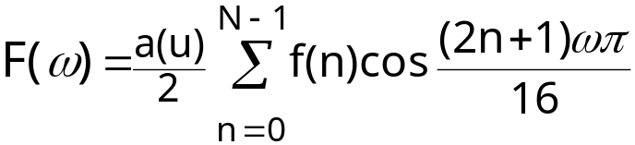
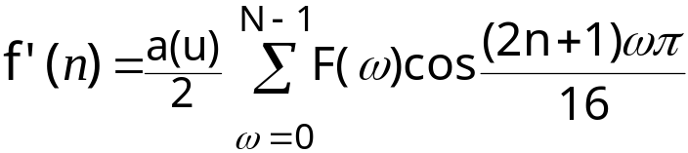
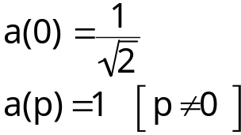
DCT : Discrete Cosine Transform
DCT converts the information contained in a block(8x8) of pixels from spatial domain to the frequency domain.
  A simple analogy: Consider a unsorted list of 12 numbers between 0 and 3 -> (2, 3, 1, 2, 2, 0, 1, 1, 0, 1, 0, 0). Consider a transformation of the list involving two steps (1.) sort the list (2.) Count the frequency of occurrence of each of the numbers ->(4,4,3,1 ). : Through this transformation we lost the spatial information but captured the frequency information.
  There are other transformations which retain the spatial information. E.g., Fourier transform, DCT etc. Therefore allowing us to move back and forth between spatial and frequency domains.
1-D DCT: 1-D Inverese DCT:

Slide 5
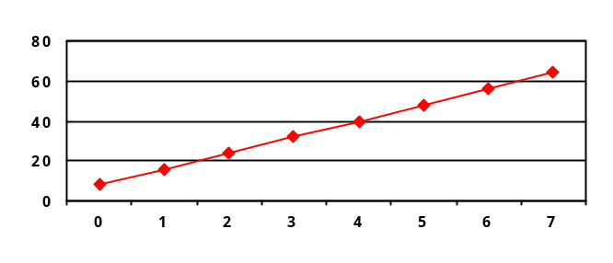
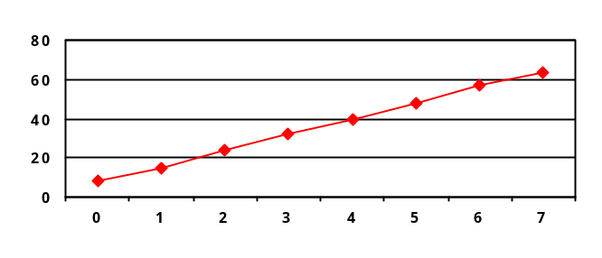
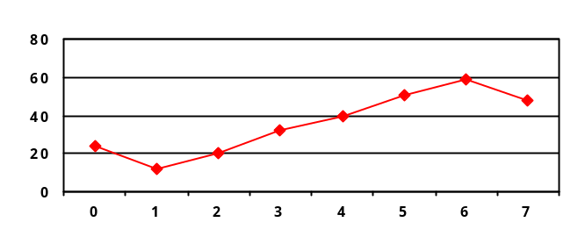
Example and Comparison
DCT
FFT
100 | -52 | 0 | -5 | 0 | -2 | 0 | 0.4
36 | 10 | 10 | 6 | 6 | 4 | 4 | 4
100 | -52 | 0 | -5 | 0 | -2 | 0 | 0.4
36 | 10 | 10 | 6 | 6 | 4 | 4 | 4
Inverse DCT
Inverse FFT
8 | 15 | 24 | 32 | 40 | 48 | 57 | 63
24 | 12 | 20 | 32 | 40 | 51 | 59 | 48
Example Description:
  f(n) is given from n = 0 to 7; (N=8)
  Using DCT(FFT) we compute F(ω) for ω = 0 to 7
  We truncate and use Inverse Transform to compute f’(n)

Slide 6


2-D DCT
Images are two-dimensional; How do you perform 2-D DCT?
  Two series of 1-D transforms result in a 2-D transform as demonstrated in the figure below
1-D
Row-
wise
1-D
Column-
wise
8x8
8x8
8x8
F(0,0) is called the DC component and the rest of F(i,j) are called AC components

Slide 7


2-D Transform Example
The following example will demonstrate the idea behind a 2-D transform by using our own cooked up transform: The transform computes a running cumulative sum.
1
1
1
1
1
1
1
1
1
1
1
1
1
1
1
1
My Transform:
1
1
1
1
1
1
1
1
1
1
1
1
1
1
1
1
1
1
1
1
1
1
1
1
8
7
6
5
4
3
2
1
1
1
1
1
1
1
1
1
8
7
6
5
4
3
2
1
1
1
1
1
1
1
1
1
8
7
6
5
4
3
2
1
1
1
1
1
1
1
1
1
1-D
Row-
wise
8
7
6
5
4
3
2
1
8x8
8
7
6
5
4
3
2
1
8
7
6
5
4
3
2
1
64
56
48
40
32
24
16
8
8
7
6
5
4
3
2
1
1-D
Column-
wise
56
49
42
35
28
21
14
7
8
7
6
5
4
3
2
1
48
42
36
30
24
18
12
6
8x8
40
35
30
25
20
15
10
5
32
28
24
20
16
12
8
4
24
21
18
15
12
9
6
3
Note that this is only a hypothetical transform. Do not confuse this with DCT
16
14
12
10
8
6
4
2
8
7
6
5
4
3
2
1
8x8

Slide 8
Quantization
Why? -- To reduce number of bits per sample
  F’(u,v) = round(F(u,v)/q(u,v))
Example: 101101 = 45 (6 bits).
Truncate to 4 bits: 1011 = 11. (Compare 11 x 4 =44 against 45)
Truncate to 3 bits: 101 = 5. (Compare 8 x 5 =40 against 45)
Note, that the more bits we truncate the more precision we lose
Quantization error is the main source of the Lossy Compression.
Uniform Quantization:
  q(u,v) is a constant.
Non-uniform Quantization -- Quantization Tables
  Eye is most sensitive to low frequencies (upper left corner in frequency matrix), less sensitive to high frequencies (lower right corner)
  Custom quantization tables can be put in image/scan header.
  JPEG Standard defines two default quantization tables, one each for luminance and chrominance.

Slide 9
Zig-Zag Scan
Why? -- to group low frequency coefficients in top of vector and high frequency coefficients at the bottom
Maps 8 x 8 matrix to a 1 x 64 vector
8x8
. . .
1x64

Slide 10
DPCM on DC Components
The DC component value in each 8x8 block is large and varies across blocks, but is often close to that in the previous block.
Differential Pulse Code Modulation (DPCM): Encode the difference between the current and previous 8x8 block. Remember, smaller number -> fewer bits
45
45
1x64
1x64
54
9
1x64
1x64
48
-6
.
.
.
1x64
.
.
.
1x64
32
12
1x64
1x64
36
4
1x64
1x64

Slide 11
RLE on AC Components
The 1x64 vectors have a lot of zeros in them, more so towards the end of the vector.
  Higher up entries in the vector capture higher frequency (DCT) components which tend to be capture less of the content.
  Could have been as a result of using a quantization table
Encode a series of 0s as a (skip,value) pair, where skip is the number of zeros and value is the next non-zero component.
  Send (0,0) as end-of-block sentinel value.
. . .
0
0
0
0
0
1
1
0
0
0
0
0
0
0
0
2
. . .
1x64
5,1
7,2

Slide 12
Entropy Coding: DC Components
DC components are differentially coded as (SIZE,Value)
  The code for a Value is derived from the following table
SIZE | Value | Code
0 | 0 | ---
1 | -1,1 | 0,1
2 | -3, -2, 2,3 | 00,01,10,11
3 | -7,…, -4, 4,…, 7 | 000,…, 011, 100,…111
4 | -15,…, -8, 8,…, 15 | 0000,…, 0111, 1000,…, 1111
. |  | .
. |  | .
11 | -2047,…, -1024, 1024,… 2047 | …
Size_and_Value Table

Slide 13
Entropy Coding: DC Components (Contd..)
DC components are differentially coded as (SIZE,Value)
  The code for a SIZE is derived from the following table
SIZE | Code Length | Code
0 | 2 | 00
1 | 3 | 010
2 | 3 | 011
3 | 3 | 100
4 | 3 | 101
5 | 3 | 110
6 | 4 | 1110
7 | 5 | 11110
8 | 6 | 111110
9 | 7 | 1111110
10 | 8 | 11111110
11 | 9 | 111111110
Example: If a DC component is 40 and the previous DC component is 48. The difference is -8. Therefore it is coded as:
1010111
0111: The value for representing –8
(see Size_and_Value table)
101: The size from the same table reads 4. The corresponding code from the table at left is 101.
Huffman Table for DC component SIZE field

Slide 14
Entropy Coding: AC Components
AC components (range –1023..1023) are coded as (S1,S2 pairs):
  S1: (RunLength/SIZE)
    RunLength: The length of the consecutive zero values [0..15]
    SIZE: The number of bits needed to code the next nonzero AC component’s value. [0-A]
    (0,0) is the End_Of_Block for the 8x8 block.
    S1 is Huffman coded (see AC code table below)
  S2: (Value)
    Value: Is the value of the AC component.(refer to size_and_value table)
Partial Huffman Table for AC Run/Size Pairs
Run/ SIZE | Code Length | Code
0/0 | 4 | 1010
0/1 | 2 | 00
0/2 | 2 | 01
0/3 | 3 | 100
0/4 | 4 | 1011
0/5 | 5 | 11010
0/6 | 7 | 1111000
0/7 | 8 | 11111000
0/8 | 10 | 1111110110
0/9 | 16 | 1111111110000010
0/A | 16 | 1111111110000011
Run/ SIZE | Code Length | Code
1/1 | 4 | 1100
1/2 | 5 | 11011
1/3 | 7 | 1111001
1/4 | 9 | 111110110
1/5 | 11 | 11111110110
1/6 | 16 | 1111111110000100
1/7 | 16 | 1111111110000101
1/8 | 16 | 1111111110000110
1/9 | 16 | 1111111110000111
1/A | 16 | 1111111110001000
… 15/A | More | Such rows

Slide 15
Entropy Coding: Example
Example: Consider encoding the AC components by arranging them in a zig-zag order -> 12,10, 1, -7 2 0s, -4, 56 zeros
12: read as zero 0s,12: (0/4)12 → 10111100
  1011: The code for (0/4 from AC code table)
  1100: The code for 12 from the Size_and_Value table.
10: (0/4)10 → 10111010
1: (0/1)1 → 001
-7: (0/3)-7 → 100000
2 0s, -4: (2/3)-4 → 1111110111011
  1111110111: The 10-bit code for 2/3
  011: representation of –4 from Size_and_Value table.
56 0s: (0,0) → 1010 (Rest of the components are zeros therefore we simply put the EOB to signify this fact)
40
12
0
0
0
0
0
0
10
-7
-4
0
0
0
0
0
1
0
0
0
0
0
0
0
0
0
0
0
0
0
0
0
0
0
0
0
0
0
0
0
0
0
0
0
0
0
0
0
0
0
0
0
0
0
0
0
0
0
0
0
0
0
0
0

Slide 16
JPEG Modes
Sequential Mode:
Each image is encoded in a single left-to-right, top-to-bottom scan.
  The technique we have been discussing so far is an example of such a mode, also referred to as the Baseline Sequential Mode.
  It supports only 8-bit images as opposed to 12-bit images as described before.

Slide 17

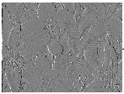
JPEG Modes
Lossless Mode:
Truly lossless
It is a predictive coding mechanism as opposed to the baseline mechanism which is based on DCT and quantization(the source of the loss).
Here is the simple block diagram of the technique:
Predictive
Difference
Huffman
EnCoder
Lossless
Coding

Slide 18
Lossless Mode (Contd..)
Predictive Difference:
  For each pixel a predictor (one of 7 possible) is used that best predicts the value contained in the pixel as a combination of up to 3 neighboring pixels.
  The difference between the predicted value and the actual value (X)contained in the pixel is used as the predictive difference to represent the pixel.
  The predictor along with the predictive difference are encoded as the pixel’s content.
  The series of pixel values are encoded using huffman coding
Predictor | Prediction
P1 | A
P2 | B
P3 | C
P4 | A+B-C
P5 | A + (B-C)/2
P6 | B + (A-C)/2
P7 | (A+B)/2
Notes:
The very first pixel in location (0, 0) will always use itself.
Pixels at the first row always use P1,
Pixels at the first column always use P2.
The best (of the 7) predictions is always chosen for any pixel.
C
B
A
X

Slide 19
JPEG Modes
Progressive Mode: It allows a coarse version of an image to be transmitted at a low rate, which is then progressively improved over subsequent transmissions.
  Spectral Selection : Send DC component and first few AC coefficients first, then gradually some more ACs.
Spectral Selection:
First Scan:
Second Scan:
Third Scan:
.
.
N^{th} Scan:
Image Pixels

Slide 20
Progressive Mode
Successive Approximation : All the DCT components are sent few bits at a time: For example, send n1 (say,4) bits (starting with MSB) of all pixels in the first scan, the next n2(say 1) bits of all pixels in the second and so on.
Pixels ordered (zig-zag-wise)
MSB
7
6
5
4
3
2
1
0
LSB
One Pixel
First Scan:
. . .
Second Scan:
. . .
Third Scan:
. . .
.
.
.
.
5th Scan:
. . .

Slide 21
Hierarchical Mode
Used primarily to support multiple resolutions of the same image which can be chosen from depending on the target’s capabilities.
The figure here shows a description of how a 3-level hierarchical encoder/decoder works:
I₄
L₄
4x4
Encode
Decode
4x4
I’₄
Decode
2x2
2x2
I₂
-
L₂
2x2
+
Encode
Decode
+
I’₂
Decode
+
+
2x2
2x2
I
-
L₁
+
Encode
Decode
+
I’
Encoding
Decoding

