Slide 1
SUDOKU
EASY
MEDIUM
HARD
EXPERT
EVIL
HELP

Slide 2

TETRIS
EASY MODE
HARD MODE
HELP

Slide 3
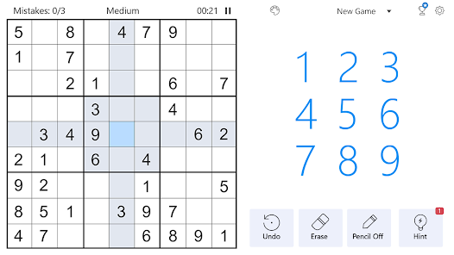
🆕
🔢
❌
🔚
💡
NEW
GAME
AUTO
CANDIDATE
DELETE
SHOW
SOLUTION
HINT

Slide 4

SUDOKU
🆕
NEW GAME
🔢
AUTO CANDIDATE
❌
DELETE
💡
HINT ONE
🗝
HINT TWO
💯

Slide 5
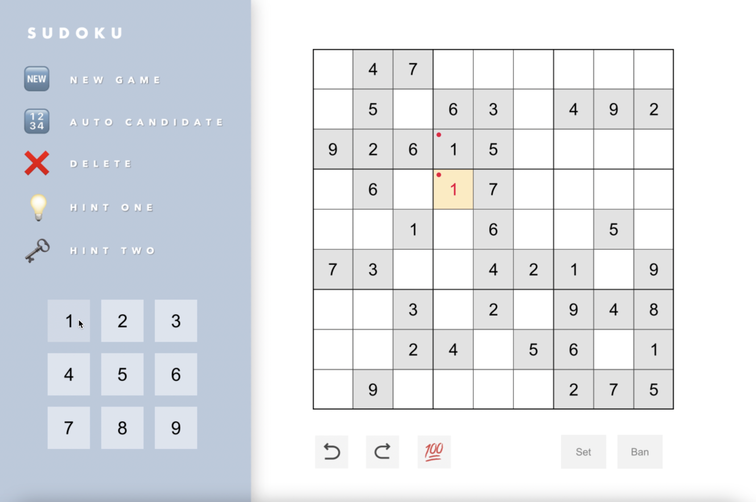
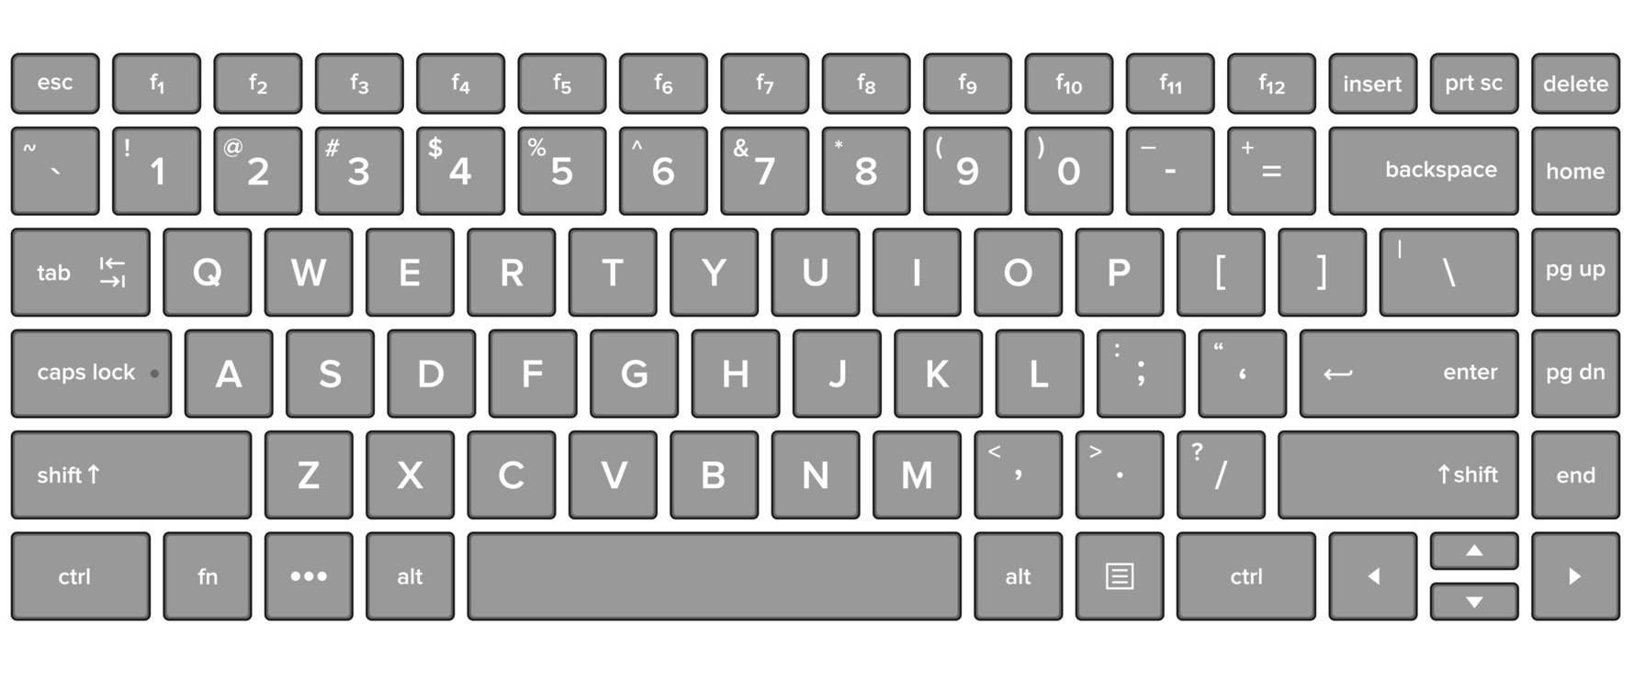
To select cells

Slide 6
HELP
Choose a difficulty level that suits you.
The game board will appear with some numbers already filled in. Your goal is to fill in the rest of the empty squares with numbers 1 to 9.
To fill in a cell, click on it to select it. Then, click on the number that you want to place in that square. You can also use keyboard to select cells or numbers.
If you place a number that violates the rules of Sudoku, the game will show an error message.
Use the Undo button to correct your mistakes.
If you get stuck, use the Hint button to get a suggestion for the next move.
Continue filling in numbers until you have filled in all the empty squares and completed the puzzle.
Press New Game to start a new Sudoku puzzle.
Remember to have fun and enjoy the game!
Press ‘s’ to go back.

Slide 7
HELP
Select numbers
ON/OFF auto candidate mode
Select cells
'a': highlight all singletons | 'q': hint 2 level 1 | 'u': undo
's': set all singletons | 'w': hint 2 level 2 | 'r': redo
Remember to have fun and enjoy the game!
Press ‘s’ to go back.

Slide 8
Your selected level is:
😀
Easy
Press to start the game!

Slide 9
Your selected level is:
🙂
Medium
Press to start the game!

Slide 10
Your selected level is:
🥲
Hard
Press to start the game!

Slide 11
Your selected level is:
🤯
Expert
Press to start the game!

Slide 12
Your selected level is:
😱
Evil
Press to start the game!

Slide 13
YOU WIN!
Press to start a new game.

