Slide 1

User Guide for phrases validation’s application

Slide 2
Application’s purpose
The app's purpose is to validate user-provided phrases, It achieves this by identifying language errors and subsequently searching for validated similar phrases. The app then predicts the validation as a percentage, offering a quick assessment of phrase validity. This integrated approach optimizes the validation process, assisting engineers in effective communication.

Slide 3
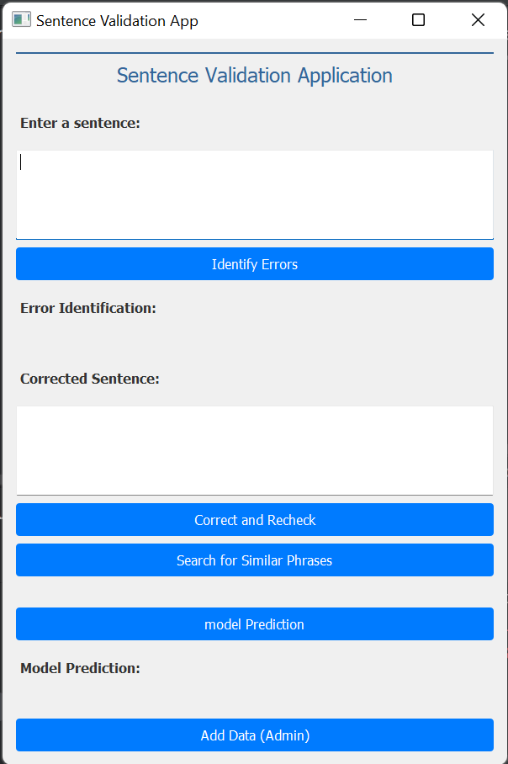
Application’s user Interface
As depicted in the provided image, the interface comprises 11 distinct features. This guide has been designed to offer a comprehensive understanding of how to effectively interact with each of these features.

Slide 4
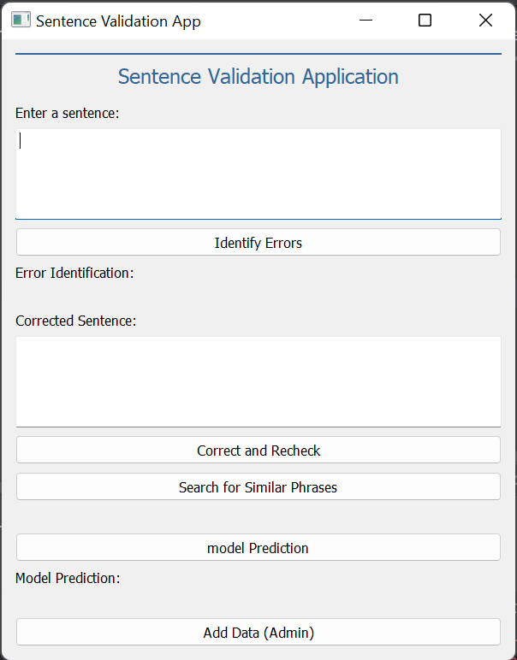
Application’s user Interface
The first interface feature is the text input field for users to enter phrases in French. Below, a prominent 'Identify Errors' button triggers language error detection. If errors are found, they're displayed under 'Error Identification' for quick review.

Slide 5
Application’s user Interface
The second field is provided for entering the corrected sentence. Beneath it, the 'Correct and Recheck' button enables users to validate the amended phrase. Similar to the initial process, the app performs language error detection, and any identified errors are presented under 'Error Identification'

Slide 6
Application’s user Interface
The 'Search for Similar Phrases' button allows users to explore analogous phrases within previously validated content. Upon clicking, a list of results is promptly displayed directly beneath the button, aiding users in finding relevant existing phrases.

Slide 7
Application’s user Interface
The 'Model Prediction' button enables users to assess the validity of a phrase by evaluating its compliance with the guidelines outlined in the 'GUIDE REDACTIONNEL: Règles Génériques de rédaction d’un livrable APV.'

Slide 8
Application’s user Interface
The 'Add Data' button provides administrative users with the capability to enhance the model's dataset and facilitate retraining. Clicking on this button opens a separate window where both valid and invalid data can be added. This data is then used to retrain the model, improving its accuracy and performance

