Slide 1

Mashup’s and CORS
Maruti C Vinit Mehta

Slide 2
Mashup’s
What is a Mashup ?
What are its types ?
Business (or enterprise) mashups
Consumer mashups
Data mashups
What are the characteristics of a mashup ?
Notes:
mash-up – COMPUTING
A mashup, in web development, is a web page, or web application, that uses content from more than one source to create a single new service , heavily used in the Consumer and Web 2.0 space,
.
The main characteristics of a mashup are combination, visualization, and aggregation. It is important to make existing data more useful, for personal and professional use. To be able to permanently access the data of other services, mashups are generally client applications
There are many types of mashup, such as business mashups, consumer mashups, and data mashups.
Business (or enterprise) mashups define applications that combine their own resources, application and data, with other external Web services.[3] They focus data into a single presentation and allow for collaborative action among businesses and developers. This works well for an agile development project, which requires collaboration between the developers and customer (or customer proxy, typically a product manager) for defining and implementing the business requirements. Enterprise mashups are secure, visually rich Web applications that expose actionable information from diverse internal and external information sources.
Consumer mashups combine data from multiple public sources in the browser and organize it through a simple browser user interface.[5] (e.g.: Wikipediavision combines Google Map and a Wikipedia API)
Data mashups, opposite to the consumer mashups, combine similar types of media and information from multiple sources into a single representation. The combination of all these resources create a new and distinct Web service that was not originally provided by either source.

Slide 3
Mashup’s
What is a Mashup ?
What are its types ?
Business (or enterprise) mashups
Consumer mashups
Data mashups
What are the characteristics of a mashup ?
Notes:
mash-up – COMPUTING
A mashup, in web development, is a web page, or web application, that uses content from more than one source to create a single new service , heavily used in the Consumer and Web 2.0 space,
.
The main characteristics of a mashup are combination, visualization, and aggregation. It is important to make existing data more useful, for personal and professional use. To be able to permanently access the data of other services, mashups are generally client applications
There are many types of mashup, such as business mashups, consumer mashups, and data mashups.
Business (or enterprise) mashups define applications that combine their own resources, application and data, with other external Web services.[3] They focus data into a single presentation and allow for collaborative action among businesses and developers. This works well for an agile development project, which requires collaboration between the developers and customer (or customer proxy, typically a product manager) for defining and implementing the business requirements. Enterprise mashups are secure, visually rich Web applications that expose actionable information from diverse internal and external information sources.
Consumer mashups combine data from multiple public sources in the browser and organize it through a simple browser user interface.[5] (e.g.: Wikipediavision combines Google Map and a Wikipedia API)
Data mashups, opposite to the consumer mashups, combine similar types of media and information from multiple sources into a single representation. The combination of all these resources create a new and distinct Web service that was not originally provided by either source.

Slide 4
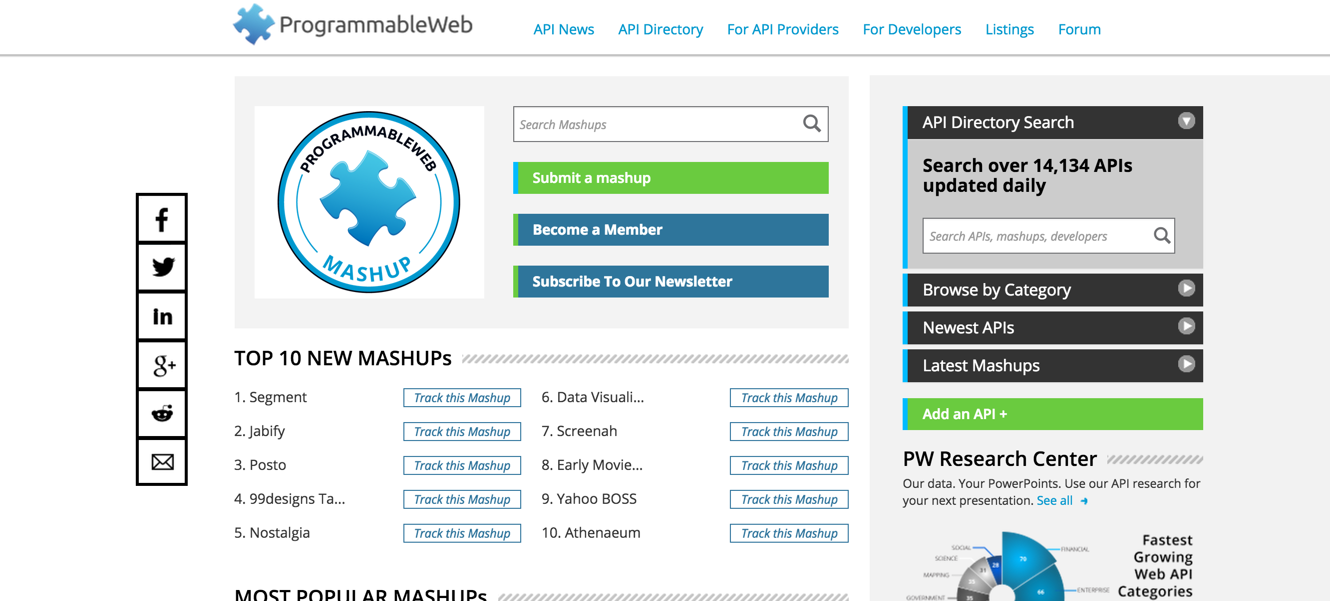
World of Mashup’s
Notes:
The leading source of news & information about APIs and mashups
it has a mashup dashboard where you can view the popular , top and any news about mashups .
Pls have a look at that offline so you can get more ideas and know how people are building mashups and even u can use them
grouped by tags and labels

Slide 5
Architecture of Mashup’s
Presentation / User Interface
APIs
Data
Notes:
The architecture of a mashup is divided into three layers:
Presentation / user interaction: this is the user interface of mashups.
Web Services/APIs : the product's functionality can be accessed using API services.
Because API’s expose system functionality to other systems and users, they play a critical part in the whole mashup space.
Data: handling the data like sending, storing and receiving.
Architecture of mashups :
The architecture of a mashup is divided into three layers:
Presentation / user interaction: this is the user interface of mashups. The technologies used are HTML/XHTML, CSS, Javascript, Asynchronous Javascript and Xml (Ajax).
Web Services: the product's functionality can be accessed using API services. The technologies used are XMLHTTPRequest, XML-RPC, JSON-RPC, SOAP, REST.
Data: handling the data like sending, storing and receiving. The technologies used are XML, JSON, KML.
Architecturally, there are two styles of mashups: Web-based and server-based. Whereas Web-based mashups typically use the user's web browser to combine and reformat the data, server-based mashups analyze and reformat the data on a remote server and transmit the data to the user's browser in its final form.^{[9]}
Mashups appear to be a variation of a façade pattern.[10] That is: a software engineering design pattern that provides a simplified interface to a larger body of code (in this case the code to aggregate the different feeds with different APIs).

Slide 6
Code or Configure
Notes:
EDGE
Mashups are cool and what can make it more easier ?
If you are familiar with APigee , u may noticed how it is easy to build apiproxies or applications .
We can definitely use Edge for any web-based or server-based mashups .
You can use the policies to quickly create or even use scrips to code
These are the various policies that are available , if you are interested and wants to know more , pls refer the apigee documentation.

Slide 7
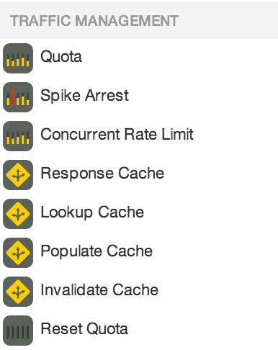
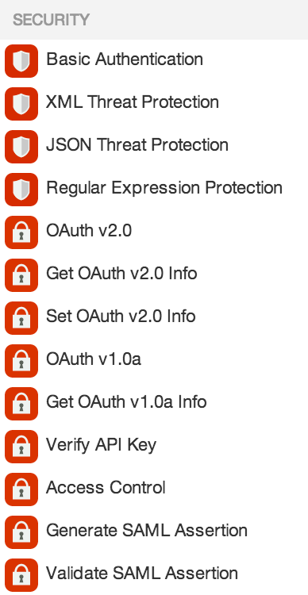
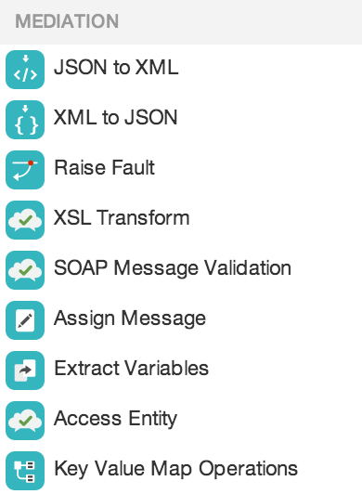
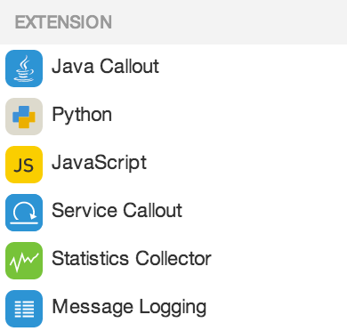
Power of Policies
Manage interactions with API consumers and optimize performance
Secure APIs and protect back-end systems from attack
Transform, translate and reformat data for easy consumption
Extend with programming when you need it

Slide 8
Advantages
Immediate Value
Development effort
Innovate new ideas and use information in ways not originally planned for
Notes:
Advantages :
Mashups provide immediate benefit at little cost.
Development effort is less
Innovate new ideas and use information in ways not originally planned for .

Slide 9
{
“Hungry?”: “AskAnApigeek!”,
“Stressed?": “AskAnApigeek!”,
“Car Wash?": “AskAnApigeek!”,
“Beer?”: “Definitely_AskAnApigeek!!”
}
Notes:
DEMO 1 – AskAnApigeek
APIs are the threads that let you stitch together a rich web experience. But this experience has a hard time translating to the browser,

Slide 10
Cross-Origin Resource Sharing (CORS)
Notes:
Cross-Origin Resource Sharing (CORS) is a W3C spec that allows cross-domain communication from the browser.
Cross-origin resource sharing (CORS) is a mechanism that allows restricted resources (e.g. fonts) on a web page to be requested from another domain outside the domain from which the resource originated.
The use-case for CORS is simple.
Imagine the site alice.com has some data that the site bob.com wants to access. This type of request traditionally wouldn’t be allowed under the browser’s same origin policy. However, by supporting CORS requests, alice.com can add a few special response headers that allows bob.com to access the data.
While CORS lays the groundwork for making cross-domain requests, the CORS headers are not a substitute for sound security practices. You shouldn't rely on the CORS header for securing resources on your site. Use the CORS headers to give the browser directions on cross-domain access, but use some other security mechanism, such as cookies or OAuth2, if you need additional security restrictions on your content.

Slide 11
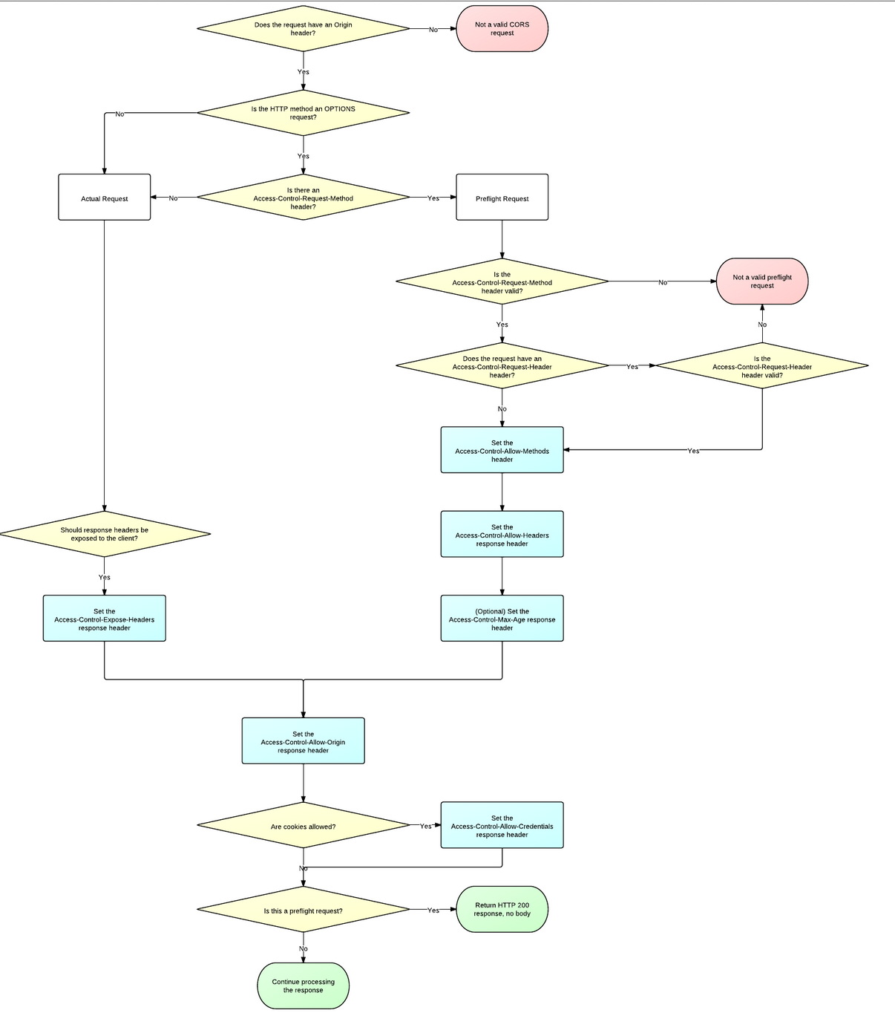
Notes:
http://www.html5rocks.com/static/images/cors_server_flowchart.png

