Slide 1
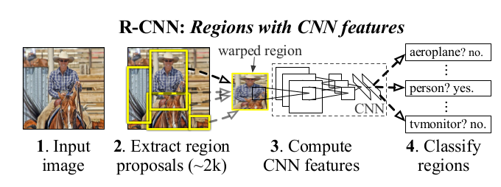
RCNN
Pipeline
region proposals
feature extraction
classification

Slide 2
RCNN
Region proposals
有非常多方法，论文里使用selective search
主要是为了和先前的工作进行对比
Feature extraction
proposal region => tight bounding box
tight bounding box → dilated bounding box (context)
warp to fixed size 227x227 (RGB)
尺寸取决于用来提特征的CNN
有多种warp的方法，论文里忽略长宽比直接resize
先减均值，再forward输出4096维特征向量

Slide 3
RCNN
Test pipeline
Input one image
Run selective search to get ~2000 region proposals
Warp each proposal and extract feature
Use svm to score extracted feature vector
针对每一类都会单独训练一个SVM
用svm对每一类的每一个特征向量进行评分
Apply nms to all scored regions
reject a region if its IoU overlap with a higher scoring region larger than a learned threshold
对每个类分别执行

Slide 4
RCNN
Training
Supervised pre-training
ILSVRC2012 classification (CNN with 1000-way out)
Domain-specific fine-tuning
将CNN结构中的输出层节点数从1000改为(N+1)
data: warped region proposals
positives: RPs with >= 0.5 IoU overlap with a GT box, negative: the rest
在每一轮迭代中，均匀采样32个正样本和96个负样本
mini-batch size: 128

Slide 5
RCNN
Training
Object category classifiers
IoU overlap threshold: 0.3
grid search over {0,0.1,…,0.5} on a validation set
data: feature vectors and labels
针对每个类别单独训练一个SVM
为什么使用SVM，而不是直接使用fine-tuned CNN的输出softmax层？

Slide 6
RCNN

