Slide 1
CS 535/435 Introduction to Data Mining
(Fall 2017)
Lecture 10
Lei Yu
Department of Computer Science
Binghamton University
www.cs.binghamton.edu/~lyu

Slide 2

Tasks of Data Preprocessing
Introduction to Data Mining

Slide 3
Feature Selection
Motivation
Major issues of feature selection
  Subset search
  Evaluation measures (filter vs. wrapper)
Introduction to Data Mining

Slide 4


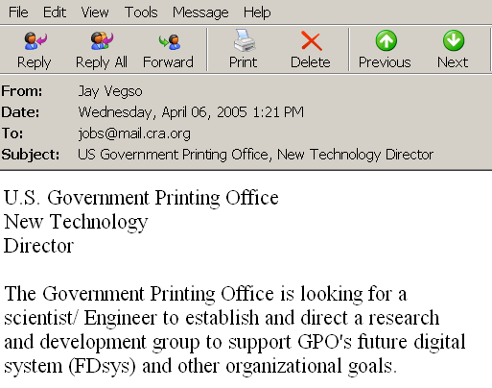

Document Classification
Terms
Web Pages
Emails
T₁ T₂ ….…… T_{N}
C
Sports
12 0 ….…… 6
D₁
D₂
Travel
3 10 ….…… 28
Documents
…
…
…
…
D_{M}
0 11 ….…… 16
Jobs
Internet
Task: To classify unlabeled documents into categories
Challenge: thousands of terms
Solution: to apply feature selection
ACM Portal
IEEE Xplore
PubMed
Digital Libraries
Introduction to Data Mining

Slide 5
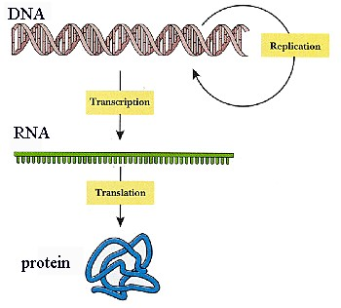
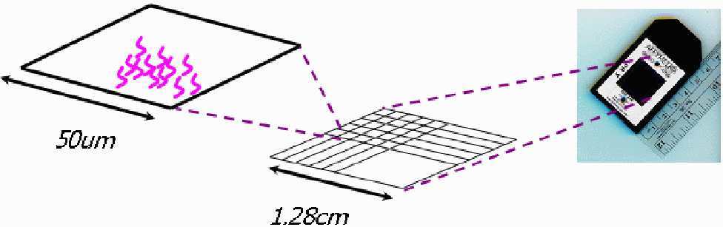
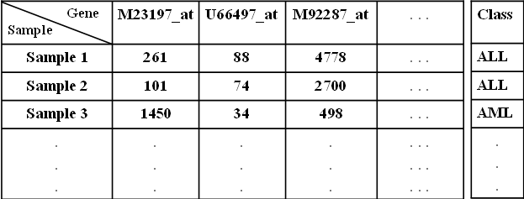
Gene Expression Microarray Analysis
Expression Microarray
Image Courtesy of Affymetrix
Task: To classify novel samples into known disease types (disease diagnosis)
Challenge: thousands of genes, few samples
Solution: to apply feature selection
Expression Microarray Data Set
Introduction to Data Mining

Slide 6
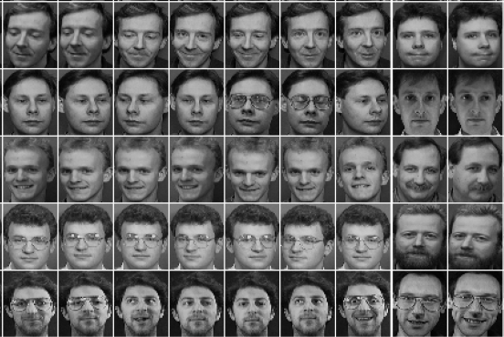
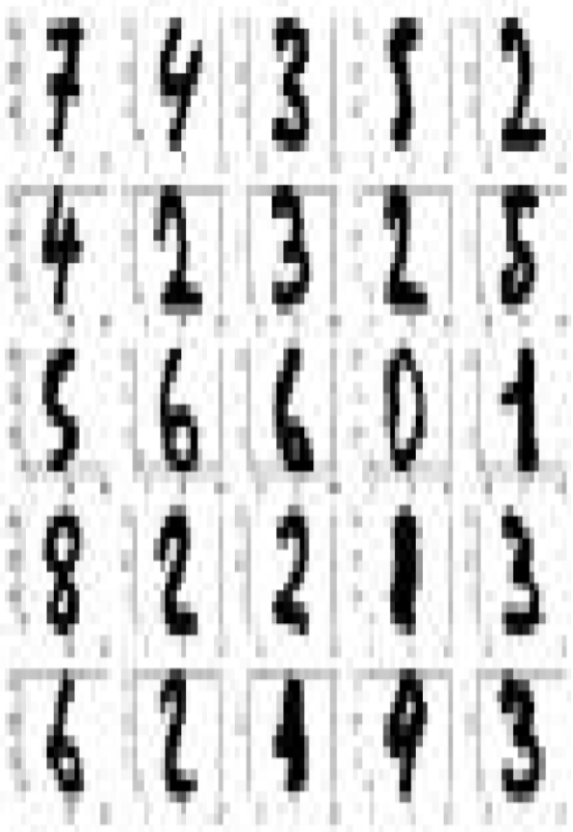
Other Types of High-Dimensional Data
Face images
Handwritten digits
Introduction to Data Mining

Slide 7
Dimensionality Reduction Motivation
Avoid curse of dimensionality
    Sample size required for learning accurate models goes up exponentially with the number of features
    The intrinsic dimensions of a problem may be much fewer
    Reducing the dimensions leads to exponential reduction in sample requirements
Help to eliminate irrelevant or redundant information
Reduce amount of time and memory required by data mining algorithms
Allow data mining results to be easily comprehensible
Introduction to Data Mining
Introduction to Data Mining

Slide 8
Dimensionality Reduction Major Techniques
Feature selection
    Select a subset of M features from N original features, M<N, to produce the best performance for a learning task (classification, clustering,…)
    Discard the rest of the features, easily interpretable results
Feature extraction
    Form M new features based on N original features, M<N, by linear or nonlinear combination of the original feature values, to produce the best performance for a learning task (classification, clustering,…)
    Principal Component Analysis (PCA), Linear Discriminant Analysis (LDA) (See appendix B of textbook)
    Deep neural networks (more advanced, successful in image, speech recognition)
Introduction to Data Mining
Introduction to Data Mining

Slide 9
Feature Selection
Irrelevant features
  Contain no information that is useful for the data mining task at hand
  Example: students' ID is often irrelevant to the task of predicting students' GPA
Redundant features
  Duplicate much or all of the information contained in one or more other attributes
  Example: purchase price of a product and the amount of sales tax paid
Informally, feature selection is to select a subset of relevant but non-redundant features from a data set
Formally, given a full set F, to select a minimum subset G such that P(C|G) is equal or as close as possible to P(C|F)
Introduction to Data Mining

Slide 10
An Example for Optimal Subset
Data set (whole set)
  Five Boolean features
  C = F₁∨F₂
  F₃ = ┐F₂ , F₅ = ┐F₄
  Optimal subset:
  {F₁, F₂} or {F₁, F₃}
Combinatorial nature of searching for an optimal subset
F₁ | F₂ | F₃ | F₄ | F₅ | C
0 | 0 | 1 | 0 | 1 | 0
0 | 1 | 0 | 0 | 1 | 1
1 | 0 | 1 | 0 | 1 | 1
1 | 1 | 0 | 0 | 1 | 1
0 | 0 | 1 | 1 | 0 | 0
0 | 1 | 0 | 1 | 0 | 1
1 | 0 | 1 | 1 | 0 | 1
1 | 1 | 0 | 1 | 0 | 1
Introduction to Data Mining
Notes:
Ex: How to find the optimal subset?

Slide 11
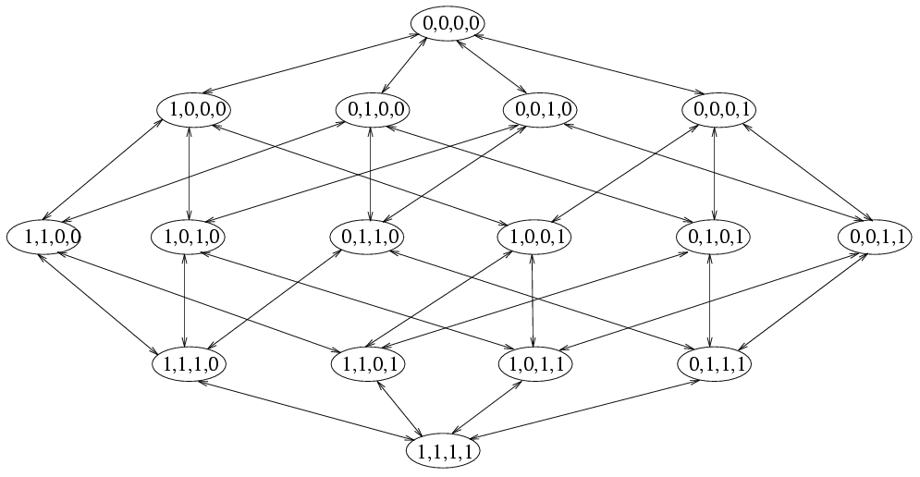
Feature Selection – A Search Problem
An example of search space
Introduction to Data Mining
Introduction to Data Mining

Slide 12
Feature Selection – A Search Problem (cont’d)
0
Exponential search space – 2^{N}
Search starting points
  Empty set
  Full set
  Random point
  Bi-directional
Search strategies
  Exhaustive (enumeration)
  Heuristic search (sequential forward/backward search, feature ranking)
  Nondeterministic search (random search, evolutionary search)
0.1
0.3
0.2
0.2
0.4
0.2
0.5
0.2
0.4
0.3
0.6
0.7
0.5
0.6
1
Sequential Forward Search Example
Values in bold represent the quality of
subsets measured by information gain
Introduction to Data Mining
Introduction to Data Mining

Slide 13
Feature Selection – How to evaluate?
Goodness measures of features
  Information, distance, consistency …
  Accuracy (classifier based)
Filter model
  Separating feature selection from classifier learning
  Relying on intrinsic data characteristics of the training data (information, distance, consistency)
  Computational efficient, but not optimized for a particular classification algorithm
Wrapper model
  Relying on the performance of a predetermined classification algorithm
  Using predictive accuracy as goodness measure
  High accuracy, computationally very expensive
Introduction to Data Mining
Introduction to Data Mining

Slide 14
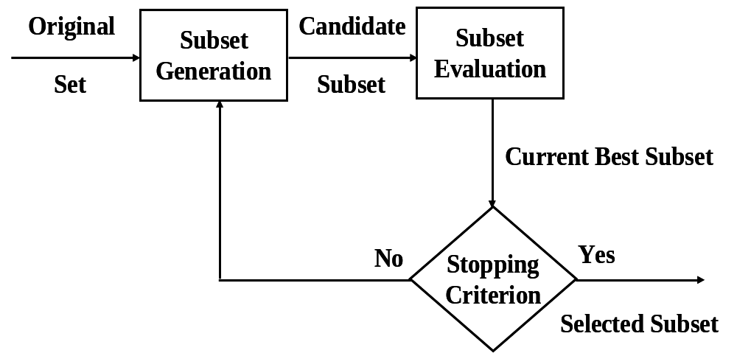
Feature Selection – A General Framework
Many algorithms exist
  Huan Liu and Lei Yu. "Toward Integrating Feature Selection Algorithms for Classification and Clustering". IEEE Transactions on Knowledge and Data Engineering, 17(4), 491-502, 2005.
Introduction to Data Mining

Slide 15
Next Class
Class Imbalance problem
Reading
  Chapters 5.7.1, 5.7.2
Introduction to Data Mining

