Slide 1
CS 535/435 Introduction to Data Mining
(Fall 2017)
Lecture 11
Lei Yu
Department of Computer Science
Binghamton University
www.cs.binghamton.edu/~lyu

Slide 2
Class Imbalance Problem
The problem
Metrics for evaluation under imbalanced classes
Solutions to the problem (selective topics for student presentation)
  Cost-sensitive learning
  Sampling-based approaches
Introduction to Data Mining

Slide 3
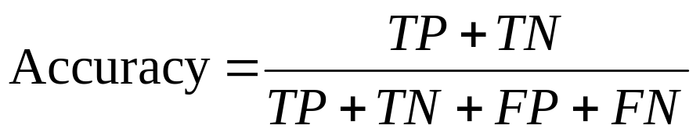
Metrics for Performance Evaluation
Focus on the predictive capability of a model
  Rather than how fast it takes to classify or build models, scalability, etc.
Confusion Matrix:
Most widely-used metric:
 | PREDICTED CLASS
ACTUAL CLASS |  | Class=Yes | Class=No
 | Class=Yes | TP | FN
 | Class=No | FP | TN
TP (true positive)
FN (false negative)
FP (false positive)
TN (true negative)
Introduction to Data Mining

Slide 4
Limitation of Accuracy
Consider a 2-class problem
  Number of Class No examples = 9990
  Number of Class Yes examples = 10
If model predicts everything to be class No, accuracy is 9990/10000 = 99.9 %
  Accuracy is misleading because model does not detect any class No example
Introduction to Data Mining

Slide 5
Cost Matrix
 | PREDICTED CLASS
ACTUAL CLASS | Cost(i|j) | Class=Yes | Class=No
 | Class=Yes | Cost(Yes|Yes) | Cost(No|Yes)
 | Class=No | Cost(Yes|No) | Cost(No|No)
Cost(i|j): Cost of classifying example of true class j as class i
Introduction to Data Mining

Slide 6
Computing Cost of Classification
Cost Matrix | PREDICTED CLASS
ACTUAL CLASS | Cost(i|j) | + | -
 | + | -10 | 100
 | - | 1 | 0
Model M₁ | PREDICTED CLASS
ACTUAL CLASS |  | + | -
 | + | 9 | 1
 | - | 10 | 80
Model M₂ | PREDICTED CLASS
ACTUAL CLASS |  | + | -
 | + | 5 | 5
 | - | 5 | 85
Accuracy = 89%
Cost = 20
Accuracy = 90%
Cost = 455
Introduction to Data Mining

Slide 7
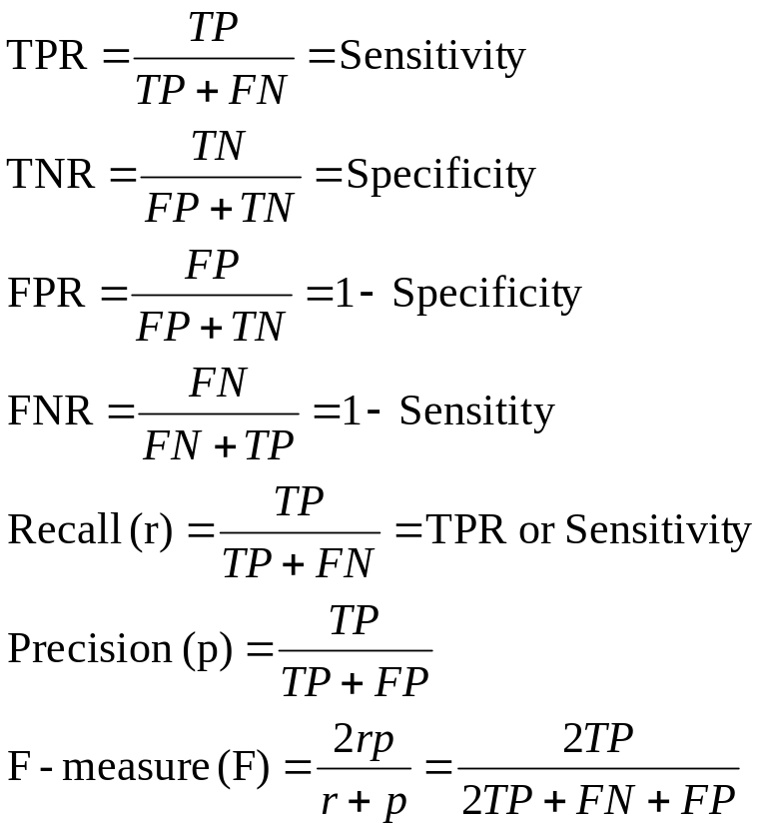
Cost-Sensitive Measures
 | PREDICTED CLASS
ACTUAL CLASS |  | Class=Yes | Class=No
 | Class=Yes | TP | FN
 | Class=No | FP | TN
Introduction to Data Mining

Slide 8
ROC (Receiver Operating Characteristic)
Developed in 1950s for signal detection theory to analyze noisy signals
  Characterize the trade-off between positive hits and false alarms
ROC curve plots TP (on the y-axis) against FP (on the x-axis)
Performance of each classifier represented as a point (or a set of points) on the ROC curve
Introduction to Data Mining

Slide 9
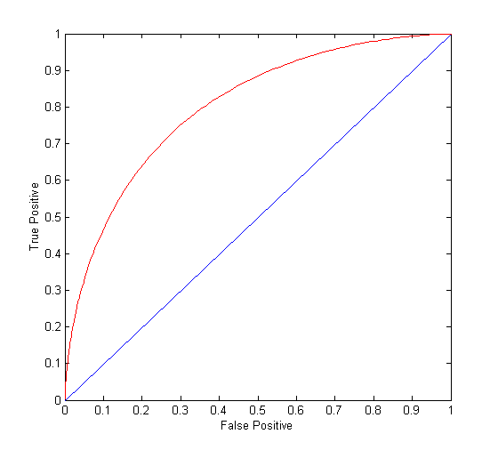
ROC Curve
(FP,TP):
(0,0): declare everything
to be negative class
(1,1): declare everything
to be positive class
(0,1): ideal
(1,0): the worst
Diagonal line:
  Random guessing
  Below diagonal line
    Meaning ?
Introduction to Data Mining

Slide 10
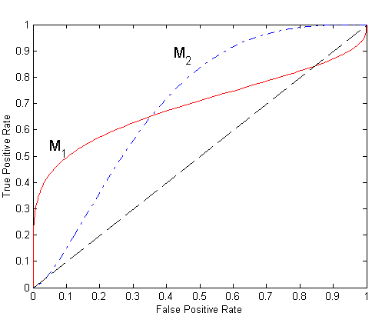
Using ROC for Model Comparison
No model consistently outperform the other
  M₁ is better when FPR is small
  M₂ is better when FPR is large
Area Under the ROC curve
  Ideal:
    Area = 1
  Random guess:
    Area = 0.5
Introduction to Data Mining

Slide 11
How to Construct an ROC curve
For classifier that produces posterior probability for each test instance P(+|A)
Sort the instances according to P(+|A) in decreasing order
Apply threshold at each unique value of P(+|A)
Count the number of TP, FP,
TN, FN at each threshold
TP rate, TPR = TP/(TP+FN)
FP rate, FPR = FP/(FP + TN)
Instance | P(+|A) | True Class
1 | 0.95 | +
2 | 0.93 | +
3 | 0.87 | -
4 | 0.85 | +
5 | 0.85 | -
6 | 0.85 | -
7 | 0.76 | -
8 | 0.53 | +
9 | 0.43 | -
10 | 0.25 | +
Introduction to Data Mining

Slide 12
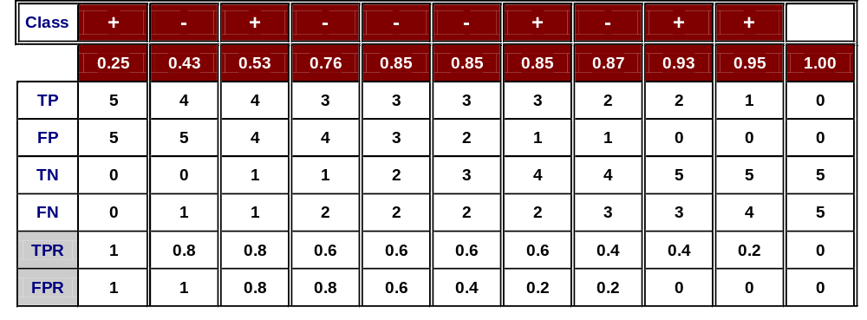
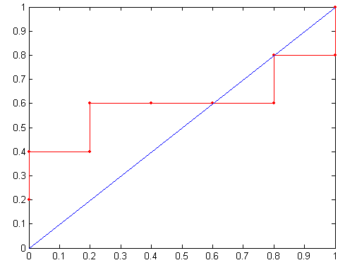
How to construct an ROC curve
Threshold >=
ROC Curve:
Introduction to Data Mining

Slide 13
Next Class
Introduction to Clustering
  Chapter 8.1
K-Means
  Chapter 8.2
Introduction to Data Mining

