Slide 1
CS 535/435 Introduction to Data Mining
(Fall 2017)
Lecture 12
Lei Yu
Department of Computer Science
Binghamton University
www.cs.binghamton.edu/~lyu

Slide 2
Clustering
What is clustering
Different types of clusters
Representative clustering algorithms
  K-means
  Hierarchical clustering
  DBSCAN
  …
Introduction to Data Mining

Slide 3
What is Clustering?
One type of unsupervised learning - learning to understand the data
Clustering - the process of grouping objects into classes of similar objects
Cluster – a collection of objects that are similar to one another
Inter-cluster distances are maximized
Intra-cluster distances are minimized
Introduction to Data Mining

Slide 4
What is not Clustering?
Supervised learning
  Class label information is available
Simple segmentation
  Dividing students into different registration groups based on gender or age
Introduction to Data Mining

Slide 5
Different Types of Clusters
Partition-based Clustering
  Well-separated clusters
  Center-based clusters
  Contiguity-based clusters
  Density-based clusters
  …
Hierarchical Clustering
Introduction to Data Mining

Slide 6
Types of Clusters: Well-Separated
A cluster is a set of objects in which each object is closer (or more similar) to every other object in the cluster than to any object not in the cluster
Maximum intra-cluster distance is smaller than minimum inter-cluster distance
2 well-separated clusters
Introduction to Data Mining

Slide 7
Types of Clusters: Center-Based
A cluster is a set of objects in which each object is closer (or more similar) to the “center” of the cluster than to the “center” of any other cluster
The center of a cluster
  A centroid - the average of all the points in the cluster
  A medoid - the most “representative” point of a cluster
4 center-based clusters
Introduction to Data Mining

Slide 8
Types of Clusters: Contiguity-Based
A cluster is a set of objects in which each object is closer (or more similar) to some other object in the cluster than to any object not in the cluster
Distance to nearest neighbor in the same cluster is smaller than nearest neighbor in another cluster
8 contiguous clusters
Introduction to Data Mining

Slide 9
Types of Clusters: Density-Based
A cluster is a dense region of objects, which is separated from other regions of high density by a region of low density.
Often used when noise and outliers are present.
6 density-based clusters
Introduction to Data Mining

Slide 10
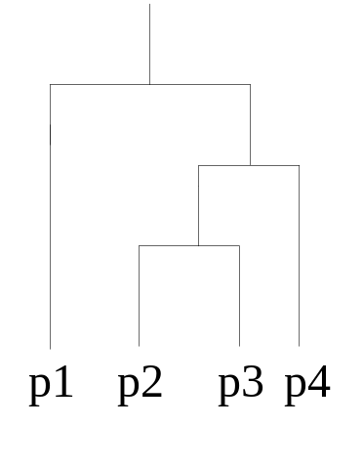
Types of Clusters: Hierarchical Clusters
Partition-based clustering (all previous examples)
  Dividing objects into a set of non-nested partitions
Hierarchical clustering
  Dividing objects into a set of nested clusters organized as a hierarchical tree (dendrogram)
p1
p3
p4
p
2
Hierarchical Clustering
Dendrogram
Introduction to Data Mining

Slide 11
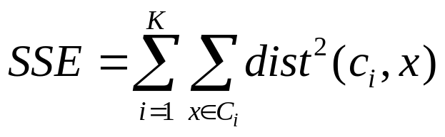
K-means Clustering
Partition-based clustering approach
  Each cluster is associated with a centroid (mean)
  Each point is assigned to the cluster with the closest centroid
  Number of clusters, K, must be specified
Most common objective function is to minimize Sum of Squared Error (SSE)
  x is a data point in cluster C_{i} and c_{i} is the mean for cluster C_{i}
  Often, Euclidean distance is used
Introduction to Data Mining

Slide 12

K-means Clustering Algorithm
Initial centroids are often chosen randomly
  Clusters produced vary from one run to another
Try an example on 1-dimensional data with K=2
  2, 3, 4, 6, 7, 8, 9
Introduction to Data Mining

Slide 13



Two different K-means Clustering Results
Original Points
Optimal Clustering
Sub-optimal Clustering
Introduction to Data Mining

Slide 14






Illustrating K-Means Clustering
Introduction to Data Mining

Slide 15
Illustrating K-Means Clustering…
Introduction to Data Mining

Slide 16
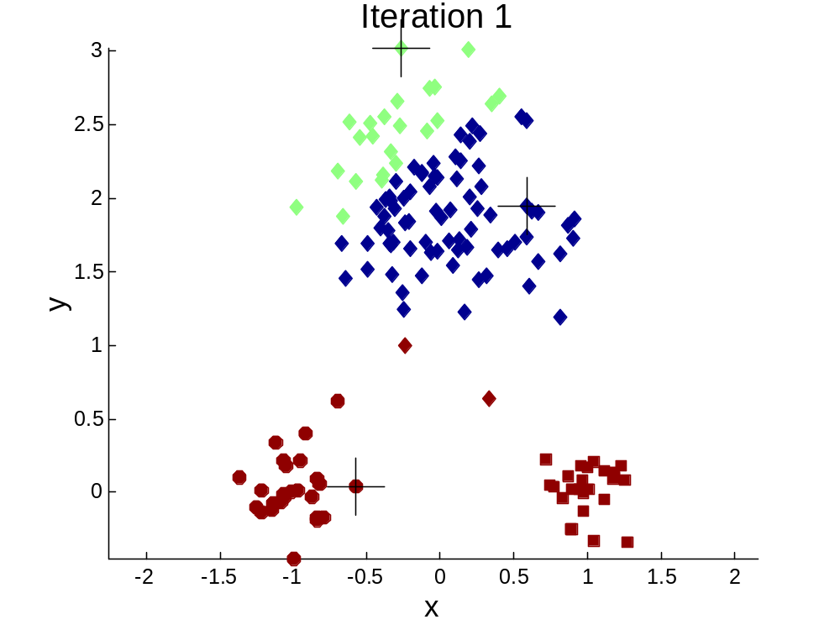


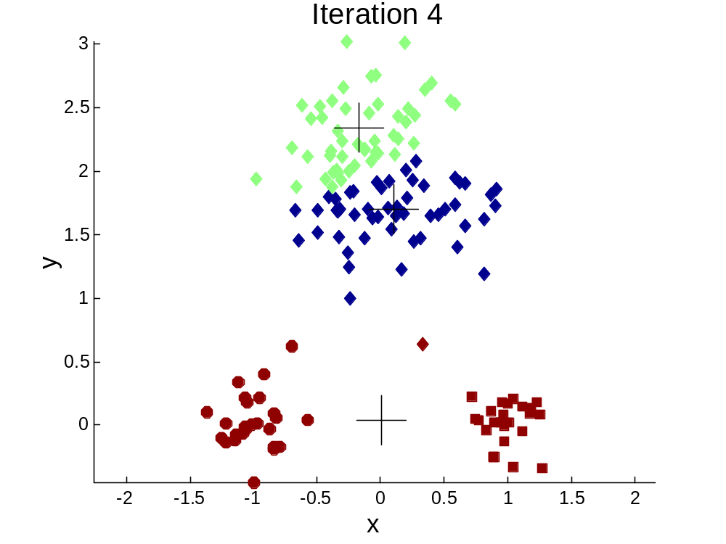
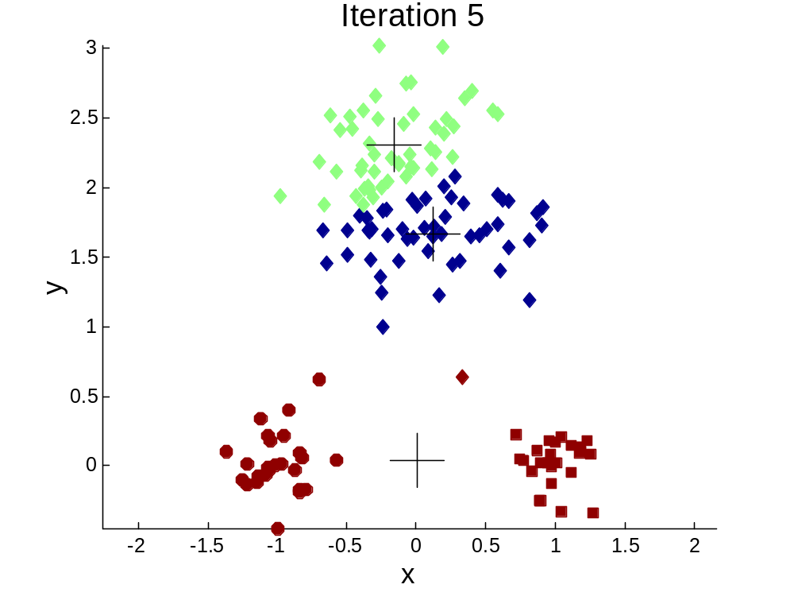
Importance of Choosing Initial Centroids
Introduction to Data Mining

Slide 17
Importance of Choosing Initial Centroids…
Introduction to Data Mining

Slide 18
Solutions to Initial Centroids Problem
Multiple runs of random selection
Select a centroid for all the data points and then select each successive initial centroid based on the farthest distance
Sample data first and then select centroids
Post-processing
  Splitting
  Merging
Other variations (Bisecting K-means)
Introduction to Data Mining

Slide 19
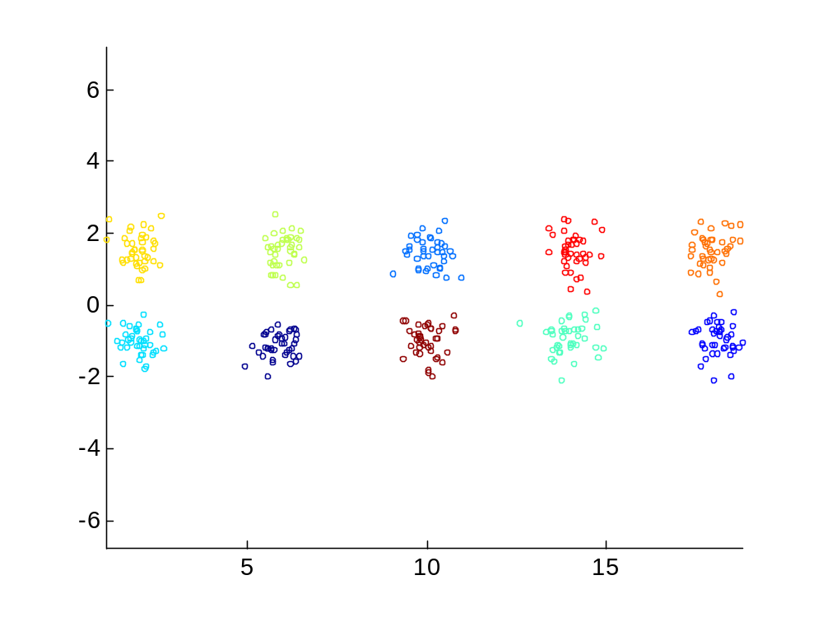
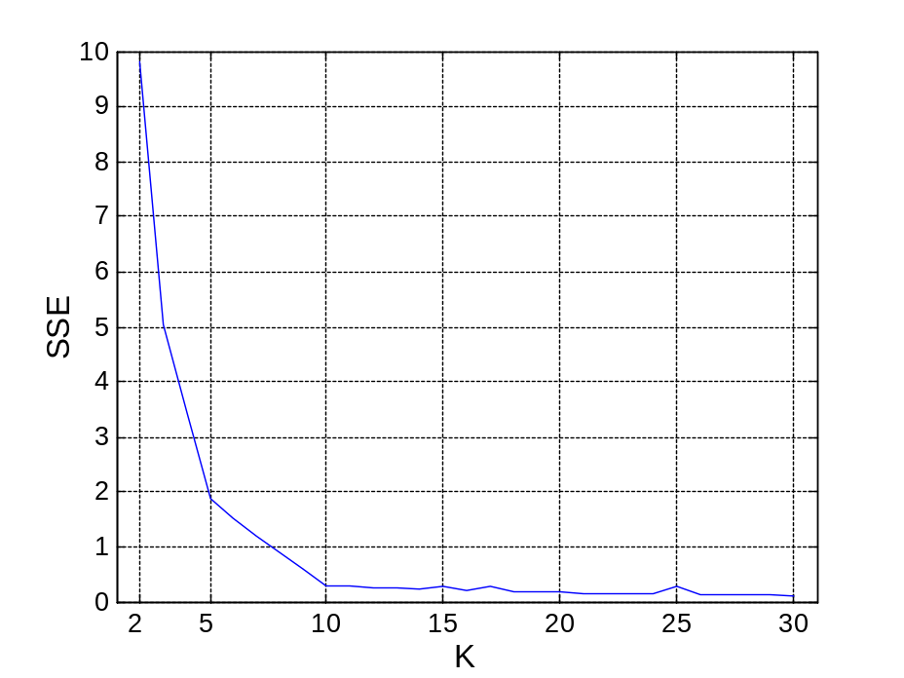
Estimating the Correct Number of Clusters
Example 1
SSE of clusters found using K-means
Introduction to Data Mining

Slide 20
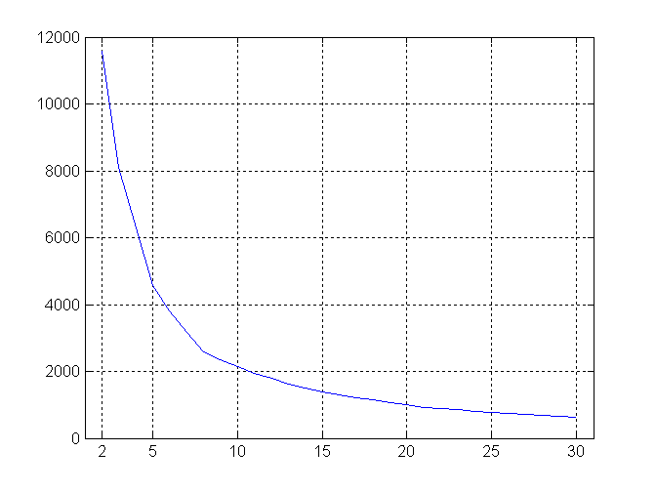
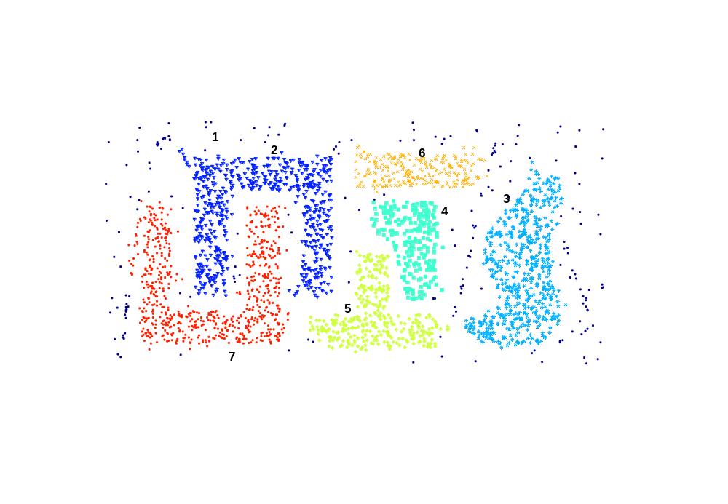
Estimating the Correct Number of Clusters …
Example 2
SSE of clusters found using K-means
Introduction to Data Mining

Slide 21
Strengths and Weaknesses of K-means
Strengths
  Simple to implement
  Efficient
    Time complexity ? (m = number of points, n = number of attributes, K = number of clusters, I = number of iterations)
Weakness
  Not suitable for nominal data
    Solution: K-medoids or PAM (Partition around medoids)
  Sensitive to noise or outliers
  Difficult to decide initial centriods
  Difficult to estimate K
  Incapable of detecting clusters of arbitrary shapes
Introduction to Data Mining

Slide 22
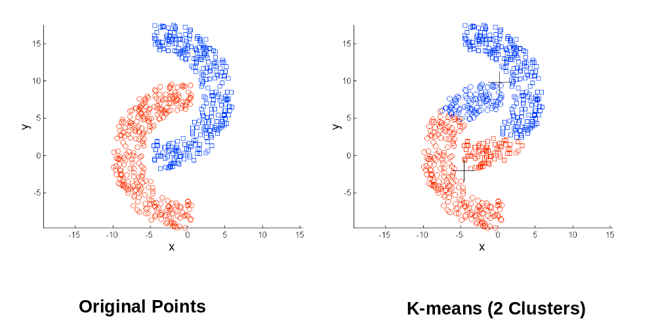
Limitations of K-means: Non-globular Shapes
Introduction to Data Mining

Slide 23
Next Class
  Hierarchical clustering algorithms
Reading
  Chapters 8.2.1, 8.2.2 of Tan’s Data Mining book
Introduction to Data Mining

