Slide 1
CS 535/435 Introduction to Data Mining
(Fall 2017)
Lecture 13
Lei Yu
Department of Computer Science
Binghamton University
www.cs.binghamton.edu/~lyu

Slide 2
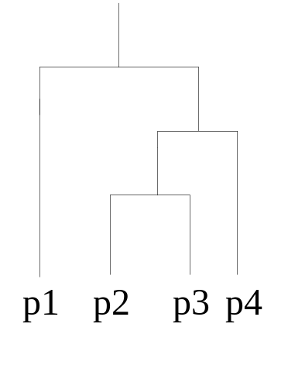
Hierarchical Clustering
Produces a set of nested clusters organized as a hierarchical tree
Can be visualized as a dendrogram
  A tree like diagram that records the sequences of merges or splits
p1
p3
p4
p
2
Nested Clusters
Dendrogram
Introduction to Data Mining

Slide 3
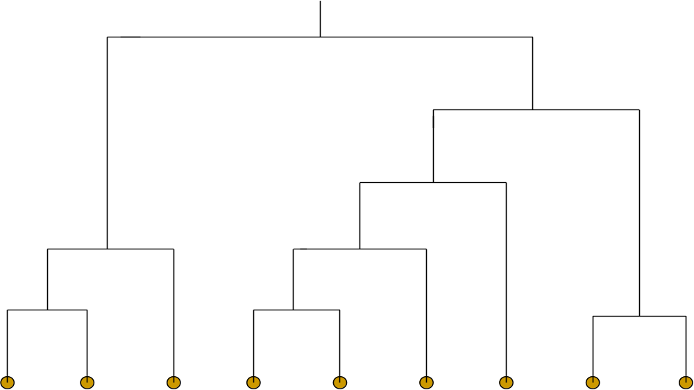
Dendrograms
  A clustering of data objects is obtained by cutting the dendrogram at the desired level, then each connected component forms a cluster.
Introduction to Data Mining

Slide 4
Two Main Approaches
Two main approaches of hierarchical clustering
  Agglomerative (bottom up):
    Start with each data point as one cluster
    At each step, merge the closest pair of clusters until only one cluster (or k clusters) left
  Divisive (top down):
    Start with one, all-inclusive cluster
    At each step, split a cluster until each cluster contains one point (or there are k clusters)
Introduction to Data Mining

Slide 5
Agglomerative Clustering Algorithm
Very popular hierarchical clustering technique
Basic algorithm is straightforward
  Let each data point be a cluster
  Compute the similarity/dissimilarity matrix, if necessary
  Repeat
  Merge the two closest clusters
  Update the similarity/dissimilarity matrix to reflect the similarity/dissimilarity between the new cluster and the remaining clusters
  Until only one single cluster remains
A key issue is the computation of the similarity of two clusters
  Different approaches of defining the similarity between clusters distinguish different algorithms
Introduction to Data Mining

Slide 6
How to Define Inter-Cluster Similarity
Similarity?
MIN
MAX
Group Average
Distance Between Centroids
Introduction to Data Mining

Slide 7
How to Define Inter-Cluster Similarity
MIN (Single Link)
MAX (Complete Link)
Group Average (Average Link)
Distance Between Centroids
Introduction to Data Mining

Slide 8
How to Define Inter-Cluster Similarity
MIN (Single Link)
MAX (Complete Link)
Group Average (Average Link)
Distance Between Centroids
Introduction to Data Mining

Slide 9
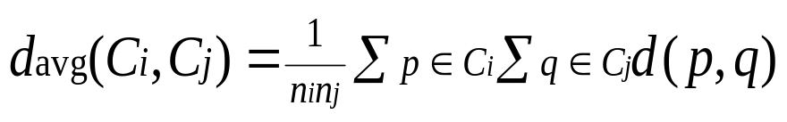
How to Define Inter-Cluster Similarity
MIN (Single Link)
MAX (Complete Link)
Group Average (Average Link)
Distance Between Centroids
Introduction to Data Mining

Slide 10
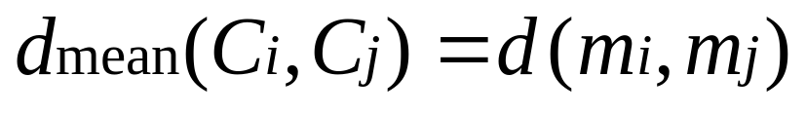
How to Define Inter-Cluster Similarity
×
×
MIN
MAX
Group Average
Distance Between Centroids
Introduction to Data Mining

Slide 11
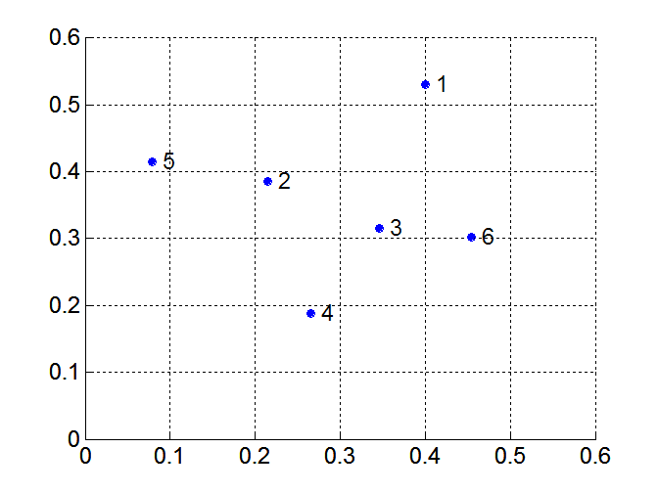
Illustrative Data Set
Point | x Coordinate | y Coordinate
P1 | 0.40 | 0.53
P2 | 0.22 | 0.38
P3 | 0.35 | 0.32
P4 | 0.26 | 0.19
P5 | 0.08 | 0.41
p6 | 0.45 | 0.30
 | P1 | P2 | P3 | P4 | P5 | P6
P1 | 0.00 | 0.24 | 0.22 | 0.37 | 0.34 | 0.23
P2 |  | 0.00 | 0.15 | 0.20 | 0.14 | 0.25
P3 |  |  | 0.00 | 0.15 | 0.28 | 0.11
P4 |  |  |  | 0.00 | 0.29 | 0.22
P5 |  |  |  |  | 0.00 | 0.39
P6 |  |  |  |  |  | 0.00
Introduction to Data Mining
Euclidean distance matrix

Slide 12

Hierarchical Clustering: MIN
5
1
3
5
2
1
2
3
6
4
4
Nested Clusters
Dendrogram
Introduction to Data Mining

Slide 13
Hierarchical Clustering: Comparison
5
1
3
5
2
1
MIN
2
3
6
4
4
4
1
1
2
5
2
5
2
5
2
MAX
3
6
3
6
Group Average
3
1
3
1
4
4
4

Slide 14
Next Class
Issues of hierarchical clustering
Cluster evaluation
Reading
  Chapters 8.3 & 8.4
Introduction to Data Mining

