Slide 1
CS 535/435 Introduction to Data Mining
(Fall 2017)
Lecture 14
Lei Yu
Department of Computer Science
Binghamton University
www.cs.binghamton.edu/~lyu

Slide 2
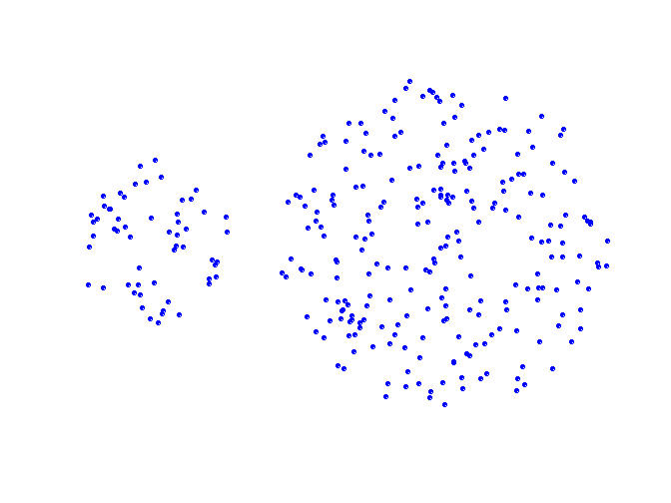
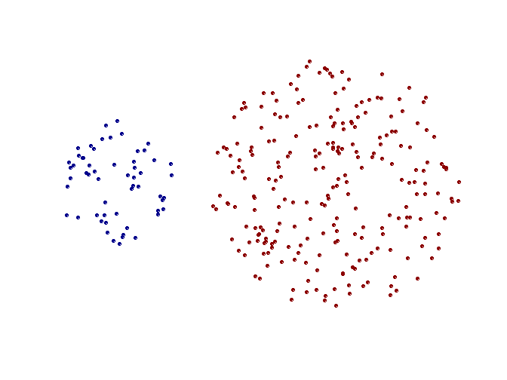
Strength of MIN
Original Points
Two Clusters
Can handle non-spherical shapes

Slide 3
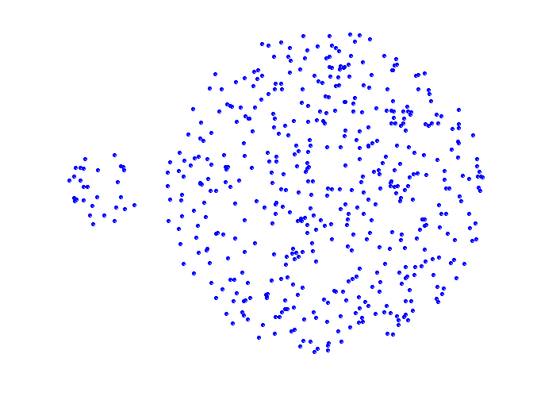
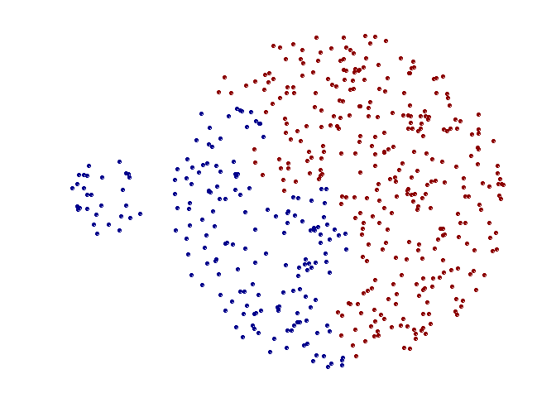
Limitation of MAX
Original Points
Two Clusters
Tends to break large clusters

Slide 4
Limitation of MIN
Original Points
Two Clusters
Sensitive to noise and outliers

Slide 5
Strength of MAX
Original Points
Two Clusters
Less susceptible to noise and outliers

Slide 6
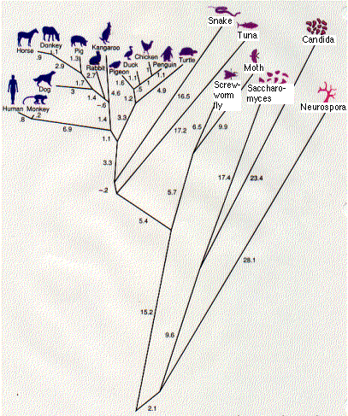
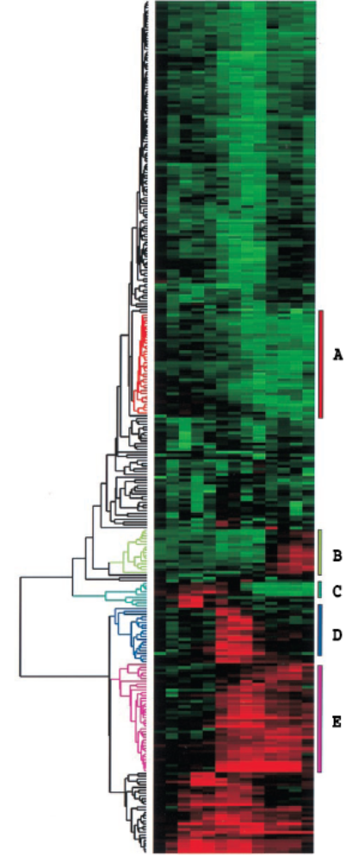
Strengths of Hierarchical Clustering
Do not have to assume any particular number of clusters
  Any desired number of clusters can be obtained by ‘cutting’ the dendogram at the proper level
They may correspond to meaningful taxonomies
  Example in biological sciences (e.g, phylogenetic tree, gene grouping…)
Introduction to Data Mining

Slide 7
Limitations of Hierarchical Clustering
Once a decision is made, it cannot be undone
Do not scale well to large data sets (m - number of objects, n - number of attributes)
  Time complexity
    O(m³n) without maintaining a similarity/dissimilarity matrix
    if maintaining a similarity/dissimilarity matrix
      O(m²n) for initially computing the similarity/dissimilarity matrix
      O(m²logm) for iteratively merging clusters
  Space complexity of for similarity/dissimilarity matrix
    O(m²)
Introduction to Data Mining

Slide 8
Performance Evaluation of Clustering
For classification, there are a variety of measures to evaluate the “goodness” of a classification model
  Accuracy, precision, recall, F-measures, ROC curve, etc.
For clustering, the analogous question is how to evaluate the “goodness” of the resulting clusters?
Why do we want to evaluate them?
  To avoid finding “fake” patterns from data
  To compare two sets of clustering results
    From different clustering algorithms
    From different settings of the same algorithm
  To compare two clusters
Introduction to Data Mining

Slide 9
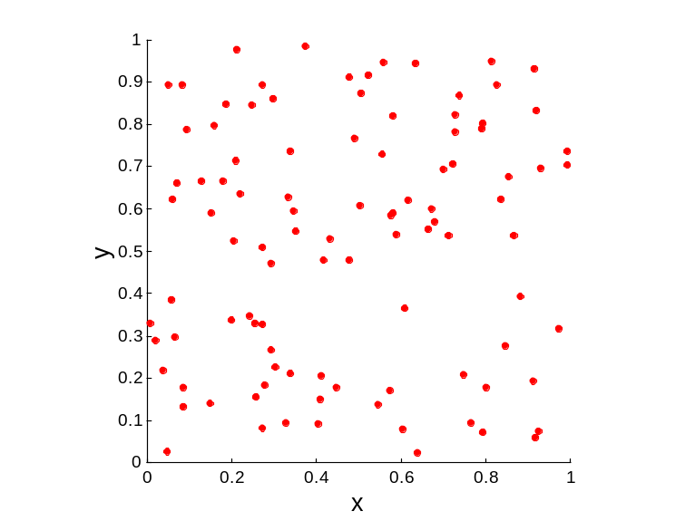
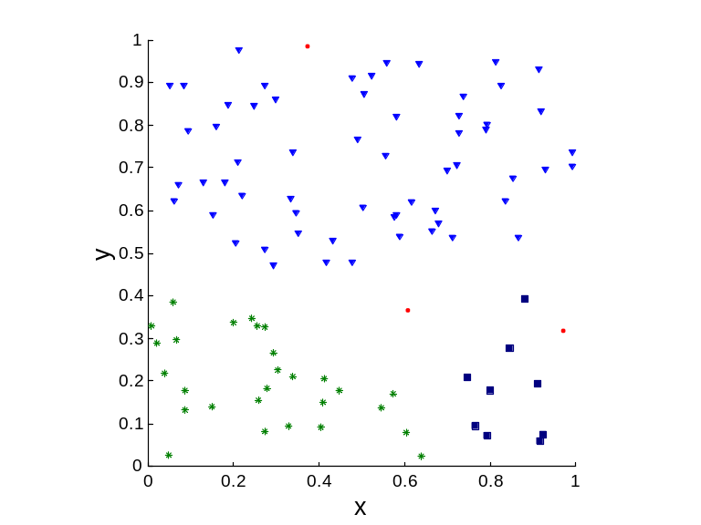
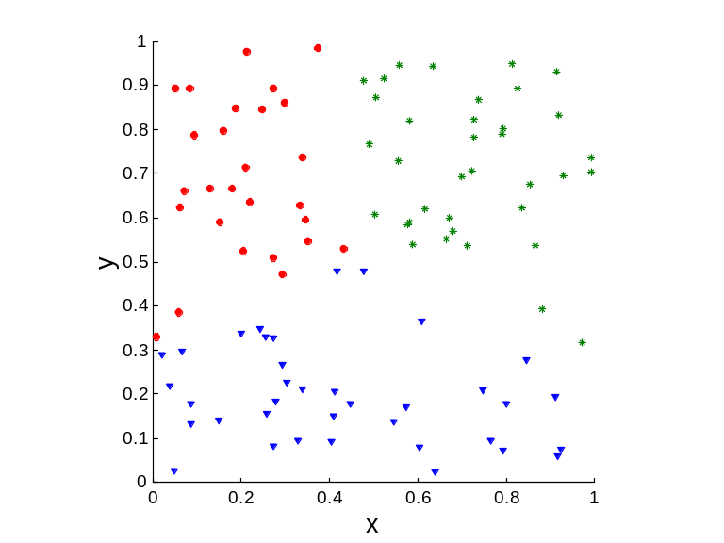
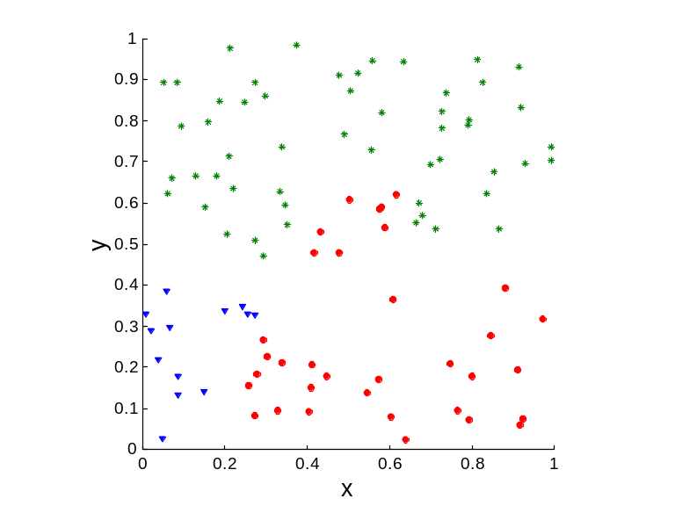
Clusters of Random Data (100 points)
Random Points
DBSCAN
K-means
Complete Link
Introduction to Data Mining

Slide 10
Measures of Cluster Evaluation
External measures
  Used to measure how well a clustering result fits prior knowledge about the data
    For example, cluster labels
  Using measures for classification
    Accuracy, Precision, Recall, F-measures, etc.
Internal measures
  Used to measure how well a clustering result fits the data without reference to prior knowledge
    Only based on the data distribution
  Using measures of cohesion or separation
Introduction to Data Mining

Slide 11
Internal Measures: Cohesion and Separation
Cluster Cohesion (Compactness, Tightness): measures how closely related the objects in one cluster are (intra-cluster similarity)
Cluster Separation (Isolation): measures how distinct or well-separated a cluster is from other clusters (inter-cluster dissimilarity)
Introduction to Data Mining

Slide 12
Measures: Cohesion and Separation
×
×
×
×
Cohesion
Separation
Cohesion
Separation
Introduction to Data Mining

Slide 13
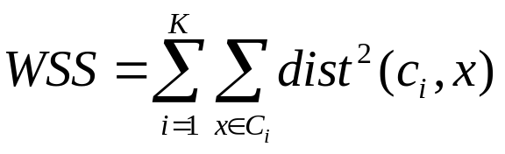
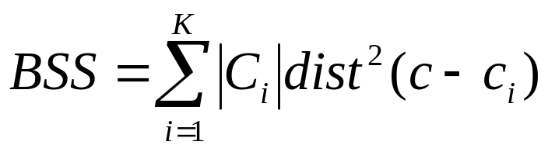
Example: Sum of Squared Error (SSE)
Cohesion: measured by within cluster sum of squares
  For each data point, its error defined as its distance to its own cluster center
  To get SSE, we square these errors and sum them.
  x is a data point in cluster C_{i} and c_{i} is the center for cluster C_{i}
Separation: measured by between cluster sum of squares
  c is the center of all data points and c_{i} is the center for cluster C_{i}
Introduction to Data Mining

Slide 14
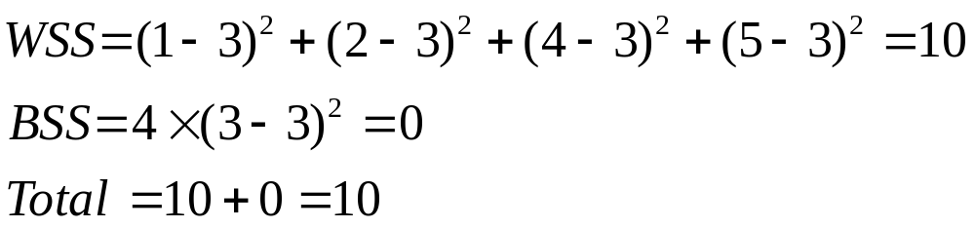
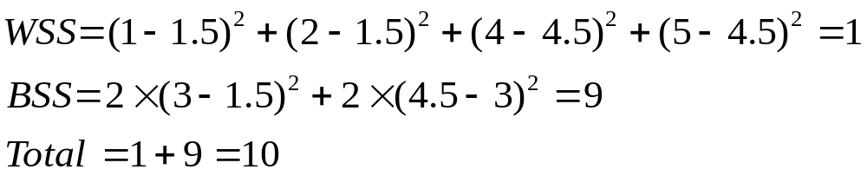
Example: Sum of Squared Error (SSE)
BSS + WSS = constant
m
×
×
×
1
m₁
2
3
4
m₂
5
K=1:
K=2:
Introduction to Data Mining

Slide 15
Assessing the Significance of Measurements
Need a mechanism to interpret any measurement
  For example, if the value of an evaluation measure is 10, is it good, fair, or poor?
Statistics is often used to assess the significance of evaluation measures
  To judge how likely it is that a measurement may be achieved by random chance
  The more “unusual” a clustering result is, the more likely it represents valid structure in the data
Introduction to Data Mining

Slide 16
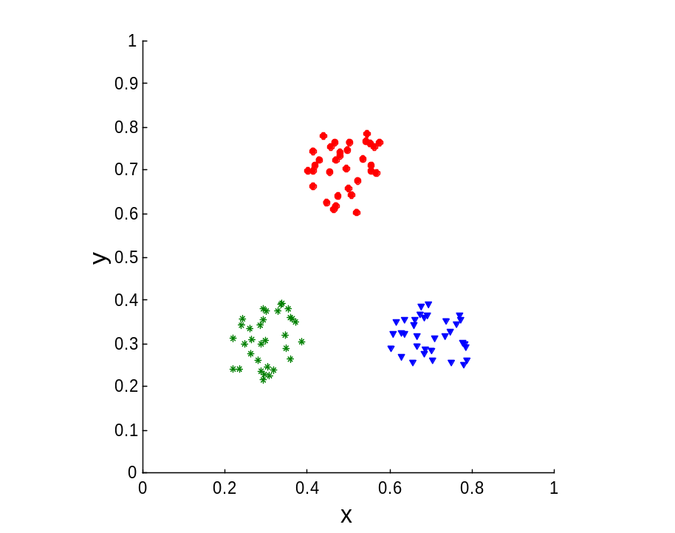
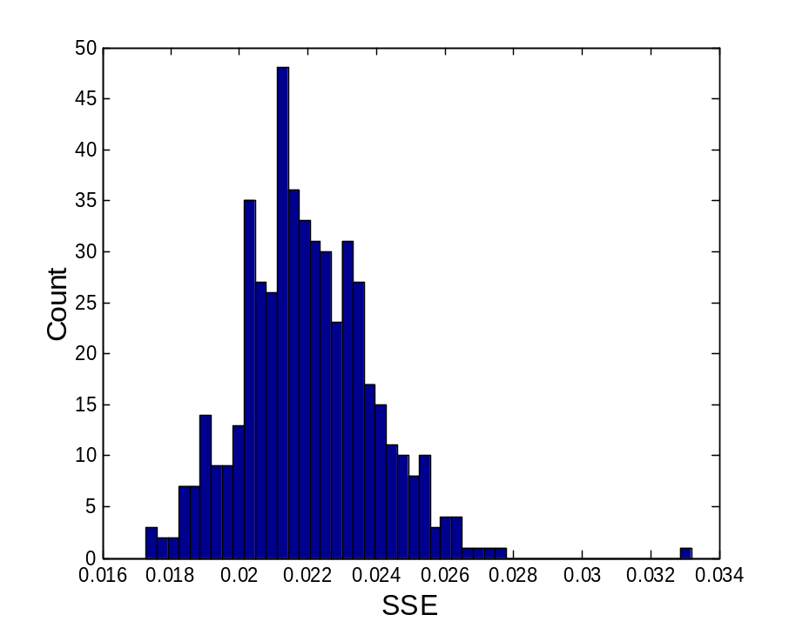
Assessing the Significance of Measurements ...
Example
  Compare SSE of 0.005 against three clusters in random data
  Histogram shows SSE of three clusters in 500 sets of random data points of size 100 distributed over the range 0.2 – 0.8 for x and y values
Introduction to Data Mining

Slide 17
Next Class
Density-based clustering and DBSCAN algorithm
Reading
  Chapter 8.3
Introduction to Data Mining

