Slide 1
CS 535/435 Introduction to Data Mining
(Fall 2017)
Lecture 15
Lei Yu
Department of Computer Science
Binghamton University
www.cs.binghamton.edu/~lyu

Slide 2
Density-Based Clustering
A cluster is a dense region of objects, separated from other regions of high density by a region of low density
Often used when noise and outliers are present
6 density-based clusters
Introduction to Data Mining

Slide 3
Main Issues to Consider
How to estimate density?
  A fundamental issue in density-based clustering
  Various approaches exist
How to form clusters based on density estimation?
  DBSCAN algorithm (an example of center based approach)
How to deal with clusters of various sizes and density?
  A challenging issue
Introduction to Data Mining

Slide 4
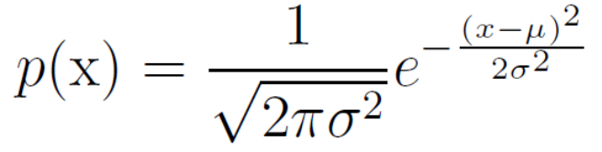
Density Estimation
The problem - modeling a probability density function (pdf) p(x) given a finite number of data points x drawn from a data distribution with pdf p(x)
Two basic approaches
  Parametric density estimation: assuming a given form for the density function, estimating the parameters of the function based on the data
    Gaussian distribution with unknown
    mean and variance
  Nonparametric density estimation: no assumption on particular form of the density function
    Histogram (the simplest form of grid based approach)
    Kernel density estimation
    KNN density estimation
centered based approach
Introduction to Data Mining
Notes:
optimized by fitting the model to the data set

Slide 5
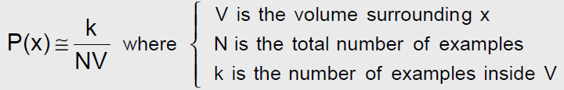
Nonparametric Density Estimation
General expression for non-parametric density estimation
Applying this result to practical density estimation problems:
  k Nearest Neighbor (kNN) approach - choose a fixed value of k and determine the corresponding volume V from the data.
  Kernel Density Estimation (KDE) approach - choose a fixed value of the volume V and determine k from the data.
Introduction to Data Mining
Notes:
optimized by fitting the model to the data set

Slide 6

DBSCAN: A Center-Based Approach
Density notion
    Density of a center point (center-based approach)
      The number of data points within a specified radius (Eps)
Classification of data points
  Core point - has more than a specified number of points (MinPts) within Eps-neighborhood
    At the interior of a cluster
  Border point - has fewer than or equal to MinPts points within Eps-neighborhood, but is within the Eps-neighborhood of a core point
  Noise point - any point neither a core point nor a border point
User-defined Eps and MinPts
Introduction to Data Mining

Slide 7
DBSCAN Algorithm
1: Label all points as core, border, or noise points
2: Eliminate noise points and perform clustering on the remaining points (core, border points)
  1. Put an edge between all core points that are within Eps-neighborhood of each other
  2. Make each group of connected core points into a separate cluster
  3. Assign each border point to one of the clusters to which the border point is closest
Introduction to Data Mining

Slide 8


DBSCAN: Example
Original Points (3000)
Point types: core, border, noise
MinPts = 4, Eps = 10
Introduction to Data Mining

Slide 9
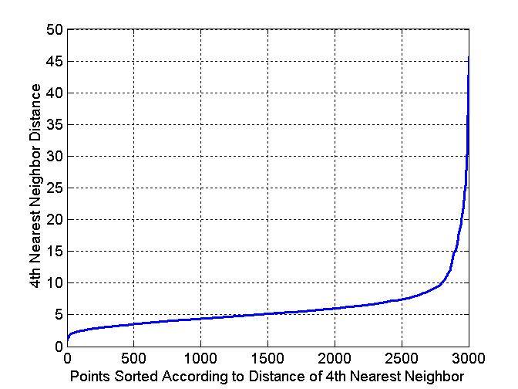
Determining Parameters (Eps and MinPts)
For points in a cluster, their k^{th} nearest neighbors are at small distance, and roughly the same
Noise points have the k^{th} nearest neighbors at large distance
So, plot sorted distance of every point to its k^{th} nearest neighbor
How to decide K?
  A complicated issue
  User’s estimate of
  the minimum number
  of points for a cluster
Introduction to Data Mining

Slide 10



Clusters of Varying Density
(MinPts=4, Eps=9.92).
Original Points
(MinPts=4, Eps=9. 75)
Introduction to Data Mining

Slide 11
DBSCAN: Strengths and Weaknesses
Strengths:
  Resistant to noise and outliers
  Able to find clusters of arbitrary shapes
Weaknesses
  Computationally expensive (time complexity?)
  Hard to decide parameters
  Have trouble with clusters of widely varying densities
Some variations to DBSCAN
  Grid-based density
Introduction to Data Mining

Slide 12
Next Class
Association rule mining
Reading
  Chapters 8.4
Introduction to Data Mining
Introduction to Data Mining

