Slide 1
CS 535/435 Introduction to Data Mining
(Fall 2017)
Lecture 16
Lei Yu
Department of Computer Science
Binghamton University
www.cs.binghamton.edu/~lyu

Slide 2

Association Rule Discovery: Definition
Given a set of records, each of which contain some number of items from a given collection
Find rules which will predict occurrence of an item based on occurrences of other items
Rules Discovered:
{Milk} --> {Coke}
{Diaper, Milk} --> {Beer}
Introduction to Data Mining

Slide 3

Key Definitions
Itemset
  A collection of one or more items
    Example: {Milk, Bread, Diaper}
  k-itemset
    An itemset that contains k items
Support count (σ)
  Frequency of occurrence of an itemset
  E.g. σ({Milk, Bread,Diaper}) = 2
Support
  Fraction of transactions that contain an itemset
  E.g. s({Milk, Bread, Diaper}) = 2/5
Frequent Itemset
  An itemset whose support is greater than or equal to a minsup threshold
Introduction to Data Mining

Slide 4
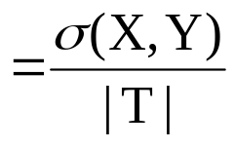


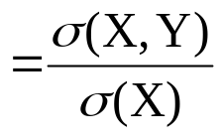

Key Definitions …
Association Rule
  An implication expression of the form X → Y, where X and Y are itemsets
  (X and Y are disjoint and non-empty)
  Example: {Milk, Diaper} → {Beer}
Rule Evaluation Metrics
  Support (s) s(X → Y)
    Fraction of transactions that contain both X and Y
  Confidence (c) c(X → Y)
    Measures how often items in Y
    appear in transactions that
    contain X
Example:
Introduction to Data Mining

Slide 5
Association Rule Mining Task
Given a set of transactions, the goal of association rule mining is to find all rules having
  support ≥ minsup threshold
  confidence ≥ minconf threshold
Why use support and confidence as the metrics?
Brute-force approach:
  List all possible association rules
  Compute the support and confidence for each rule
  Prune rules that fail the minsup and minconf thresholds
  ⇒ Computationally prohibitive!
Introduction to Data Mining
Introduction to Data Mining

Slide 6

Itemset Lattice
Given d items, there are 2^{d} possible candidate itemsets
Introduction to Data Mining
Introduction to Data Mining

Slide 7
Mining Association Rules
Two-step approach:
  Frequent Itemset Generation
    Generate all itemsets whose support ≥ minsup
  Rule Generation
    Generate high confidence rules from each frequent itemset, where each rule is a binary partitioning of a frequent itemset
Frequent itemset generation is still computationally expensive
  Efficient solutions are needed
Introduction to Data Mining

Slide 8
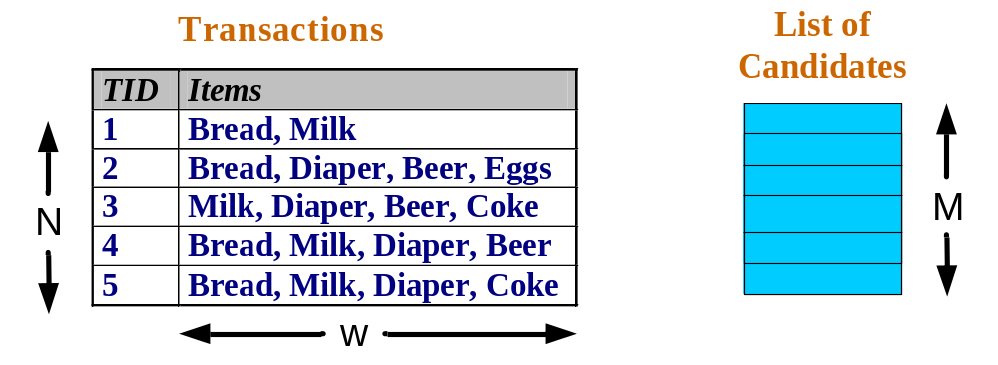
Frequent Itemsets Generation
Brute-force approach:
  Each itemset in the lattice is a candidate itemset
  Count the support of each candidate by scanning the database
  Match each transaction against every candidate
  Complexity ~ O(NMw) => Expensive since M = 2^{d} !!!
Introduction to Data Mining

Slide 9
Frequent Itemsets Generation Strategies
Reduce the number of candidates (M)
  Exhaustive search: M=2^{d}
  Use pruning techniques to reduce M
Reduce the number of comparisons
  Use efficient data structures to store the candidates
  Avoid matching every candidate against every transaction
Reduce the number of transactions (N)
  Sampling (cannot guarantee the exact solution)
Introduction to Data Mining

Slide 10
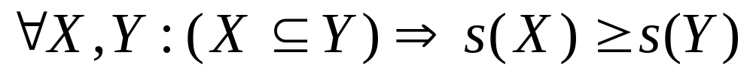
Reducing Number of Candidates
Apriori principle:
  If an itemset is infrequent, then all of its supersets must also be infrequent
Apriori principle holds due to the following property of the support measure:
  Support of an itemset never exceeds the support of its subsets
  This is known as the anti-monotone property of support
Introduction to Data Mining

Slide 11


Illustrating Apriori Principle
Found to be Infrequent
Pruned supersets
Introduction to Data Mining

Slide 12
Frequent Itemsets Generation of Apriori
Algorithm Summary
  Generate all frequent itemsets of size 1 based on all candidate itemsets of size 1
  Repeat
    Generate all candidate itemsets of size (k+1) from frequent itemsets of size k
    Count the support of each candidate itemset of size (k+1) by scanning the transaction database
    Eliminate candidates that are infrequent, leaving only frequent itemsets of size (k+1)
  Until no new frequent itemsets are identified
Introduction to Data Mining

Slide 13

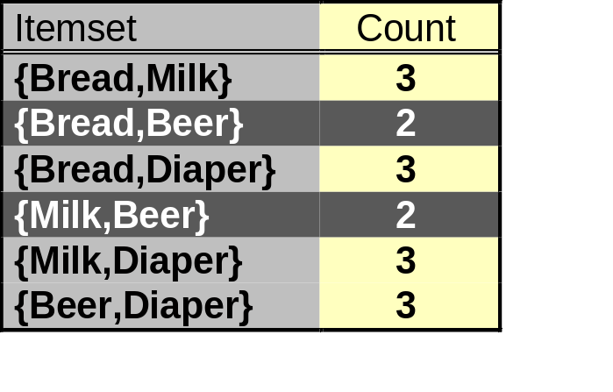
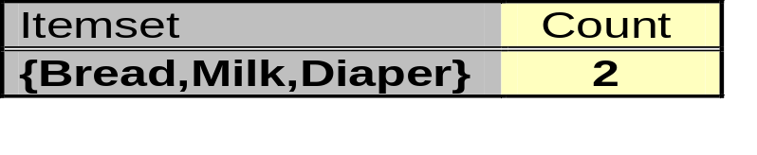
Frequent Itemsets Generation of Apriori
Candidate 1-itemsets
Candidate 2-itemsets
Minimum Support = 3
Candidate 3-itemsets
If every subset is considered,
⁶C₁ + ⁶C₂ + ⁶C₃ = 41
With support-based pruning,
6 + 6 + 1 = 13
Introduction to Data Mining
Notes:
Why not bread milk beer, why not bread diaper bear

Slide 14
How to Generate Candidates?
Step 1: Merging a pair of frequent k-itemsets only if their first (k-1) items are identical
Step 2: Pruning based on Apriori principle
Example of candidate-generation
  Given frequent 3-itemsets: abc, abd, acd, ace, bcd
  Merging
    abcd from abc and abd
    acde from acd and ace
  Pruning:
    acde is removed because ade is not frequent
  Candidate 4-itemsets: abcd
Introduction to Data Mining

Slide 15
Next Class
Rule Generation by Apriori
Additional issues of Apriori
Reading
  Chapters 6.3, 6.7
Introduction to Data Mining

