Slide 1
CS 535/435 Introduction to Data Mining
(Fall 2017)
Lecture 17
Lei Yu
Department of Computer Science
Binghamton University
www.cs.binghamton.edu/~lyu

Slide 2
Frequent Itemsets Generation of Apriori
Algorithm Summary
  Generate all frequent itemsets of size 1 based on all candidate itemsets of size 1
  Repeat
    Generate all candidate itemsets of size (k+1) from frequent itemsets of size k
    Count the support of each candidate itemset of size (k+1) by scanning the transaction database
    Eliminate candidates that are infrequent, leaving only frequent itemsets of size (k+1)
  Until no new frequent itemsets are identified
Introduction to Data Mining

Slide 3
How to Efficiently Count Supports of Candidates?
Why counting supports of candidates a problem?
  The total number of candidates can be very huge
  The total number of transactions can be very huge
To reduce the number of comparisons
  Candidate itemsets of the same size are stored in a hash-tree
  Leaf node of hash-tree contains a list of itemsets and counts
  Instead of matching each transaction against every candidate, match it against candidates contained in the hashed buckets

Slide 4
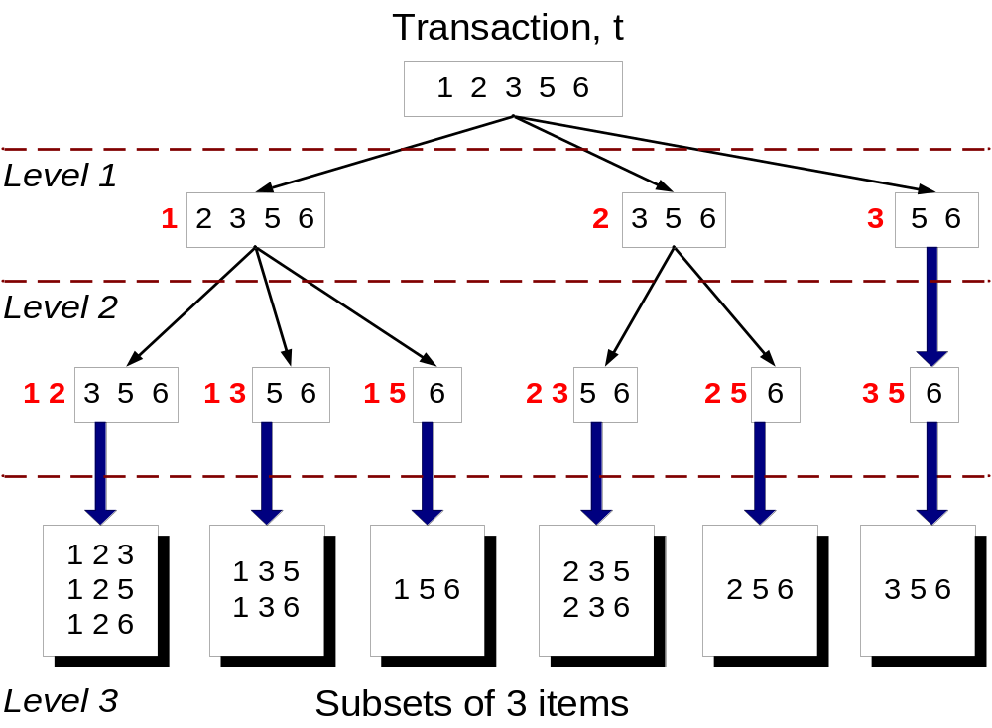
Subset Enumeration
Given a transaction t, what are the possible subsets of size 3?

Slide 5
Generating Hash Tree
Suppose you have 15 candidate itemsets of length 3:
{1 4 5}, {1 2 4}, {4 5 7}, {1 2 5}, {4 5 8}, {1 5 9}, {1 3 6}, {2 3 4}, {5 6 7}, {3 4 5}, {3 5 6}, {3 5 7}, {6 8 9}, {3 6 7}, {3 6 8}
You need to decide:
a Hash function
Max leaf size: max number of itemsets stored in a leaf node (if number of candidate itemsets exceeds max leaf size, split the node)
Hash function
1,4,7
3,6,9
2 3 4
5 6 7
2,5,8
1 4 5
3 4 5
3 5 6
3 5 7
6 8 9
3 6 7
3 6 8
1 3 6
h(x) = x mod 3
1 2 4
4 5 7
Max leaf size = 3
1 2 5
4 5 8
1 5 9

Slide 6
Subset Matching Based on Hash Tree
Merge the examples in the previous two slides
1 2 3 5 6
transaction
Hash Function
1 +
2 3 5 6
2 +
3 5 6
1,4,7
3,6,9
1 2 +
3 5 6
3 +
5 6
2,5,8
1 3 +
5 6
2 3 4
1 5 +
6
5 6 7
1 4 5
1 3 6
3 4 5
3 5 6
3 6 7
3 5 7
3 6 8
1 2 4
1 2 5
1 5 9
6 8 9
4 5 7
4 5 8

Slide 7
Mining Association Rules
Two-step approach:
  Frequent Itemset Generation
    Generate all itemsets whose support ≥ minsup
  Rule Generation
    Generate high confidence rules from each frequent itemset, where each rule is a binary partitioning of a frequent itemset
Frequent itemset generation is still computationally expensive
Introduction to Data Mining

Slide 8

Lattice of Itemsets
Given d items, there are 2^{d} possible candidate itemsets
Introduction to Data Mining

Slide 9
Rule Generation
Given a frequent itemset L, find all non-empty proper subsets f ⊂ L such that f → L – f satisfies the minimum confidence requirement
  If {A,B,C,D} is a frequent itemset, candidate rules:
    A →BCD, B →ACD, C →ABD, D →ABC
    AB →CD, AC → BD, AD → BC, BC →AD,
    BD →AC, CD →AB,
    ABC →D, ABD →C, ACD →B, BCD →A
If |L| = k, then there are 2^{k} – 2 candidate association rules (ignoring L → ∅ and ∅ → L)
Introduction to Data Mining

Slide 10
Rule Generation …
How to efficiently generate rules from frequent itemsets?
  Confidence of rules f → L – f generated from the same itemset L has an anti-monotone property in terms of |L – f |
  For example, L = {A,B,C,D}:
  c(ABC → D) ≥ c(AB → CD) ≥ c(A → BCD)
Introduction to Data Mining
Notes:
AC->D A->BCD

Slide 11
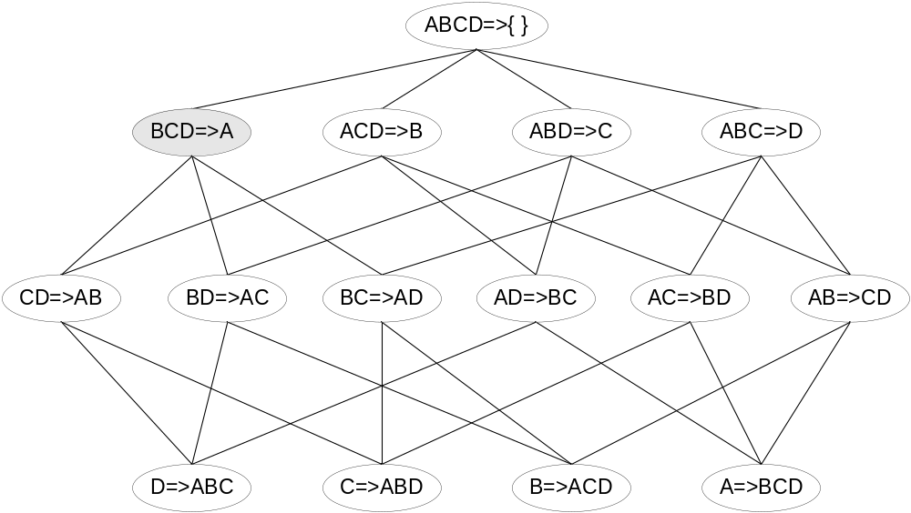

Lattice of Rules
Low Confidence Rule
Pruned Rules
Introduction to Data Mining

Slide 12
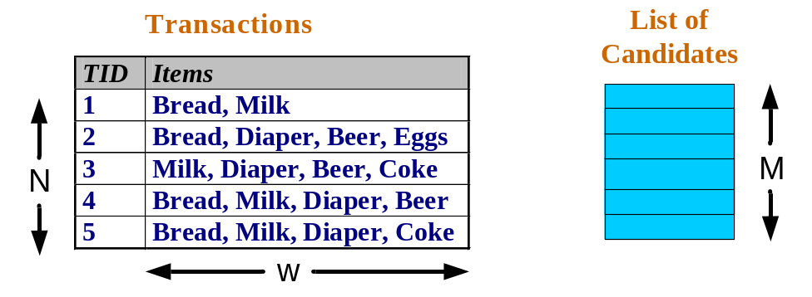
Factors Affecting Complexity
Dimensionality (number of items) of the data set
  Exponential increase of search space with increased dimensionality
  Storage space is needed to store support count of each candidate
Size of database
  Apriori makes multiple passes of the database (how many?)
  Run time of algorithm increases with number of transactions
Average transaction width
  Transaction width increases with denser databases
  Number of subsets in a transaction increases with its width
  This may increase max length of frequent itemsets and traversals of hash trees
Choice of minimum support threshold
  Lowering support threshold results in more frequent itemsets
  This may also increase number of candidates and max length of frequent itemsets
Introduction to Data Mining

Slide 13
Next Class
Association rule evaluation
FP-Growth Algorithm
Reading
  Chapters 6.5, 6.6

