Slide 1
CS 535/435 Introduction to Data Mining
(Fall 2017)
Lecture 18
Lei Yu
Department of Computer Science
Binghamton University
www.cs.binghamton.edu/~lyu

Slide 2
Frequent Itemsets Generation of Apriori
Algorithm Summary
  Generate all frequent itemsets of size 1 based on all candidate itemsets of size 1
  Repeat
    Generate all candidate itemsets of size (k+1) from frequent itemsets of size k
    Count the support of each candidate itemset of size (k+1) by scanning the transaction database
    Eliminate candidates that are infrequent, leaving only frequent itemsets of size (k+1)
  Until no new frequent itemsets are identified
Introduction to Data Mining
Introduction to Data Mining

Slide 3

Itemset Lattice
Given d items, there are 2^{d} possible candidate itemsets
Introduction to Data Mining
Introduction to Data Mining

Slide 4
FP-Growth Algorithm
Use depth-first search instead of breadth-first search in traversing the search space
Use a compressed representation of the database by an FP-tree
Once an FP-tree has been constructed, it uses a recursive divide-and-conquer approach to mine the frequent itemsets
Introduction to Data Mining

Slide 5
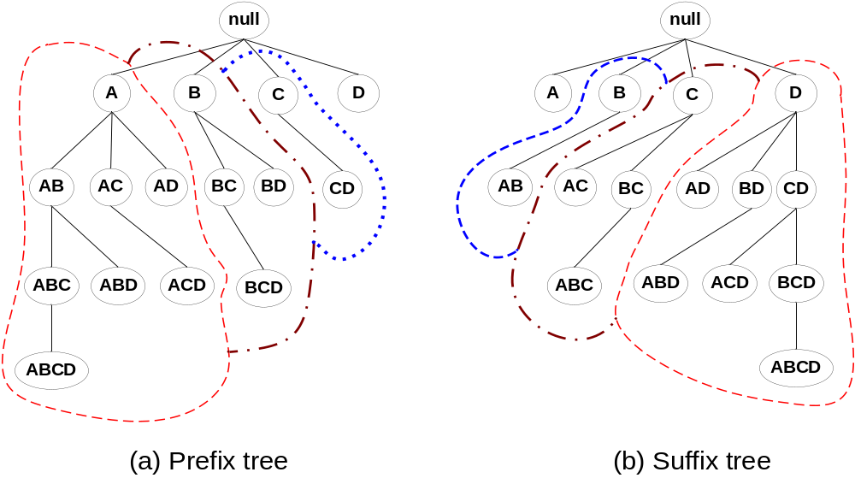
Example of Divide-and-Conquer
Prefix or Suffix Equivalent Classes
FP-Growth algorithm uses a similar way of partitioning the search space
Introduction to Data Mining

Slide 6
FP-Tree Structure
TID Items bought (ordered) frequent items
1 {f, a, c, d, g, i, m, p} {f, c, a, m, p}
2 {a, b, c, f, l, m, o} {f, c, a, b, m}
3 {b, f, h, j, o, w} {f, b}
4 {b, c, k, s, p} {c, b, p}
5 {a, f, c, e, l, p, m, n} {f, c, a, m, p}
min_support = 3
{}
Header Table
Item frequency head
f 4
c 4
a 3
b 3
m 3
p 3
Scan DB once, find all frequent 1-itemset
Sort frequent items in frequency descending order, F-list
Scan DB again, construct FP-tree
f:4
c:1
c:3
b:1
b:1
a:3
p:1
m:2
b:1
F-list=f-c-a-b-m-p
p:2
m:1
Introduction to Data Mining

Slide 7
Benefits of the FP-tree Presentation
Completeness
  Preserve complete information for frequent patterns
  Never break a long pattern of any transaction
Compactness
  Reduce irrelevant info — infrequent items are gone
  Items in frequency descending order — the more frequently occurring, the more likely to be shared
  The more the paths overlap with one another, the more compression we can achieve
    Best case?
    Worse case
  Most often, the size of the entire PF-tree fits into main memory
Introduction to Data Mining

Slide 8
Forming Conditional Pattern-Bases
For each frequent item
  Starting at the frequent item header table in the FP-tree
  Traverse the FP-tree by following the link of each frequent item
  Accumulate all of transformed prefix paths of the item to form its conditional pattern base
{}
Header Table
Item frequency head
f 4
c 4
a 3
b 3
m 3
p 3
f:4
c:1
Conditional pattern bases
item cond. pattern base
c f:3
a fc:3
b fca:1, f:1, c:1
m fca:2, fcab:1
p fcam:2, cb:1
c:3
b:1
b:1
a:3
p:1
m:2
b:1
p:2
m:1
Introduction to Data Mining

Slide 9
From Conditional Pattern-Bases to Conditional FP-Trees
For each pattern-base
  Accumulate the count for each item in the base
  Construct the FP-tree for the frequent items of the pattern base
m-conditional pattern base:
  fca:2, fcab:1
{}
Header Table
Item frequency head
f 4
c 4
a 3
b 3
m 3
p 3
f:4
c:1
All frequent patterns relate to m
m,
fm, cm, am,
fcm, fam, cam,
fcam
{}
c:3
b:1
b:1

f:3

a:3
p:1
m:2
b:1
c:3
p:2
m:1
a:3
m-conditional FP-tree
Introduction to Data Mining

Slide 10
Mining Frequent Patterns With FP-Trees
Idea: Frequent pattern growth
  Recursively grow frequent patterns by pattern and database partition
Method
  For each frequent item, construct its conditional pattern-base, and then its conditional FP-tree
  Repeat the process on each newly created conditional FP-tree
  Until the resulting FP-tree is empty, or it contains only one path
    For a single path, we can generate all the combinations of its sub-paths, each of which is a frequent pattern
Introduction to Data Mining

Slide 11

FP-Growth vs. Apriori
Introduction to Data Mining

Slide 12
Evaluation of Association Rules
Two basic concerns?
  Completeness - Are all interesting rules found?
  Robustness - Are all found rules interesting?
Interestingness measures can be used to prune the derived association rules
  Subjective measures
    Rank patterns according to user’s interpretation
    A pattern is interesting if it reveals unexpected information or can lead to profitable actions
    Butter -> Bread (obvious), Diapers – Bear (might be interesting)
  Objective measures
    Use statistics derived from data
    Support, confidence, lift, correlation,…
Introduction to Data Mining

Slide 13
Computing Interestingness Measure
Given a rule X → Y, information needed to compute rule interestingness can be summarized in a contingency table
Contingency table for X → Y
f₁₁: support of X and Y
f₁₀: support of X and Y
f₀₁: support of X and Y
f₀₀: support of X and Y
 | Y | Y
X | f₁₁ | f₁₀
X | f₀₁ | f₀₀
Used to define various measures
support, confidence, lift, etc.
Introduction to Data Mining

Slide 14
Problem with Support Threshold
How to set the appropriate minsup threshold?
  If minsup is set too high, we could miss itemsets involving interesting rare items (e.g., expensive products) and large-size itemsets
  If minsup is set too low, it is computationally expensive and the number of itemsets is very large
Using a single minimum support threshold may not be effective (advanced issues)
  Using different support thresholds for different items
  Multi-level association rules
Introduction to Data Mining

Slide 15
Problem with Confidence Threshold
 | Coffee | Coffee
Tea | 15 | 5 | 20
Tea | 75 | 5 | 80
 | 90 | 10 | 100
Association Rule: Tea → Coffee
Confidence= P(Coffee|Tea) = 15/20 = 0.75
but P(Coffee) = 90/100 = 0.9
Although confidence is high, rule is misleading
P(Coffee|Tea) = 75/80 = 0.9375
Introduction to Data Mining

Slide 16
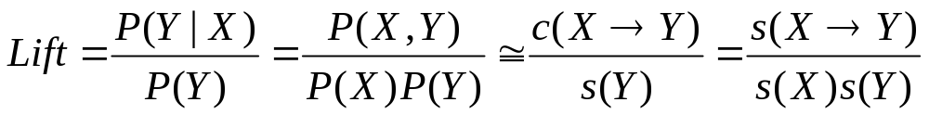
Statistical-based Measures
Some measures that take into account statistical dependence
 | Coffee | Coffee
Tea | 15 | 5 | 20
Tea | 75 | 5 | 80
 | 90 | 10 | 100
Association Rule: Tea → Coffee
Confidence= P(Coffee|Tea) = 0.75
but P(Coffee) = 0.9
Lift = 0.75/0.9= 0.8333 (< 1, therefore is negatively correlated)
Introduction to Data Mining

Slide 17
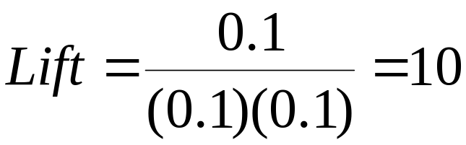
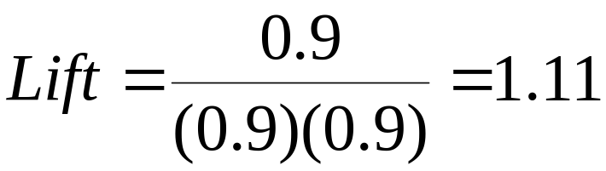
Problem of Lift
 | Y | Y
X | 10 | 0 | 10
X | 0 | 90 | 90
 | 10 | 90 | 100
 | Y | Y
X | 90 | 0 | 90
X | 0 | 10 | 10
 | 90 | 10 | 100
Have to consider support!
Introduction to Data Mining

