Slide 1
CS 535/435 Introduction to Data Mining
(Fall 2017)
Lecture 2
Lei Yu
Department of Computer Science
Binghamton University
www.cs.binghamton.edu/~lyu

Slide 2
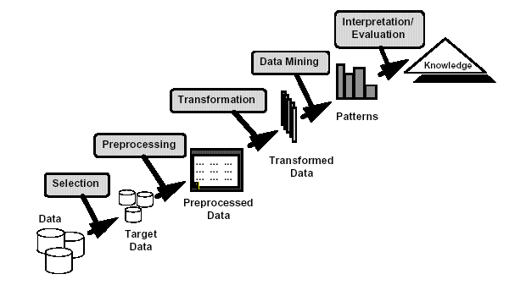
What is Data Mining?
Many Definitions
  A non-trivial process of extracting interesting (implicit, previously unknown and potentially useful) patterns or knowledge from data
  Exploration and analysis, by automatic or semi-automatic means, of large quantities of data in order to discover meaningful patterns
  A process, not plug-and-play
Introduction to Data Mining

Slide 3
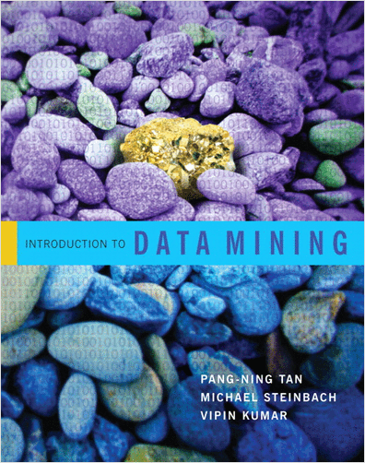
Textbook (recommended)
Introduction to Data Mining
Pang-Ning Tan, Michael Steinbach, and Vipin Kumar
Addison-Wesley, April 2005.
Chapters to be covered: 1,2,4,5,6,8,9
Sample chapters 4, 6 and 8 available at Blackboard.
Introduction to Data Mining

Slide 4
Agenda (tentative)
CS 535 Introduction to Data Mining Fall 2005
Lectures
Student Presentations
  About 6 lectures at the end of the semester
  Candidate topics
    Chapters 5.1, 5.6, 5.7, 5.8, 6.4, 9.2, 9.3
    Others published later
Topics | Classes
Introduction | 2
Classification | 7
Data Preprocessing | 2
Clustering | 4
Association-rules | 3
H1
Exam I
H2
H3
H4
Exam II
Introduction to Data Mining
Last updated on

Slide 5
Acknowledgements
Pang-Ning Tan, Michael Steinbach, and Vipin Kumar (Introduction to Data Mining)
Jiawei Han and Micheline Kamber
(Data Mining: Concepts and Techniques)
The lecture slides in this class are partially based on the textbook slides of the above authors with constant modifications by the instructor
Introduction to Data Mining

Slide 6

What is a Data Set?
A data set is a collection of objects described by a number of attributes
An attribute is a property or characteristic of an object
  Examples: eye color of a person, temperature, etc.
  Attribute is also known as variable, field, characteristic, feature, dimension, etc.
A collection of attributes describe an object
  Object is also known as record, point, case, sample, entity, or instance
Attributes
Objects
Introduction to Data Mining

Slide 7
Why Studying Data
Data sets differ in a number of ways
  Different attribute types (quantitative or qualitative)
  Special characters of data (time series, explicit relationships to one another)
Type of data determines the choice of data mining methods and tools
Different quality of data
Data mining research/application is “Data” driven
Introduction to Data Mining

Slide 8
Types of Data Sets
Record
  Standard data format
  Data Matrix
  Transaction (Market Basket) Data
  Document Data
Graph-based
  World Wide Web
  Molecular Structures
  …
Ordered
  Temporal Data
  Spatial Data
  …
Introduction to Data Mining

Slide 9
Record Data
Data that consists of a collection of records, each of which consists of a fixed set of attributes
Introduction to Data Mining

Slide 10
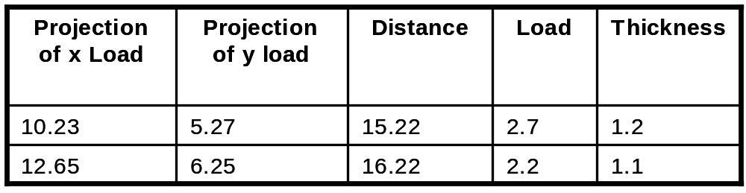
Data Matrix
If data objects have the same fixed set of numeric attributes, then the data objects can be thought of as points in a multi-dimensional space, where each dimension represents a distinct attribute
Such data set can be represented by an m by n matrix, where there are m rows, one for each object, and n columns, one for each attribute
Introduction to Data Mining

Slide 11

Transaction Data
A special type of record data
  Each record (transaction) involves a set of items
  For example, consider a grocery store
    The set of products purchased by a customer during one shopping trip constitute a transaction
  How can it be viewed as a record data?
Introduction to Data Mining

Slide 12

Document Data
Each document becomes a `term' vector
  Each term is a component (attribute) of the vector
  The value of each component is the number of times the corresponding term occurs in the document
  How to save storage for sparse matrix?
Introduction to Data Mining

Slide 13
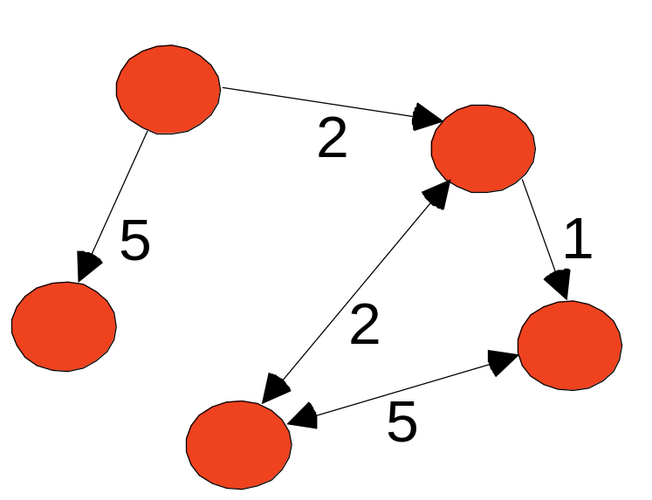
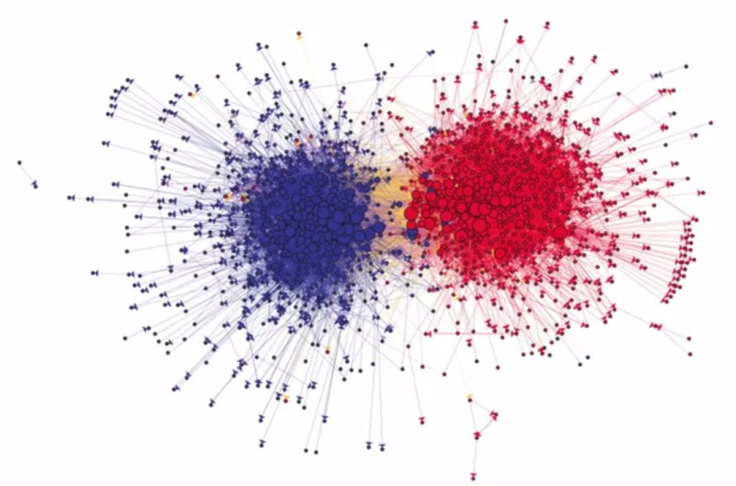
Graph Data (I)
Data with relationships among objects
  Data objects are nodes
  Relationships are captured by links
  What can be “mined” out of a graph?
Source: Lada Adamic; Coursera course: “Social Network Analysis”
Introduction to Data Mining

Slide 14
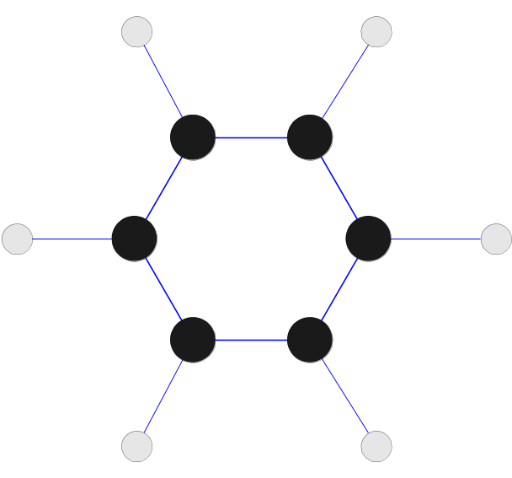
Graph Data (II)
Data with objects that are graphs
  Objects contain substructures that have relationships
  Determine frequent substructure among a set of graphs
  How to handle this type of data?
Benzene Molecule: C₆H₆
Introduction to Data Mining

Slide 15
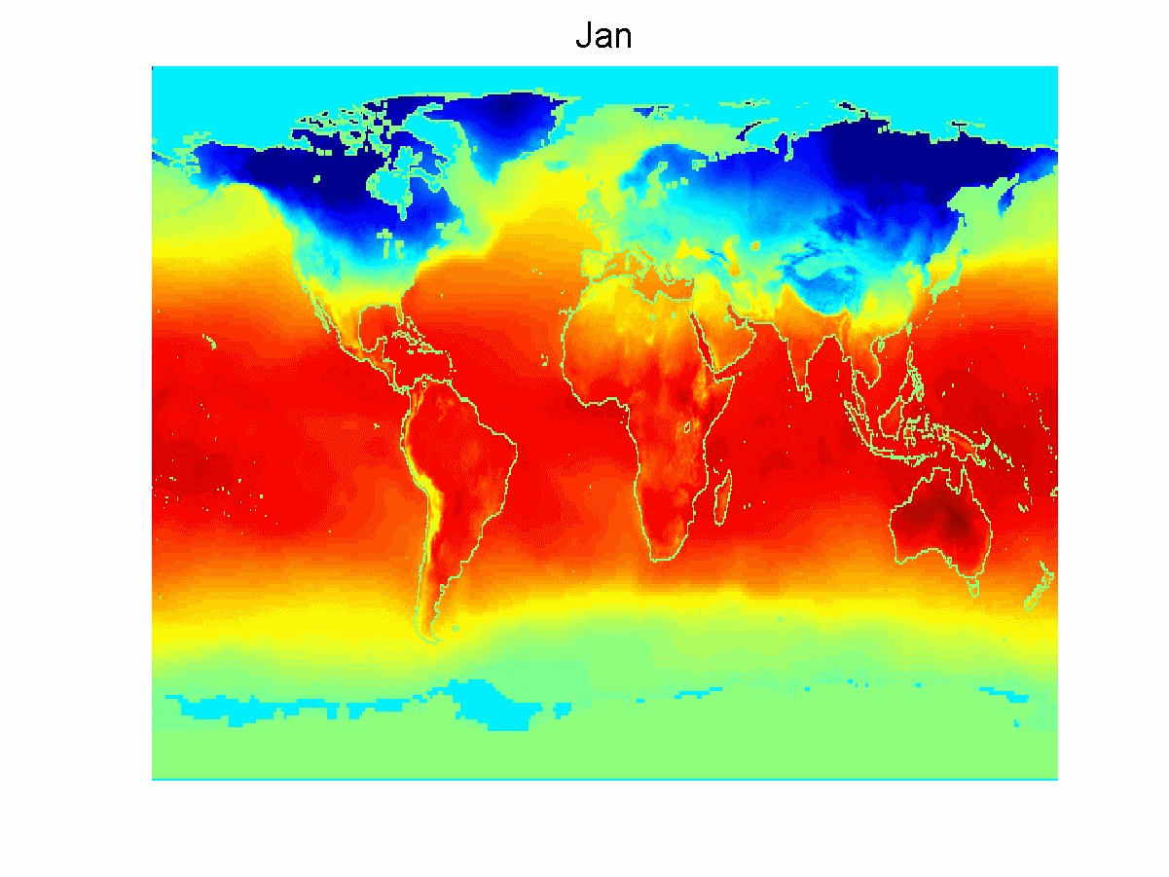
Ordered Data – Spatial/Temporal
Special properties?
How to handle this type of data?
Average Monthly Temperature of land and ocean
Introduction to Data Mining

Slide 16
Where to Find References?
Data mining and KDD
  Conferences: ACM-SIGKDD, IEEE-ICDM, SIAM-DM, PKDD, PAKDD, etc.
  Journal: Data Mining and Knowledge Discovery, KDD Explorations, IEEE-TKDE, etc.
AI & Machine Learning
  Conferences: ICML, AAAI, IJCAI, COLT, etc.
  Journals: Machine Learning, JMLR, Artificial Intelligence, etc.
Database systems
  Conferences: ACM-SIGMOD, ACM-PODS, VLDB, IEEE-ICDE, etc.
  Journals: ACM-TODS, JIIS, J. ACM, etc.
Statistics
  Conferences: Joint Stat. Meeting, etc.
  Journals: Annals of statistics, etc.
Visualization
  Conference proceedings: CHI, ACM-SIGGraph, etc.
  Journals: IEEE Trans. visualization and computer graphics, etc.
Introduction to Data Mining

Slide 17
Additional Reference Books
• Data Mining: Concepts and Techniques, Second Edition, by Jiawei Han and Micheline Kamber, Morgan Kaufmann, 2005.
• Data Mining: Practical Machine Learning Tools and Techniques, Second Edition, by I. H. Witten and E. Frank, Morgan Kaufmann, 2005
• Machine Learning, by T. M. Mitchell, McGraw Hill, 1997.
• The Elements of Statistical Learning: Data Mining, Inference, and Prediction, by T. Hastie, R. Tibshirani, and J. Friedman, Springer-Verlag, 2001
Introduction to Data Mining

Slide 18
Next Class
Classification (chapter 4.1, 4.2., 4.3)
  General concepts
  Decision trees
Reading assignment (by next class, no submission needed)
  Use Google News (http://news.google.com/) to find recent news stories involving “data mining” and “Big Data”
  Describe the role of "data mining" in the story (data mining tasks)
  Think about what the data looks like and the characteristics of the data in each data mining application
Review basic concepts of probability and statistics from MATH 327 (during the first two weeks)
  Refer to Appendix C in Tan’s textbook for a list of necessary concepts
Introduction to Data Mining

