Slide 1
CS 535/435 Introduction to Data Mining
(Fall 2017)
Lecture 3
Lei Yu
Department of Computer Science
Binghamton University
www.cs.binghamton.edu/~lyu

Slide 2
Today’s schedule
Introduction on classification
Introduction on Decision Tree algorithms
Introduction to Data Mining

Slide 3
Classification: Definition
Informally, the task of assigning objects to one of several predefined categories
Given a collection of records (x, y), classification is the task of learning a target function f that maps each attribute set x to one of the predefined class labels y
  Each record contains a set of attributes, one of the attributes is the class
  Find a model for class attribute as a function of the values of other attributes
  Goal: previously unseen records should be assigned a class as accurately as possible
Different from regression
  Class label is numeric

Slide 4

Illustrating Classification Task

Slide 5
Classification Techniques
Decision tree based methods
Rule-based methods
Instance-based methods
Bayesian methods
Artificial Neural Networks (ANN)
Support Vector Machines (SVM)

Slide 6
Assumptions for Why Classification Works?
Stationary - IID (Independently and Identically Distributed) training and test sets drawn from the sample space
Sufficiently large training set
Limited size of the hypothesis space (space of possible models)
PAC (Probably Approximately Correct) learning
  Accept errors in the prediction, and associate a probability with an error bound
  Probability of at least (1 − δ) that the model has error at most ϵ

Slide 7
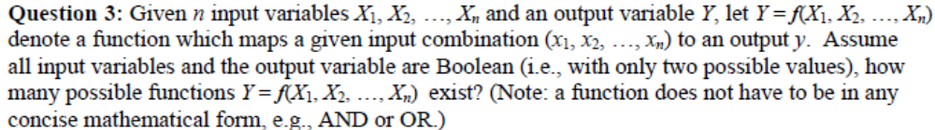
Sample Space vs. Hypothesis Space
Question from Prerequisite quiz
Sample space – the set of all possible inputs
Hypothesis space – the set of all possible hypothesis (functions)
  Size of the sample space 2^{n}
  Size of the hypothesis space 2^{2n}

Slide 8
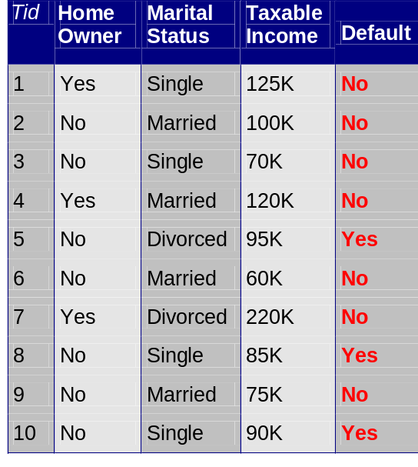
Example of a Decision Tree
categorical
categorical
continuous
class
Splitting Attributes
Home
Yes
No
NO
MarSt
Single, Divorced
Married
TaxInc
NO
< 80K
> 80K
NO
YES
Training Data
Model: Decision Tree

Slide 9
Another Example of Decision Tree
categorical
categorical
continuous
class
MarSt
Single, Divorced
Married
NO
Home
Yes
No
NO
TaxInc
< 80K
> 80K
NO
YES
There could be more than one tree that fits the same data!

Slide 10

Decision Tree Classification Task
Decision Tree

Slide 11
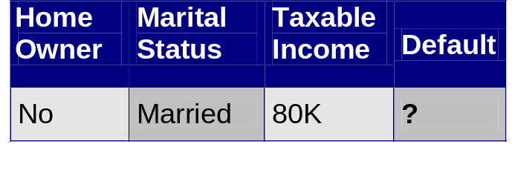
Apply Model to Test Data
Test Data
Start from the root of tree.
Home
Yes
No
NO
MarSt
Single, Divorced
Married
TaxInc
NO
< 80K
> 80K
NO
YES

Slide 12
Apply Model to Test Data
Test Data
Home
Yes
No
NO
MarSt
Single, Divorced
Married
TaxInc
NO
< 80K
> 80K
NO
YES

Slide 13
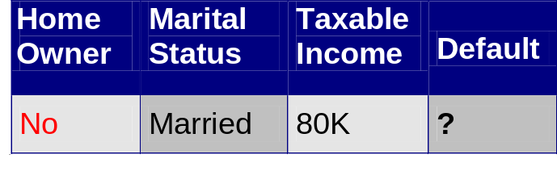
Apply Model to Test Data
Test Data
Home
Yes
No
NO
MarSt
Single, Divorced
Married
TaxInc
NO
< 80K
> 80K
NO
YES

Slide 14
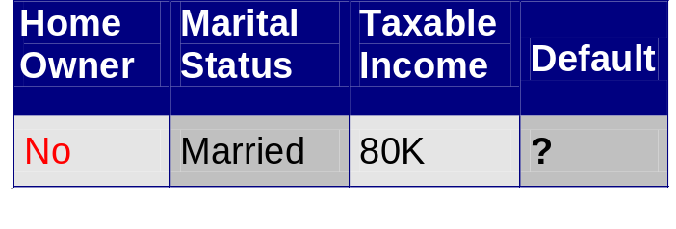
Apply Model to Test Data
Test Data
Home
Yes
No
NO
MarSt
Single, Divorced
Married
TaxInc
NO
< 80K
> 80K
NO
YES

Slide 15
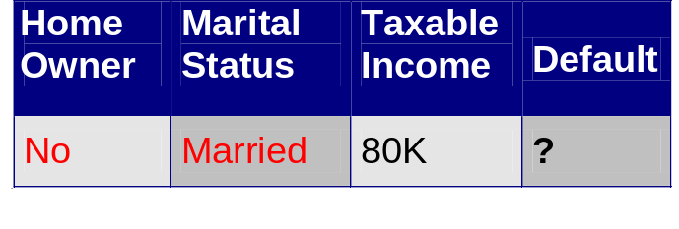
Apply Model to Test Data
Test Data
Home
Yes
No
NO
MarSt
Single, Divorced
Married
TaxInc
NO
< 80K
> 80K
NO
YES

Slide 16
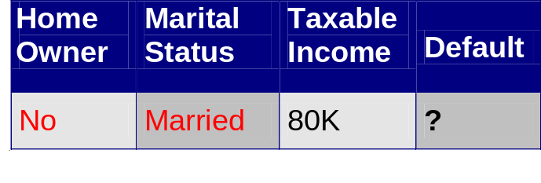
Apply Model to Test Data
Test Data
Home
Yes
No
NO
MarSt
Single, Divorced
Married
Assign Default to “No”
TaxInc
NO
< 80K
> 80K
NO
YES

Slide 17

Decision Tree Classification Task
Decision Tree

Slide 18
Decision Tree Induction
Use a greedy strategy to split the records based on an optimization criterion
Issues
  Determine how to split the records
  Determine when to stop splitting
Many Algorithms:
  Hunt’s Algorithm (the basic algorithm)
  CART
  ID3, C4.5
Introduction to Machine Learning

Slide 19
General Structure of Hunt’s Algorithm
Let D_{t} be the set of training records that reach a node t
General Procedure:
  If D_{t} contains records that belong to the same class, then t is a leaf node
  If D_{t} contains records that belong to more than one class, use an attribute test condition to split the data into smaller subsets
  Recursively apply the above procedure to each subset
D_{t}
?

Slide 20
Hunt’s Algorithm
Home
No/Yes
(10)
Yes
No
No
(3)
No/Yes
7
Home
Home
Yes
No
Yes
No
No
(3)
Marital
Status
No
(3)
Marital
Status
Single,
Divorced
Married
Single,
Divorced
Married
Taxable
Income
No
(3)
No/Yes
4
Yes
(3)
< 80K
>= 80K
No
(1)
Yes
(3)

Slide 21
Next Class
Classification (Chapter 4.3)
  Decision trees
Basic review of Probability
Introduction to Entropy concepts
Reading assignment
  Chapter 4.1, 4.2, 4.3

