Slide 1
CS 535/435 Introduction to Data Mining
(Fall 2017)
Lecture 4
Lei Yu
Department of Computer Science
Binghamton University
www.cs.binghamton.edu/~lyu

Slide 2
Today’s Agenda
Basic review of Probability
Introduction to Entropy concepts
  Entropy (Shannon's entropy)
  Conditional Entropy
Decision tree algorithm
Introduction to Data Mining

Slide 3
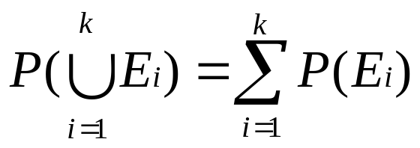
Probability
A random experiment is the act of measuring a process whose outcome is uncertain
The set of all possible outcomes of a random experiment is known as the sample space, S
  For example, S ={1, 2, 3, 4, 5, 6} for rolling a die
An event E is any subset of outcomes from S
  For example, E = {2, 4, 6}
A probability P is defined on the sample space S
Probability of an event, P(E)
  0<=P(E)<=1
  P(S) = 1
  For any set of disjoint events, E₁, E₂, …, E_{k} in S
Introduction to Data Mining

Slide 4
Basic Probability Notations
Prior probability (unconditional probability)
  About an event: P(Sunny)
  About a random variable: P(X), where X represents weather
  Each random variable has a domain
    X ={Sunny, Cloudy, Rain, Snow}
  Probability distribution P(X)
    Probability mass function for discrete variable
    Probability density function for continuous variable
Posterior probability (conditional probability)
  P(A|B) = P(A^B)/P(B)
Introduction to Data Mining

Slide 5
Basic Probability Rules
The probability of a disjunction
  P(AvB)=P(A)+P(B)-P(A^B)
The probability of a conjunction (product rule)
  P(A^B)=P(A|B)P(B) = P(B|A)P(A)
Independent events A, B
  P(B|A)=P(B)
  P(A|B)=P(A)
  P(A,B)=P(A)P(B)
Introduction to Data Mining

Slide 6
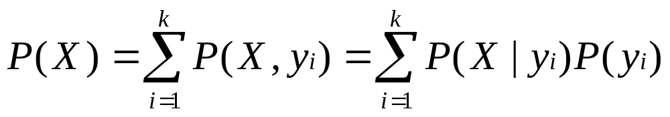
Joint Probability Distribution
If {y₁,y₂,…,y_{k}} is the set of mutually exclusive and exhaustive outcomes of a random variable Y, then
For example
  P(A) = P(A,B)+P(A,!B) = P(A|B)P(B)+P(A|!B)P(!B)
  P(!A) = P(!A,B)+P(!A,!B) = P(!A|B)P(B)+P(!A|!B)P(!B)
Introduction to Data Mining

Slide 7
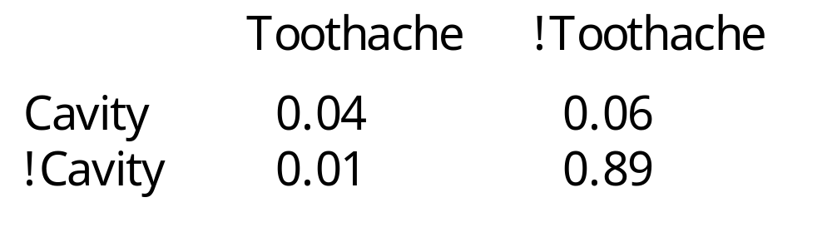
Joint Probability Example
An example of two Boolean variables
Observations: mutually exclusive and collectively exhaustive
P(Cavity) = 0.1
P(Cavity ^ Toothache) = 0.04
P(Cavity V Toothache) = 0.11
P(Cavity|Toothache) = 0.8
Introduction to Data Mining
Notes:
Impractical to specify all the entries for the Joint over n Boolean variable.
If there is a Joint, we can read off any probability we need.
Sidestep the Joint and work directly with conditional probability using Bayes rule
P(Cavity) = 0.04 +0.06
P(Cavity or Toothache) = P(C) + P(T) - P(CT)
P(C|T) =P(CT)/P(T)

Slide 8

Entropy
Entropy measures the uncertainty associated with a random variable
Example
  X is a 2-class problem (x₁,x₂), p & n instances; let t = p+n
  H(X) = - (p/t) log₂ (p/t) - (n/t) log₂ (n/t)
  For p=14, n=0, H(X)= - (14/14) log₂ (14/14) - (0/14) log₂ (0/14) = 0
  p=7, n=7, H(X)= - (7/14) log₂ (7/14) - (7/14) log₂ (7/14) = 1
  p=9, n=5, H(X) = - (9/14) log₂ (9/14) - (5/14) log₂ (5/14) = 0.940
Introduction to Data Mining
Notes:
More than 2 classes:
Entropy([s₁,s₂,…,s_{k}])= - Σ(s_{i}/s) log₂ (s_{i}/s); s= Σs_{i}.

Slide 9
Entropy Curve
For p/(p+n) between 0 & 1, the 2-class entropy is
  0 when p/(p+n) is 0
  1 when p/(p+n) is 0.5
  0 when p/(p+n) is 1
  monotonically increasing between 0 and 0.5
  monotonically decreasing between 0.5 and 1
For a random variable X with 4 values such that P(x_{i}) = ¼, H(X) = ?
1
0
0.5
1
Introduction to Data Mining
Notes:
H(x) =2
4 random vars P(x1)=P(x2)=1/2 and P(x3)=P(x4)=0, will give H(x)=1
For random variable with 8 outcomes, i.e P(xi) = 1/8 , H(x) = - (1/8) [log2(1/8)] * 8

Slide 10

Conditional Entropy
Contingency Table
Entropy of X after observing Y
  Example
    H(X|Y)= - (8/14) [(6/8)log₂ (6/8)+(2/8)log₂ (2/8)] - (6/14) [(1/6)log₂ (1/6)+(5/6)log₂ (5/6)] =
    H(X|Y)= - (7/14) [(7/7)log₂ (7/7)+(0/7)log₂ (0/7)] - (7/14) [(0/7)log₂ (0/7)+(7/7)log₂ (7/7)] = 0
Information Gain
y₁
y₂
X₁
6
1
X₂
2
5
y₁
y₂
X₁
7
0
X₂
0
7
Introduction to Data Mining
Notes:
IG(X|Y)=IG(Y|X)
It‘s better to use: H(X|Y) where X is a constant values in IG(X|Y) = H(X) – H(X|Y)

Slide 11
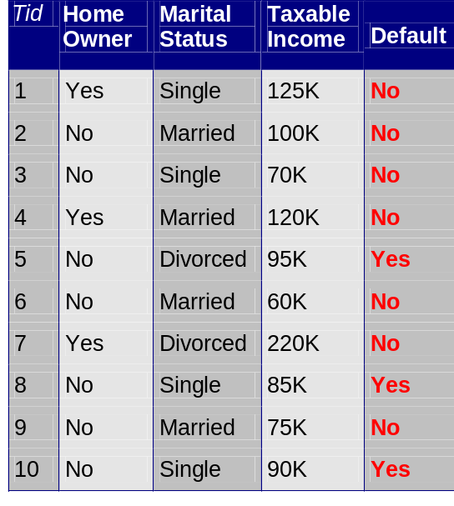
General Structure of Hunt’s Algorithm
Let D_{t} be the set of training records that reach a node t
General Procedure:
  If D_{t} contains records that belong to the same class, then t is a leaf node
  If D_{t} contains records that belong to more than one class, use an attribute test condition to split the data into smaller subsets
  Recursively apply the above procedure to each subset
D_{t}
?
Introduction to Data Mining

Slide 12
Tree Induction
Greedy strategy for inducing a decision tree
  Split the records based on an attribute test condition that optimizes certain criterion
Issues
  Determine how to split the records
    How to specify the attribute test condition?
    How to determine the best split?
  Determine when to stop splitting
Introduction to Data Mining

Slide 13
How to Specify Attribute Test Condition
Depends on attribute types
  Nominal
  Ordinal
  Numeric
Depends on different ways to split
  Binary split
  Multi-branch split
Introduction to Data Mining

Slide 14
Splitting Based on Nominal Attributes
Multi-branch split: divide values into as many partitions as the number of distinct values
Binary split: divide values into two partitions
CarType
Family
Luxury
Sports
CarType
CarType
CarType
{Sports, Luxury}
{Family,
Luxury}
{Family,
Sports}
{Family}
{Sports}
{Luxury}
Introduction to Data Mining

Slide 15
Splitting Based on Ordinal Attributes
Multi-branch split: divide values into as many partitions as the number of distinct values
Binary split: divide values into two partitions
  Need to preserve the order among attribute values
What about this split?
Size
Small
Large
Medium
Size
Size
{Small, Medium}
{Medium,
Large}
{Large}
{Small}
Size
{Small, Large}
{Medium}
Introduction to Data Mining

Slide 16
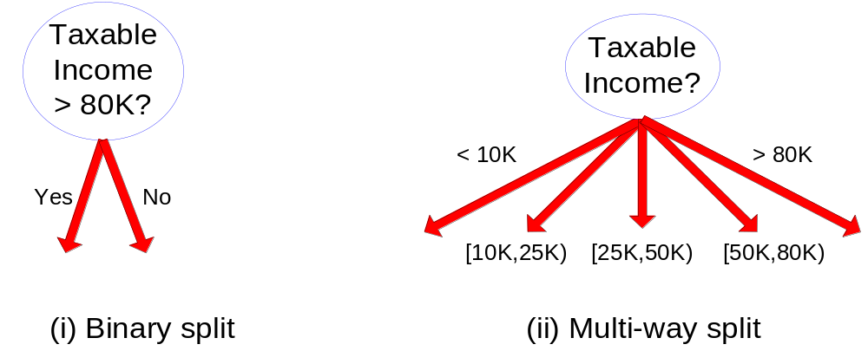
Splitting Based on Numeric Attributes
Feature discretization: form a binary attribute or an ordinal attribute (To be discussed later)
Binary split
Multi-branch split
Introduction to Data Mining
Notes:
Smaller the branch better it is.

Slide 17
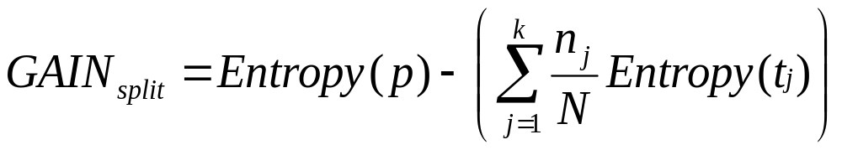
Splitting Based on Entropy
When a node p (parent node) is split into k partitions t_{j} (child nodes), the quality of split can be computed as
Information Gain:
where, n_{j} = number of objects at child node t_{j}
N = number of objects at node p
Measure Entropy reduction achieved because of the split
Used in ID3
Introduction to Data Mining
Notes:
Entropy(p) = Entropy of split

Slide 18

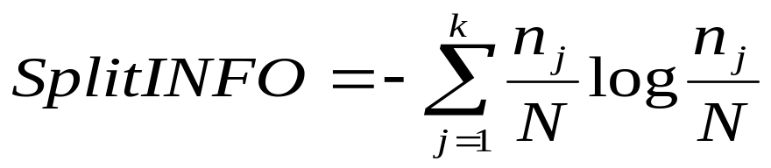
Splitting Based on Entropy ...
Gain Ratio
  Adjusts Information Gain by the entropy of the splitting attribute
  Higher entropy partitioning (large number of small partitions) is penalized!
  Used in C4.5
  Designed to overcome the disadvantage of Information Gain
Introduction to Data Mining
Notes:
Gain Ration = IG / (Entropy of condition)

Slide 19
Stopping Criteria for Tree Induction
Stop expanding a node when all the records belong to the same class
Stop expanding a node when all the records share the same values for all attributes (no more attributes to select from)
Early termination (decision tree pruning)
Introduction to Data Mining
Introduction to Data Mining

Slide 20
Next Class
Classification (Chapter 4.4)
  Model overfitting and model selection
Introduction to Data Mining

