Slide 1
CS 535/435 Introduction to Data Mining
(Fall 2017)
Lecture 5
Lei Yu
Department of Computer Science
Binghamton University
www.cs.binghamton.edu/~lyu

Slide 2
Today’s Agenda
Model overfitting
  Phenomenon
  Reason
  How to handle (model selection)
Empirical procedures of model selection
Introduction to Data Mining

Slide 3
Two Types of Classification Errors
Training errors (resubstitution errors)
  Number of misclassification errors committed on training records
True errors (generalization errors)
  Expected number of misclassification errors on previously unseen records
Introduction to Data Mining

Slide 4

Overfitting Example
500 circular and 500 triangular data points.
Circular points:
0.5 ≤ sqrt(x₁²+x₂²) ≤ 1
Triangular points:
sqrt(x₁²+x₂²) < 0.5 or
sqrt(x₁²+x₂²) > 1
Randomly sample 30% data points as training data and 70% as testing data
Introduction to Data Mining

Slide 5

Underfitting and Overfitting
Overfitting
Underfitting
Introduction to Data Mining

Slide 6

Overfitting due to Noise
Decision boundary is distorted by noise point
Introduction to Data Mining

Slide 7
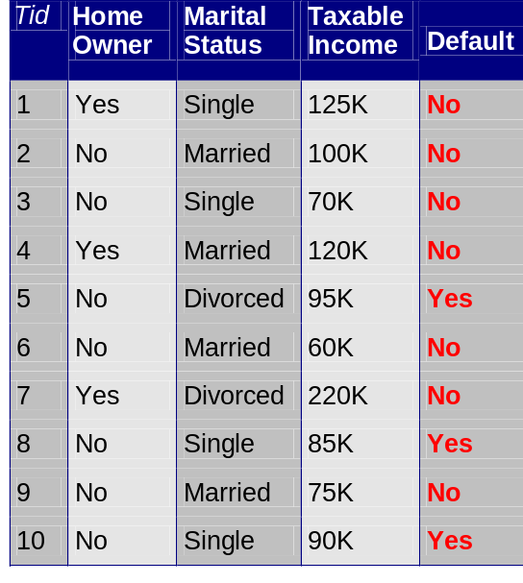
Overfitting Due to Noise in Training Data
Home
Yes
No
Noise
No
(3)
Marital
Status
Single,
Divorced
Married
Taxable
Income
No
(3)
< 80K
>= 80K
No
(1)
Yes
(3)
Testing instance
95 No divorced 65K Yes
Introduction to Data Mining

Slide 8

Overfitting due to Insufficient Samples
Lack of data points in the lower half of the diagram makes it difficult to predict correctly the class labels of that region
Introduction to Data Mining

Slide 9
Notes on Overfitting
Overfitting results in decision trees that are more complex than necessary
Training error no longer provides a good estimate of how well the tree will perform on previously unseen records
Need new ways for estimating errors
The complexity of a model has an impact on model overfitting
How to determine the model complexity
  By model selection procedures which decide the best model based on estimated generalization errors
Introduction to Data Mining

Slide 10
Estimation of Generalization Errors
The best one can do is to estimate generalization errors
Optimistic approach: using resubstitution errors (training errors)
  Assumption: training data is a good representation of the overall data
  Problem?
Using a validation set (commonly used)
  Dividing the original training data into two disjoint sets, one set used for training, and the other used for estimating the generalization error
  Problem?
Introduction to Data Mining

Slide 11
Procedures of Model Evaluation
Holdout
  Reserve one part of data for training and the other part for validation
Random Subsampling
  Repeated holdout
Cross validation
  Partition data into k disjoint subsets
  k-fold: train on k-1 partitions, test on the remaining one
  Leave-one-out: k=n
Pros and cons for each procedure?
Introduction to Data Mining
Notes:
How many times is given training record is used in training validation if k=3?
1
And 2 times in trianing

Slide 12
Next Class
Reading for this class
  Chapter 4.4, 4.5
Next class
  Decision tree pruning
  Other issues about decision trees
Introduction to Data Mining

