Slide 1
CS 535/435 Introduction to Data Mining
(Fall 2017)
Lecture 6
Lei Yu
Department of Computer Science
Binghamton University
www.cs.binghamton.edu/~lyu

Slide 2
Today’s Topics
Empirical procedures of model selection
Decision tree pruning
Other issues about decision trees
Instructions on project
Introduction to Data Mining

Slide 3
Estimation of Generalization Errors
The best one can do is to estimate generalization errors
Optimistic approach: using resubstitution errors (training errors)
  Assumption: training data is a good representation of the overall data
  Problem? – model overfitting
Using a validation set (commonly used)
  Dividing the original training data into two disjoint sets, one set used for training, and the other used for estimating the generalization error
  Problem? – dilemma between reduced training set size and small validation set
Introduction to Data Mining

Slide 4
Procedures of Model Evaluation
Holdout
  Reserve one part of data for training and the other part for validation
Random Subsamping
  Repeated holdout
Cross validation
  Partition data into k disjoint subsets
  k-fold: train on k-1 partitions, test on the remaining one
  Leave-one-out: k=n
Pros and cons for each procedure?
Introduction to Data Mining

Slide 5
Model Selection for Decision Trees
Decision tree pruning
  Pre-pruning
    Stop before reaching a fully-grown tree
  Post-pruning
    Grow decision tree to its maximum size
    Trim the nodes of the decision tree in a bottom-up fashion
Stopping criteria in decision tree pruning
  Number of instances in a node is less than some threshold (used in pre-pruning)
  Estimated generalization error does not improve (also called reduced-error pruning, used in post-pruning)
  Pros and cons?
Introduction to Data Mining

Slide 6
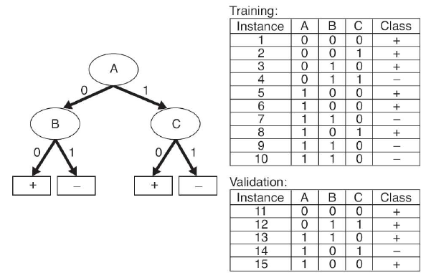
Decision Tree Post-Pruning Example
Prune the decision tree in a bottom up direction based on the estimated generalization error before and after pruning
Introduction to Data Mining
Introduction to Data Mining

Slide 7
Issues of Decision Tree Classification
Search strategy
Data fragmentation
Expressiveness
Decision boundary
Introduction to Data Mining

Slide 8
Search Strategy
Finding an optimal decision tree is intractable
The algorithm presented so far uses a greedy, top-down, recursive partitioning strategy to induce a reasonable solution
Efficiency of decision tree classification
  Inexpensive to construct
    Time complexity?
  Extremely fast at classifying unknown records
    Time complexity?
Introduction to Data Mining
Notes:
Hunt’s algorithm O()?

Slide 9
Data Fragmentation
Number of instances gets smaller as you traverse down the tree
Number of instances at the leaf nodes could be too small to make any statistically significant decision
How to solve?
  Decision tree pruning
Introduction to Data Mining

Slide 10
Expressiveness
Decision tree provides expressive representation for learning discrete-valued function
  Small sized trees are easy to interpret
But they do not work well to certain types of Boolean functions
  Examples: parity problems
Not expressive enough for modeling relationships among continuous attributes
F1 | F2 | C
0 | 0 | 1
0 | 1 | 0
1 | 0 | 0
1 | 1 | 1
Introduction to Data Mining

Slide 11
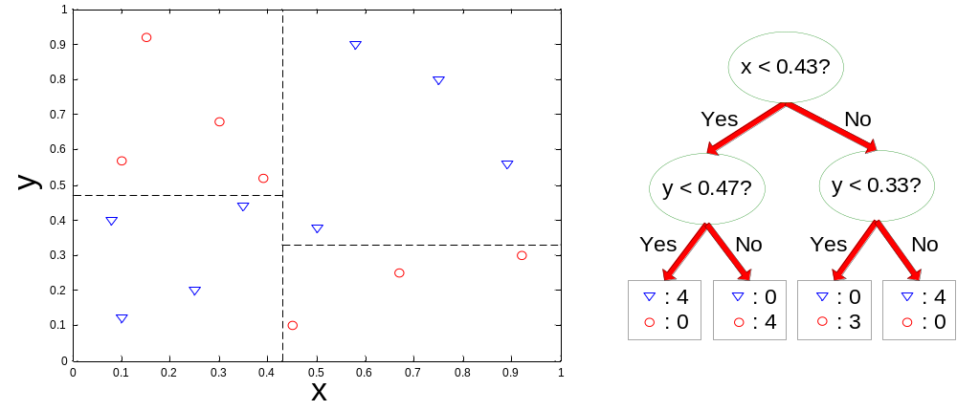
Decision Boundary
Border line between two neighboring regions of different classes is known as decision boundary
Decision boundary is parallel to axes because test condition involves a single attribute at-a-time
Introduction to Data Mining

Slide 12
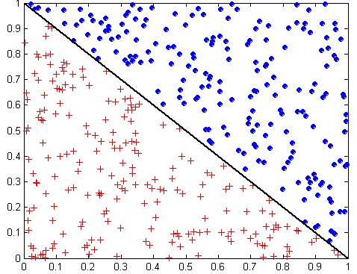
Oblique Decision Trees
x + y < 1
Class = +
Class =
Test condition may involve multiple attributes
More expressive representation
Finding optimal test condition is computationally expensive
Introduction to Data Mining

Slide 13
Instructions on Project (CS535)
In a group of two or three students
Two general types of projects
  Data mining applications
    Applying data mining algorithms and techniques learned in this class to a real-world problem or a research problem in another field
  Data mining case studies
    Investigating and analyzing existing mining applications in a given domain (e.g., business, healthcare, industry, etc.) and identifying potential opportunities for new data mining applications in the same domain
Deliverables
  Submit and present in class a progress report in the mid of Oct.
  Submit a final project report at the end of semester
Introduction to Data Mining

Slide 14
What to do for an Application
Identify a problem domain of interest
Investigate the need of data mining
Decide the data mining task
Find a publicly available data set
  Kaggle (70+ data sets), UCI machine learning repository (350+ data sets)
Choose data mining tools
  Weka, RapidMiner, Orange, etc.
Process data and perform the data mining task
Collect and analyze results
Write a project report
Introduction to Data Mining

Slide 15
What to do for a Case Study
Identify a problem domain of interest
Investigate the need of data mining
Decide the data mining task
Gather publications which perform case study on the identified data mining task
Study and analyze these papers
Write a survey report
Introduction to Data Mining

Slide 16
Report Presentation
3-5 slides, 5-8 minutes for each group
What is the problem and why it is interesting
Why is it feasible to do?
  Available data sets
  Existing related studies
  Available algorithms and tools
Tasks to do and timeline
Tasks completed and results (depending on progress)
Introduction to Data Mining

Slide 17
Next Class
Reading for this class
  Chapter 4.4.5, 4.5
Next class
  Bayesian classification
  Chapter 5.3.1-5.3.3
Introduction to Data Mining

