Slide 1
CS 535/435 Introduction to Data Mining
(Fall 2017)
Lecture 7
Lei Yu
Department of Computer Science
Binghamton University
www.cs.binghamton.edu/~lyu

Slide 2
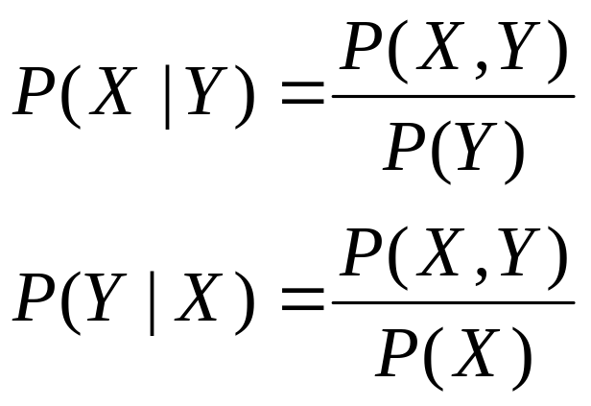
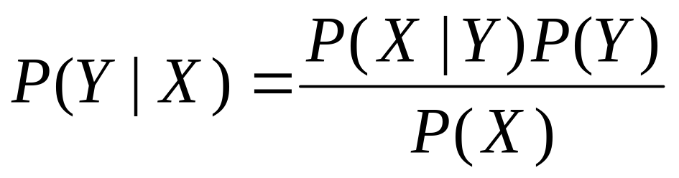
Bayesian Classification
A probabilistic framework for solving classification problems
Conditional Probability:
Bayes Theorem:
Introduction to Data Mining

Slide 3

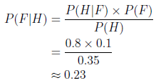
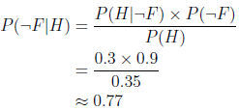
Example of Bayesian Inference
  Given: prior knowledge about Headache (H), Flu (F)
  To decide: whether a person has Flu or not given the person has headache
  Conclusion: more likely the person does not have Flu
Introduction to Data Mining

Slide 4
Bayesian Classifiers
    Combine Bayesian inference with observed data
Consider each attribute and class label as random variables
Given a record with attributes (A₁, A₂,…,A_{n})
  Goal is to predict class C
  Specifically, we want to find the value of C that maximizes P(C| A₁, A₂,…,A_{n} )
Can we estimate P(C| A₁, A₂,…,A_{n} ) directly from data?
Introduction to Data Mining

Slide 5

Take a look at the Data
  What are the probabilities that can be estimated from the observed data?
Introduction to Data Mining

Slide 6
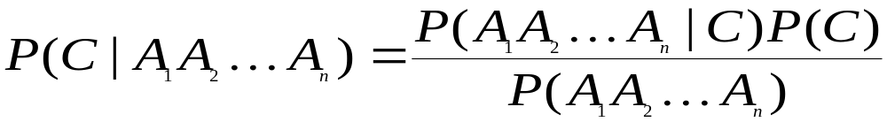
Bayesian Classifiers…
Approach:
  compute the posterior probability P(C | A₁, A₂, …, A_{n}) for all values of C using the Bayes theorem
  Choose value of C that maximizes
  P(C | A₁, A₂, …, A_{n})
  Equivalent to choosing value of C that maximizes
  P(A₁, A₂, …, A_{n}|C) P(C)
How to estimate P(A₁, A₂, …, A_{n} | C )?
Introduction to Data Mining

Slide 7
Naïve Bayes Classifier
Assume independence among attributes A_{i} when class is given:
  P(A₁, A₂, …, A_{n} |C) = P(A₁| C) P(A₂| C)… P(A_{n}| C)
  Can estimate P(A_{i}| C) for all value combinations of A_{i} and C.
  New point is classified to C_{j} if P(C_{j}) Π P(A_{i}| C_{j}) is maximal.
Introduction to Data Mining

Slide 8
Example of Naïve Bayes Classifier
  For the same data set used for decision tree learning, decide the class label of the instance
  Note: discretize the values of Income attribute to >=80K or <80K
Introduction to Data Mining

Slide 9
Example of Naïve Bayes Classifier
Naive Bayes Classifier:
P(No) = 7/10
P(X|Class=No) = P(Home=Yes|Class=No)
× P(Married|Class=No)
× P(Income<80k|Class=No)
= 3/7 × 4/7 × 3/7 = 0.105
P(X|Class=Yes) = P(Home=Yes|Class=Yes)
× P(Married|Class=Yes)
× P(Income<80K| Class=Yes)
= 0 × 0 × 0 = 0
P(No|X) = P(X|No)P(No)/P(X) = 0.105 × 0.7 /P(X)
P(Yes|X) = P(X|Yes)P(Yes)/P(X) = 0 × 0.3 /P(X)
Therefore, P(No|X) > P(Yes|X)
=> Class = No
P(Yes) = 3/10
P(Home=Yes|No) = 3/7
P(Home=No|No) = 4/7
P(Home=Yes|Yes) = 0/3
P(Home=No|Yes) = 3/3
P(Marital Status=Single|No) = 2/7
P(Marital Status=Divorced|No)=1/7
P(Marital Status=Married|No) = 4/7
P(Marital Status=Single|Yes) = 2/3
P(Marital Status=Divorced|Yes)=1/3
P(Marital Status=Married|Yes) = 0/3
P(Income>=80K|No) = 4/7
P(Income<80K|No) = 3/7
P(Income>=80k|Yes) = 3/3
P(Income<80K|Yes) = 0/3
Introduction to Data Mining

Slide 10
Naïve Bayes (Summary)
Robust to isolated noise points
Handle missing values by ignoring the instance during probability estimate calculations
Very efficient in training the model and applying the model for unseen records
Independence assumption may not hold for some attributes
  Use other techniques such as Bayesian Belief Networks (BBN)
Introduction to Data Mining

Slide 11
Next Class
Nearest Neighbor Classification
Eager learner vs. lazy learner
Reading
  Chapter 5.2
Introduction to Data Mining

