Slide 1
CS 535/435 Introduction to Data Mining
(Fall 2017)
Lecture 8
Lei Yu
Department of Computer Science
Binghamton University
www.cs.binghamton.edu/~lyu

Slide 2

Eager Learners vs. Lazy Learners
Eager learners
  Learn a classification model as soon as the training data becomes available
  Examples: decision trees, NBC
Lazy learner
  Delay the learning process until it is needed to classify a test example
  Examples: Nearest neighbor classifier
Introduction to Data Mining

Slide 3
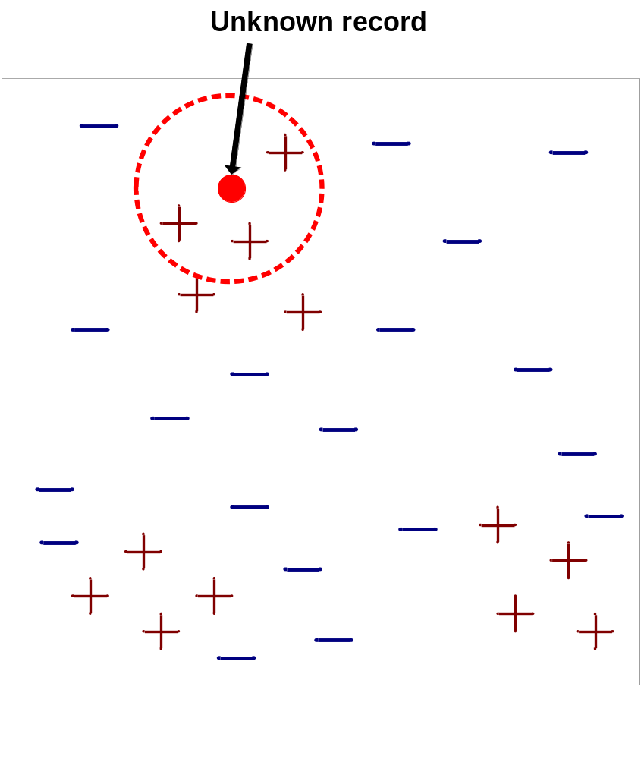
Nearest-Neighbor Classifiers
Requires three things
  The set of training records
  Distance measure to compute distance between records
  The value of k, the number of nearest neighbors to retrieve
To classify an unknown record:
  Compute distance to each training record
  Identify k nearest neighbors
  Use class labels of nearest neighbors to determine the class label of unknown record
Introduction to Data Mining

Slide 4

Definition of Nearest Neighbors
K-nearest neighbors of a record x are data points that have the k smallest distance to x
Introduction to Data Mining

Slide 5
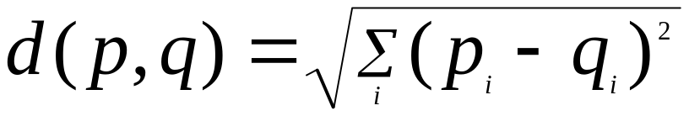
Nearest Neighbor Classification
Compute distance between two points:
  Numeric attributes: Euclidean distance
  Nominal or ordinal attributes?
    Transform to numeric values by special encoding
Determine the class from nearest neighbor list
  Take the majority vote of class labels among the k-nearest neighbors
  Weigh the vote according to distance
    weight factor, w = 1/d²
Introduction to Data Mining

Slide 6
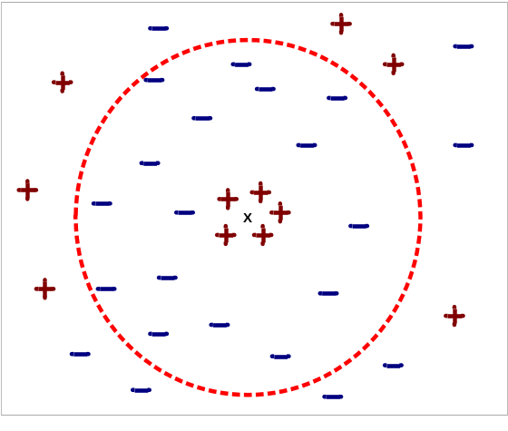
Issues of Nearest Neighbor Classification
Choosing the value of k:
  If k is too small, sensitive to noise points
  If k is too large, neighborhood may include points from other classes
How to deal with the sensitivity of K?
  Model selection – treat K as a model parameter and tune it based on a validation set or cross validation
Introduction to Data Mining

Slide 7
Eager Learners vs. Lazy Learners
Fixed, global model vs. flexible, local model
Time complexity for building a global model
  For eager learners, depend on the type of the model
  For lazy learners, no need to build a global model
Time complexity for classifying a new record
  For eager learners, depend on the type of the model
  For lazy learners, same as building a local model
Storage
  For eager learners, need to store a global model
  For lazy learners, need to store the training data set
Introduction to Data Mining

Slide 8
Time Complexity DT, NBC, vs. KNN
Given a training data set (m instances, n features)
and a test data set (m’ instances, n features)
In which condition, KNN is more efficient than decision tree overall?
Roughly, when n>=m’
 | Decision Trees | NBC | KNN
Building the model | O(n²m) | O(nm) | O(0)
Classifying a test set | O(nm’) | O(nm’) | O(nmm’)
Overall | O(n²m+nm’) | O(nm+nm’) | O(nmm’)
Introduction to Data Mining

Slide 9
Next Class
Data Preprocessing
Reading
  Chapters 2.2, 2.3
Introduction to Data Mining

