Slide 1
CS 535/435 Introduction to Data Mining
(Fall 2017)
Lecture 9
Lei Yu
Department of Computer Science
Binghamton University
www.cs.binghamton.edu/~lyu

Slide 2

Tasks of Data Preprocessing
Introduction to Data Mining

Slide 3
Data Quality
Examples of data quality problems:
  Missing values
  Duplicate data
  Inconsistent data
  Noise and outliers
How to solve these problem – data cleaning
Introduction to Data Mining

Slide 4
Missing Values
Reasons for missing values
  Information is not collected
  (e.g., people decline to give their age and weight)
  Attributes may not be applicable to all cases
  (e.g., annual income is not applicable to children)
Handling missing values
  Eliminating data objects or attributes
  Ignoring missing value during analysis
  Estimating missing values
Introduction to Data Mining

Slide 5
Duplicate Data
Data set may include data objects that are duplicates, or almost duplicates of one another
  Major issue when merging data from heterogonous sources
Examples
  Same person with multiple email addresses
Handling duplicate data
  True duplicate data
  “Seemingly” duplicate data
Introduction to Data Mining

Slide 6
Inconsistent Data
Data may be inconsistent with common sense
Examples
  Inappropriate values (negative age)
  Same town, different zip code
  Two objects having the same values for all attributes, but different class labels
Handling inconsistent data
  Using common sense
  Using additional information
Introduction to Data Mining

Slide 7
Noisy Data
Noise: random error or variance in a measured variable
Incorrect attribute values may due to
  Faulty data collection instruments
  Data entry problems
  Data transmission problems
  Technology limitation
Outliers
  Anomalous objects
  Anomalous values
  Are outliers always bad?
Introduction to Data Mining

Slide 8
How to Handle Noisy Data?
Signal processing, image processing techniques
Clustering
  Detect and remove outliers
Combined computer and human inspection
  detect suspicious values and check by human (e.g., deal with possible outliers)
Regression
  Smoothing data by fitting the data into regression functions (curve fitting)
Introduction to Data Mining

Slide 9

Outlier Detection by Clustering
Introduction to Data Mining

Slide 10
Outlier Detection by Regression
y
Y1
Y1’
y = x + 1
X1
x
Introduction to Data Mining

Slide 11
Tasks of Data Preprocessing
Introduction to Data Mining

Slide 12
Attribute Transformation
A transformation applied to all the values of a variable.
  Simple functions: |x|, 1/x, log(x), e^{x},
  Normalization and Standardization
  Feature discretization
Reasons
  Scaling data
  Transforming data into normal distribution
Cautions?
Introduction to Data Mining

Slide 13
Normalization
Decimal scaling
  v’(i) = v(i)/10^{k} for the smallest k such that max(|v’(i)|)<1.
  For the range between -991 and 99, k is 3 (1000), -991 ⇒ -.991
Min-max normalization into the new max/min range:
  v’ = (v - min)/(max - min) * (max’ – min’) + min’
  v = 62 in [12,112] ⇒ v’= 0.5 in [0,1] (new range)
Zero-mean (z-score) normalization:
  v’ = (v - mean) / std_dev
  If meanIncome = 54000 and std_devIncome = 16000,
  then v = 73600 ⇒ 1.225
Introduction to Data Mining

Slide 14
Feature Discretization
Unsupervised methods
  Binning methods
    Equal-width
    Equal-frequency
  Clustering methods
Supervised methods
  Entropy-based
H. Liu, F. Hussain, C.L. Tan, and M. Dash. "Discretization: An Enabling Technique", Journal of Data Mining and Knowledge Discovery 6(4): 393-423; Oct 2002
Introduction to Data Mining

Slide 15
Simple Methods: Binning
Equal-width (distance) partitioning:
  Divide the range into N intervals of equal size: uniform grid
  If A and B are the lowest and highest values of the attribute, the width of intervals will be: W = (B –A)/N
  Problems?
Equal-depth (frequency) partitioning:
  Divide the range into N intervals, each containing approximately same number of samples
  Problems?
Introduction to Data Mining

Slide 16
Binning Example
Attribute values (for one attribute e.g., age):
  0, 4, 12, 16, 16, 18, 24, 26, 28
Equal-width binning – for bin width of 10:
  Bin 1: 0, 4
  Bin 2: 12, 16, 16, 18
  Bin 3: 24, 26, 28
Equal-frequency binning – for bin frequency of 3:
  Bin 1: 0, 4, 12
  Bin 2: 16, 16, 18
  Bin 3: 24, 26, 28
Introduction to Data Mining

Slide 17




Discretization Without Using Class Labels
Data
Equal interval width
Equal frequency
K-means
Introduction to Data Mining

Slide 18
Entropy-based
Given attribute-value/class pairs:
  (0,P), (4,P), (12,P), (16,N), (16,N), (18,P), (24,N), (26,N), (28,N)
Entropy-based binning:
  Intuitively, find best split so that the bins are as pure as possible
  Formally characterized by maximizing the information gain
Let v be a possible split. Then S is divided into two sets:
  S1: value <= v and S2: value > v
What is the information gain if v = 14?
Is v = 20 a better split?
Introduction to Data Mining

Slide 19
Tasks of Data Preprocessing
Introduction to Data Mining

Slide 20
Data Reduction
Object (instance) reduction
  Data aggregation
  Sampling
Dimensionality reduction
  Feature selection
  Feature extraction
Introduction to Data Mining

Slide 21
Aggregation
Transaction ID | Item | Store Location | Date | Price | …
101123 | Watch | Binghamton | 09/06/04 | $25.99 | …
101124 | Shoes | Binghamton | 09/06/04 | $15.99 | …
101125 | Battery | Syracuse | 09/06/04 | $5.99 | …
… | … | … | … | … | …
Combining two or more objects into a single object
Purpose
  Data reduction
    Reduce the number of objects (less storage, processing time)
  Change of scale
    Cities aggregated into regions, states, countries, etc.
    Days aggregated into months, years, etc.
  More “stable” data
    Aggregated data tends to have less variability
Introduction to Data Mining

Slide 22
Sampling
Sampling is to select n elements from the population of size N (n<=N)
Key principle for effective sampling
  Using a sample will work almost as well as using the entire population, if the sample is representative
  A sample is representative if it has approximately the same property (of interest) as the population
Introduction to Data Mining

Slide 23
Types of Sampling
Simple random sampling
  Equal probability of selecting any particular object
Stratified sampling
  Split the data into several non-overlapping partitions (N₁+N₂,…,+N_{l} =N); then draw random samples from each partition
Adaptive sampling
  Progressively increasing the sample size depending on results obtained from the current sample
Introduction to Data Mining

Slide 24
Stratified Sampling
Raw Data
Stratified Sampling
Introduction to Data Mining

Slide 25

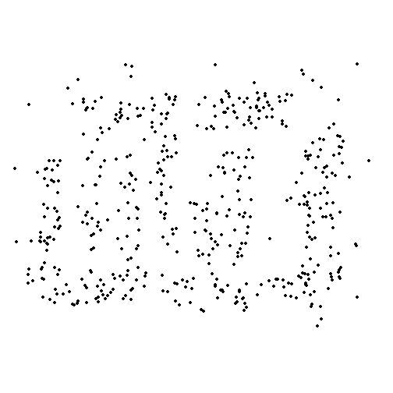
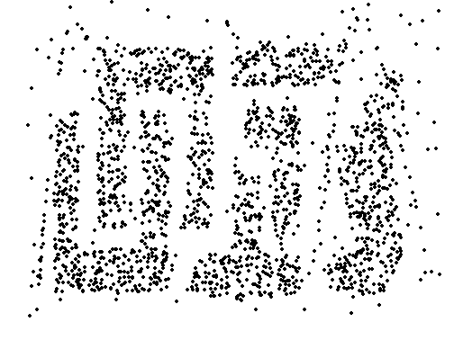
Sample Size
8000 points 2000 Points 500 Points
Introduction to Data Mining

Slide 26
Next Class
Feature selection
Reading
  Chapters 2.3.3 and 2.3.4
Introduction to Data Mining

