Slide 1
Pytcraft
This report is based on v1.6.9

Slide 2
What is Pytcraft?
Pytcraft is a 2d minecraft made with python and pygame made by Andrew Rodebaugh.

Slide 3
Why Python?
Python is a simple coding language that is sometimes not used because it’s not as powerful as Java or c and other languages.
But, it also has an advantage because you can import add-ons called modules to make stuff like GUI’s that you can not do without a module.

Slide 4
How it works!
How it works is very simple there are 3 parts:
Pylaunch – Checks if everything is ok to see if it is launchable.
Door – Checks if all modules exists.
Pytcraft – The Main Game

Slide 5
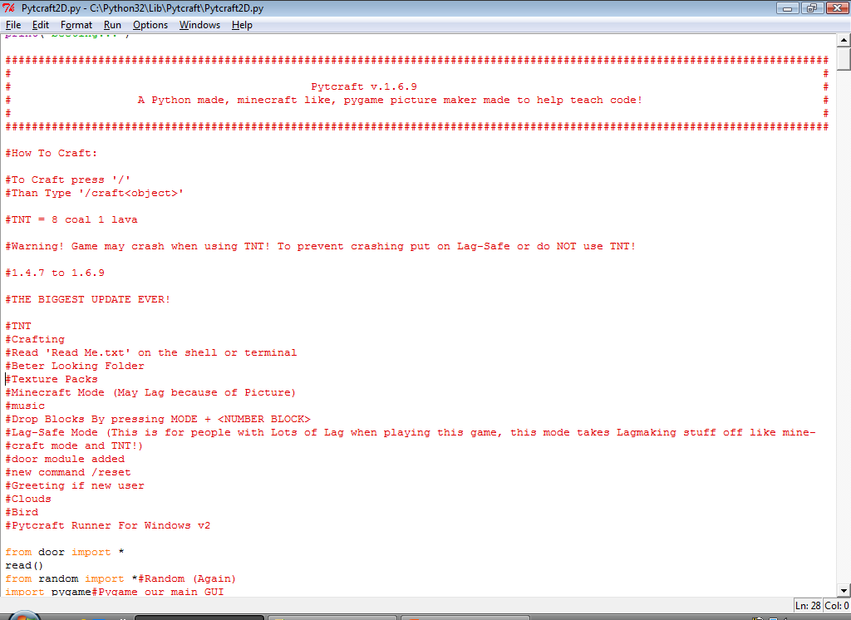
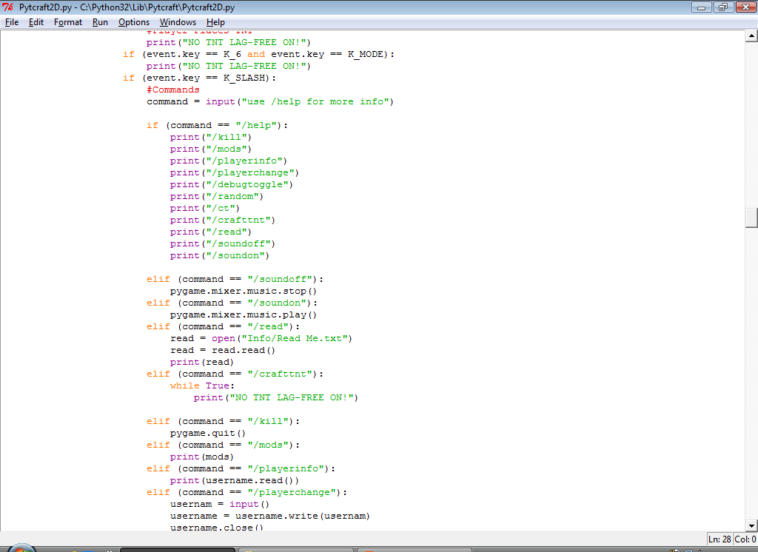
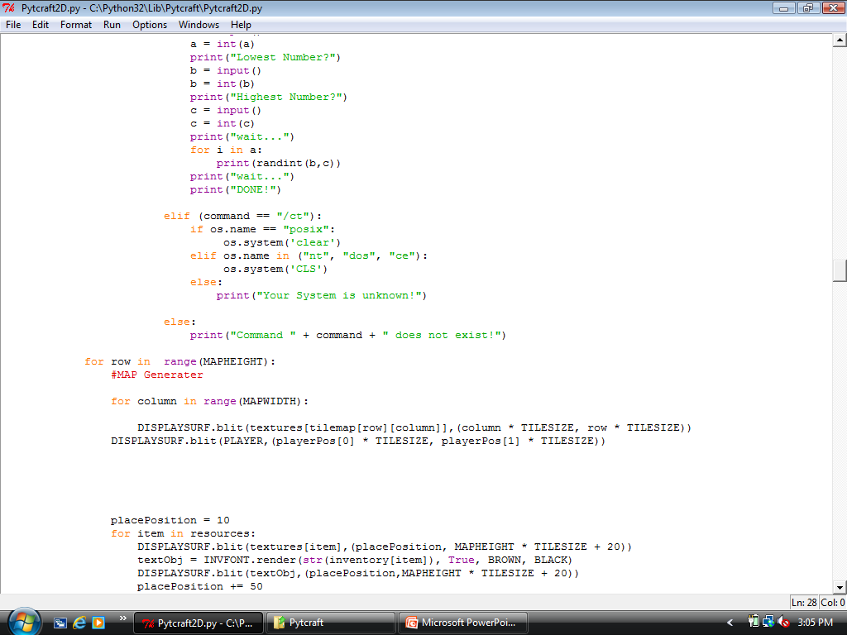
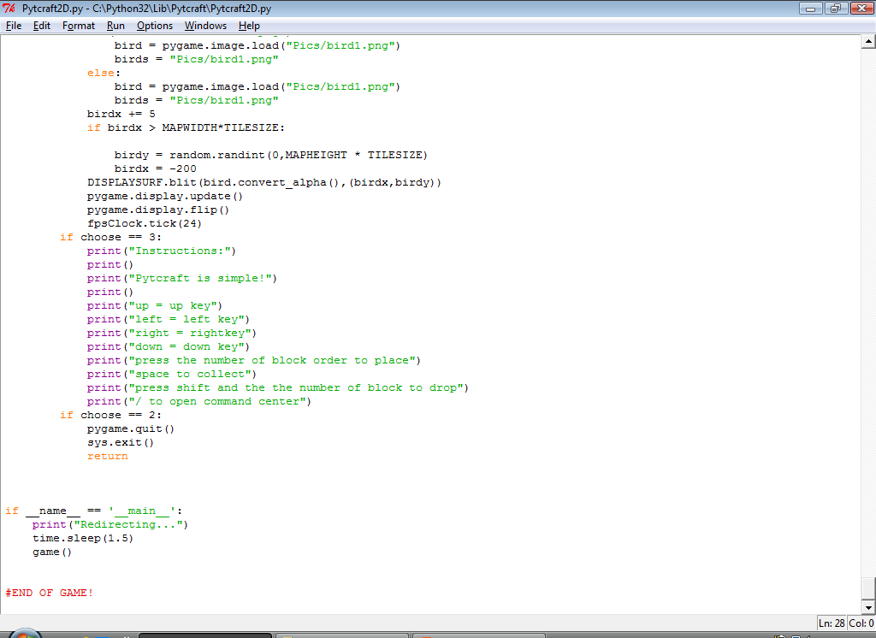
Code Screenshots!

Slide 6
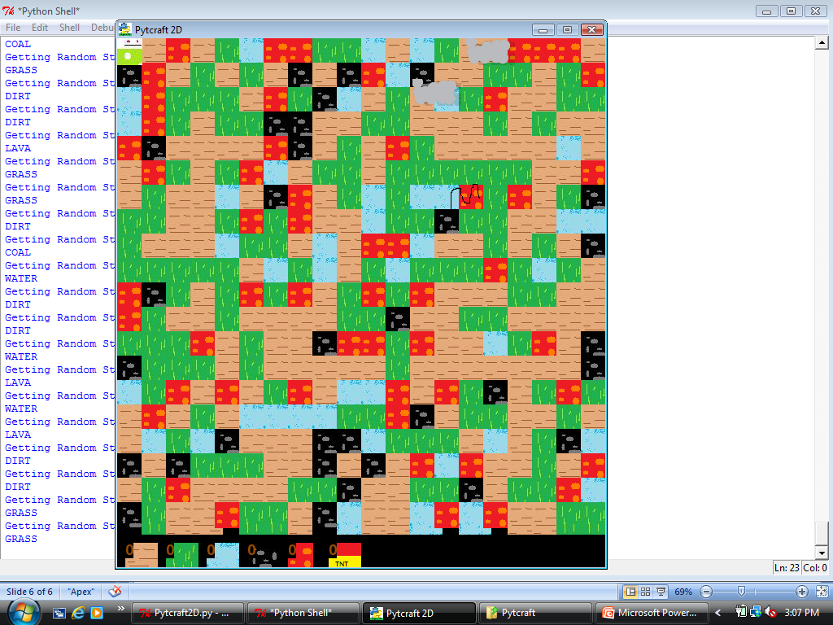
Game Screenshots!
The Character
Clouds
Bird
Inventory

Slide 7
Any Questions?
Twitter - @andrewrodebaugh
Email – rodeboys5@gmail.com

