Slide 1
Java 8
New and Noteworthy
Presented By: Andrey Loskutov
All Rights Reserved - ADVANTEST CORPORATION
08.03.2018

Slide 2
Agenda
Motivation
Java 8 Highlights
  Lambdas
  Lambdas
  Lambdas
  Default methods
  Streams
Known issues
All Rights Reserved - ADVANTEST CORPORATION
08.03.2018

Slide 3
Motivation
Java release 8 represents (from Java 7 point of view):
2 years work on the next major Java release
Better support for scripting languages (faster "invokedynamic")
Java bytecode specification changes
Java language syntax changes
lot of new API's
various other smaller enhancements…
*Note for C/C++ programmers:
… code written for Java 1.1 (1997) is still supported on 1.8 (2014)
All Rights Reserved - ADVANTEST CORPORATION
08.03.2018

Slide 4
Lambdas
“Classic” way to write some small function pointer in Java
Lambda’s way to do the same:
This looks much cleaner, but where is the catch?
Runnable helloWorld = new Runnable() {
@Override
public void run() {
System.out.println("Hello world");
}
};
// later in other place:
helloWorld.run();
Runnable helloWorld = () -> System.out.println("Hello lambda");
All Rights Reserved - ADVANTEST CORPORATION
08.03.2018

Slide 5
Lambdas: Motivation
Motivation
Function pointers for Java (functions as objects)
Alternative for anonymous classes
Cleaner code
“Fluent” programming style with Streams
Caution
Lambdas is NOT same as anonymous classes
Complex expressions are hard to read
Compiler/debugger/tool support is still evolving
Some subtle identity issues
Syntax in four words
Lambda parameters -> Lambda body
All Rights Reserved - ADVANTEST CORPORATION
08.03.2018

Slide 6
Lambdas: Syntax
https://docs.oracle.com/javase/specs/jls/se8/html/jls-15.html#jls-15.27
() -> {} // No parameters; result is void
() -> 42 // No parameters, expression body
() -> null // No parameters, expression body
() -> { return 42; } // No parameters, block body with return
() -> { System.gc(); } // No parameters, void block body
() -> { // Complex block body with returns
if (true) return 12;
else {
int result = 15;
for (int i = 1; i < 10; i++)
result *= i;
return result;
}
}
(int x) -> x+1 // Single declared-type parameter
(int x) -> { return x+1; } // Single declared-type parameter
(x) -> x+1 // Single inferred-type parameter
x -> x+1 // Parentheses optional for
// single inferred-type parameter
(String s) -> s.length() // Single declared-type parameter
(Thread t) -> { t.start(); } // Single declared-type parameter
s -> s.length() // Single inferred-type parameter
t -> { t.start(); } // Single inferred-type parameter
(int x, int y) -> x+y // Multiple declared-type parameters
(x, y) -> x+y // Multiple inferred-type parameters
(x, int y) -> x+y // Illegal: can't mix inferred and declared types
(x, final y) -> x+y // Illegal: no modifiers with inferred types
All Rights Reserved - ADVANTEST CORPORATION
08.03.2018

Slide 7
Lambdas: SAM
SAM aka @FunctionalInterface - Single Abstract Method
Many existing classes:
JDK: Runnable, Callable, Function, Predicate, Consumer, Supplier …
Eclipse: ICoreRunnable, ISafeRunnable, DisposeListener, IPropertyChangeListener …
@FunctionalInterface
public interface DisposeListener extends SWTEventListener {
/**
* Sent when the widget is disposed.
*
* @param e an event containing information about the dispose
*/
public void widgetDisposed(DisposeEvent e);
...
Control control = getParentControl();
Job refreshJob = createRefreshJob();
control.addDisposeListener(e -> refreshJob.cancel());
All Rights Reserved - ADVANTEST CORPORATION
08.03.2018

Slide 8
Lambdas: Surprises
Are lambdas Objects?
But there is no new!
Is ()->42 == ()->42 ?
It depends!
What about () -> return this ?
Lamda expressions do not introduce new scope!
“Lambda expression's local variable cannot redeclare another local variable defined in an enclosing scope.”
int x = 42;
Consumer<Integer> c = (i) -> {
// Does not compile
// int x = i;
};
All Rights Reserved - ADVANTEST CORPORATION
08.03.2018

Slide 9
Lambdas: Capture
Non capturing vs capturing lambdas
Non capturing lambdas have no state
Non capturing lambdas can be reused by JVM
Capturing lambdas can have state thanks to captured objects
"Any local variable, formal parameter, or exception parameter used but not declared in a lambda expression must either be declared final or be effectively final."
AtomicReference<Long> ref = new Atomicreference(42);
Runnable nonCapturing = () -> System.out.println("Hello");
Runnable capturing = () -> System.out.println(ref.get());
All Rights Reserved - ADVANTEST CORPORATION
08.03.2018

Slide 10
Lambdas: Method References
We have now method and constructor references
Looks differently to lambdas!
Implemented same way in the bytecode (invokedynamic)
List<Integer> list = Arrays.asList(1, 3, 1, 2);
HashSet<Integer> set = list.stream().collect(HashSet::new, HashSet::add, HashSet::addAll);
Supplier<HashSet<Integer>> supplier = HashSet::new;
BiConsumer<HashSet<Integer>, ? super Integer> biConsumer = HashSet::add;
BiConsumer<HashSet<Integer>, HashSet<Integer>> combiner = HashSet::addAll;
set = list.stream().collect(supplier, biConsumer, combiner);
// Good old Java API to do the same
set = new LinkedHashSet<>(list);
Consumer<Object> println = System.out::println;
list.forEach(println);
Comparator<Integer> comparator = Integer::compare;
list.sort(comparator);
All Rights Reserved - ADVANTEST CORPORATION
08.03.2018

Slide 11
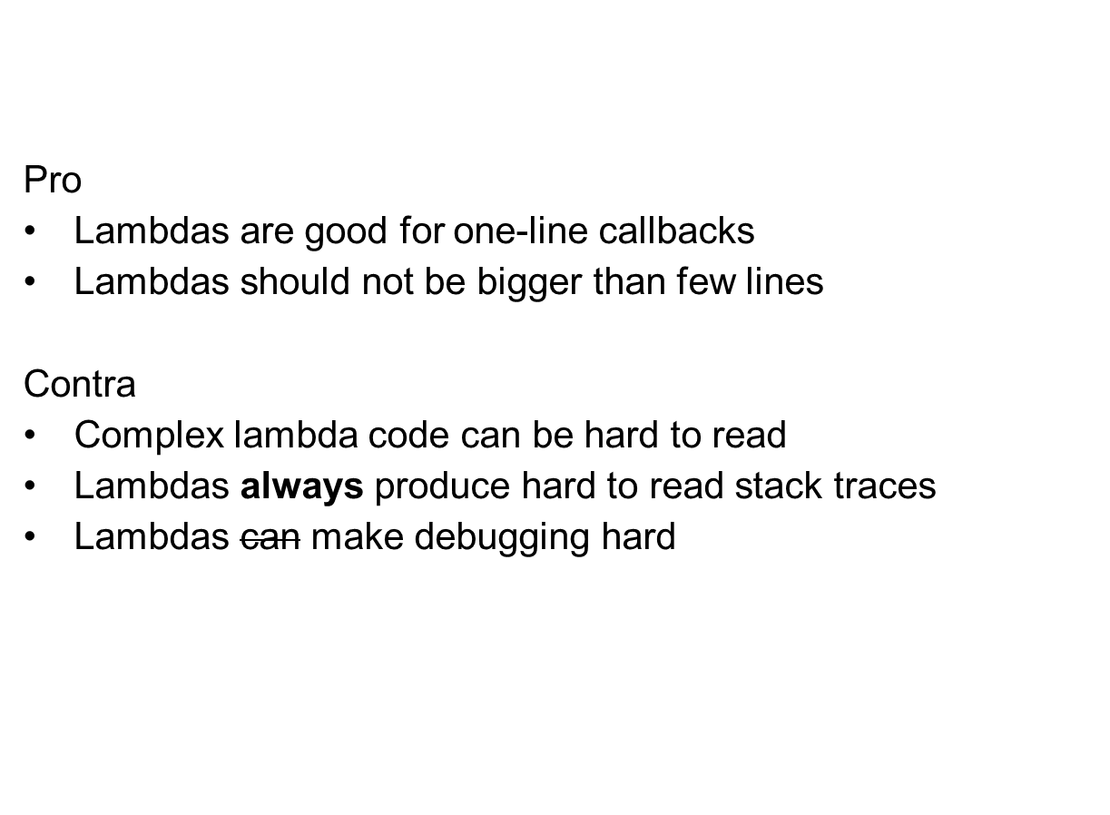
Lambdas vs Inner: Use
All Rights Reserved - ADVANTEST CORPORATION
08.03.2018

Slide 12
Lambdas vs Inner: Stack traces
Lambda anti-pattern: https://bugs.eclipse.org/498051
Huston, we have a problem…
OK, may be if we look at the code we could get an idea?
Message: Unhandled event loop exception
java.lang.ArrayIndexOutOfBoundsException: null
at java.lang.System.arraycopy(null:-2)
at java.util.Arrays.copyOfRange(null:-1)
at java.util.Arrays.copyOfRange(null:-1)
at org.eclipse.ui.internal.ide.ChooseWorkspaceDialog.lambda$7(ChooseWorkspaceDialog.java:380)
at java.util.stream.ReferencePipeline$3$1.accept(null:-1)
at java.util.ArrayList$ArrayListSpliterator.forEachRemaining(null:-1)
at java.util.stream.AbstractPipeline.copyInto(null:-1)
at java.util.stream.AbstractPipeline.wrapAndCopyInto(null:-1)
at java.util.stream.ReduceOps$ReduceOp.evaluateSequential(null:-1)
at java.util.stream.AbstractPipeline.evaluate(null:-1)
at java.util.stream.ReferencePipeline.collect(null:-1)
at org.eclipse.ui.internal.ide.ChooseWorkspaceDialog.createUniqueWorkspaceNameMap(ChooseWorkspaceDialog.java:382)
All Rights Reserved - ADVANTEST CORPORATION
08.03.2018

Slide 13
Lambdas vs Inner: Stack traces
Lambda anti-pattern: https://bugs.eclipse.org/498051
The “code”. The code. Try to find the error or count lambdas ☺
NEVER DO THIS!!!
List<String[]> splittedWorkspaceNames = Arrays.asList(launchData.getRecentWorkspaces()).stream()
.filter(s -> s != null && !s.isEmpty()).map(s -> s.split(Pattern.quote(fileSeparator)))
.collect(Collectors.toList());
for (int i = 1; !splittedWorkspaceNames.isEmpty(); i++) {
final int c = i;
Function<String[], String> stringArraytoName = s -> String.join(fileSeparator,
Arrays.copyOfRange(s, s.length - c, s.length));
List<String> uniqueNames = splittedWorkspaceNames.stream().map(stringArraytoName)
.collect(Collectors.groupingBy(s -> s, Collectors.counting())).entrySet().stream()
.filter(e -> e.getValue() == 1).map(e -> e.getKey()).collect(Collectors.toList());
splittedWorkspaceNames.removeIf(a -> {
String joined = stringArraytoName.apply(a);
if (uniqueNames.contains(joined)) {
uniqueWorkspaceNameMap.put(joined, String.join(fileSeparator, a));
return true;
}
return false;
});
}
All Rights Reserved - ADVANTEST CORPORATION
08.03.2018

Slide 14
Lambdas vs Inner: Performance
Some observations about Lambdas
Reduce compile time (for huge projects)
Reduce I/O and ClassLoader overhead
Increase outer class size (more methods generated)
Capture part: slower before JIT optimization starts
Invocation: exactly same performance
Lambdas | Inner classes
No .class files Runtime linkage Variables capture Invocation | Compile time generation Runtime class loading Instantiation Invocation
All Rights Reserved - ADVANTEST CORPORATION
08.03.2018

Slide 15
Lambdas vs Inner: Memory
Simple capturing lambda in a static context and anonymous class have same memory footprint (16 bytes)
Same lambda in a non static context uses 24 bytes
Lambdas itself don’t have state
Lambdas don’t automatically keep reference to outer class
Capturing and non-capturing lambdas
  Captured variables are references to “outer” world
  Captured objects can have state
  Capturing lambdas are garbage collected, non capturing not
  Non-capturing lambdas can be “reused” by JVM
All Rights Reserved - ADVANTEST CORPORATION
08.03.2018

Slide 16
Default methods
„Default methods enable you to add new functionality to the
interfaces of your libraries and ensure binary compatibility with
code written for older versions of those interfaces.“
First attempt:
Adding domain logic:
etc …
interface Figure {
int getX();
int getY();
}
interface Figure {
int getX();
int getY();
default Point getPoint() {
return new Point(getX(), getY());
}
}
All Rights Reserved - ADVANTEST CORPORATION
08.03.2018

Slide 17
API Changes: Streams
java.util.stream.Stream<T>
All collection classes support streams now:
Collection
  default Stream<T> stream()
  default Stream<T> parallelStream()
Easy to switch from single threaded computation to parallel:
Lazy evaluation!
Stream<Integer> transform(List<Integer> numbers) {
return numbers.stream().map(e -> e * 2);
}
Stream<Integer> transform(List<Integer> numbers) {
return numbers.parallelStream().map(e -> e * 2);
}
// The stream have not calculated anything so far!
Stream<Integer> stream = transform(numbers);
// Calculation starts here!
System.out.println(stream.collect(toList()));
All Rights Reserved - ADVANTEST CORPORATION
08.03.2018

Slide 18
Known problems
Javac and ecj compiler have sometimes different opinion about valid Java code ☺
In case you see strange compile errors, call me
SpotBugs (formerly known as FindBugs) can’t analyze lambdas yet.
JDT/SpotBugs: we accept high quality patches!
  https://wiki.eclipse.org/JDT_Core_Committer_FAQ
  https://github.com/spotbugs/spotbugs
All Rights Reserved - ADVANTEST CORPORATION
08.03.2018

Slide 19
Links
Official Java 8 Documentation
  http://www.oracle.com/technetwork/java/javase/8-relnotes-2226341.html
  http://www.oracle.com/technetwork/java/javase/8-whats-new-2157071.html
Lambdas
  http://www.lambdafaq.org
  http://www.oracle.com/technetwork/java/jvmls2013kuksen-2014088.pdf
  https://de.slideshare.net/PeterLawrey/streams-and-lambdas-the-good-the-bad-and-the-ugly
All examples and this presentation
    git clone https://code.google.com/p/java7examples/
All Rights Reserved - ADVANTEST CORPORATION
08.03.2018

