Slide 1
MENTOSCOPE
An AI-Assisted ENT Examination Assistant
& Training Kit for Healthcare Students
Chulabhorn Innovation Awards 2026 · Team 3134 (CIA26509)
Satit Prasarnmit Demonstration School (Secondary),
Srinakharinwirot University
INNOVATION PROPOSAL HIGHLIGHTS: [5] Proposed Innovation | [6] Scientific Foundation | [7] Parameters & Testing

Slide 2
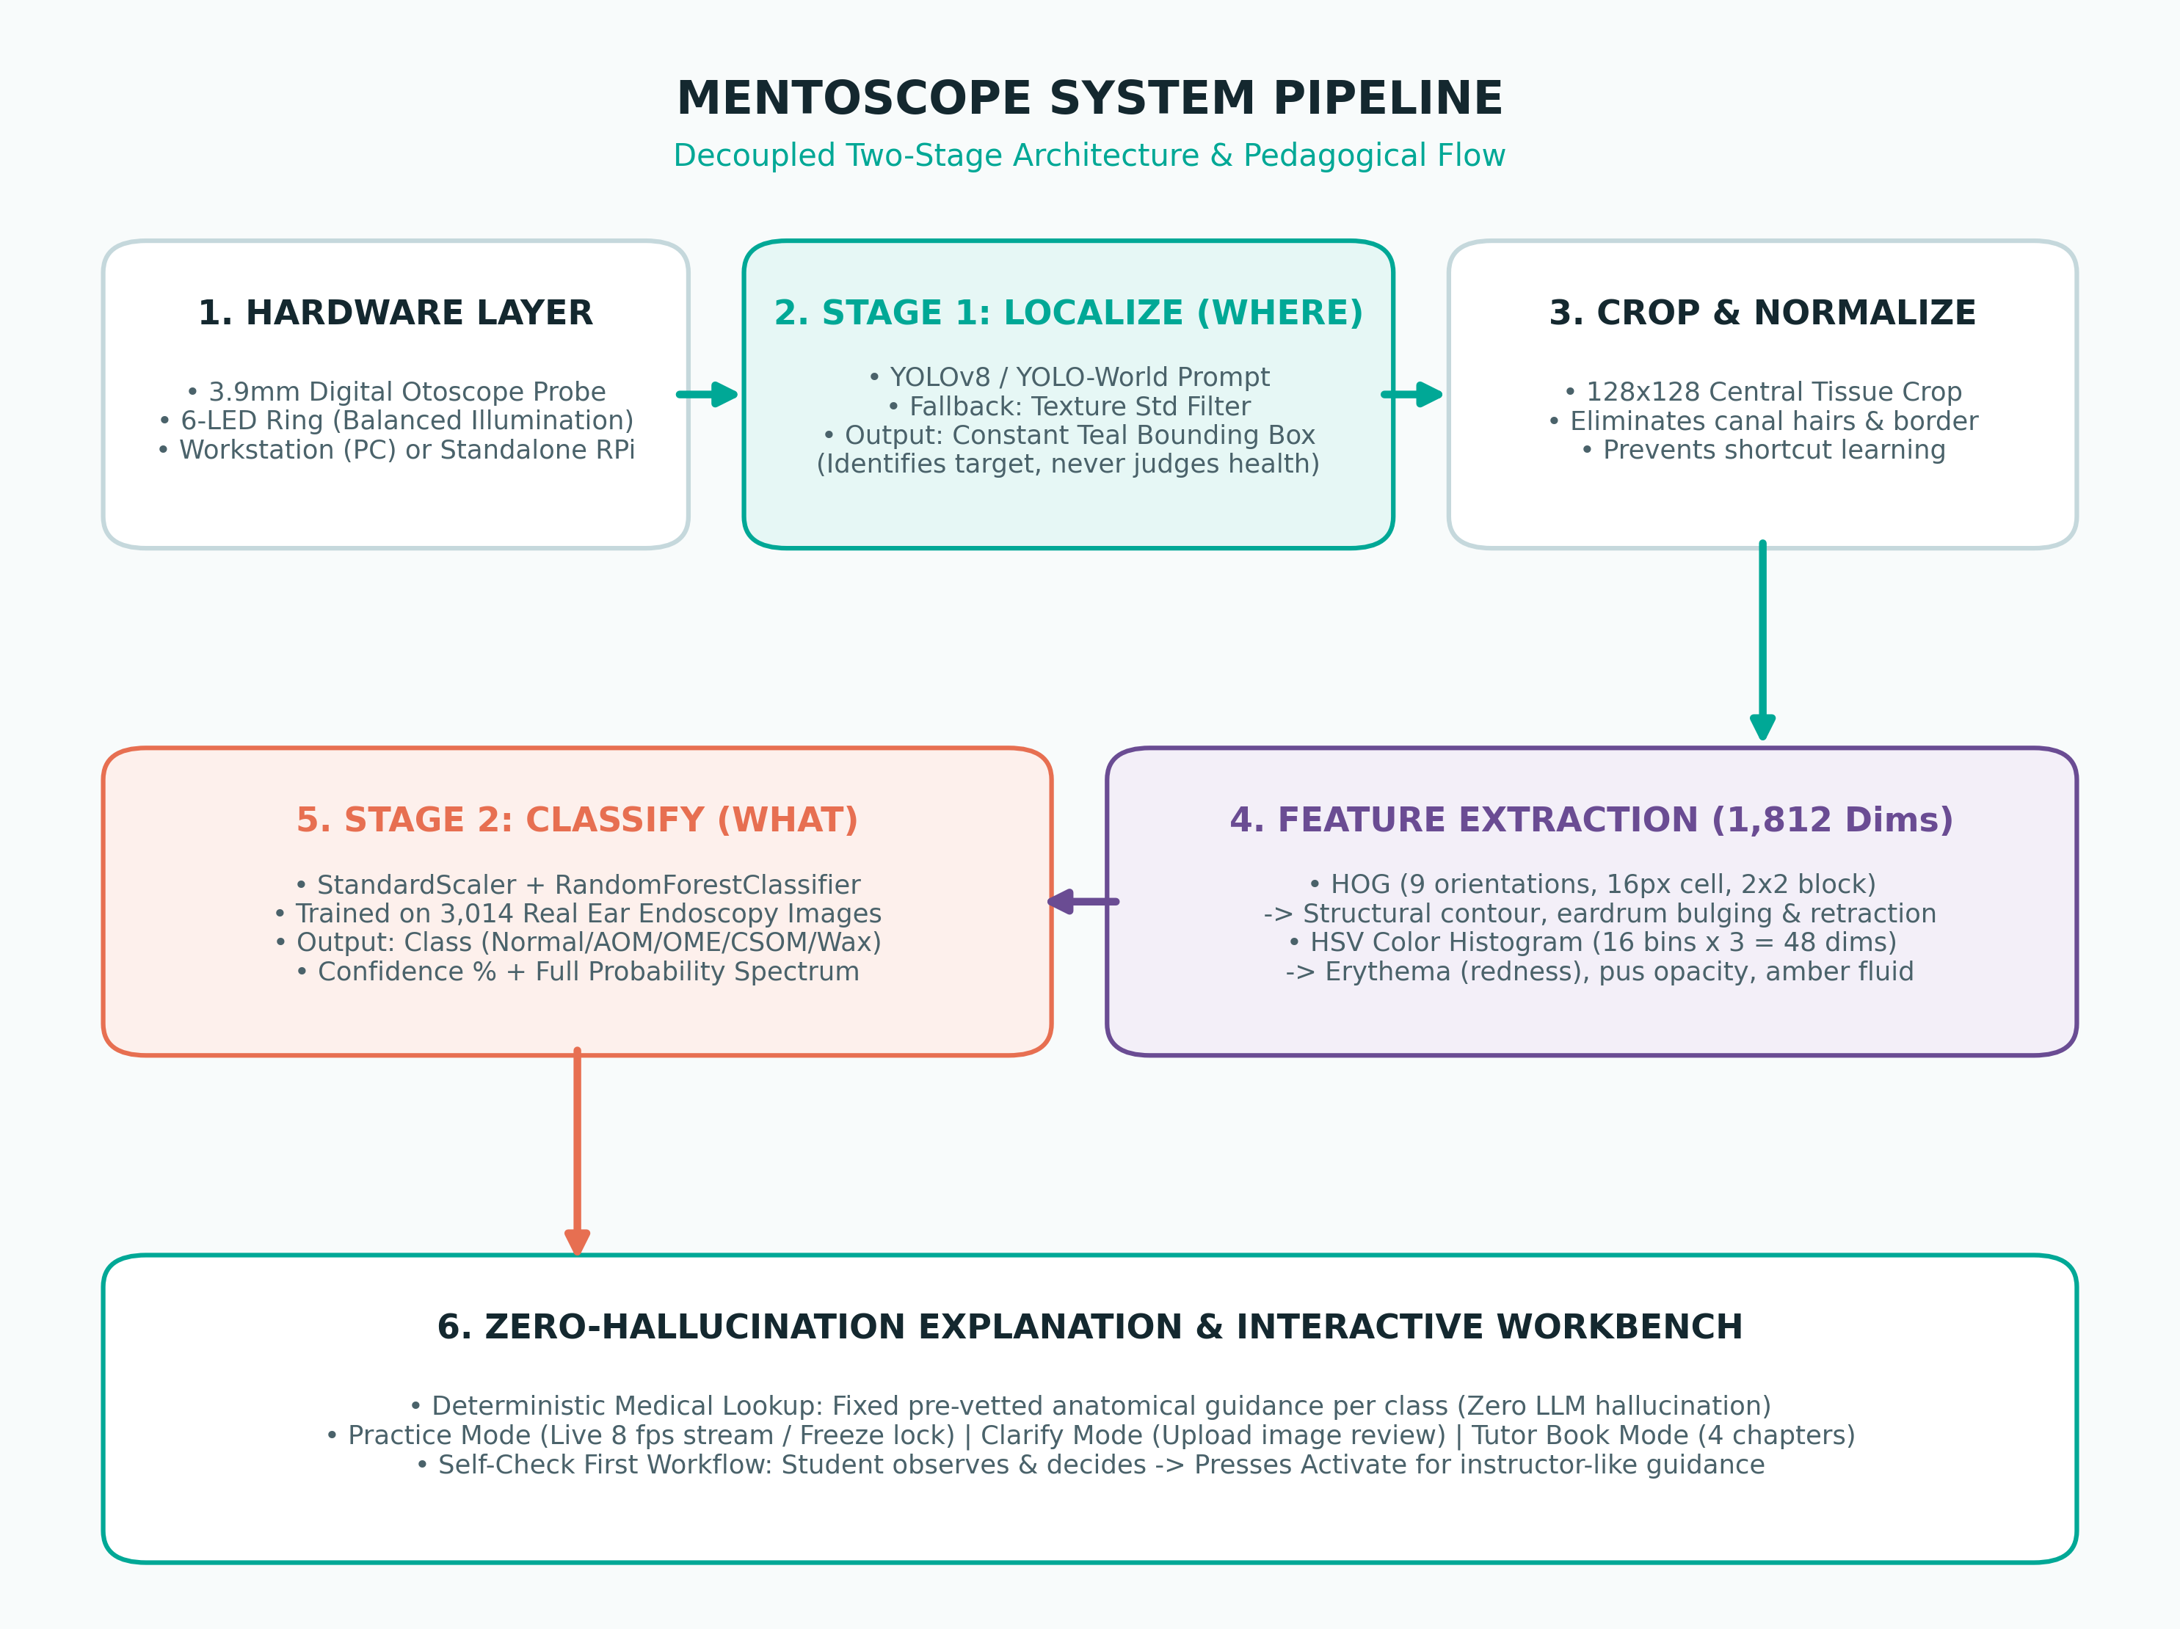
5
PROPOSED INNOVATION
Present your proposed solution, including its components, how it works, and how it helps solve the problem.
1. Dual-Form Hardware & Optics
• 3.9mm probe (matches canal) + 6-LED balanced ring light
• Workstation (Laptop/PC) or Standalone Kit (RPi 4/5 + Touchscreen)
2. Two-Stage Decoupled AI Pipeline
• Stage 1 (YOLOv8): Localizes tissue (Where) without judging health
• Stage 2 (Random Forest): Classifies condition (What) on 1,812 HOG+HSV features
3. Active Retrieval Pedagogy & 3 Modes
• Practice Mode: Live 8 fps / Freeze single-shot (Self-Check -> Activate)
• Clarify (Upload review) & Tutor Book (4 ENT chapters + Red Flags)
HOW IT SOLVES THE HEALTHCARE PROBLEM:
Breaks 1:4–1:20 instructor shortage via on-demand 'over-the-shoulder' guidance · Prevents childhood hearing loss (OME) & AMR from misdiagnosis · Low cost vs 1M THB VR manikins

Slide 3
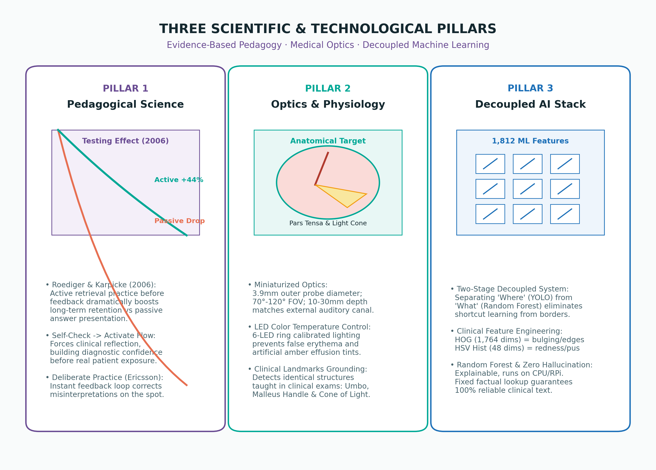
6
SCIENTIFIC FOUNDATION
Explain the science, principles, technologies, and important components behind your innovation.
1. Cognitive Pedagogy (Testing Effect)
• Roediger & Karpicke (2006): Active retrieval practice before seeing answers increases long-term diagnostic retention by +44% vs passive review
• Deliberate Practice (Ericsson): Instant feedback loop stops habituation of errors
2. Optical Physics & ENT Physiology
• 3.9mm lens, 70°–120° FOV, short focal depth (10–30mm) matches ear canal
• Calibrated 6-LED ring prevents false erythema and artificial jaundice reflections
• Anatomical Grounding: Pars Tensa/Flaccida, Malleus Handle, Cone of Light
3. Decoupled AI & Feature Engineering
• Decoupled Where vs What: Isolates tissue, eliminating shortcut learning
• HOG (1,764 dims for shape/bulging) + HSV Hist (48 dims for erythema/effusion)
• Random Forest (1,812 features) + Pre-scripted lookup = Zero Hallucination
PEER-REVIEWED SCIENTIFIC EVIDENCE:
Roediger & Karpicke (2006) Psychol Sci · Lundberg et al. (2024) BMC Prim Care (GP accuracy 36–71%, Kappa 0.30) · Pichichero (2022) J Otolaryngol · EPOS 2020 Rhinology

Slide 4
7
PARAMETERS → PROPOSED TARGETS → TESTING METHODS
Explain what you will measure, your expected target, and how you will test each parameter.
Parameter (What to Measure) | Proposed Target | Testing & Evaluation Method | Clinical Significance
1. Anatomical Localization (Tympanic Membrane Where) | IoU ≥ 0.75 Detection Rate ≥ 92% 0% Crash Fallback | Benchmark on 300 expert-labeled clinical otoscopy frames across varied angles; fallback to texture localizer on 0 detection | Prevents shortcut learning; grounds AI in true anatomical landmark
2. Multi-Class Diagnostic Accuracy (What: Normal/AOM/OME/CSOM) | Overall Acc ≥ 85% Macro F1 ≥ 0.82 AOM Sensitivity ≥ 90% | 5-fold stratified cross-validation on 3,014 verified otoscopy images (train_classifier.py) + blind test set (600 images) | Matches/exceeds GP baseline (36–71%); prevents missed acute infections
3. System Latency & Framerate (Real-Time Usability) | Freeze Mode < 250ms RPi Standalone < 450ms Live Stream ≥ 8 fps | Automated time.perf_counter() profiling across 500 consecutive frame captures and MJPEG stream inference cycles | Ensures fluid hand-eye coordination during active probe manipulation
4. Trainee Diagnostic Lift & Retention (Educational Efficacy) | Immediate Lift ≥ +35% (Accuracy ~50% -> ≥85%) 4-Wk Retention ≥ +25% | Randomized Controlled Trial (RCT) on 60 nursing/medical students: Pre-test -> MentoScope training -> Post-test -> 4-week delayed test | Proves Testing Effect & Deliberate Practice translate to long-term clinical skill
5. Medical Content Safety (Zero-Hallucination Integrity) | 0.0% Hallucination 100% EPOS / AAO-HNS Guideline Adherence | Independent ENT specialist review of all rule-based diagnostic text mappings; adversarial testing with out-of-distribution non-ear frames | Zero medical misinformation risk compared to generic LLM chatbots

Slide 5
✓
MENTOSCOPE: VALUE SUMMARY & PROJECT TEAM
An AI-Assisted ENT Examination Assistant & Training Kit for Healthcare Students
Pedagogical Innovation
• Self-Check -> Activate:
Forces active recall before answers
• Testing Effect (2006):
Proven +44% retention gain
• Practice, Clarify & Tutor Book:
Full ENT examination curriculum
Engineering Rigor
• Decoupled Two-Stage AI:
Where (YOLO) vs What (RF)
• 1,812 HOG + HSV Features:
Trained on 3,014 real images
• Deterministic Factual Lookup:
Zero hallucination risk on device
Public Health Impact
• 13,000–18,000 Students/Year:
Accessible Skills Lab kit
• 9,871 PCUs nationwide:
Frontline screening support
• Prevents hearing loss in children
• Halts unnecessary antibiotic AMR
TEAM 3134 · CIA26509 | CHULABHORN INNOVATION AWARDS 2026
Student Developers: Teerawee Preechatorn (Punn), Apiwit Kaewdee (Gio), Laksanaporn Khamthong (Vit)
(Contributors: Tenten, Uea)
Project Advisor: Channarong Samrit | Satit Prasarnmit Demonstration School (Secondary), Srinakharinwirot University

