Slide 1
Sinatra
DataMapper
Passenger
a lightweight app stack

Slide 2
Drew Olson
ThoughtWorks
aolson@thoughtworks.com

Slide 3
code
git://github.com/drewolson/sinatra_guestbook_presentation.git

Slide 4

Sinatra
a tiny web framework

Slide 5
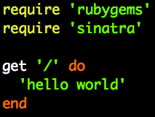
Sinatra
hello world

Slide 6
Sinatra
hello world
seriously

Slide 7
some things to note

Slide 8
some things to note
route = action

Slide 9
some things to note
body

Slide 10
some things to note
simple string

Slide 11
some things to note
or render a template

Slide 12
some things to note
http verb

Slide 13
some things to note
RESTful

Slide 14
code time
01_hello_world

Slide 15
Sinatra embraces REST

Slide 16
Sinatra embraces REST
HTTP | CRUD
POST | Create
GET | Read
PUT | Update
DELETE | Delete

Slide 17
Sinatra has flexible routes

Slide 18
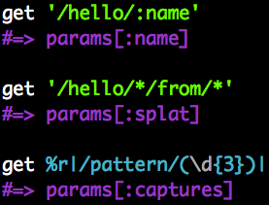

Sinatra has flexible routes

Slide 19
Sinatra has flexible routes

Slide 20
Sinatra has flexible routes

Slide 21
code time
02_fun_with_routes

Slide 22

DataMapper
new ORM hotness

Slide 23
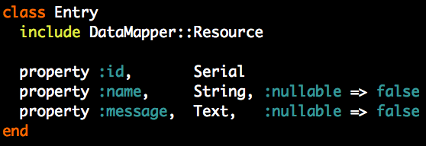
DataMapper
sample resource

Slide 24
some things to note

Slide 25
some things to note
mixin

Slide 26
some things to note
no inheritance needed

Slide 27
some things to note
properties stay with your resource

Slide 28
some things to note
and can differ from your db table

Slide 29
DataMapper
finders

Slide 30
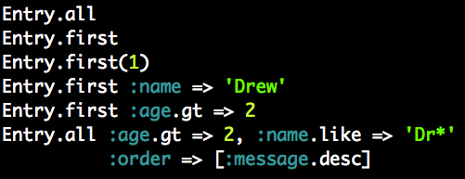
DataMapper
finders

Slide 31
DataMapper
finders

Slide 32
DataMapper
finders

Slide 33
DataMapper
finders

Slide 34
DataMapper
finders

Slide 35
DataMapper
finders

Slide 36
DataMapper
is lazy

Slide 37
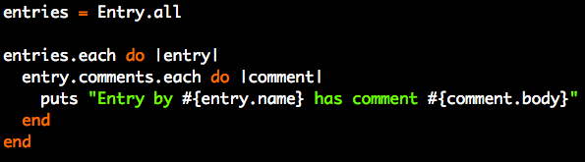
DataMapper
is lazy

Slide 38
DataMapper
is lazy
n+1 queries in ActiveRecord

Slide 39
DataMapper
is lazy
2 in DataMapper

Slide 40
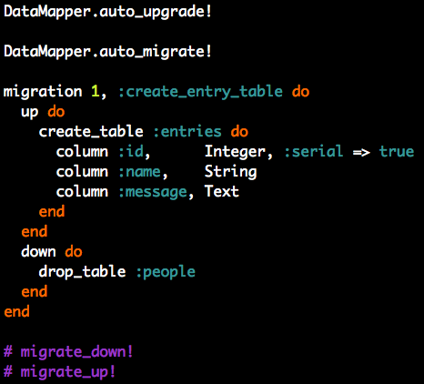
DataMapper
migrations

Slide 41
DataMapper
migrations

Slide 42
DataMapper
migrations

Slide 43
DataMapper
migrations

Slide 44
code time
03_adding_a_database

Slide 45
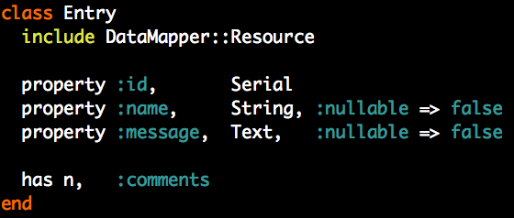
DataMapper
associations

Slide 46
code time
04_adding_comments

Slide 47

Passenger
KISS for deployment

Slide 48
Passenger
no mongrels
manages your app cluster

Slide 49
Passenger
runs on apache/nginx

Slide 50
Passenger
dead simple install

Slide 51
Passenger
dead simple install
(i can do it)

Slide 52
Passenger
works on top of Rack

Slide 53
Sinatra
built on Rack

Slide 54
All you need
a rackup config

Slide 55
code time
05_deploy_with_passenger

Slide 56
Tools used

Slide 57
Tools used
Sinatra
sinatra.github.com

Slide 58
Tools used
DataMapper
datamapper.github.com

Slide 59
Tools used
Passenger
modrails.com

Slide 60
Tools used
Shoulda
github.com/thoughtbot/shoulda

Slide 61
questions?
??!oneeleven

