Slide 1
Introduction to Electricity with Lego Mindstorms
I Love Neutrinos
Juan Antonio Breña Moral

Slide 2
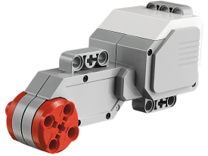
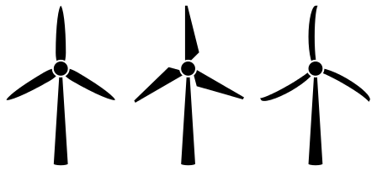
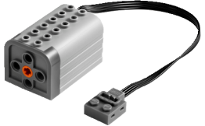
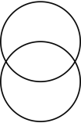
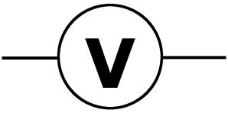
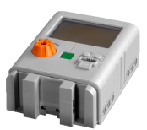
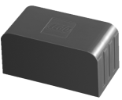
Exercise 1
How many Watts generates your power plant?
-
+
motor
Simulating wind power with a Motor connected with an EV3 Brick
C

Slide 3
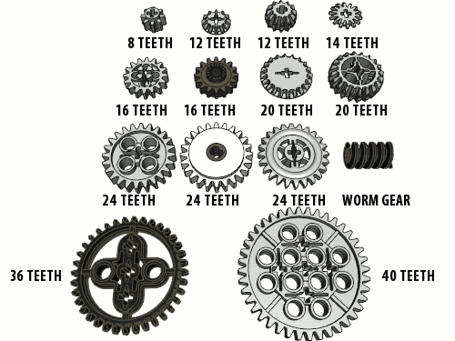
Exercise 2
What is the best gear relation to generate Energy?

Slide 4
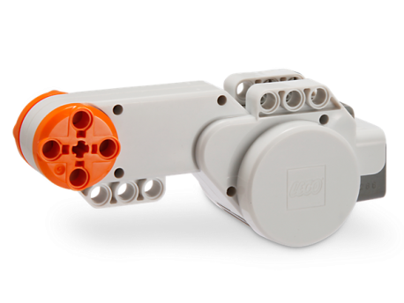
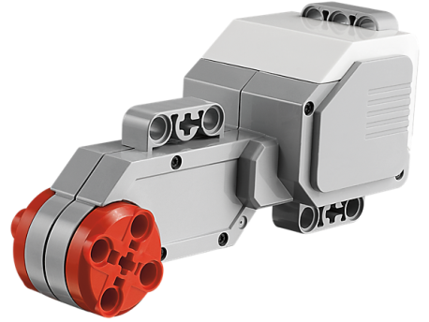
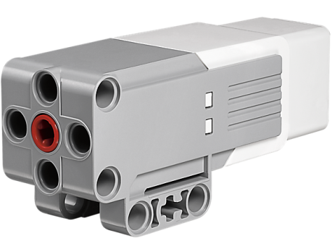
Exercise 3
What is the motor with the best performance in Watts terms?
Note: It is possible to use PF Motors

Slide 5
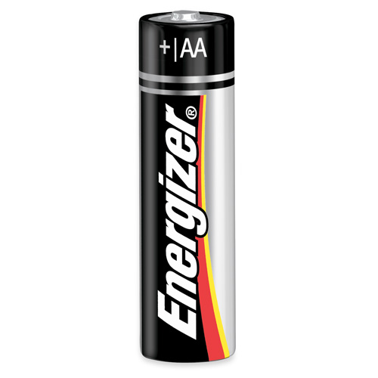
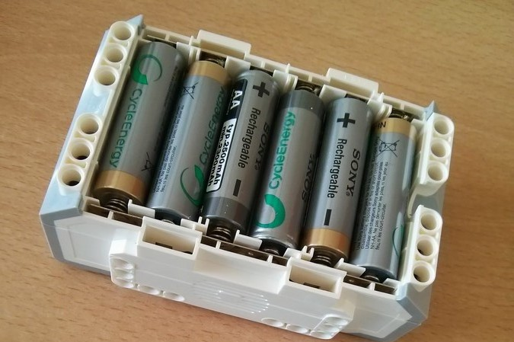
Exercise 4
What is minimum number of Volts to run a EV3 Brick?

Slide 6
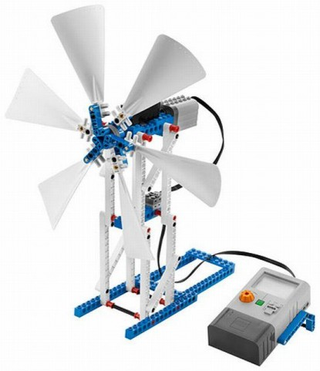
Exercise 5
Build a Wind turbine

Slide 7
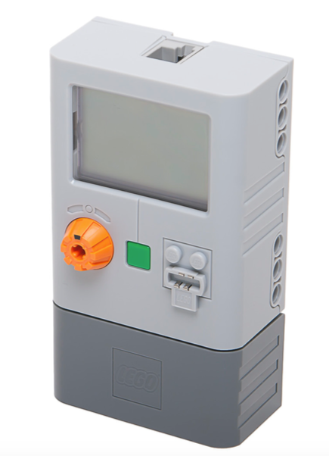
Exercise 6
Develop a EV3 program which plays a sound if Power plant reach 50J

Slide 8
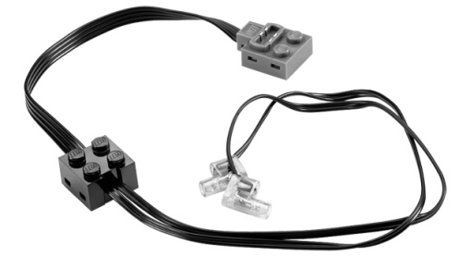
Exercise 7
How many Amps a Lego lamp needs?

Slide 9
EE HomePage.com Powerpoint Symbol Collection
Discrete
Components
Input
antenna
SPKR
microphone
Output
xtal
BiDi
SPST
connectors
SPDT
DPST
crystal
inductors
switches
VDDA
power & ground symbols
L
mechanical
ground
VDD
3Φmotor
connection point
L
motor
varistor
current
source
voltage
source
signal
source
+
+
R
R
V
+
-
-
R
-
battery
C
C
C
unpolarized
capacitor
potentiometer
fixed
resistor
variable
resistor
polarized
capacitor
http://www.eehomepage.com/symbols.ppt
Copyright 2008 by EE HomePage.com
These symbols may be freely reused.

