Slide 1


Slide 2

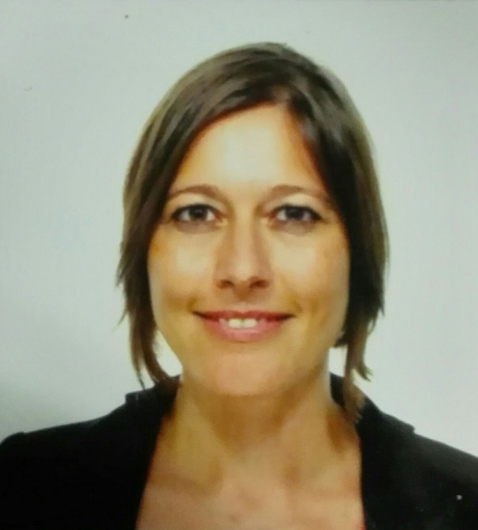
ILN Experts
Innovation
Carolina Rodríguez Rodríguez
Aeronautics
Alejandro Ceballos Gallego

