Slide 1
Introduction to Electricity with Lego Mindstorms
I Love Neutrinos
Juan Antonio Breña Moral

Slide 2
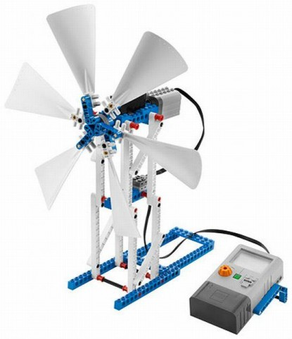
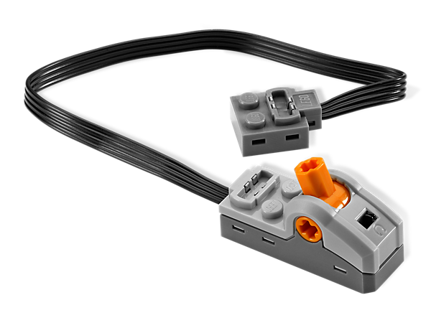
Exercise 1
Update your power plant adding a PF Switch.
Develop a EV3 program to stop storing energy when power plant reaches 80J

Slide 3
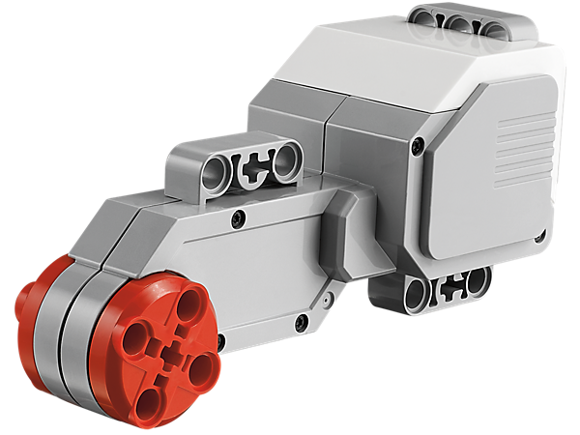
Exercise 2
Upgrade your turbine to change the orientation
Develop a EV3 program to detect a loss of energy and update the orientation
Measure energy generation in 3 angles to update the orientation

Slide 4
Exercise 3
Build a wind turbine
How many Watts generate with 3 blades?
How many Watts generate with 4 blades?
How many Watts generate with 5 blades?
How many Watts generate with 6 blades?

Slide 5
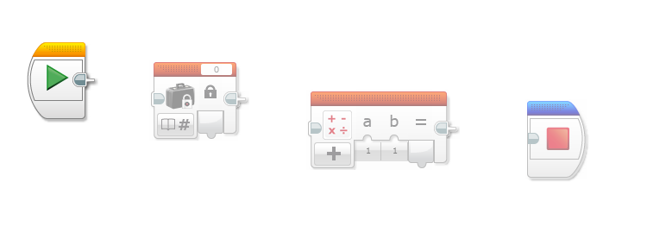
Exercise 4
How many Julius are 9800 TEP?
Develop a EV3 program to caculate the number of Julius to satisfy the energy demand of Comunidad de Madrid

