Slide 1
IntroductiontoEV3
Programming with Lego Mindstorms
I Love Neutrinos
Juan Antonio Breña Moral

Slide 2
Some questions
What is your problem to solve?
Describe in 2 lines the problem.
What kind of elements you have to handle?
Try to identify elements in the problem.
Where is the blocks in EV3 Programming environment?
Do these elements require configuration?
Is it possible to divide the problem in parts?

Slide 3
Exercise 1
Navigate in straight 2 seconds

Slide 4
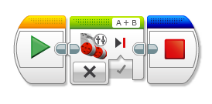
Stop Motors

Slide 5
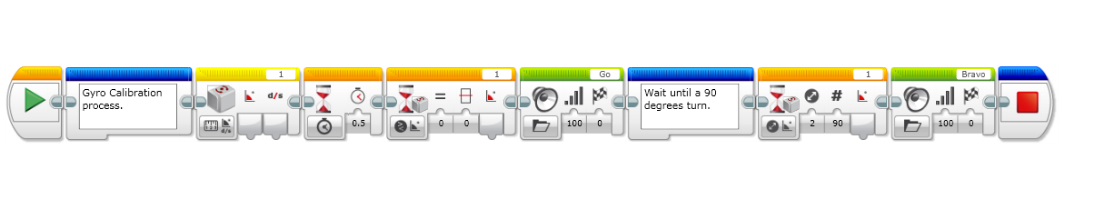
Turn using a Gyro Sensor

Slide 6
Exercise 2
Navigate in straight 4 rotations and turn 90 degrees

Slide 7
Exercise 3
Navigate in straight 2 rotations
turn 90 degrees
Navigate in straight 2 rotations
turn 90 degrees
Navigate in straight 2 rotations
turn 90 degrees
Navigate in straight 2 rotations
turn 90 degrees

