Slide 1
Introduction to Electricity with Lego Mindstorms
Juan Antonio Breña Moral, I Love Neutrinos

Slide 2
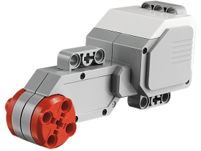
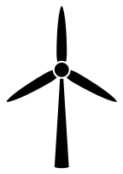
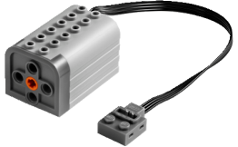
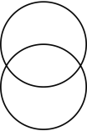
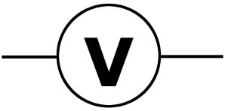
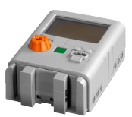
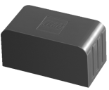
Exercise 1
How many Watts generates your power plant?
+
-
motor
Simulating wind power with a Motor connected with an EVE
C

Slide 3
EE HomePage.com Powerpoint Symbol Collection
Discrete
Components
Input
antenna
SPKR
microphone
Output
xtal
BiDi
SPST
connectors
SPDT
DPST
crystal
inductors
switches
VDDA
power & ground symbols
L
mechanical
ground
VDD
3Φ motor
connection point
L
motor
varistor
current
source
voltage
source
signal
source
+
+
R
R
V
+
-
-
R
-
battery
C
C
C
unpolarized
capacitor
potentiometer
fixed
resistor
variable
resistor
polarized
capacitor
http://www.eehomepage.com/symbols.ppt
Copyright 2008 by EE HomePage.com
These symbols may be freely reused.

