Slide 1
Introduction to Electricity with Lego Mindstorms
I Love Neutrinos
Juan Antonio Breña Moral

Slide 2

Exercise 1
How many Julius are 9800 TEP?
Develop a EV3 program to caculate the number of Julius to satisfy the energy demand of Comunidad de Madrid

Slide 3
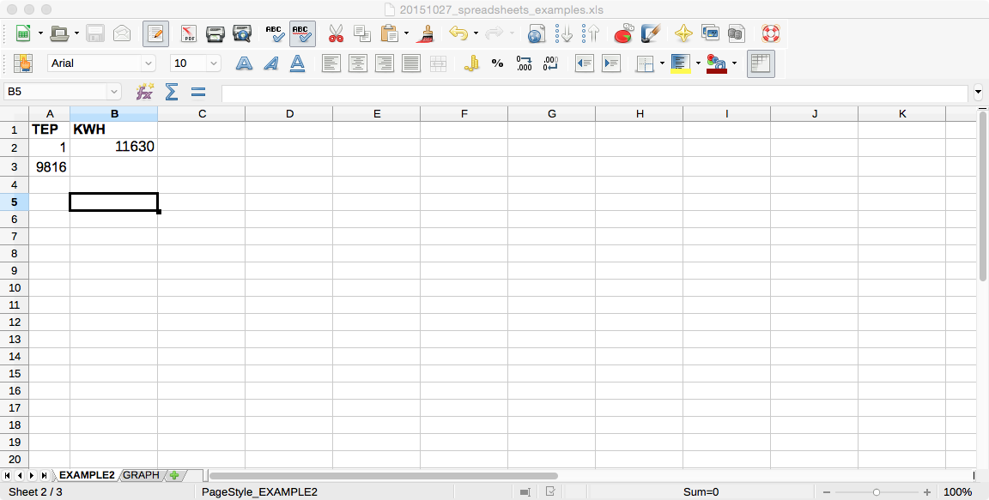
Exercise 2
How many kWH are 9800 TEPs?
Develop the calculus using a spread sheet.

Slide 4
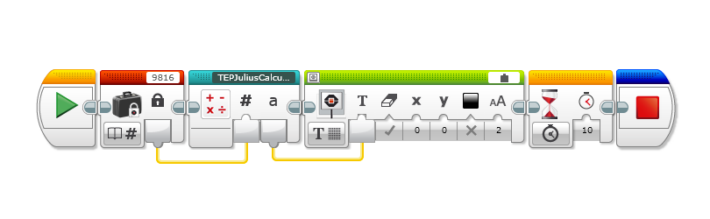
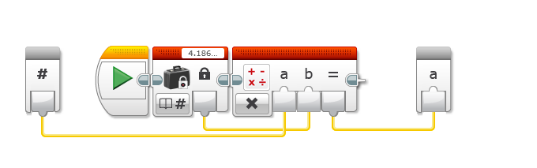
Exercise 3
How many kWH are 9800 TEPs?
Develop an EV3 program. To solve this problem, develop a module.

Slide 5
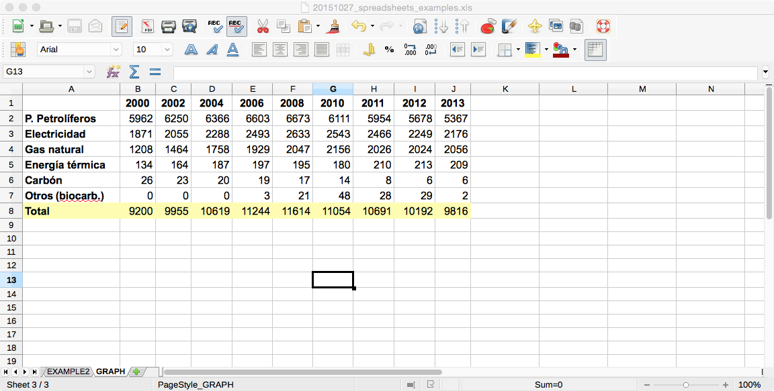
Exercise 4
What is the shape of the energy consumed in Comunidad de Madrid?
Develop a graph using a spread sheet.

