Slide 1
Introduction to Electricity with Lego Mindstorms
I Love Neutrinos
Juan Antonio Breña Moral

Slide 2
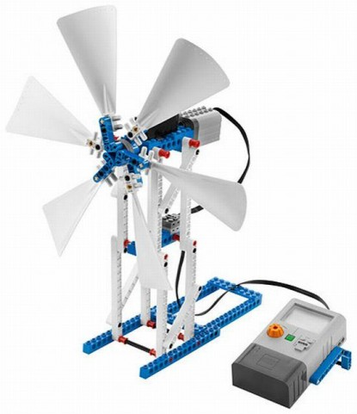
Exercise 1
Build a Wind turbine.
Test your power plant with the fan
How many Watts generate with 3 blades?
How many Watts generate with 4 blades?
How many Watts generate with 5 blades?
How many Watts generate with 6 blades?

Slide 3
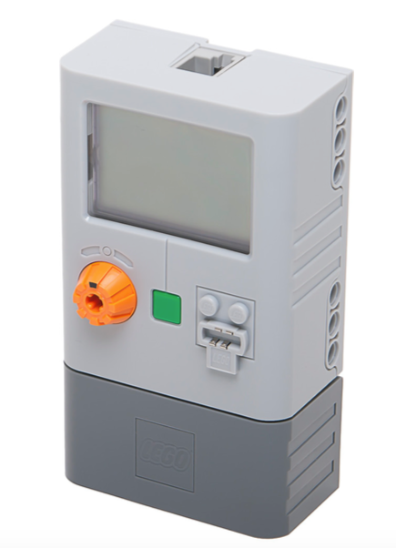
Exercise 2
Develop a EV3 program which plays a sound if Power plant reach 50J

Slide 4
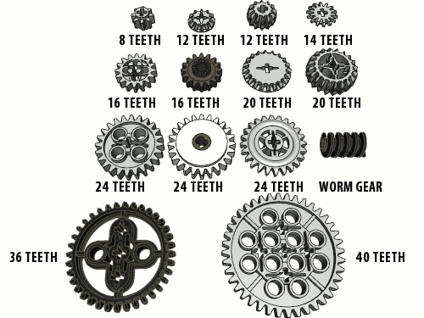
Exercise 3
What is the best gear relation to generate Energy?

